Slide 1
Jersey Number Recognition Project
COSC 519B
Instructor: Dr. Mohamed Shehata
Presentation By: Ahmed Radwan

Slide 2
SoccerNet
Soccer Video Understanding Benchmark Suite
Composed of 550 complete broadcast soccer games and 12 single camera games taken from the major European leagues.
Offers datasets and yearly challenges
5th edition at CVPR 2025 offered: Ball Action Spotting, Monocular Depth Estimation, Multi-View Foul Recognition and Game State Reconstruction
Our Project will focus on Jersey Number Recognition

Slide 3
Project Overview
Objective: Design a robust system for recognizing jersey numbers (0-99) from a player tracklet or return -1 if no number is visible.
Focus Areas: Computer vision, deep learning, and sequence-based analysis techniques.
Goals: Provide at least some incremental improvements either in accuracy, speed, or resource efficiency.

Slide 4
Why Jersey Number Recognition
Crucial for long-term player tracking in sports video analysis.
Jersey numbers are key to distinguishing players on the same team.
Enables automated game analysis and insights.

Slide 5
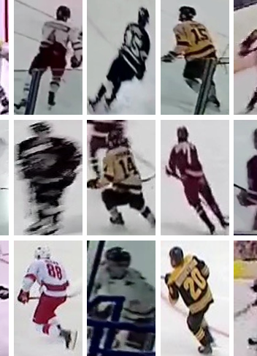
Jersey Number Recognition Challenges
Motion blur, occlusions, pose variations, jersey distortions.

Slide 6
A General Framework for Jersey Number Recognition in Sports Video
Koshkina et. al CVPR2024W

Slide 7
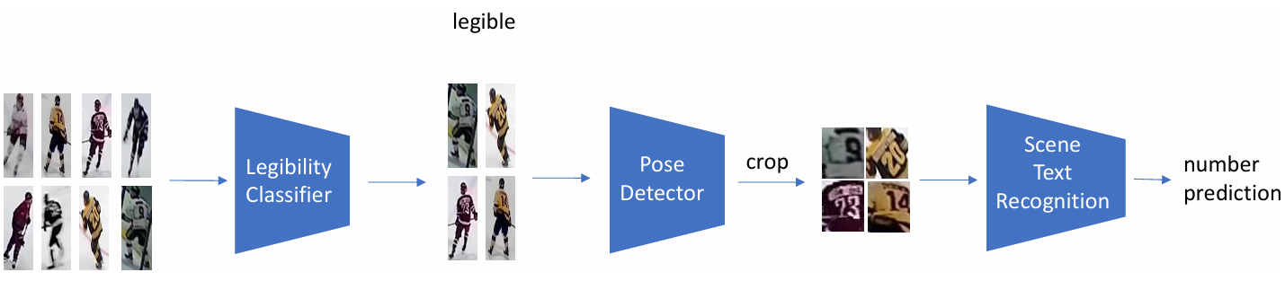
Image-Level Jersey Number Recognition Pipeline

Slide 8
Legibility Classifier
Model: ResNet34 (ImageNet pre-trained)
Training: Fine-tuned on a balanced subset of the hockey dataset (equal legible and illegible samples).
Input: Cropped player image.
Output: Binary classification (legible or illegible).
Uses Sharpness-Aware Minimization (SAM) for improved generalization.

Slide 9
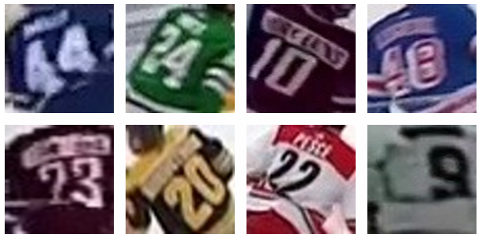
Pose Detector and Cropping
Model: ViTPose (trained on MS COCO)
Purpose: Localize the torso region for focused number recognition.
Method: Extracts body keypoints (shoulders, hips) and defines a crop region.
Padding: 5-pixel padding on the left, right, and bottom of the crop.

Slide 10
Scene Text Recognition (STR)
Model: PARSeq (state-of-the-art STR model)
Pre-training: Trained on large synthetic and real-world text datasets.
Fine-tuning: Fine-tuned on hockey jersey number images.
Input: Cropped torso region.
Output: Predicted jersey number (string).
Can predict numbers not seen during training.

Slide 11
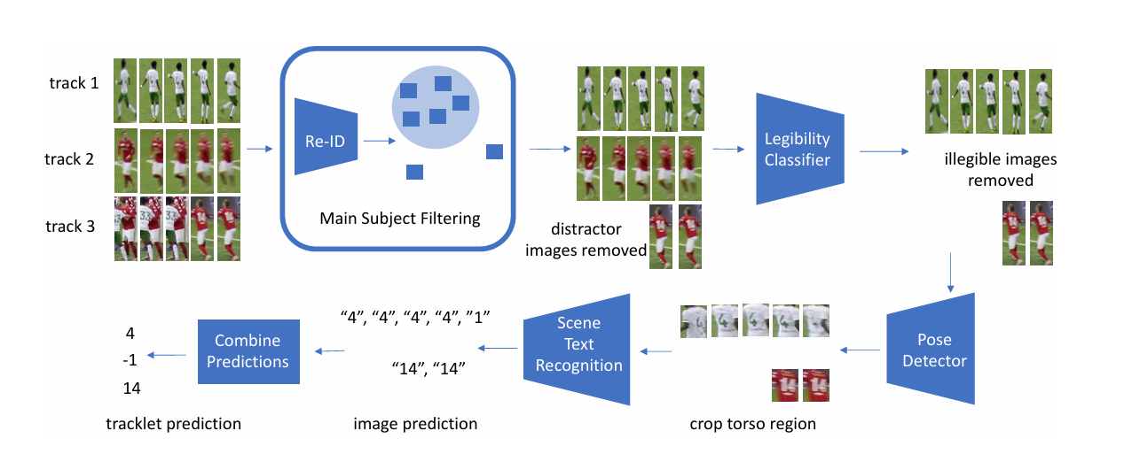
Tracklet-Level Recognition Pipeline

Slide 12
Main Subject Filtering
Remove frames where the main subject is occluded or not clearly visible.
Method: Centroid-ReID network
Process:
Extracts visual feature vectors for each image in the tracklet.
Fits an isotropic Gaussian to the feature vectors.
Excludes outlier images based on standard deviations from the mean.

Slide 13
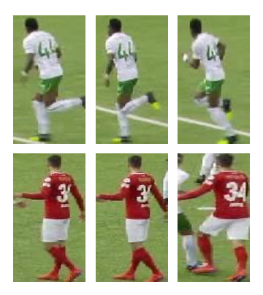
Predictions Consolidation
Two Methods:
Heuristic: Confidence-weighted majority vote, with down-weighting of single-digit predictions if two-digit predictions are also present.
Probabilistic: Calculates the sum of log-likelihoods for each digit position, assuming conditional independence. Incorporates prior probabilities for single and two-digit numbers.

Slide 14
Key Project Deliverables
Proposal
Progress Journal
GitHub Repository: Ensure all contributions are properly tracked.
EvalAI Submission: Model performance evaluation.
Demo & Presentation: Showcase results and live demo.
Final Report: Detailed documentation

Slide 15
Grading Breakdown
Proposal: 10%
Progress Journal: 10%
Model Performance: 40%
Demonstration: 20%
Final Report: 20%

Slide 16
Project Timeline
Proposal Due: Feb 27th
Progress Report Deadlines: Feb 27th & Mar 27th
Final Report & EvalAI Submission: Mar 27th
Demo & Presentation: Mar 27th
Final Report: Apr 4th

Slide 17
Team Formation
Students must complete a survey describing their past experience in deep learning and computer vision.
Team Assignments: Based on survey results, the course instructor and TA will assign teams.

Slide 18
Where to Start
Visit SoccerNet Development Kit:
Download the dataset using the SoccerNet Python package.
Access documentation and starter code.
Reproduce Results: Start by replicating results from research papers linked in the supporting materials.
EvalAI:- Sign up and make an initial submission.
GitHub Repository:Create a team repository and document contributions.

Slide 19
Resources
SoccerNet Challenge 2023: [url]
Development Kit Repository: [url]
Research Papers:
1. A General Framework for Jersey Number Recognition [url]
2. Jersey Number Recognition Using Keyframe Identification [url]

Slide 20
Thank You
Survey Time.
Any Questions?

