Slide 1
Synthesis Guide
SOC Design

Slide 2
Synthesis Guide
We synthesis under【 Vivado GUI 】
You need to select the FPGA for Synthesis
Follow up the SIM_Workflow to select FPGA Board
Edit FPGA Board in the project

Slide 3
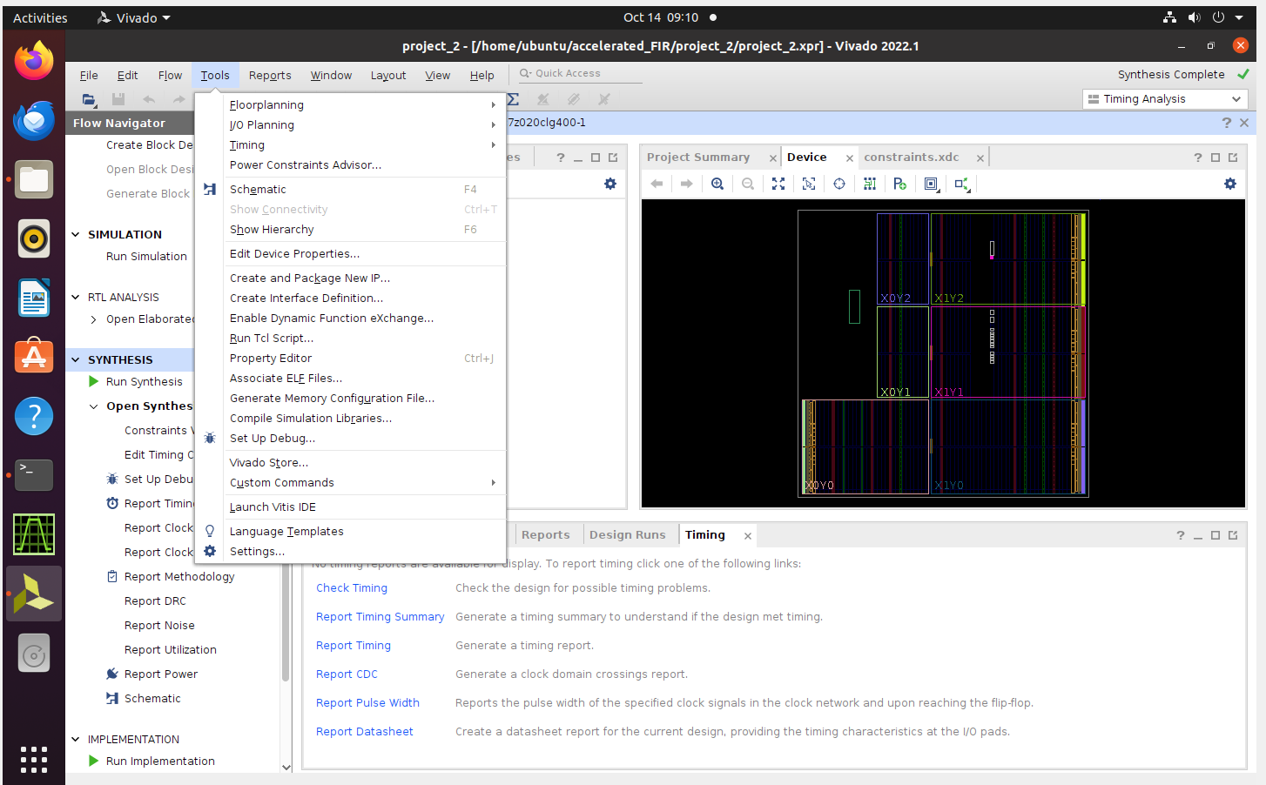
0. Select FPGA board
0.1. 左鍵點擊 Tools，並且點擊Settings

Slide 4
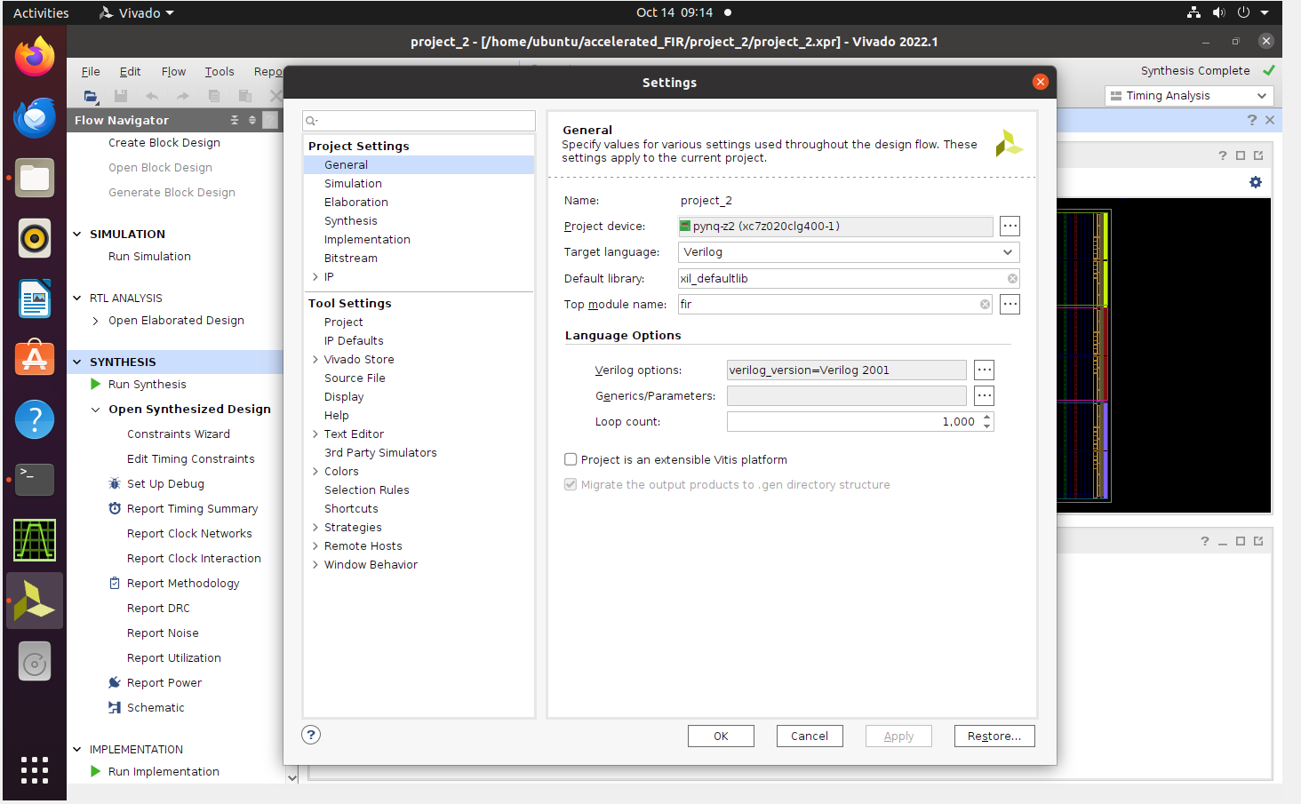
0.2. Modify Project Device
Select PYNQ-Z2 (xc7z020clg400-1)

Slide 5
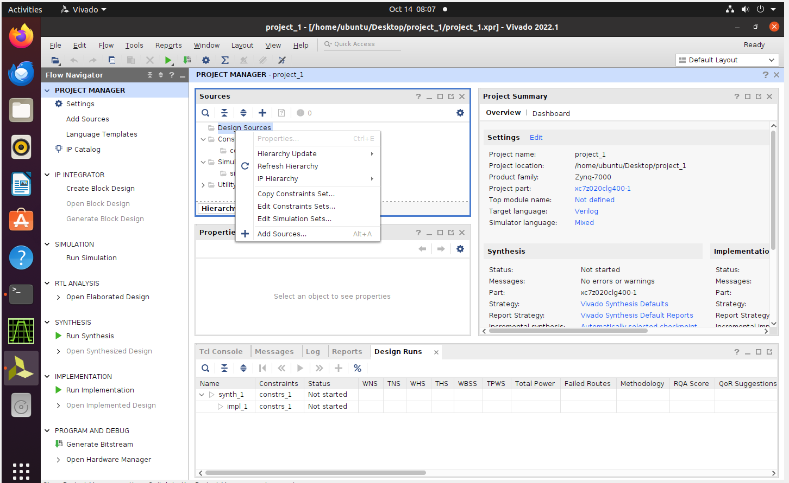
1.1 Add Constraints
1.1.1 Add Sources
【右鍵點擊Design Sources，選擇Add Sources 】

Slide 6
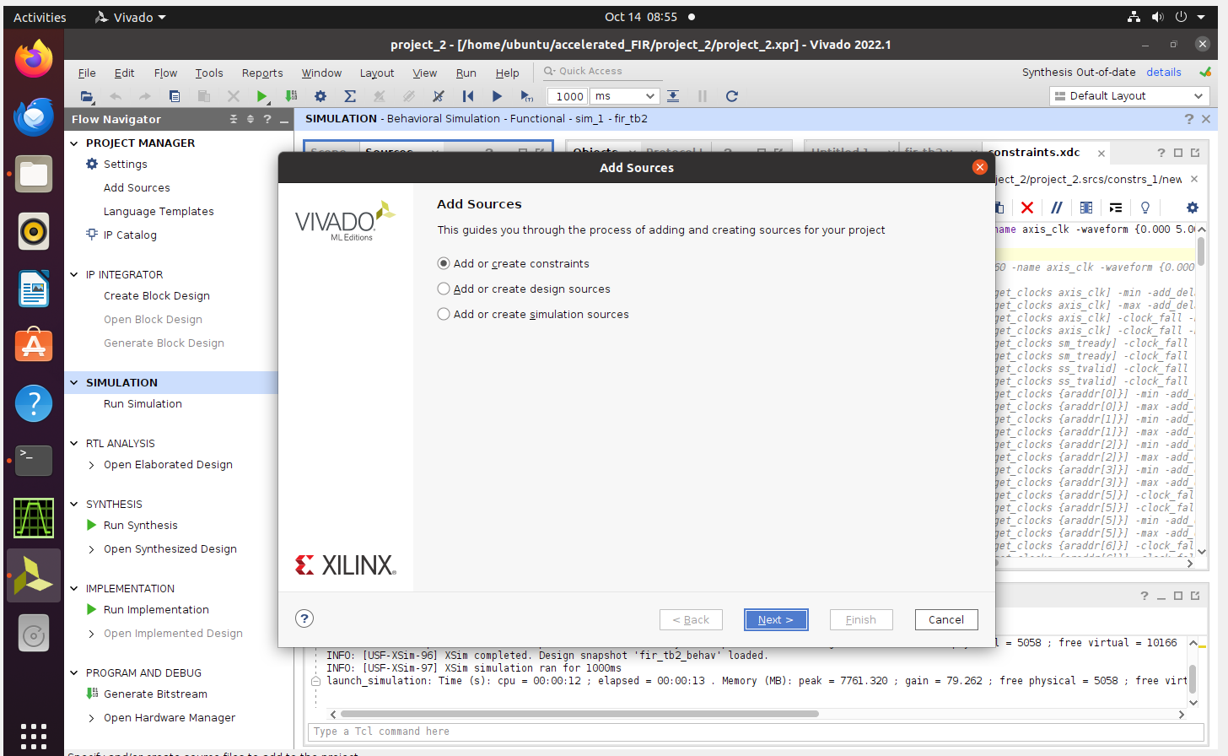
1.1.2 Add or Create constraints
【選取Add or Create constraints】

Slide 7
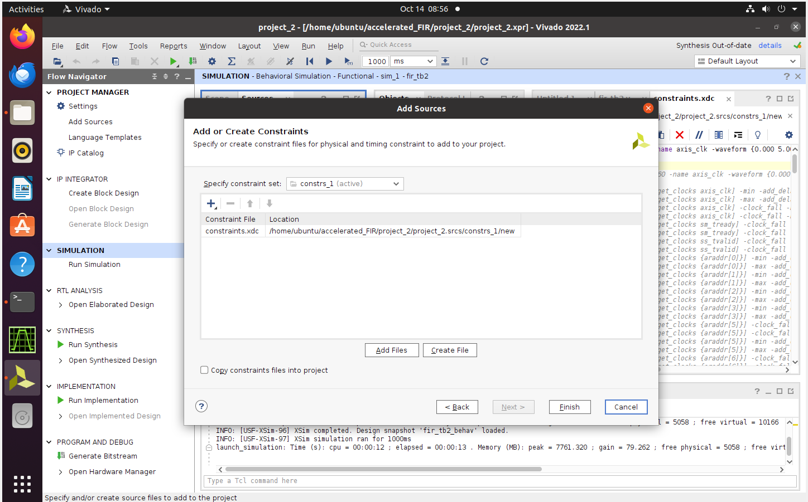
1.1.3 Add Files
【如果已有Constraints，選取Add files】
【如果沒有Constraints，選取Create file】

Slide 8
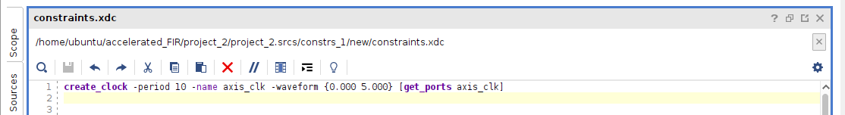
1.2 Modify Clock Constraints
1.2.1 設定Clock 的Constraints
create_clock –periods period_time –name axis_clk –waveform {Rise_time Fall_time} [get_ports axis_clk]

Slide 9
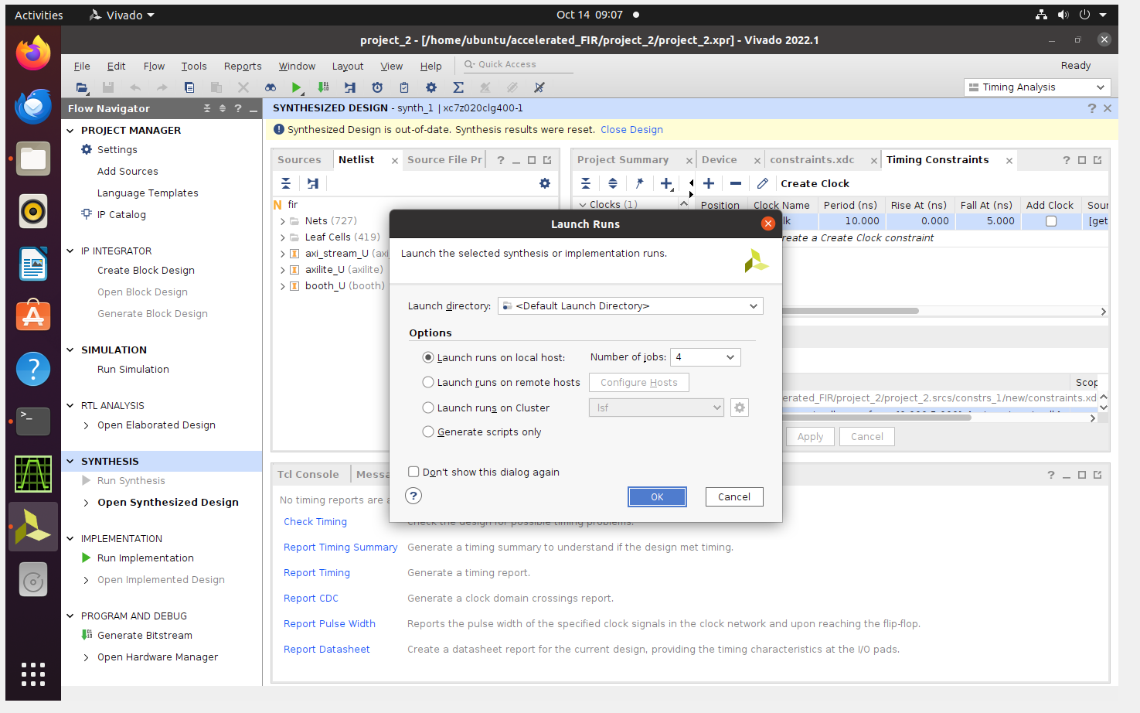
1.2.2 Run Synthesis

Slide 10
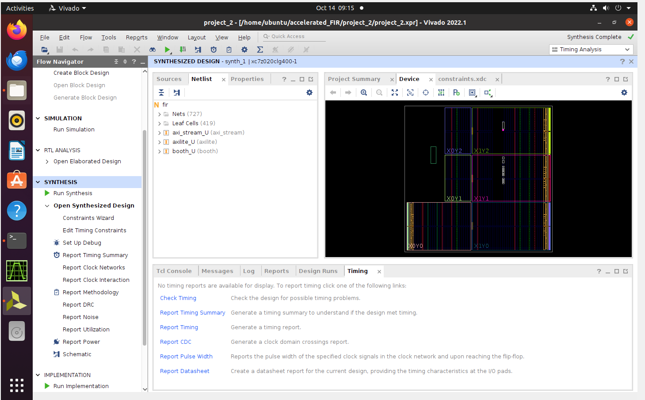
1.2.3 Report Timing Summary

Slide 11
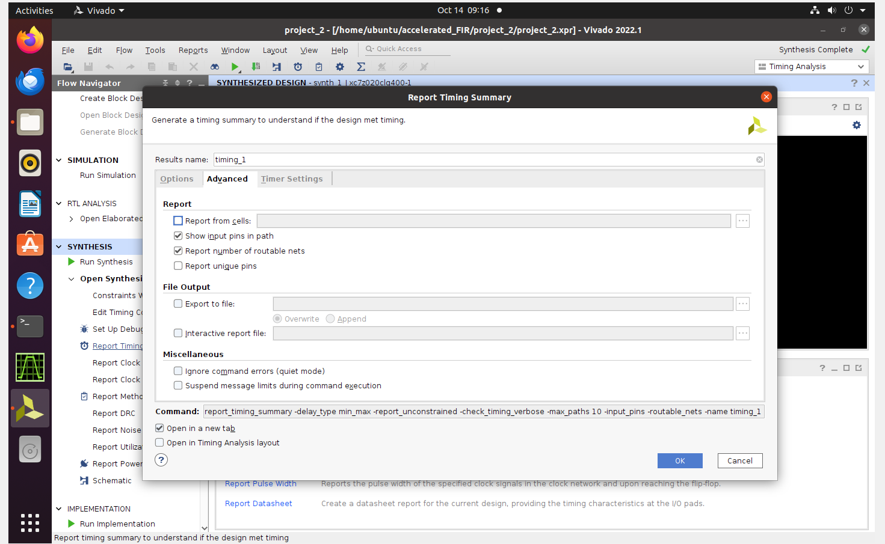
Export to timing summary file

Slide 12
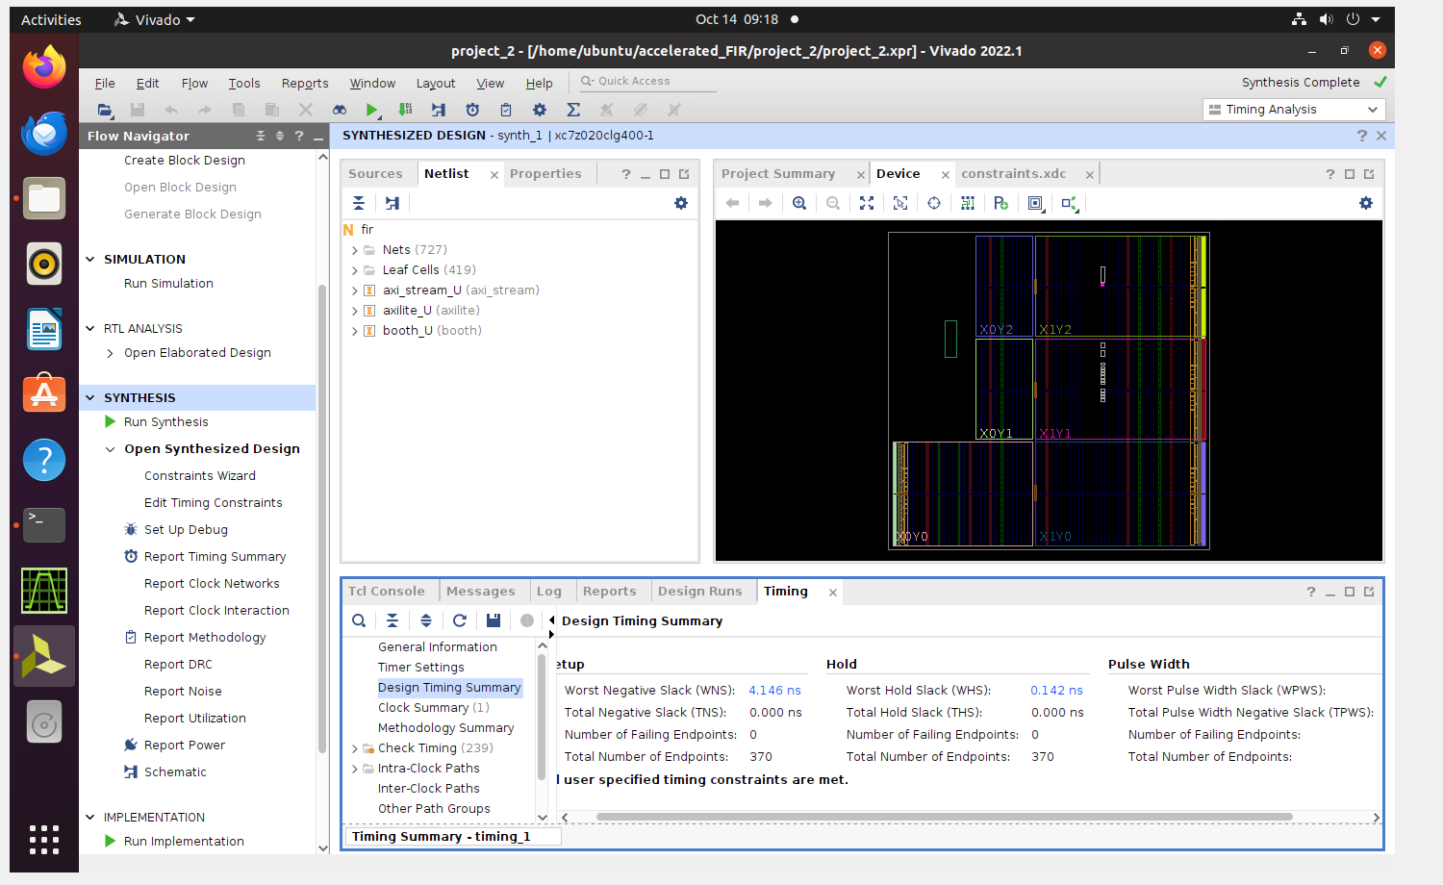
1.2.4 Check the Design Timing Summary
Slack time has to be positive integer

Slide 13
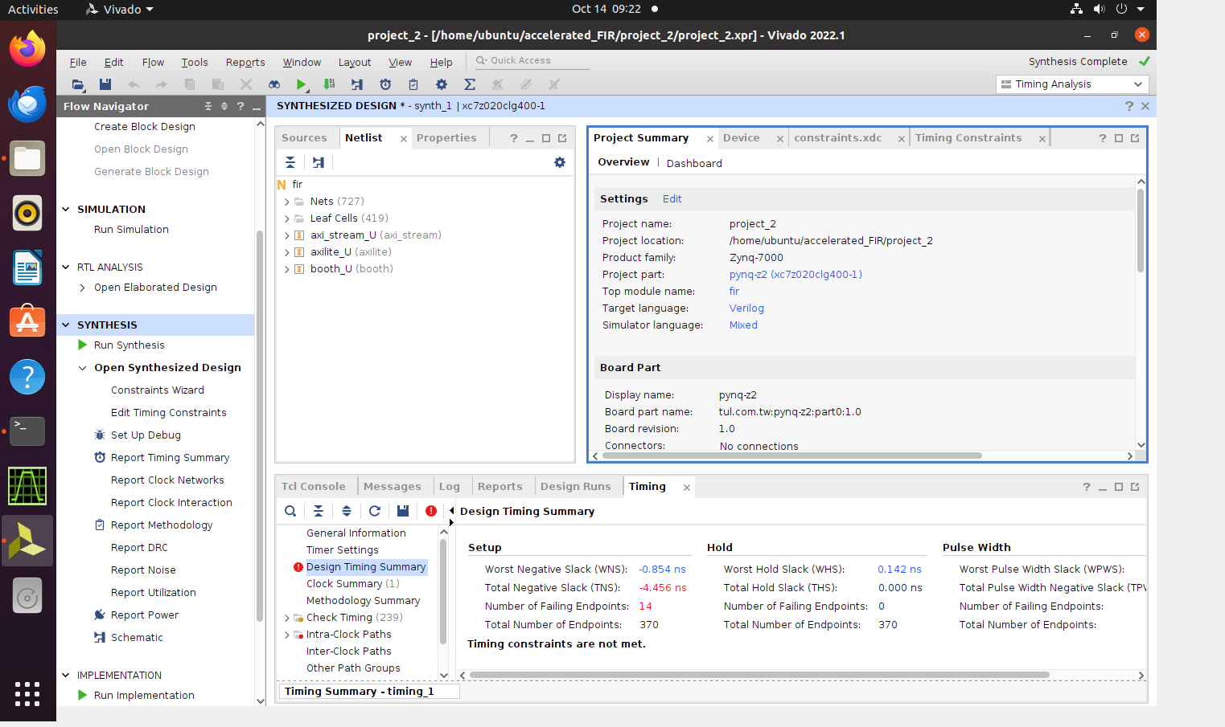
1.2.5 Edit Timing Constraints
If there is negative slack time, you need to increase timing constraints

Slide 14
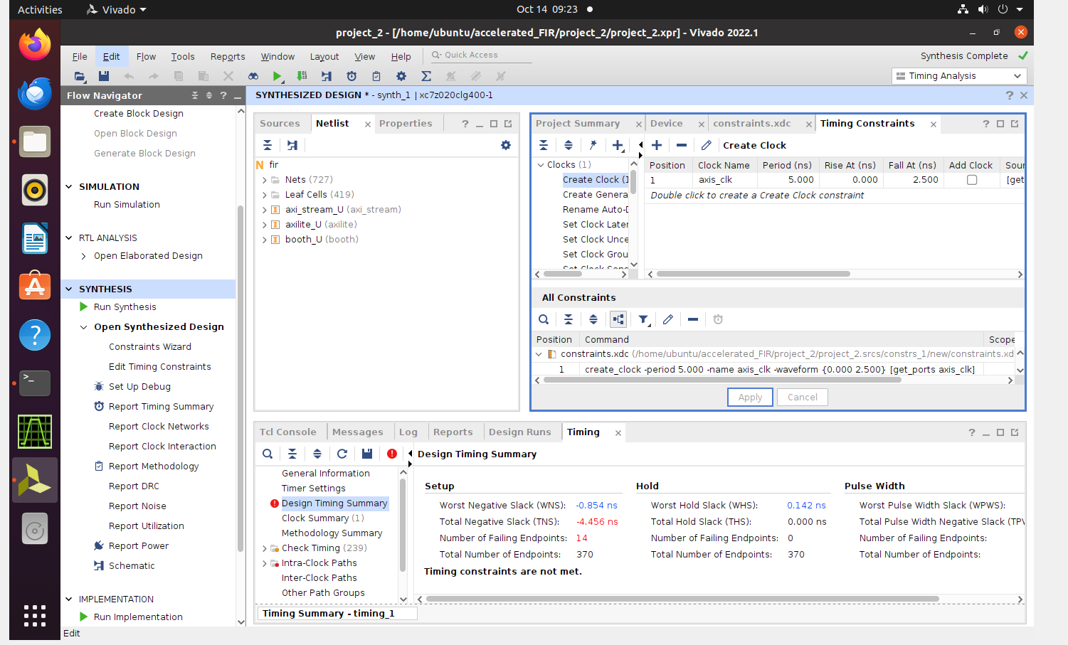
Edit the axis_clk constraints, then re-run the timing summary.

