Slide 1
JPEG
By Chia-chun, lin

Slide 2
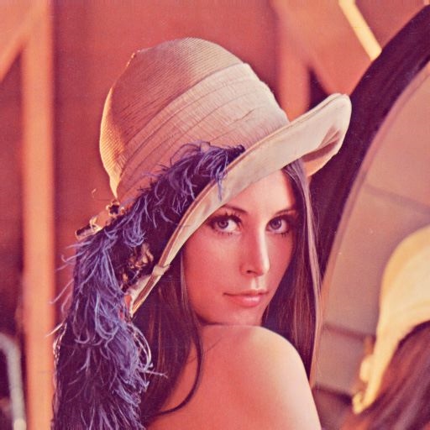
diagram
Quantization
table
RGB
To
YCbCr
Blocking
8 x 8
DCT
Quantization
AC
DC
Y、Cb、Cr
huffman
DPCM
Huffman
Tree
table
Y、Cb、Cr
RLE
zigzag

Slide 3






RGB to YCbCr YCbCr to RGB
$$\text{Y}\text{=0.299∗}\text{R}\text{ + 0.587∗}\text{G}\text{ + 0.114∗}\text{B}$$
$$\text{R}\text{=}\text{Y}\text{ + 1.402∗}\text{Cr}\text{;}$$
$$\text{Cb}\text{=0.564∗(}\text{B}\text{−}\text{Y}\text{)}$$
$$\text{G}\text{=}\text{Y}\text{ − 0.344∗}\text{Cb}\text{ − 0.714∗}\text{Cr}$$
$$\text{Cr}\text{=0.713∗(}\text{R}\text{−}\text{Y}\text{)}$$
$$\text{B}\text{=}\text{Y}\text{ + 1.722∗}\text{Cb}$$

Slide 4
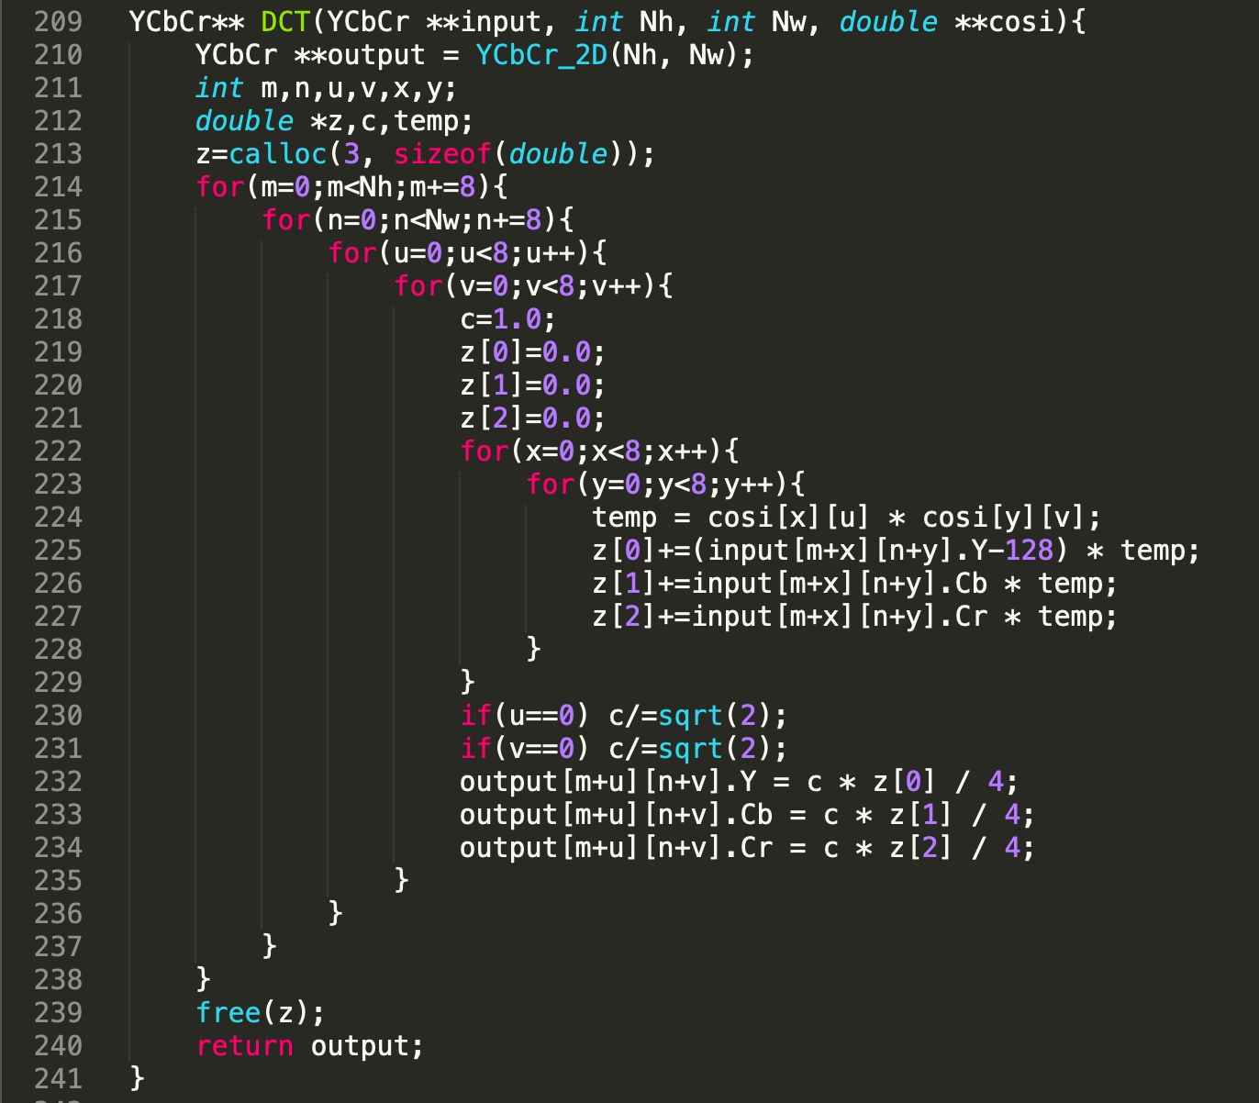
DCT

Slide 5
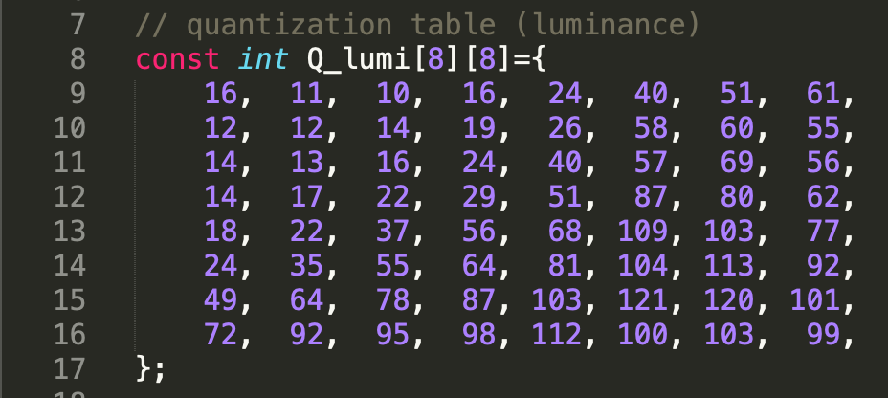
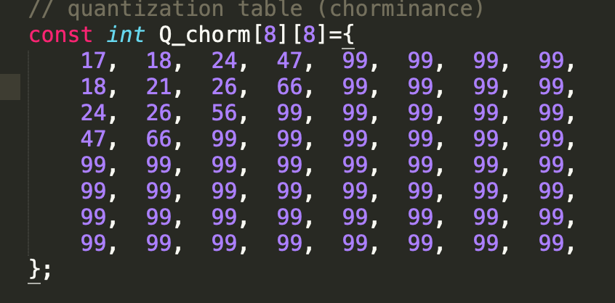
Quatization

Slide 6
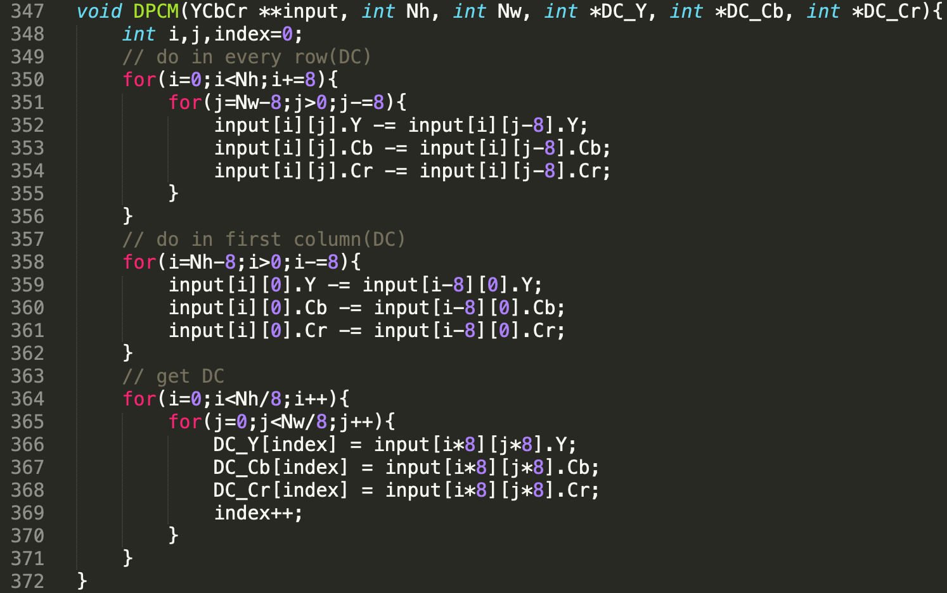
DPCM

Slide 7
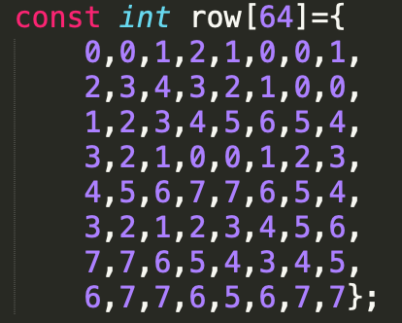
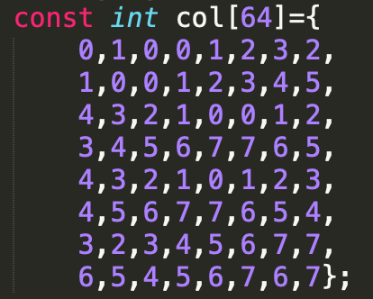
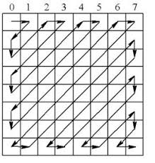
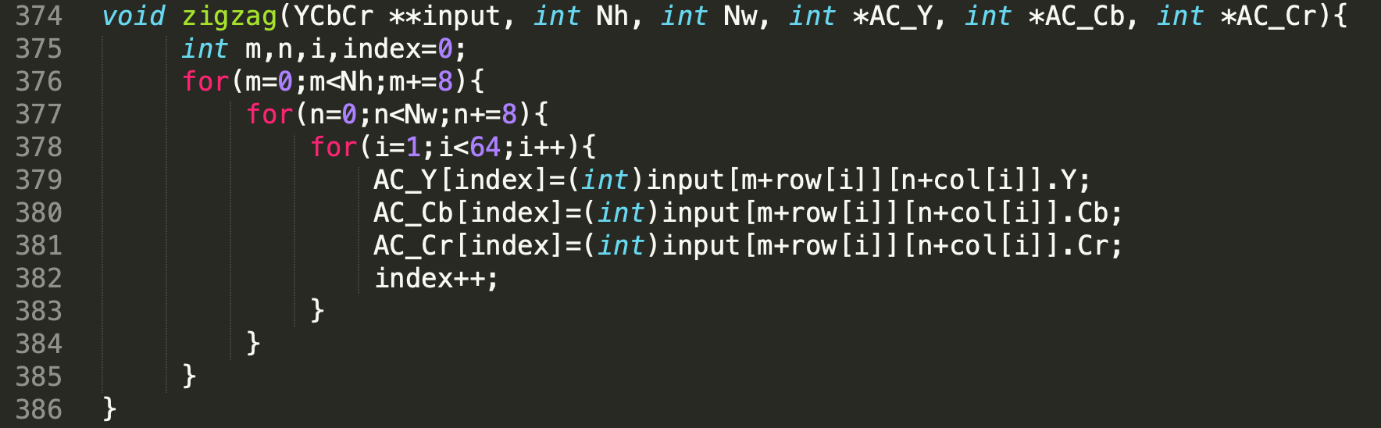
Zigzag

Slide 8
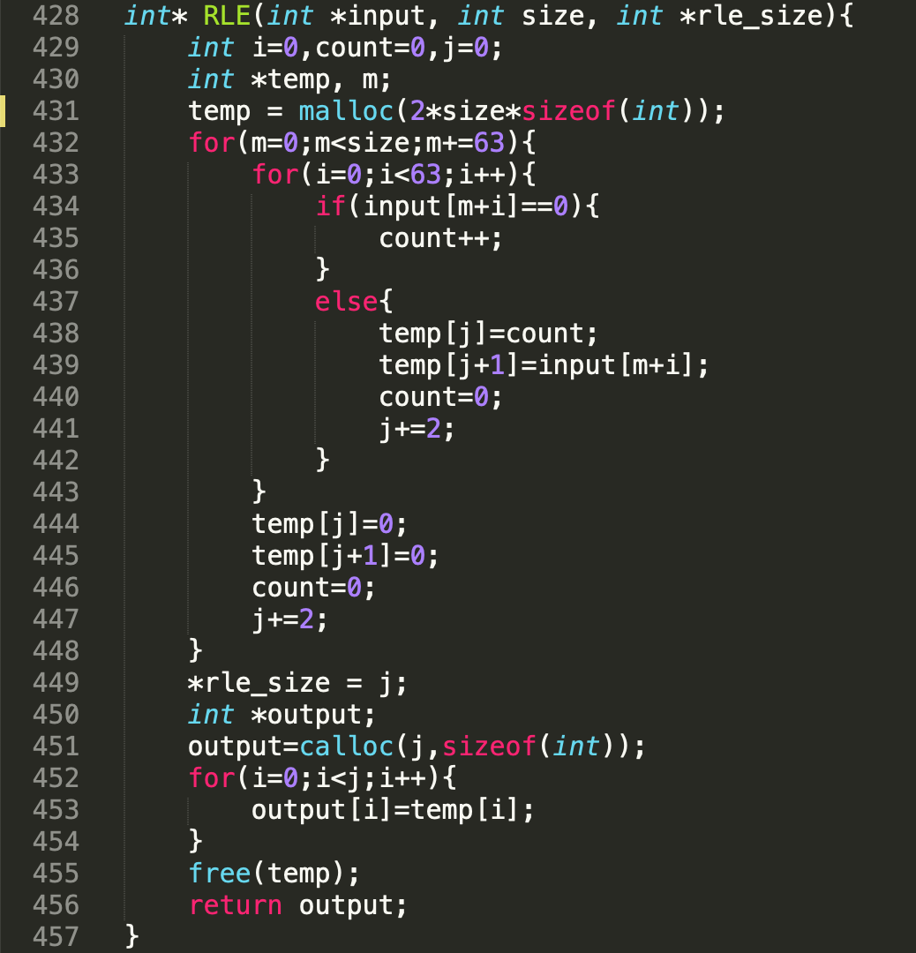
RLE

Slide 9
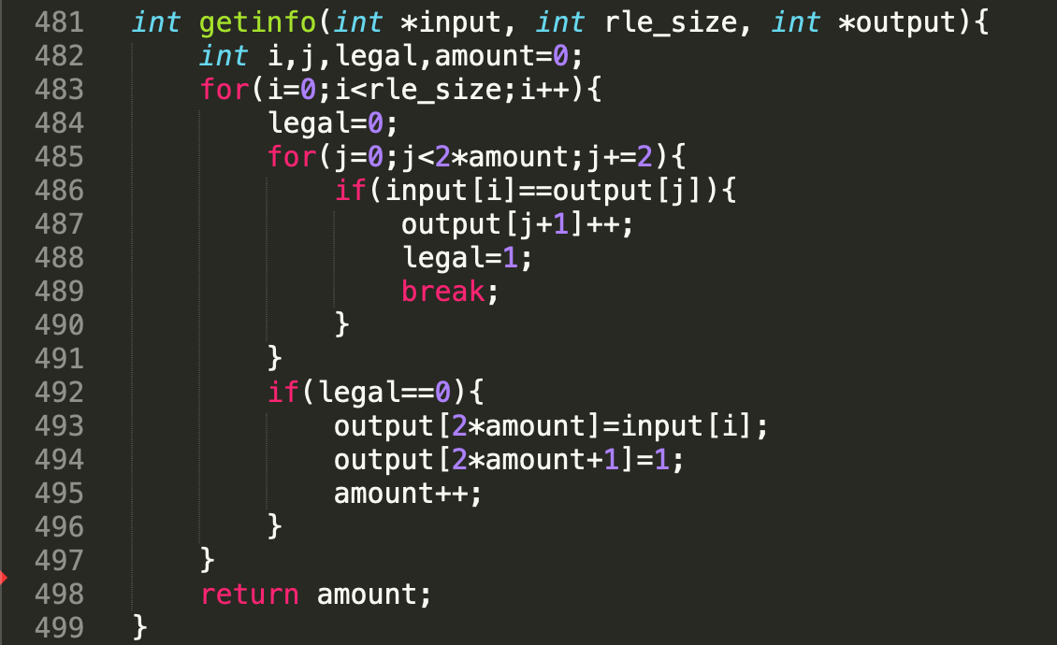
Get__info func.

Slide 10
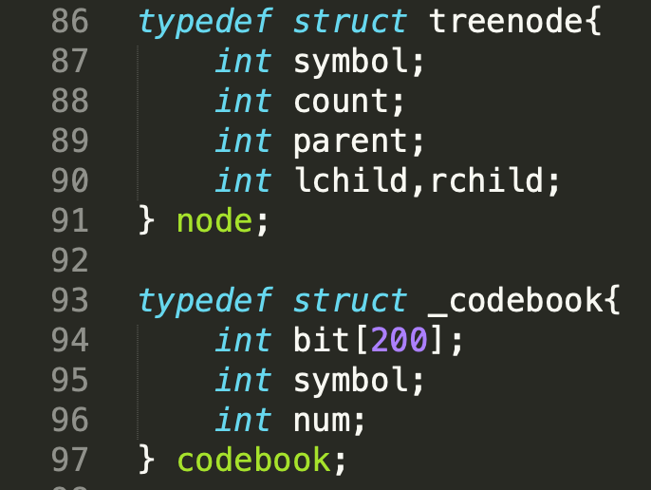
Huffman code
Symbol
==========
count
parent
Symbol
============
count
L child
R child
Symbol
==========
count
Symbol
==========
count

Slide 11
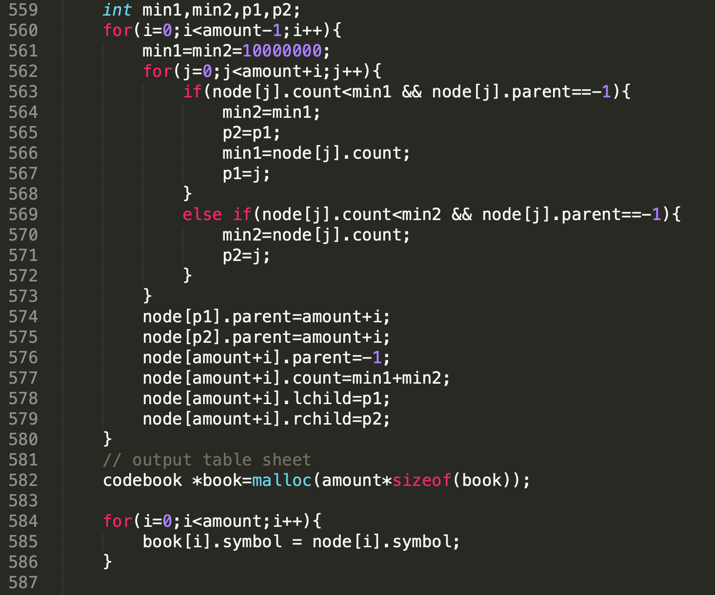
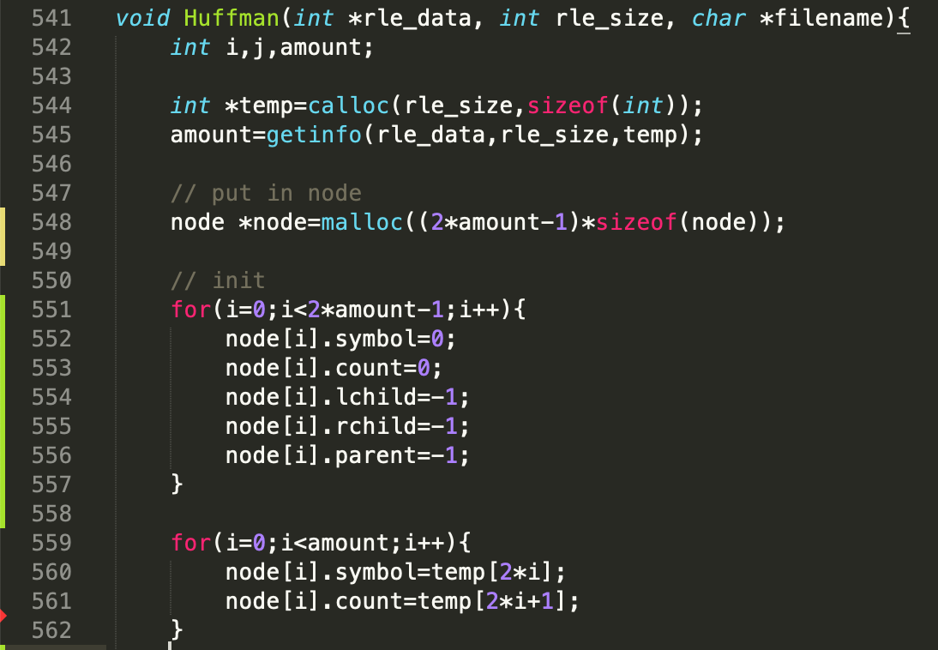
Initialize!!!
Put data in

Slide 12
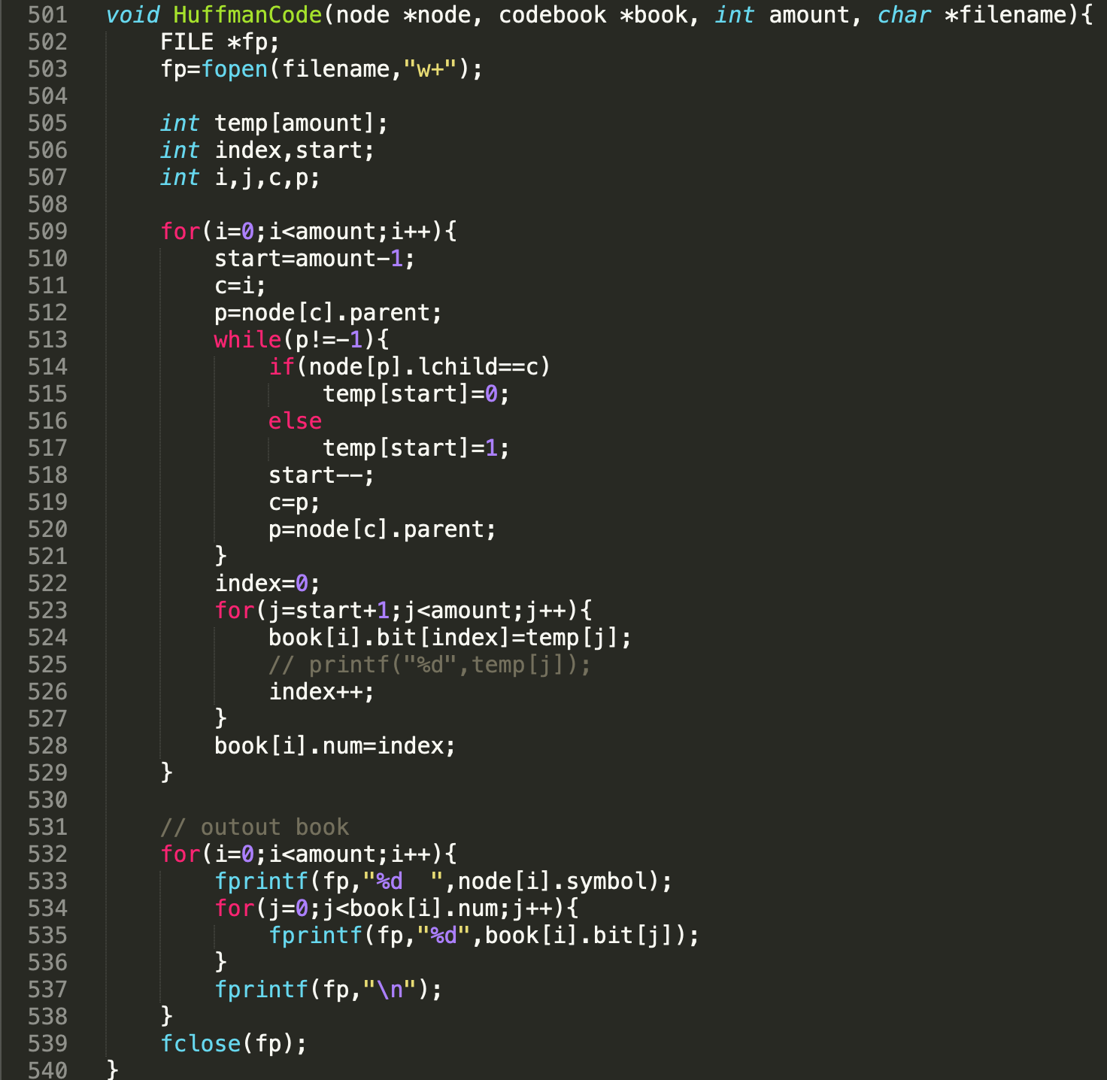
Huffman tree

Slide 13
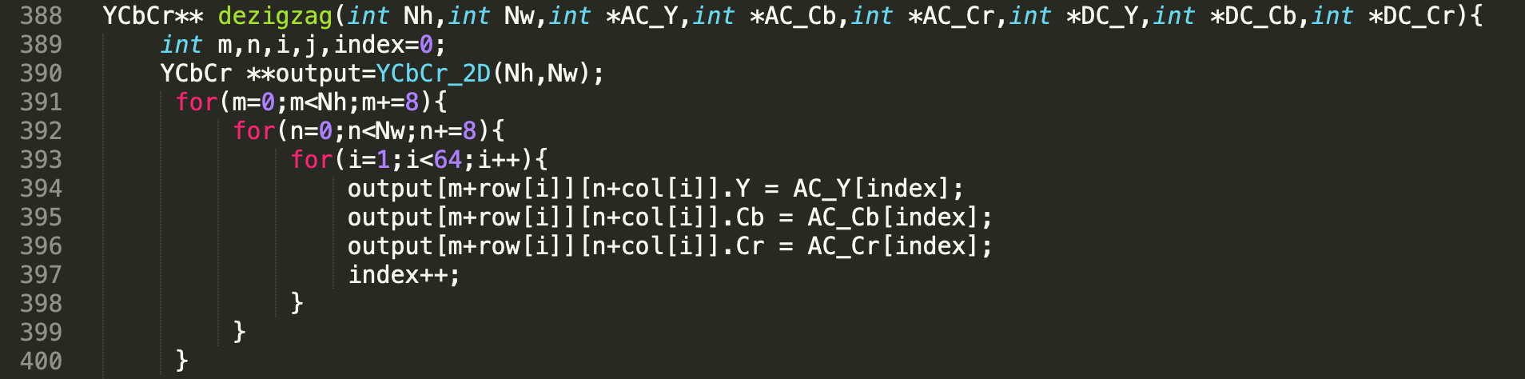
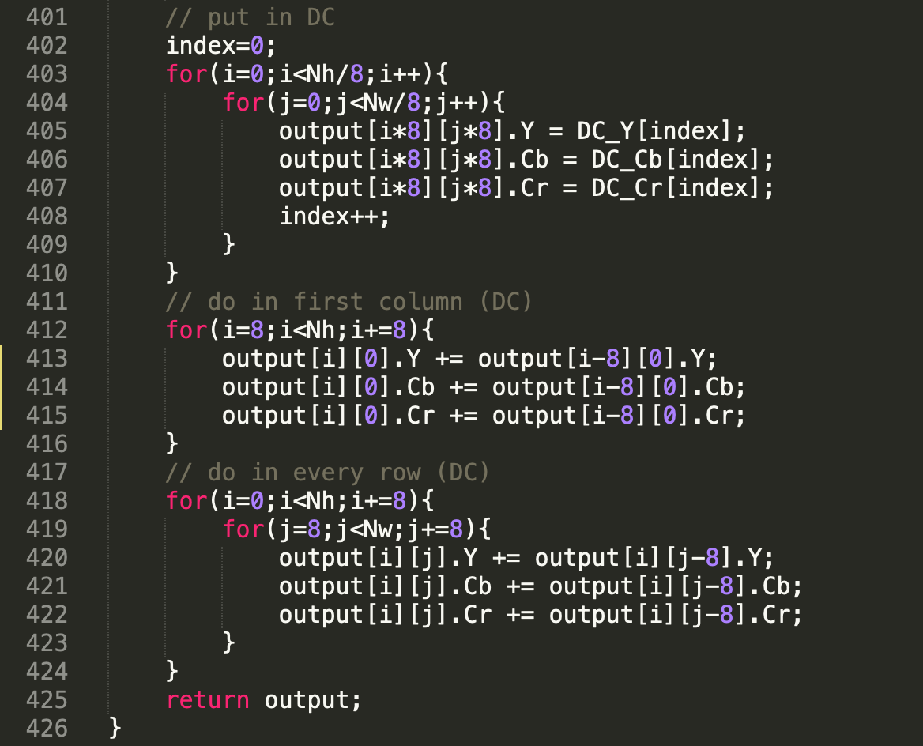
De-zigzag & inverse DPCM

Slide 14
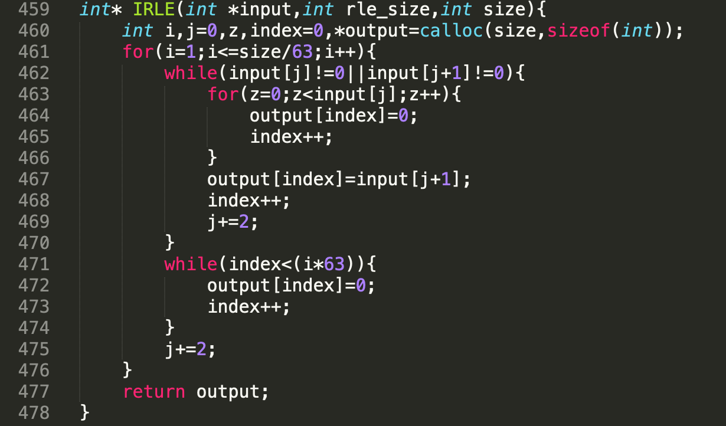
IRLE

Slide 15
deQuatization

Slide 16
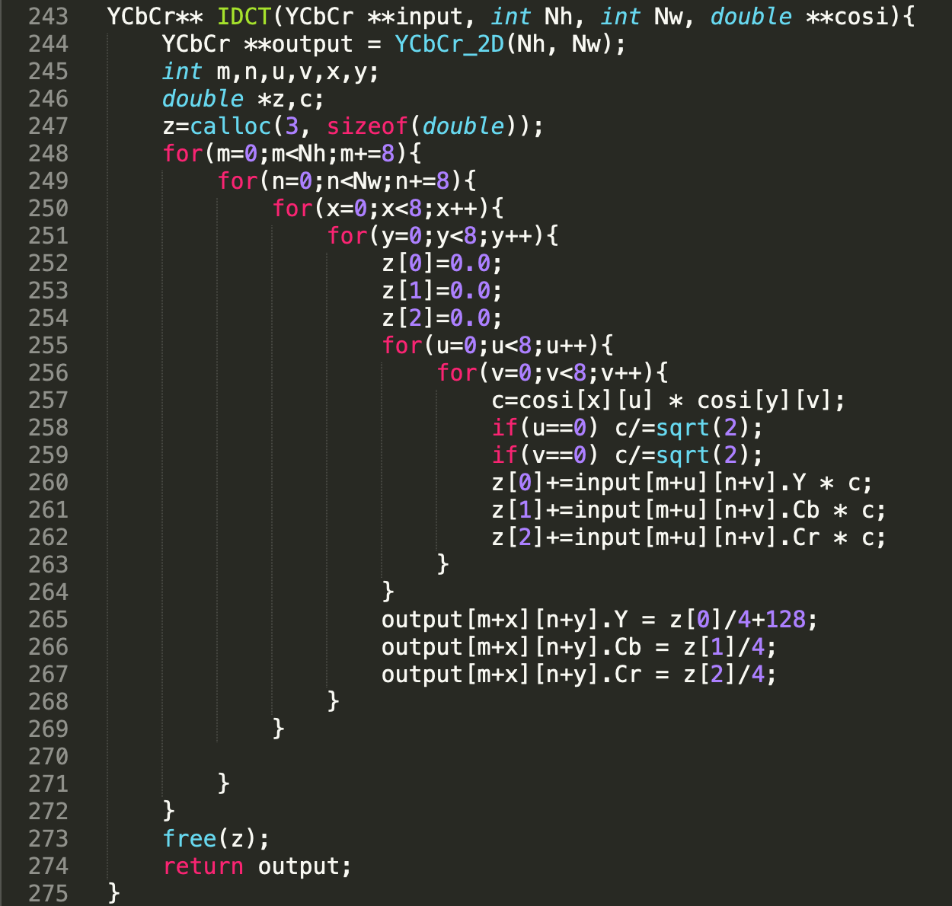
IDCT

Slide 17
RGB to YCbCr YCbCr to RGB
$$\text{Y}\text{=0.299∗}\text{R}\text{ + 0.587∗}\text{G}\text{ + 0.114∗}\text{B}$$
$$\text{R}\text{=}\text{Y}\text{ + 1.402∗}\text{Cr}\text{;}$$
$$\text{Cb}\text{=0.564∗(}\text{B}\text{−}\text{Y}\text{)}$$
$$\text{G}\text{=}\text{Y}\text{ − 0.344∗}\text{Cb}\text{ − 0.714∗}\text{Cr}$$
$$\text{Cr}\text{=0.713∗(}\text{R}\text{−}\text{Y}\text{)}$$
$$\text{B}\text{=}\text{Y}\text{ + 1.722∗}\text{Cb}$$

Slide 18
Thanks！

