Slide 1
Progress report for colon II filtering
June 26, 2015

Slide 2
WorkFlow
1. Data ETL
Put data into convenient format and structures for us to use on NLP
2. NLP
Search for keyword ‘Stage’ and ‘Grade’ and keyword for TNM staging system
Check surrounding text for words referring to colon cancer
3. Grouping
Summarize the results

Slide 3
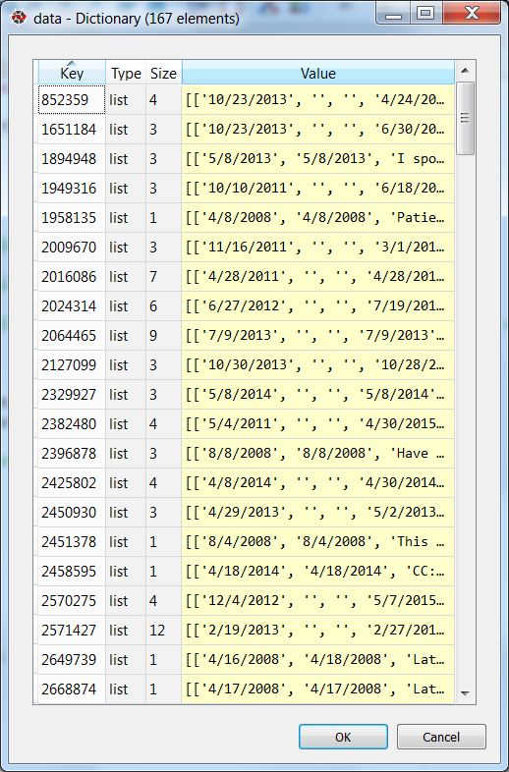
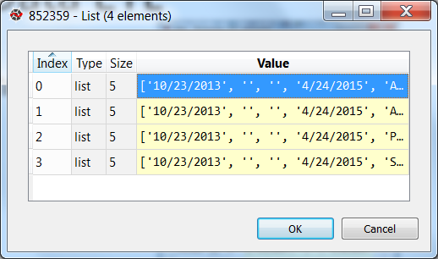
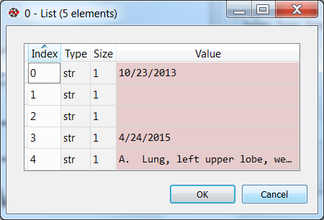
Data ETL
Language: Python
Functions:
readId
readNote
Main:
getData
Result:
A dictionary of all patient mapping to their corresponding notes

Slide 4
NLP
Language: Python
Functions:
cancer_capture
findStages
getStageFromPa
Result:
A dictionary of all stage corresponding to colon cancer occurred in each note

Slide 5
Algorithm
Use Regular Expression for keyword matching
Stage keyword: ‘Stage’ and ‘Grade’ and for TNM system
Pre-determine the distance threshold (default: 500 characters) to search for colon cancer keywords in the surrounding text of stage keyword
Colon cancer keyword: '((colon|rectal|rectosigmoid|colorectal) (cancer|carcinoma))|(cancer|enocarcinoma.*colon|sigmoid)|colon neoplasm'
Convert all returned stage into number

Slide 6
TNM (AJCC) staging system
Create a dictionary of key and stage
Extract key (e.g. T0 N0 M0) from the pathology note
Match the extracted key with the dictionary to return the stage
Reference: http://www.cancer.org/cancer/colonandrectumcancer/detailedguide/colorectal-cancer-staged

Slide 7
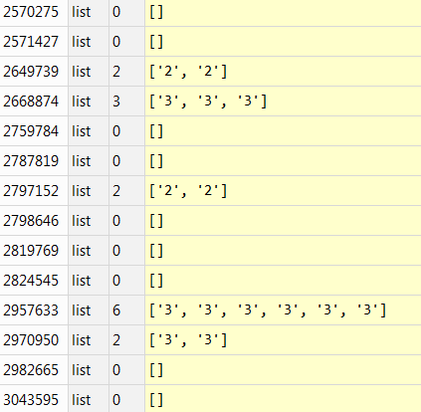
Grouping
Result: a list of cancer stage corresponding to each patient
Retrieve: 31 where Total patients: 167

Slide 8
Results
Manually observe to validate the results
The algorithm works find with notes containing stage keywords
136 patients are missed
Impossible to identify: notes contain no useful information
Require additional knowledge

Slide 9
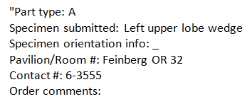

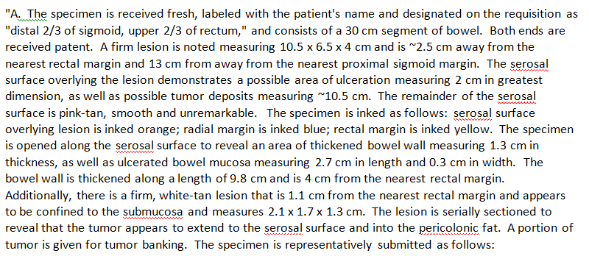
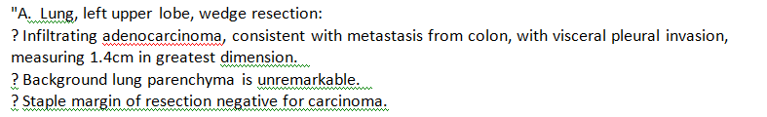
Results
Impossible to identify :
May be possible with additional knowledge:

Slide 10
Challenges
Small data set and some notes are irrelevant
Generalization of the algorithm : require a list of keywords for other types of cancers

Slide 11
Future plan/idea
Learn knowledge (topics/ clustering ,…) from results which we already know the stage of the cancer and apply with unlabeled part
caveat: data set may be too small
Get knowledge from expertise (e.g. keywords for different stages)
Generalize the algorithm for other cancer types

