Slide 1
Progress report for cancer type and stage
June 30, 2015

Slide 2
WorkFlow
1. Data ETL
Put data into convenient format and structures for us to use on NLP
2. NLP
Search for keyword ‘Stage’ and ‘Grade’ and keyword for TNM staging system
Search for keyword corresponding to cancer type
Match between cancer type and stage of that particular cancer
3. Results
Summarize the results

Slide 3
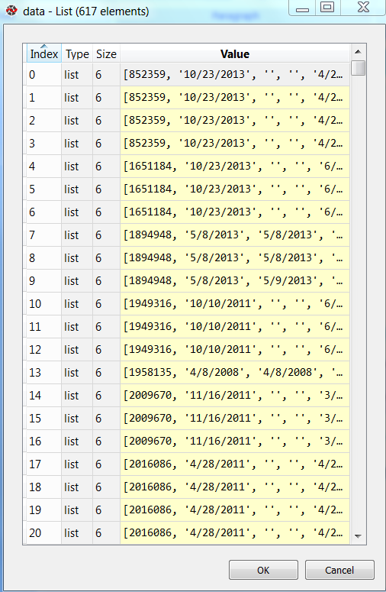
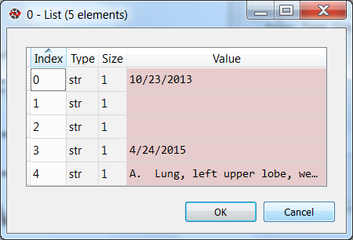
Data ETL
Language: Python
Task: read data from the csv file
and rearrange into desired format
Functions:
readId
readNote
getData
Result:
A dictionary of all rows with 5 columns corresponding to date and notes (fDate,pDate,pNote,paDate,paNote)

Slide 4
NLP
Language: Python
Task: Extract cancer type and stage from the notes
Functions:
get_stage_num
get_stage_from_pa
get_cancer_type
match_result
Result:
A dictionary of all stages corresponding to a particular type of cancer occurred in each note

Slide 5
Algorithm
Split text into a sentence level
get_stage_num:
Use Regular Expression for keyword matching
Stage keyword: ‘Stage’ and ‘Grade’
Extract stage from the sentence containing the stage keyword
Convert the returned stage into number
Return a dictionary of stage and line number (which sentence)

Slide 6
Algorithm
get_stage_from_pa:
Use when TNM(AJCC) staging system is used with a particular format
Extract stage of the cancer by detecting keywords (e.g. T0 N0 M0) from the pathology note
Match the extracted key with the dictionary (manually create) to return the stage
Return a dictionary of stage and line number
Reference: http://www.cancer.org/cancer/colonandrectumcancer/detailedguide/colorectal-cancer-staged

Slide 7
Algorithm
get_cancer_type:
Check for cancer type keywords obtained from ‘organList.txt’ and keywords indicating cancer obtained from ‘cancerList.txt’ in each line
Return a dictionary of cancer type and line number when both cancer type keywords and keywords indicating cancer are detected in the same sentence

Slide 8
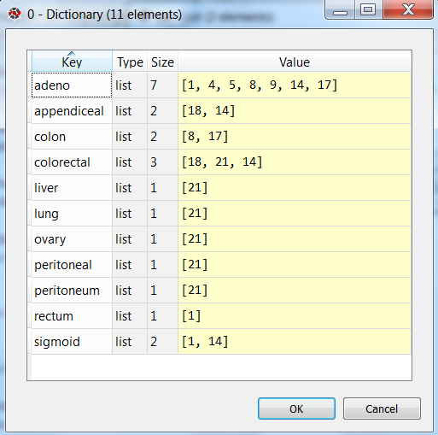
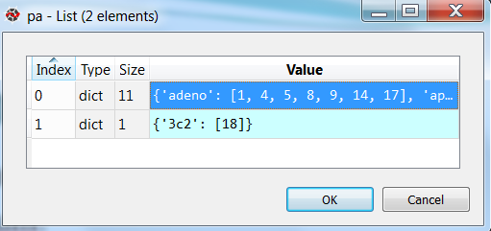
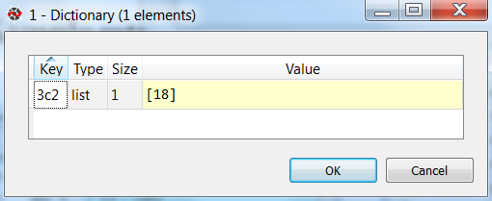
Algorithm
Returned dictionary

Slide 9
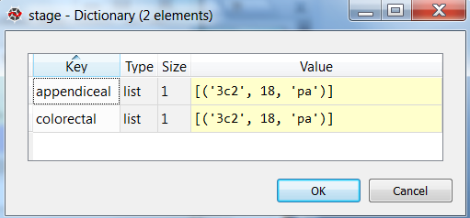
Algorithm
match_result:
Match returned results between cancer type and stage number when both appear in the same sentence
Return a dictionary of cancer type with a value of stage and note (‘p’ or ‘pa’)

Slide 10
Python script
Main
getData
get_stage_num
get_stage_from_pa
meetReq : check if given key meet req. from req. list
get_cancer_type
hasString : check if string is contained in text
getString : return a list of words appear in text
match_result

Slide 11
Results
Manually observe to validate the results
The algorithm works fine with notes containing stage keywords
Retrieve: 70 rows where Total rows: 617
547 rows are missed:
Impossible to identify: notes contain no useful information
Require additional knowledge

Slide 12
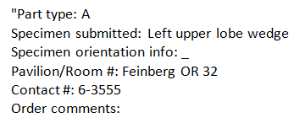

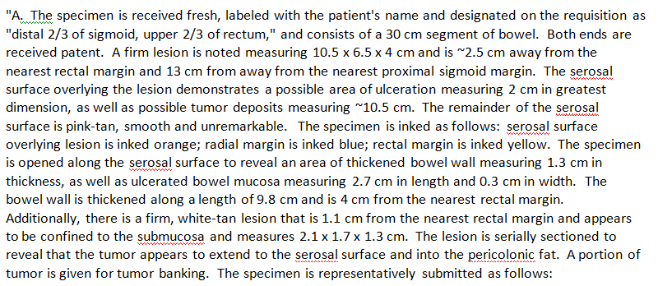
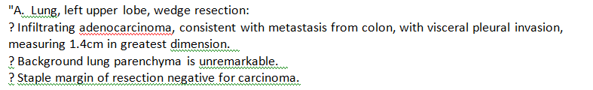
Results
Impossible to identify :
May be possible with additional knowledge:

Slide 13
Future plan/idea
Test the algorithm on a bigger data set and different cancer type
Create a user interface
Learn knowledge (topics/ clustering ,…) from results which we already know the stage of the cancer and apply with unlabeled part
caveat: data set may be too small
Get knowledge from expertise

