Slide 1
Presentation for athelets Project

Slide 2
Functional grouping
Ch0=Fp1,attention
Ch1=Fp2, judgement
Ch2=Fz, working memory/absent mindness
Ch3=Fc5,
Ch4=Fc6,
Ch5=C3,sensorimotor integration(right)
Ch6=CZ,sensorimotor integration(mid)
Ch7=C4,sensorimotor integration(left) upper arms hands
Ch8=P3, cognitive processing spacial temporal info "verbal reasoning"
Ch9=Pz, cognitive processing
Ch10=P4,cognitive processing spatial temporal info "math word problem", "non-verbal reasoning"
Ch11=O1, visual processing "if you want to remember first you have to see it"
Ch12=O2, visual processing
Ch13=IZ, Oz is Incontinence. IZ is near.
Eyes:
Ch14=E1,
Ch15=E2,
Groupings: 567, 8910,1112
Functions: Sensorimotor integration
Cognitive processing
Visual processing

Slide 3
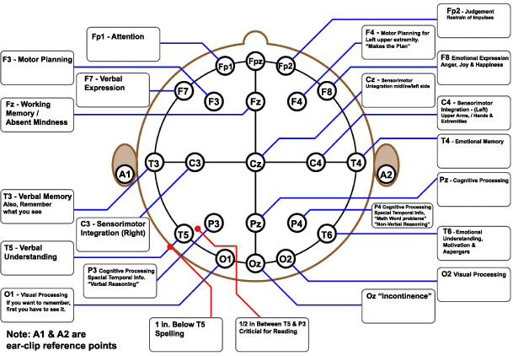
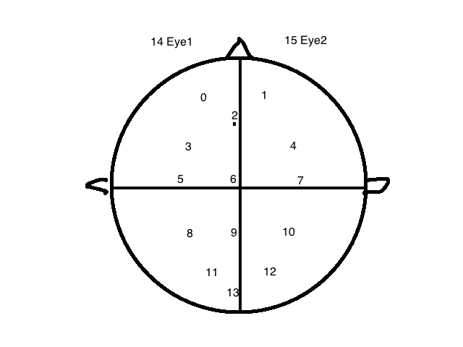
New brain map & grouping
Groupings: 567, 8910,1112
Functions: Sensorimotor integration
Cognitive processing
Visual processing

Slide 4
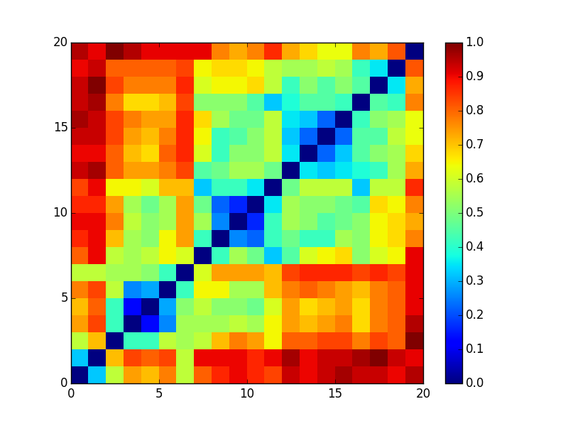
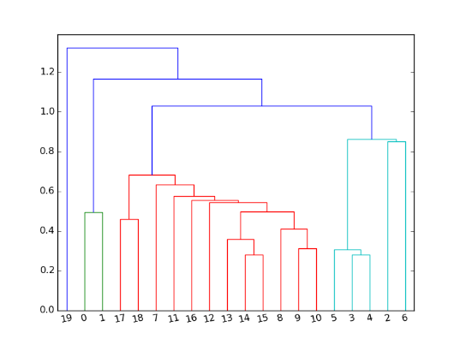
2-channel Heatmap
Data source. Note: lighter color = closer on heatmap

Slide 5
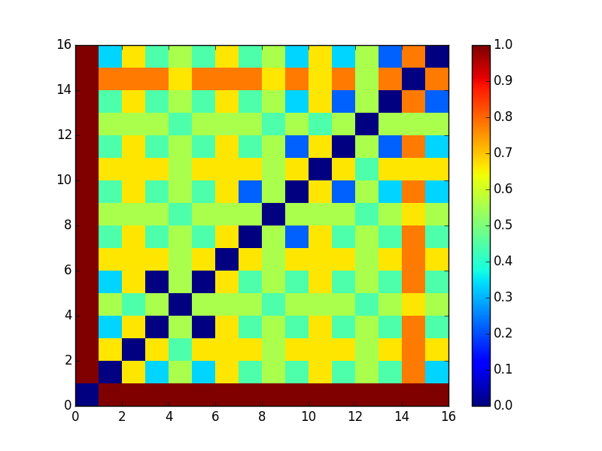
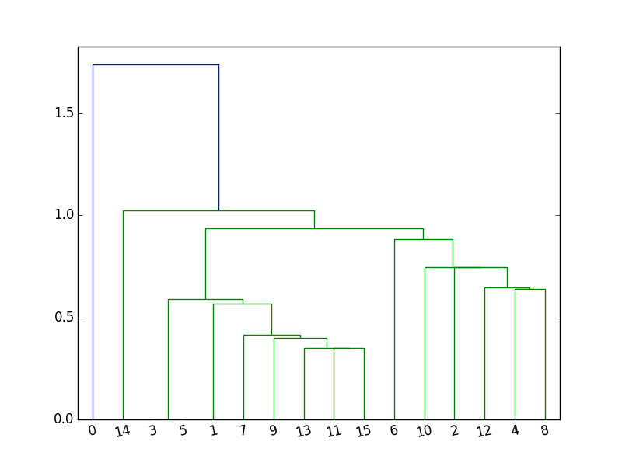
2 Channel clustering for control group
Control group
Pro
group

Slide 6
Controls 3Channel clustering
1 | 3 | 5 | 0.333333333
9 | 11 | 13 | 0.333333333
9 | 11 | 15 | 0.333333333
9 | 13 | 15 | 0.333333333
11 | 13 | 15 | 0.333333333
Does not make much sense to me
Notes:
Put the table in a clearer form. Remove duplicates. Include all. Use more than 1 nn

Slide 7
Pros 3 channel clustering
Data source. Note: smaller value = closer
Notes:
Symmatric

Slide 8
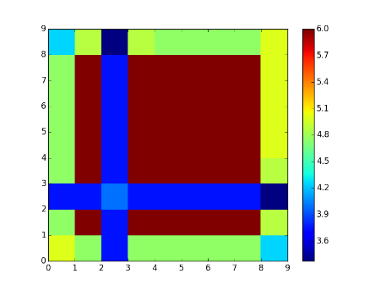
Rolling window Heatmap
 | 50_10 | 50_15 | 50_5 | 60_10 | 60_15 | 60_5 | 70_10 | 70_15 | 70_5
50_10 | 0.00 | 0.05 | 0.25 | 0.05 | 0.05 | 0.05 | 0.05 | 0.05 | 0.15
50_15 | 0.21 | 0.00 | 0.38 | 0.00 | 0.00 | 0.00 | 0.00 | 0.00 | 0.19
50_5 | 0.06 | 0.06 | 0.00 | 0.06 | 0.06 | 0.06 | 0.06 | 0.06 | 0.16
60_10 | 0.21 | 0.00 | 0.38 | 0.00 | 0.00 | 0.00 | 0.00 | 0.00 | 0.19
60_15 | 0.21 | 0.00 | 0.38 | 0.00 | 0.00 | 0.00 | 0.00 | 0.00 | 0.17
60_5 | 0.21 | 0.00 | 0.38 | 0.00 | 0.00 | 0.00 | 0.00 | 0.00 | 0.17
70_10 | 4.75 | 0.00 | 0.38 | 0.00 | 0.00 | 0.00 | 0.00 | 0.00 | 0.17
70_15 | 0.21 | 0.00 | 0.38 | 0.00 | 0.00 | 0.00 | 0.00 | 0.00 | 0.17
70_5 | 0.15 | 0.03 | 0.33 | 0.03 | 0.05 | 0.05 | 0.05 | 0.05 | 0.00
Data source Note: smaller value = closer

Slide 9
Clustering formula
Pro cpt data
Kmeans on each pro with our analytics engine
Clusterings for each Athlete
Windowlize fft

Slide 10
Channel clustering formula
Clusterings
Jaccard Index [distance matrix]
Cluster Channels across all Clusterings

Slide 11
Pro clustering formula
Clusterings
Athletes clustering
Jaccard/NMI for each athletes

Slide 12
Mean result for 1:3
channels

Slide 13
Other available metrics
1:2 1:4 1:5 2:3 2:5 3:4 4:5 1-2:4-5
1: easy1 2: easy2 3: hard1 4:hard2 5:easy3
For these combinations the results are identical to 1:5
Notes:
rework

Slide 14
New segments formula
Pro cpt data
Control cpt data
segments: Windowlized fft data for 5 segments, easy1, easy2, hard1, hard2, easy3

Slide 15
New feature formula
Segments
Transforms using analytics engine
Feature: Based on my need. Currently correlation between easy1 and easy3. More are available.

Slide 16
New distance formula
Features
Kmeans from analytics engine
Clustering result for pros and controls

Slide 17
Ttest description
Hypothesis
1. Channel mean for correlations are the same for pros and controls.
2. Mean for correlations are the same
Reject:
On even channels

Slide 18
Anova test description
Analysis of variance (ANOVA) tests the hypothesis that the means of two or more populations are equal. ANOVAs assess the importance of one or more factors by comparing the response variable means at the different factor levels.
The null hypothesis states that all population means (factor level means) are equal while the alternative hypothesis states that at least one is different.

Slide 19
Results for two tests
1 – easy1, 2 – easy2, 3 – hard1, 4 – hard2, 5- easy3
2 Tailed ttest: Pro vs control in channels null-rejects:
For even channels:
1:2, 1:3, 1:4, 1:5, 2:3, 2:4, 2:5, 3:4, 3:5, 4:5,
1-2:3-5, 1-2:4-5, 1:4-2:5, 2-3:4-5
Anova test: Pro vs control in channels null-rejects:
For even channels:
1:2, 1:3, 1:4, 1:5, 2:3, 2:4, 2:5, 3:4, 3:5, 4:5,
1-2:4-5
Notes:
Summarize the results here.

Slide 20
Clustering result
1: pros
0: non-pros
1, 1, 1, 1, 1, 1
1, 1, 1, 1, 1
1, 1, 1, 1, 1, 1, 1, 1, 1, 1, 1, 1
1
1
0, 0, 0, 0, 0, 0, 0, 0, 0
1,1
Notes:
Change it

