Slide 1
May 28 meeting

Slide 2
Agenda
Heatmaps for 2 channels being in the same cluster.
Most significant 3-channel in the same cluster
Heatmap for different time windows. (to show similarities)
Select Dendrogram with categorical label from 10.
4 Chord diagrams

Slide 3
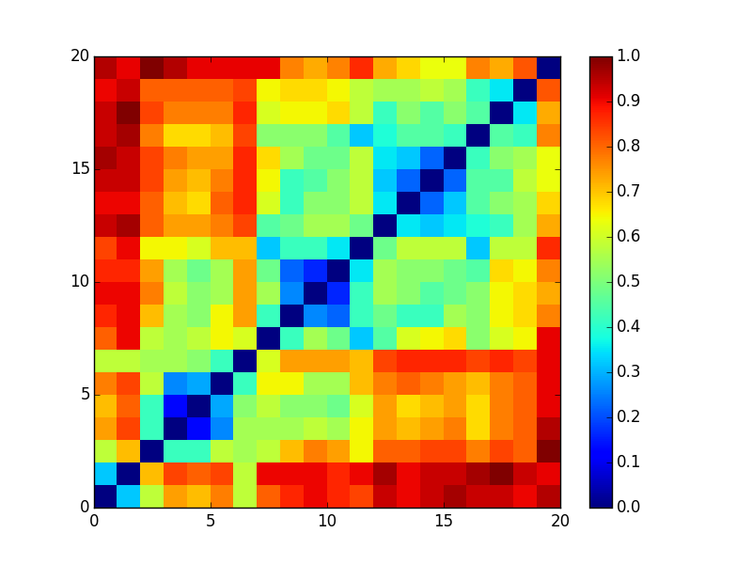
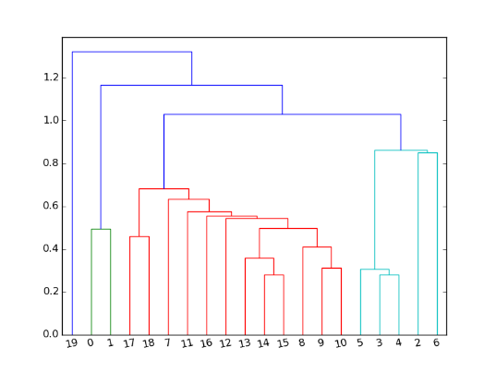
2-channel Heatmap
Data source. Note: lighter color = closer on heatmap

Slide 4
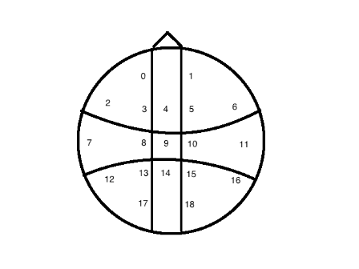
Most significant 3 channels in the same cluster
Data source. Note: smaller value = closer
Notes:
Symmatric

Slide 5
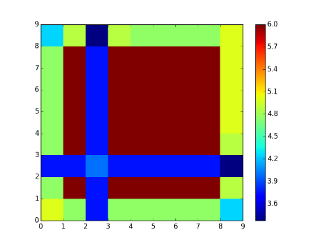
Rolling window Heatmap
 | 50_10 | 50_15 | 50_5 | 60_10 | 60_15 | 60_5 | 70_10 | 70_15 | 70_5
50_10 | 0.00 | 0.05 | 0.25 | 0.05 | 0.05 | 0.05 | 0.05 | 0.05 | 0.15
50_15 | 0.21 | 0.00 | 0.38 | 0.00 | 0.00 | 0.00 | 0.00 | 0.00 | 0.19
50_5 | 0.06 | 0.06 | 0.00 | 0.06 | 0.06 | 0.06 | 0.06 | 0.06 | 0.16
60_10 | 0.21 | 0.00 | 0.38 | 0.00 | 0.00 | 0.00 | 0.00 | 0.00 | 0.19
60_15 | 0.21 | 0.00 | 0.38 | 0.00 | 0.00 | 0.00 | 0.00 | 0.00 | 0.17
60_5 | 0.21 | 0.00 | 0.38 | 0.00 | 0.00 | 0.00 | 0.00 | 0.00 | 0.17
70_10 | 4.75 | 0.00 | 0.38 | 0.00 | 0.00 | 0.00 | 0.00 | 0.00 | 0.17
70_15 | 0.21 | 0.00 | 0.38 | 0.00 | 0.00 | 0.00 | 0.00 | 0.00 | 0.17
70_5 | 0.15 | 0.03 | 0.33 | 0.03 | 0.05 | 0.05 | 0.05 | 0.05 | 0.00
Data source Note: smaller value = closer

Slide 6
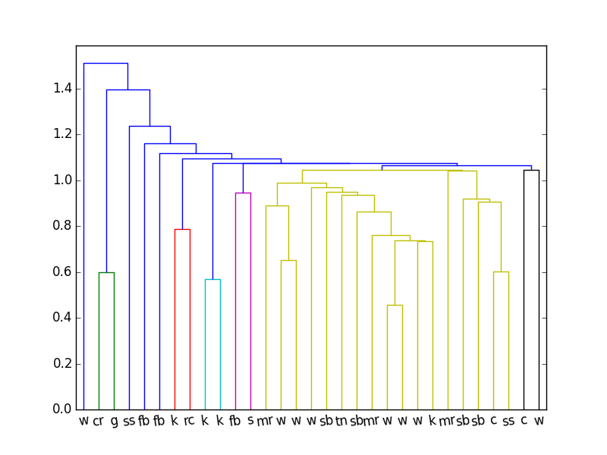
Athlete clustering
c | cyclist
cr | car racing
fb | football
g | golf
k | kayak
mr | motorcycle racing
rc | rallycross
sb | skate boarding
ss | snow skie
w | water sports
Jacc_5: theta 4-7.5 Hz
Data source: atheletsClustering/

Slide 7
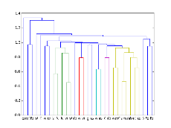
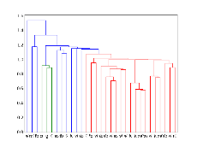
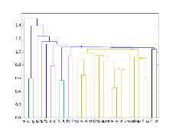
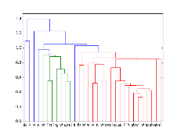
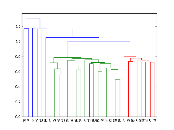
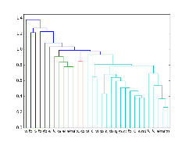
Other athlete clusterings
Those are not as good. Data source: atheletsClustering/

Slide 8
Chord Diagrams
Using NMI and Channel Clustering.
Using NMI and Athlete Clustering.
Using Jaccard and Channel Clustering.
Using Jaccard and Athlete Clustering

Slide 9
Clustering formula
Pro cpt data
Kmeans on each pro with our analytics engine
Clusterings for each Athlete
Windowlize fft

Slide 10
Channel clustering formula
Clusterings
Jaccard Index [distance matrix]
Cluster Channels across all Clusterings

Slide 11
Pro clustering formula
Clusterings
Athletes clustering
Jaccard/NMI for each athletes

Slide 12
New result

Slide 13
New clustering result
Cluster0: 1, 1, 1, 1, 1, 1, 1, 1, 1, 1, 1, 1, 1, 1, 1, 1, 1, 1, 1, 1, 1, 1, 1, 0, 1, 1, 0, 0, 0
Cluster 1: 0
Cluster 2: 0, 1, 1, 0, 0, 0, 0

Slide 14
New segments formula
Pro cpt data
Control cpt data
segments: Windowlized fft data for 5 segments, easy1, easy2, hard1, hard2, easy3

Slide 15
New feature formula
Segments
Transforms using analytics engine
Feature: Based on my need. Currently correlation between easy1 and easy3. More are available.

Slide 16
New distance formula
Features
Kmeans from analytics engine
Clustering result for pros and controls

Slide 17
Todos
Discuss and confirm our logic.
Better results using techniques such as applying a curve to each channel
Turn this into classification problem – Maybe not because we do not have many data, but still worth a try because the average values look good.

