Slide 1
Nov 6 meeting

Slide 2
Review Agenda
Heatmaps for 2 channels being in the same cluster.
Most significant 3-channel in the same cluster
Heatmap for different time windows. (to show similarities)
Select Dendrogram with categorical label from 10.
4 Chord diagrams

Slide 3
New agenda
New Brain map and functional grouping explained
Pro/Control seperation using even channels
Stats tests for channels came out positive when comparing pro vs control
Pro/Channel clustering results
Channel clustering for control group
Notes:
Combine old and new agenda

Slide 4
In words
Ch0=Fp1,attention
Ch1=Fp2, judgement
Ch2=Fz, working memory/absent mindness
Ch3=Fc5,
Ch4=Fc6,
Ch5=C3,sensorimotor integration(right)
Ch6=CZ,sensorimotor integration(mid)
Ch7=C4,sensorimotor integration(left) upper arms hands
Ch8=P3, cognitive processing spacial temporal info "verbal reasoning"
Ch9=Pz, cognitive processing
Ch10=P4,cognitive processing spatial temporal info "math word problem", "non-verbal reasoning"
Ch11=O1, visual processing "if you want to remember first you have to see it"
Ch12=O2, visual processing
Ch13=IZ, Oz is Incontinence. IZ is near.
Eyes:
Ch14=E1,
Ch15=E2,
Groupings: 567, 8910,1112
Functions: Sensorimotor integration
Cognitive processing
Visual processing

Slide 5
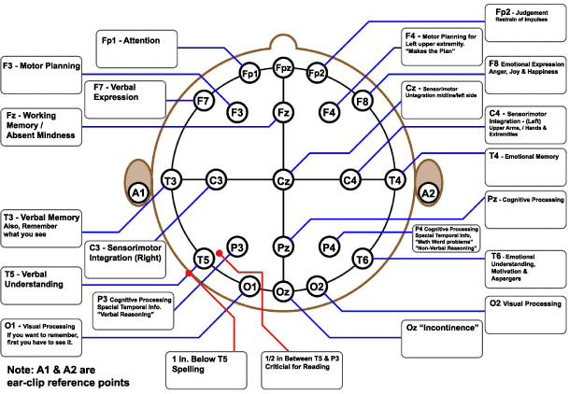
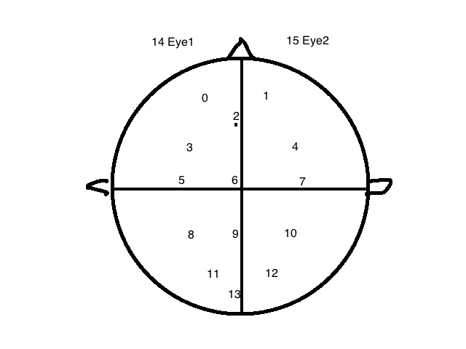
New brain map & grouping
Groupings: 567, 8910,1112
Functions: Sensorimotor integration
Cognitive processing
Visual processing

Slide 6
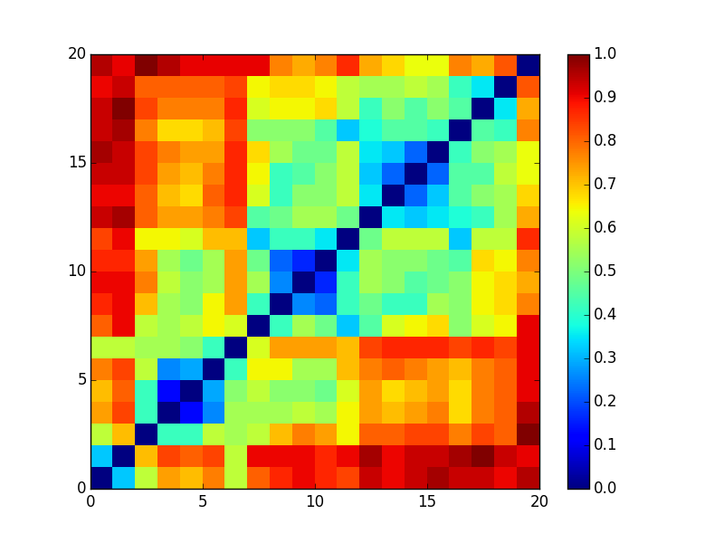
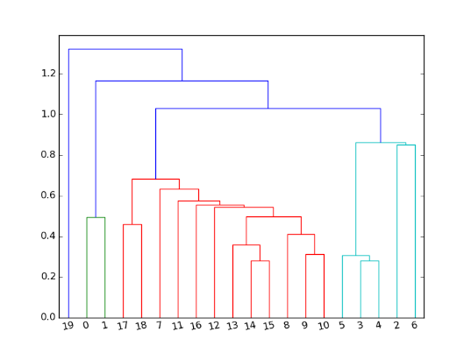
2-channel Heatmap
Data source. Note: lighter color = closer on heatmap

Slide 7
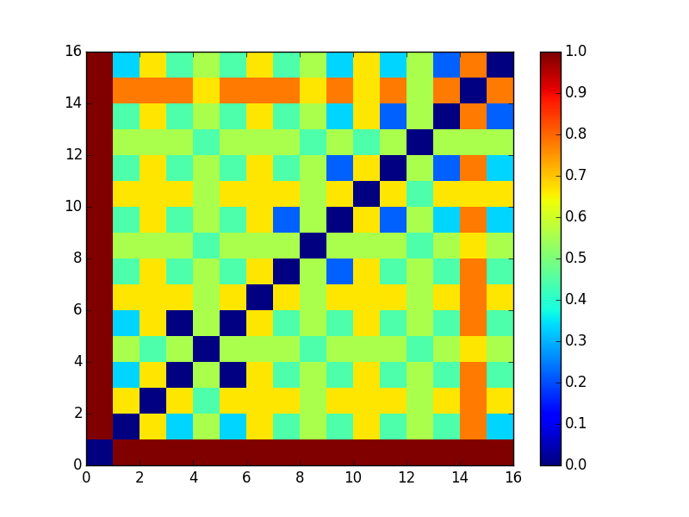
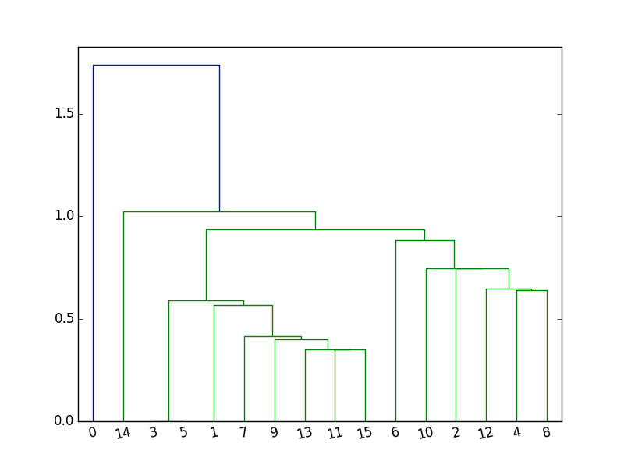
2 Channel clustering for control group
Control group
Pro
group

Slide 8
3Channel clustering
9 | 11 | 13 | 0.333333333
9 | 11 | 15 | 0.333333333
9 | 13 | 9 | 0.333333333
9 | 13 | 11 | 0.333333333
9 | 13 | 13 | 0.333333333
9 | 13 | 15 | 0.333333333
9 | 15 | 9 | 0.333333333
9 | 15 | 11 | 0.333333333
9 | 15 | 13 | 0.333333333
9 | 15 | 15 | 0.333333333
11 | 9 | 13 | 0.333333333
11 | 9 | 15 | 0.333333333
11 | 11 | 15 | 0.333333333
11 | 13 | 9 | 0.333333333
11 | 13 | 15 | 0.333333333
Does not make much sense to me
Notes:
Put the table in a clearer form. Remove duplicates. Include all.

Slide 9
Most significant 3 channels in the same cluster
Data source. Note: smaller value = closer
Notes:
Symmatric

Slide 10
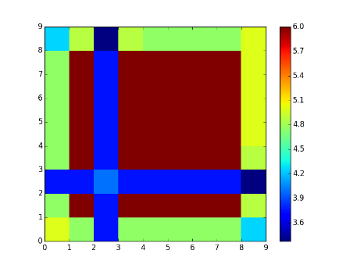
Rolling window Heatmap
 | 50_10 | 50_15 | 50_5 | 60_10 | 60_15 | 60_5 | 70_10 | 70_15 | 70_5
50_10 | 0.00 | 0.05 | 0.25 | 0.05 | 0.05 | 0.05 | 0.05 | 0.05 | 0.15
50_15 | 0.21 | 0.00 | 0.38 | 0.00 | 0.00 | 0.00 | 0.00 | 0.00 | 0.19
50_5 | 0.06 | 0.06 | 0.00 | 0.06 | 0.06 | 0.06 | 0.06 | 0.06 | 0.16
60_10 | 0.21 | 0.00 | 0.38 | 0.00 | 0.00 | 0.00 | 0.00 | 0.00 | 0.19
60_15 | 0.21 | 0.00 | 0.38 | 0.00 | 0.00 | 0.00 | 0.00 | 0.00 | 0.17
60_5 | 0.21 | 0.00 | 0.38 | 0.00 | 0.00 | 0.00 | 0.00 | 0.00 | 0.17
70_10 | 4.75 | 0.00 | 0.38 | 0.00 | 0.00 | 0.00 | 0.00 | 0.00 | 0.17
70_15 | 0.21 | 0.00 | 0.38 | 0.00 | 0.00 | 0.00 | 0.00 | 0.00 | 0.17
70_5 | 0.15 | 0.03 | 0.33 | 0.03 | 0.05 | 0.05 | 0.05 | 0.05 | 0.00
Data source Note: smaller value = closer

Slide 11
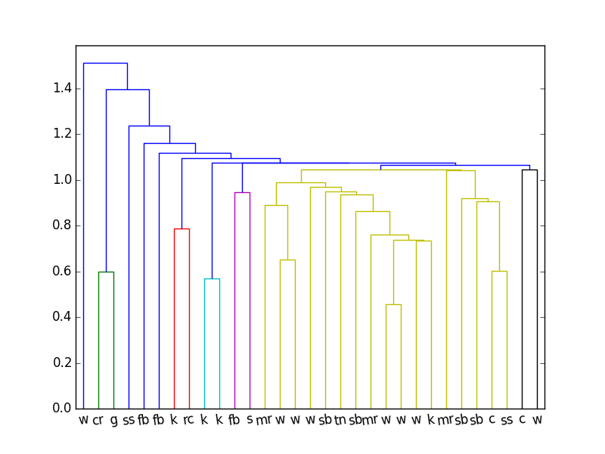
Athlete clustering
c | cyclist
cr | car racing
fb | football
g | golf
k | kayak
mr | motorcycle racing
rc | rallycross
sb | skate boarding
ss | snow skie
w | water sports
Jacc_5: theta 4-7.5 Hz
Data source: atheletsClustering/

Slide 12
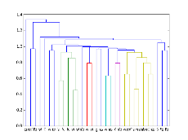
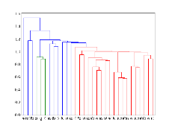
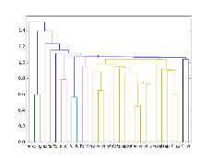
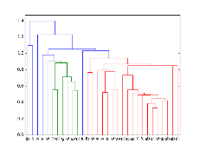
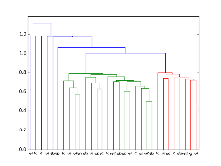
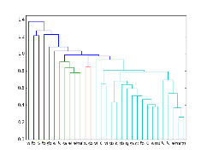
Other athlete clusterings
Those are not as good. Data source: atheletsClustering/

Slide 13
Chord Diagrams
Using NMI and Channel Clustering.
Using NMI and Athlete Clustering.
Using Jaccard and Channel Clustering.
Using Jaccard and Athlete Clustering

Slide 14
Clustering formula
Pro cpt data
Kmeans on each pro with our analytics engine
Clusterings for each Athlete
Windowlize fft

Slide 15
Channel clustering formula
Clusterings
Jaccard Index [distance matrix]
Cluster Channels across all Clusterings

Slide 16
Pro clustering formula
Clusterings
Athletes clustering
Jaccard/NMI for each athletes

Slide 17
New result

Slide 18
Other available metrics
1:2 1:4 15 23 25 34 45 1-2:4-5
1: easy1 2: easy2 3: hard1 4
For these combinations the results are identical to 1:5
Notes:
rework

Slide 19
New clustering result
Cluster0: 1, 1, 1, 1, 1, 1, 1, 1, 1, 1, 1, 1, 1, 1, 1, 1, 1, 1, 1, 1, 1, 1, 1, 0, 1, 1, 0, 0, 0
Cluster 1: 0
Cluster 2: 0, 1, 1, 0, 0, 0, 0
Notes:
Change it

Slide 20
New segments formula
Pro cpt data
Control cpt data
segments: Windowlized fft data for 5 segments, easy1, easy2, hard1, hard2, easy3

Slide 21
New feature formula
Segments
Transforms using analytics engine
Feature: Based on my need. Currently correlation between easy1 and easy3. More are available.

Slide 22
New distance formula
Features
Kmeans from analytics engine
Clustering result for pros and controls

Slide 23
Ttest description
Hypothesis
Reject

Slide 24
Anova test description
1 test.

Slide 25
Results for two tests
Notes:
Summarize the results here.

