Slide 1
RC 101
Week 2
呂奕

Slide 2
html/xml
text
json
csv
GET/POST
raw
...
non-text

Slide 3
as = "raw"
as = "text"
as = "parsed"
html/xml
text
json
csv
GET/POST
raw
...
non-text
writeBin()

Slide 4
html/xml
text
json
csv
GET/POST
raw
...
non-text

Slide 5
content(as = "text")
rvest::read_html()
rvest::html_nodes()
GET/POST
html text
xml_document
xml_nodeset

Slide 6
content(as = "text")
jsonlite::fromJSON()
GET/POST
json string
list/data.frame
list
content(as = "parsed")

Slide 7
%>%
%>%
A
B
C

Slide 8

%>%
%>%
%>%
input
output
input
output
input
output
input
output
f(x, ...) %>% f(x, ...) %>% f(x, ...) %>% f(x, ...)

Slide 9
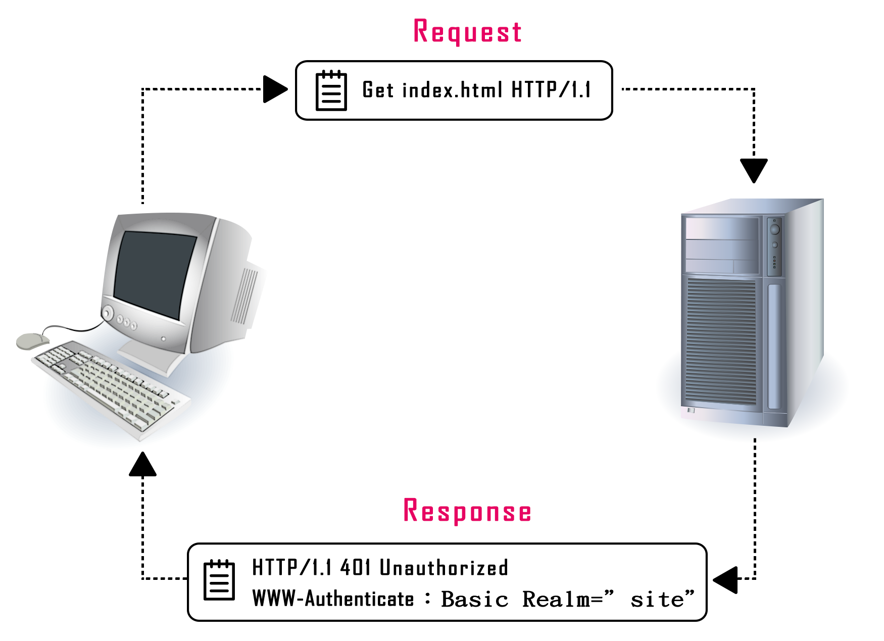



Slide 11
2
Connector
1
Data
4
Data
3
Parser

