Slide 1


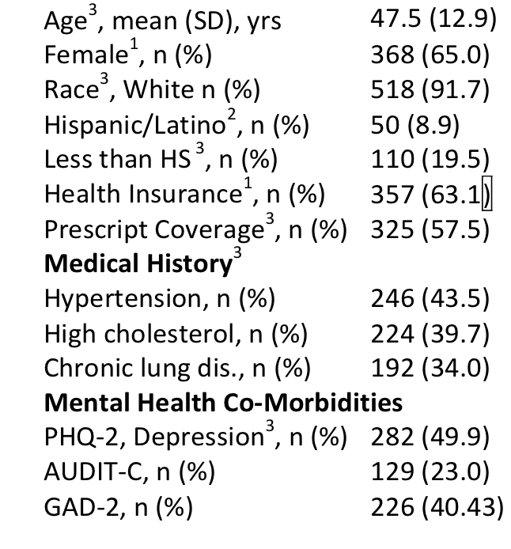
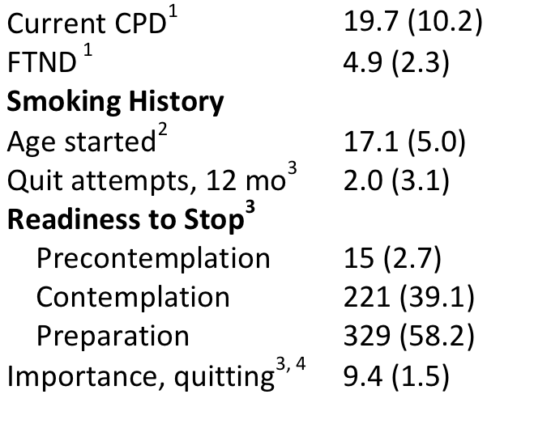
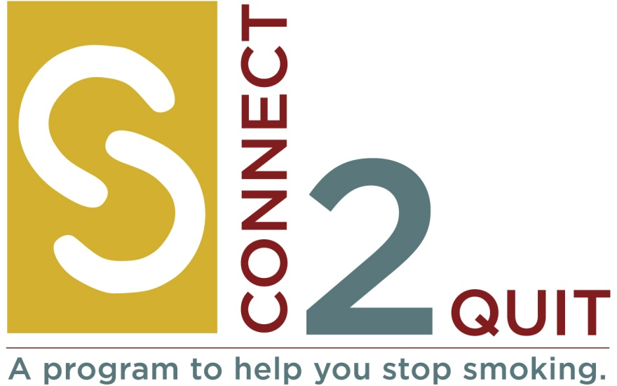

Connect2Quit: A Randomized, Controlled Trial of
Telemedicine vs Telephone Counseling for Smoking Cessation
Kimber P. Richter, Edward F. Ellerbeck, Ana Paula Cupertino, Delwyn Catley, Lisa Sanderson Cox, Kristopher Preacher,
Theresa I. Shireman, Ryan Spaulding, Jamie J. Hunt, Niaman Nazir, Leah Lambart, Laura Mussulman
Department of Preventive Medicine and Public Health; University of Kansas Medical Center, Kansas City, KS
OBJECTIVE
RESULTS: Demographics (no sig differences)
DISCUSSION
Compare 2 models for treatment at a distance for rural smokers
The primary hypotheses was not aupported…
Paricipants do not appear to perceive significant differrences in the nature of counseling (there was no difference in alliance, autonomy support , or satisfaction)
In spite of the lack of difference in the main outcomes and nature of the counseling experience important differences emerged:
ITM did have the expected advantage related to medication use which is important for enhancing treatment outcomes
QL is more convenient which increased counseling participatiion which is important for enhancing treatment outcomes
To boost treatment effects enhancing methods of providing medications for QL are needed or perhaps combining ITM with QL to get benefits of both.
INTRODUCTION
Innovative efforts are needed to provide tobacco treatment in rural areas
Telephone- and telemedicine-based approaches are 2 potential routes
Connect2Quit tests 2 models of care at a distance:
Telemedicine-delivered counseling integrated into smokers medical homes (ITM)
Quitline-like counseling (QL)
Hypotheses….
% Participants Abstinent at Follow Up
METHODS
Smokers (n=566) were recruited from 20 primary care and safety net clinics across Kansas
Randomized to: 4 sessions of ITM or Phone
ITM: real-time video counseling, similar to Skype, delivered by computer/webcams located in clinic exam rooms in patients’ medical homes
Phone: telephone counseling via cell or home phone
Fidelity assessment assured content same across groups
MI/cognitive-behavioral approach
Pharmacotherapy guidance to select/obtain meds
English or Spanish
NEXT STEPS – TEST MEDIATION/INDIRECT EFFECTS
MEASURES
Second Aim: To determine how well ITM operationalizes key features of Self-Determinaton Theory and which components of SDT are important for smoking cessation
Hypothesis: Smokers receiving ITM will report receiving significantly more autonomy support, and will have greater autonomous motivation, competence for smoking cessation, and use of quit-smoking medications, than smokers receiving Phone
SEM/Mediation Questions:
What models best fits data for 3, 12 months?
What explains early advantage of ITM over Phone?
What might explain later advantage of Phone over ITM?
What was role of pharmacotherapy in cessation?
Assessments at months 3, 6, 12
Main outcome: biochemically/proxy verified 12 mo quit
Secondary outcomes:
Prolonged abstinence
Intervention dose:
Medication use, counseling adherence
Psychological mediators:
Autonomous motivation, perceived competence, perceived support from physician, perceived support from counselor
* P=.046, controlling for gender, age, income, education dependence, Medicaid
RESULTS: Secondary outcome and mediators
MLM analysis adjusted for clustering, and controlling for gender, age, income, dependence- no sig effect of arm on prolonged abstinence (p = .931)
QL participants completed slightly more counseling sessions than ITM (2.6 vs 2.4)
External eval of counseling fidelity found no significant group differences in style or content
ITM tended to use more cessation medications than QL (55.9% vs 46.1%, p=0.03)
ITM was significantly more likely to use varenicline
Satisfaction with intervention was high across across both groups
ITM sig more likely to recommend the program to others
Funding
This study was supported by funding from the National Heart, Lung, and Blood Institute of the National Institutes of Health (R01HL087643), PI: Richter

