Slide 1
App containerization / Docker hands-on
20/04/22 – Florianopolis, Brazil – Renan Rendon
Concepts, examples and live demo

Slide 2
Content
Chapter
Page
01. Software development
003
02. Virtualization vs Container approach
005
03. Docker
007
04. Web application scenario
011
05. Docker hands-on demo
015

Slide 3
01.
Software development
Traditional approach

Slide 4
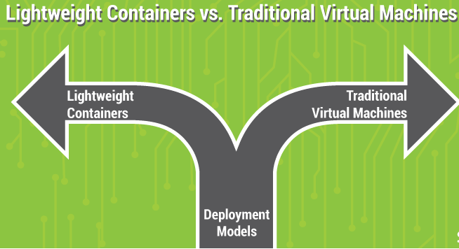
Software development
App containerization
Software development and deployment models have changed drastically over the last few decades. While software development has transitioned from the classical waterfall to agile & scrum models, deployment techniques have moved to more lightweight and lean approaches as well.
Especially, the last couple of years have been a definitive and transformative phase for the DevOps (Development-Operations) industry as it has seen a radical shift from the traditional VM model to a modern container-based approach.

Slide 5
02.
Virtualization vs Container approach
Differences between models

Slide 6
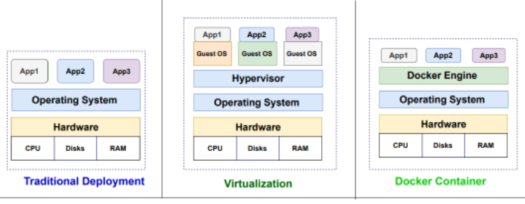
Virtualization vs Container approach
App containerization
As the name itself suggests, a virtual machine represents a logical/software abstraction of a machine that can be used by end users as a physical machine. The virtualization can be done at platform level – thereby emulating a complete operating system or at the process level – restricting it to a single process.
In both cases, a virtualization layer acts as an intermediary to the host machine to request resources such as CPU, memory, hard disk etc. A hypervisor/ virtual memory manager is the tool that typically provides this virtualization layer and is used to create, manage and maintain virtual machines
running on a host.
Container-based Approach
A more lightweight approach where
logical entities can share and the
operating system as well as
associated resources if required.
‘Containers’ which are logical entities
running on the same operating
system as the host offer a more
efficient alternative.

Slide 7
03.
Docker
Containerized approach for building distributed applications

Slide 8


What is Docker?
App containerization
In simple words, Docker provides a containerized approach for building distributed applications. Unlike virtual machines that require a guest operating system to run on, Docker uses an abstraction engine called ‘Docker Engine’ which abstracts the operating system level details from the application.
Docker vs. Traditional Virtual Machines
The essence of Docker-based containers is that they eliminate the heavy lifting involved with setting up virtual machines and making sure your applications run seamlessly across multiple such instances. Therefore, application developers are abstracted from any platform specific details and administrators can leverage standard environments (called Docker images) without worrying about differences in terms of operating system versions, CPU and memory configuration etc.
Since Docker containers do not run a guest operating system, they usually are much quicker to start than virtual machines. Similarly, Docker is more effective when it comes to snapshotting your application into an image and deploying it across multiple environments – development, test and production.

Slide 9
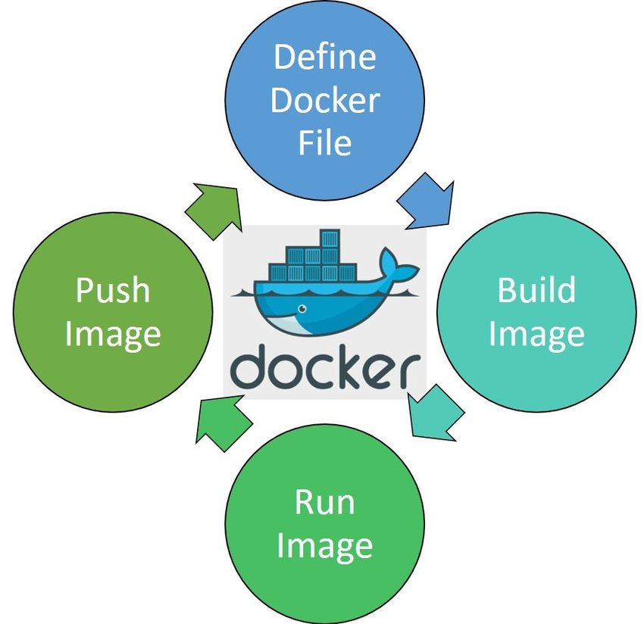
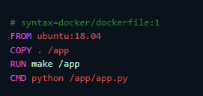
Docker image creation
App containerization
Docker builds images automatically by reading the instructions from a Dockerfile -- a text file that contains all commands, in order, needed to build a given image.
A Dockerfile adheres to a specific format and set of instructions.
A Docker image consists of read-only layers each of which represents a Dockerfile instruction. The layers are stacked and each one is a delta of the changes from the previous layer. Consider this Dockerfile:
Each instruction creates one layer:
FROM creates a layer from the ubuntu:18.04 Docker image.
COPY adds files from your Docker client’s current directory.
RUN builds your application with make.
CMD specifies what command to run within the container.

Slide 10
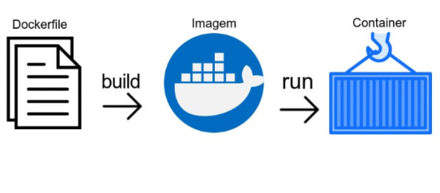
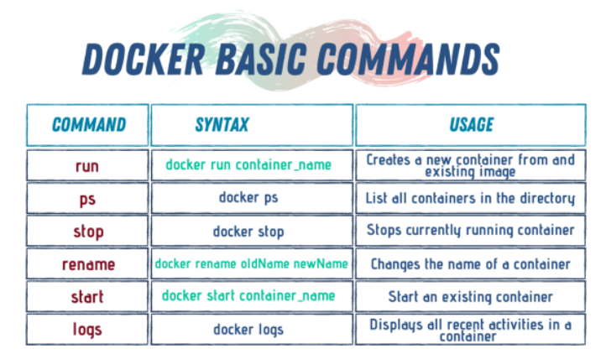
Docker life cicle
App containerization
On an image you define:
Operating system
Dependencies and rules
Use it on containers
Docker Hub is a hosted repository service provided by Docker for finding and sharing container images with your team
https://hub.docker.com/

Slide 11
04.
Web application
Traditional scenario

Slide 12
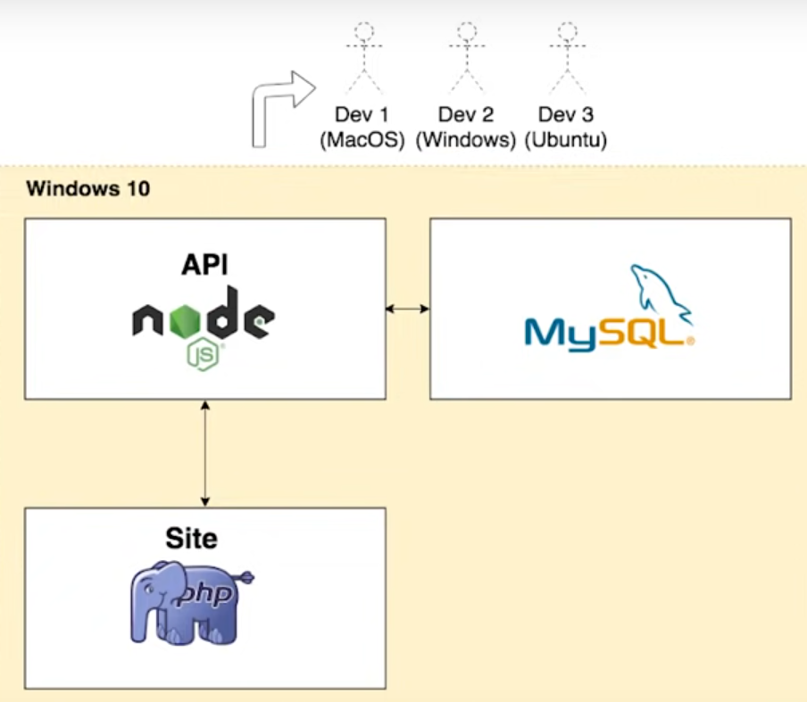
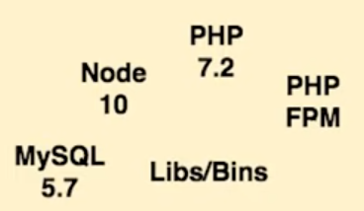
Web application scenario
App containerization
To publish a traditional web app, usually you need a web application server, a database server and an API to provide data to the frontend.
Developers must configure all local environment, with same software version, and dependencies
Dependencies
Apache

Slide 13
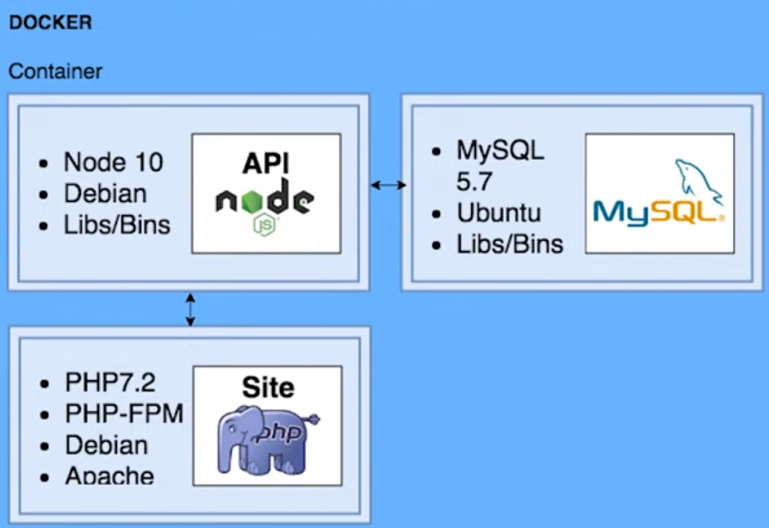
Web application containers scenario
App containerization
Trusted environments regarding software version and system dependencies

Slide 14
Containers’ Advantages over Legacy Infrastructure
App containerization
Containerized applications start faster. You don’t have to boot an entire server to start a containerized application. The server is already running; you just need to start a container to initialize your application. Containers can start in a few seconds, whereas it usually takes minutes to boot a virtual or bare-metal server and then start an application on it.
Containerized applications are “denser.” You can comfortably fit more applications onto a single bare-metal server when using containers than you could if you used virtual machines. You only need to run the container environment. As a result, you get higher application density.
Containerized applications are more scalable. The ability to start containers faster than legacy infrastructure leads to more scalability. If you need more instances of your application, you can start them quickly by spinning up new containers.
Container environments have fewer configuration variables. A Docker environment will look the same no matter which type of host operating system it runs on, or what the underlying hardware is that supports it. This means there are few configuration variables to worry about when setting up and managing a container environment.

Slide 15
05.
Docker
Hands-on demo

Slide 16
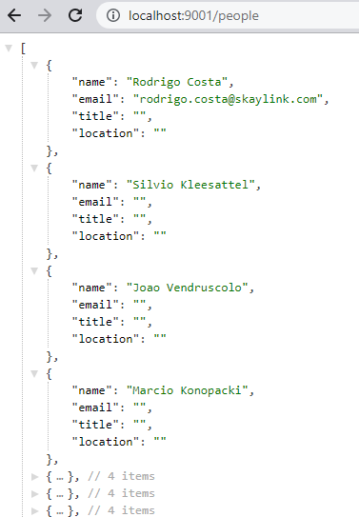
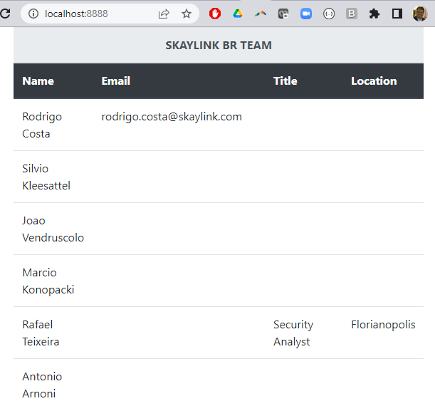
Demo: infrastructure definition
App containerization
We will create containers to provide:
MySQL Database server: a simple database for Skaylink Brazillian team, storing name, email, job title and location.
NodeJS API server: a node application to connect to the database server and run a query, exposing the returned data in JSON format as a REST API.
PHP server: will serve a HTML page connected to the API to display the Skaylink BR team data on a table.

Slide 17
20/04/22 – Florianopolis, Brazil – Renan Rendon
Thank you!

