Slide 1
Discovering Customers
Unsupervised Customer Segmentation for E‑Commerce
Final Project: RFM Analysis & Clustering

Slide 2
Problem: Identifying Actionable Groups
Goal: Transform raw transaction data into statistically distinct
customer segments for targeted marketing.
RFM Feature Engineering:
• Recency (R): Days since last purchase (Engagement)
• Frequency (F): Total number of transactions (Loyalty)
• Monetary (M): Total money spent (Value)

Slide 3
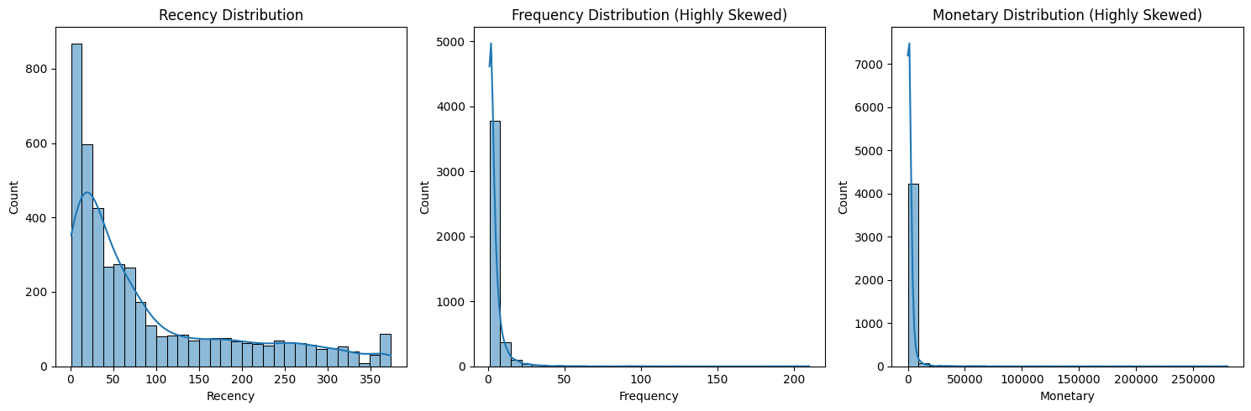
Data Preparation: Taming the Skew
The Challenge:
Retail data is inherently skewed. A few “whale” customers drive most revenue.
Solution Pipeline:
• Outlier Capping: 95th percentile
• Log Transformation: Normalizes long‑tail distributions
• Standard Scaling: Z‑score normalization treats R/F/M equally

Slide 4
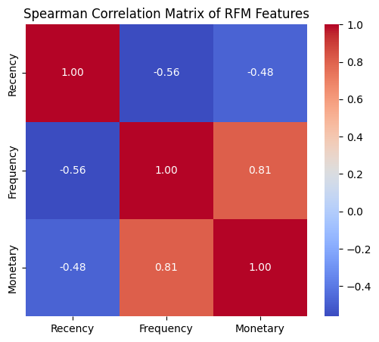
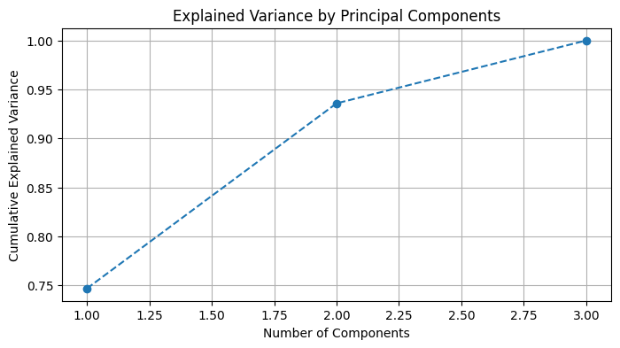
PCA: Stabilizing the Input
Why PCA?
1. Decorrelates RFM features for K‑Means
2. Scree plot shows PC1 + PC2 captures almost 95% variance

Slide 5
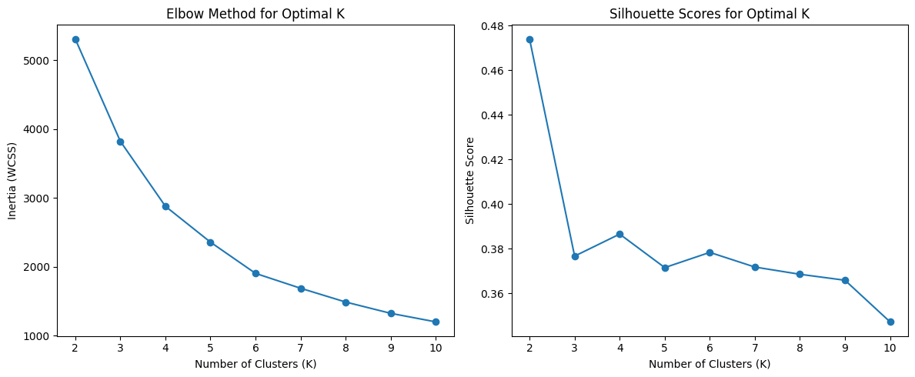
Finding the Optimal K
Optimization Strategy (K=2 to K=10):
• Elbow Method: Bend at K=4
• Silhouette Score: K=4 good compromise
Selected Optimal K = 4

Slide 6
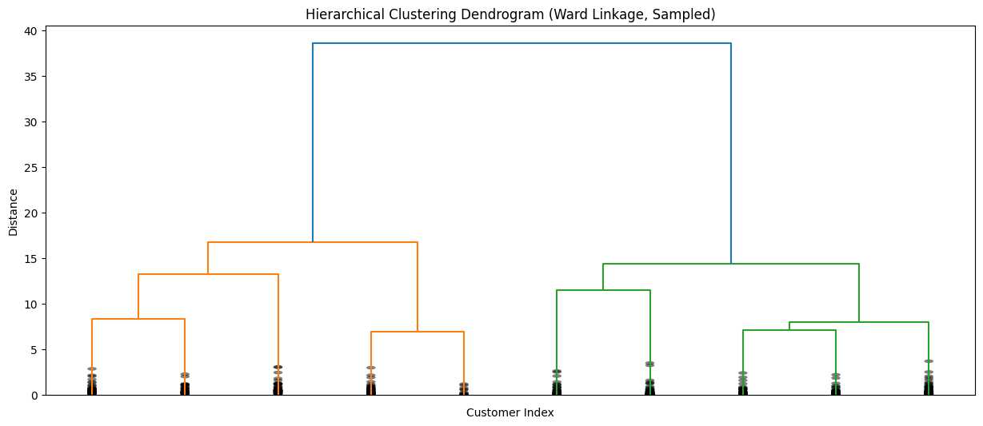
Model Comparison: K‑Means vs. Agglomerative
• K‑Means: Lower Davies‑Bouldin Index (better separation)
• Hierarchical: Dendrogram confirms grouping structure
Final choice: K‑Means

Slide 7
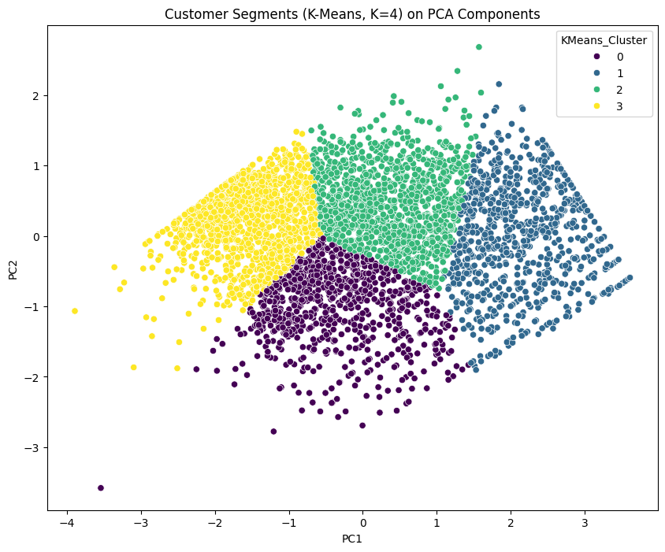
Visualizing the Clusters
PC1 vs. PC2 Space:
Clear separation between personas.
• X‑Axis (PC1): Value (Monetary + Frequency)
• Y‑Axis (PC2): Engagement (Recency)

Slide 8
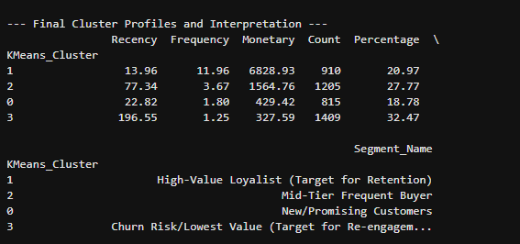
The Value Drivers: Cluster Profiles
High‑Value Loyalists — Low Recency, High Frequency, High Monetary
New / Promising — Very Low Recency, Low Monetary
Frequent Buyers — Medium Recency, High Frequency, Medium Monetary
Churn Risk — High Recency, Low Frequency, Low Monetary

Slide 9
Actionable Marketing Strategy
Loyalists → Retention
New Customers → Increase Frequency
Churn Risk → Reactivation

Slide 10
Conclusion
Unsupervised learning produced four actionable customer segments
that maximize marketing ROI.

