Slide 1

KV Engineering of AI-intensive Systems
Leon Mandler
Sandro Assek

Slide 2
Agenda
Introduction
System Goal
Requirements
Use Cases
Domain Model
Architecture Diagram
Design Questions
Next steps

Slide 3
Introduction
Base Game:
Villager trading is very static and repetitive
Reduced trading prices can be achieved by using the effect HOTV, curing Villagers, or repeated trading.
Modded:
Adds new trading and negotiation elements through a chat
Makes Villagers livelier and more fun to interact with
Change static environment to a dynamic one

Slide 4
System Goals
Make Villager NPC livelier and more fun to interact with
LMM represents the negotiation POV from the Villager
Vanilla settings
Trading with Villagers
Simple GUI/HUD
Static prices (except Hero-of-the-village-effect, zombification)
Modded settings
Trading with villagers
Talk, barter and negotiate with villagers
Advanced GUI/HUD, including a chat interface
Adaptable prices

Slide 5
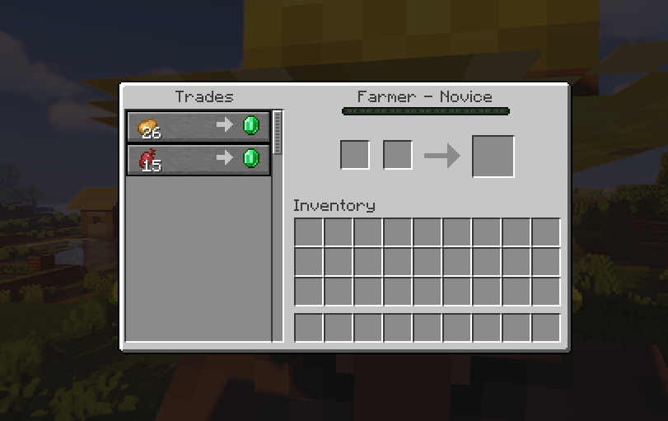
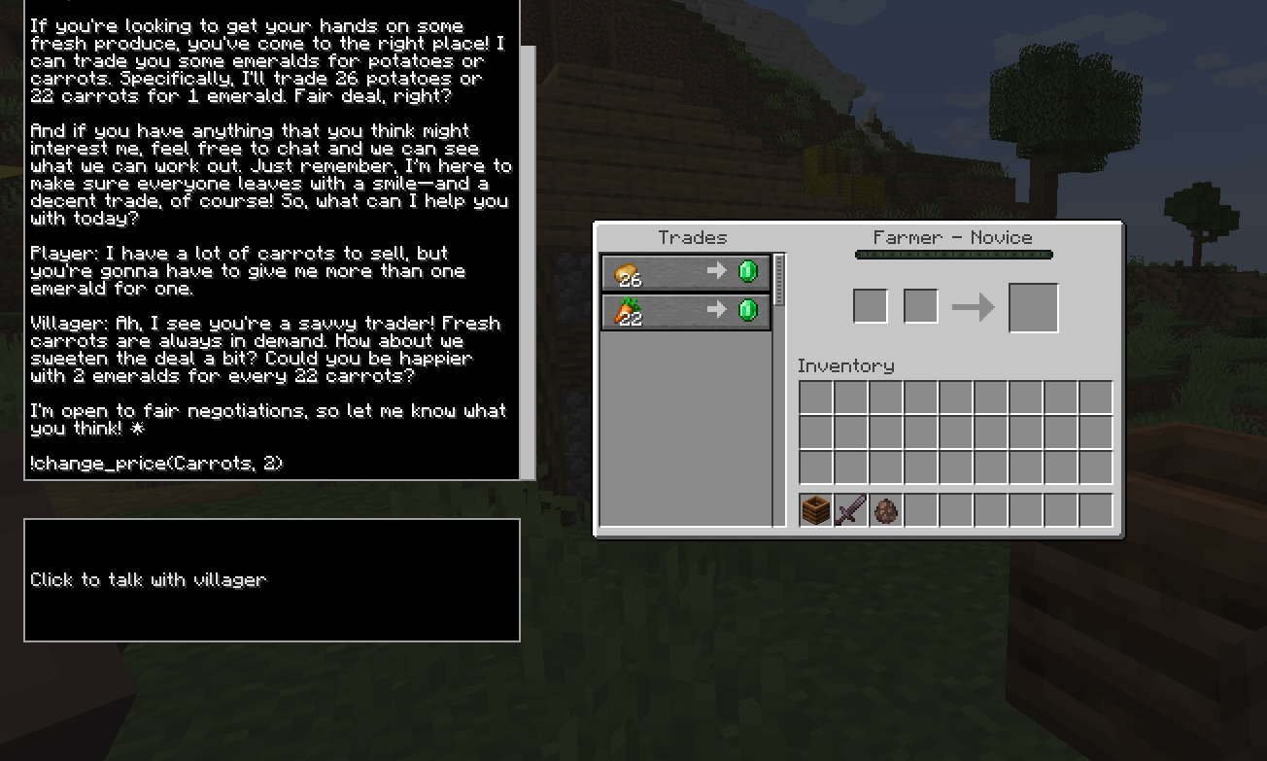
Base vs. modded Interface

Slide 6
System Goals - How
Extensive starting prompt for LLM, that tells it how to act
see Design Questions
Simple Workflow:
User text input →
Server receives input →
Server sends request to the LLM API →
API sends response back to Server→
Server sends back to Client →
Client displays response and updates prices → GoTo 1.
Fabric API & Fabric libraries
Libraries for easier modding
API for game modification and integration
Generate LLM answers using an API

Slide 7
System Goals – Non- vs AI related goals
Non-AI Goals
More immersive and interaction-based Minecraft experience
Add new Gameplay elements
AI Goals
Pre-written standard responses are not very fun or interactive after a while
Use LMM to generate custom responses based on a variety of settings
→ Make NPC trading more dynamic

Slide 8
Functional Requirements
CorrectModLoading: IF the mod is installed when the game is opened the Fabric Mod Loader shall inject the mod into the game.
GUIDrawing: IF its inventory is openable WHEN a villager is right-clicked the screen class shall add its GUI elements to the screen.
MessageSending: IF the writing field is focused WHEN enter is typed, the Network Handler shall send the prompt packet to the server.
ResponseParsing: IF the LLM response contains commands WHEN the response is received on the server, the server-side mod shall change the villager’s prices. [AI]
ChatMessages: While the villager is alive WHEN it starts a conversation all previous chat messages shall be visible to the client.
[AI]…AI-related requirement

Slide 9
Non-functional Requirements
ReqAPIResponse: When the prompt is received on the server the API interface shall make an API request to a LLM API. [AI]
ReqResTime: If the internet connection is good and the API operates normally when the LLM receives the prompt, the LLM shall respond within 3 seconds. [AI]
VillagerInteraction: While it is possible to trade with villagers, the user shall be allowed to interact with villagers.
ReqNewFunctionality: When adding new functionalities, the new code shall be easy to integrate to existing code.
ReqGameStandards: While the fabric API gets updated, the mod shall make good use of it and adhere to its standards.
ReqRunOnJavaOnly: While there is no good modding tool for other versions, the mod shall only be available in Java edition.
[AI]…AI-related requirement

Slide 10
Use Cases
[VilConv] Villager Conversation: The villager responds if the player sends a message
[NegPrc] Negotiate Price: The Villager responds to a price change
[ChaHUD] Change HUD: Add a chat window for conversations and a text box to type in

Slide 11
Supportive Use Cases
Fabric Mod Loader loads Mod
[VilConv], [NegPrc], [ChaHUD]
Send API request to LMM
[VilConv], [NegPrc]
Receive API response from LMM
[VilConv], [NegPrc], [ChaHUD]
Send packet to Client
[VilConv], [NegPrc], [ChaHUD]
Send packet to Server
[VilConv], [NegPrc]

Slide 12
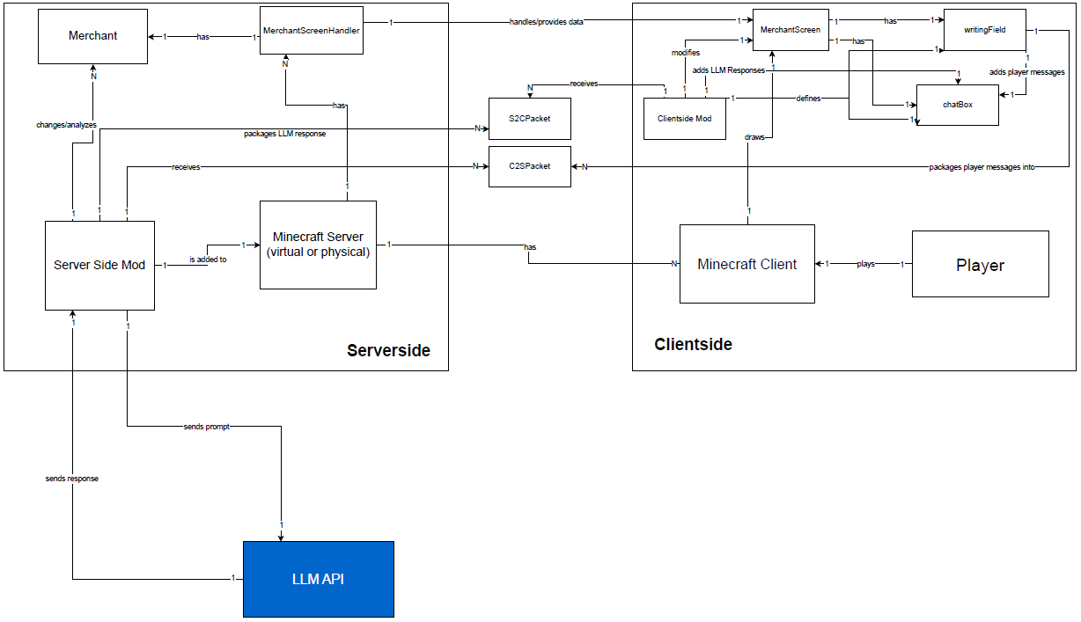
Domain Model
Differentiate between Minecraft‘s Server- and Clientside
Communication: Send and Receive Packages

Slide 13
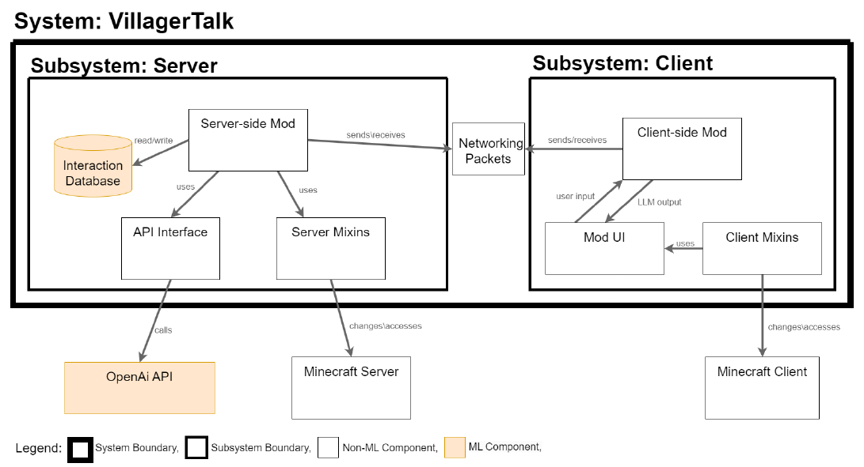
Architecture Design

Slide 14
Design Questions I
How should the LLM request prompt look like - which information to include to ensure response uniqueness?
Villager Attitudes: friendly, grumpy, cheerful, hard negotiator etc.
Previous Interactions
Villager‘s Age and Job
How should the LLM response look like?
Greet the player initially, introduction
Inclusion of commands: e.g. !change_price(ItemName, NewPrice)
Dynamic and engaged answer

Slide 15
Design Questions II
Customization options?
Maximum discount
LLM model
Starting prompt parameters
How to handle API costs?
User must specify their own API key
How do we stop users from abusing the mod, since LLMs are easily gaslit and jailbroken?
Design solid starting prompt that prevents the LLM from changing its role

Slide 16
Limitations I
Relatively easy to overrule LLM → need for good systemprompt
For example, LLM’s uncertainty on a demo:

Slide 17
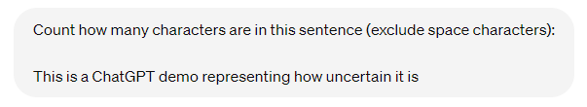
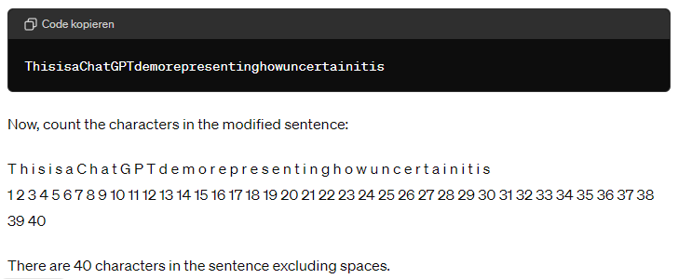

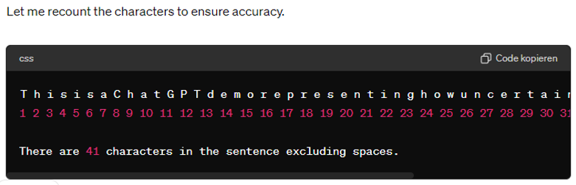
Demo of a popular LLM

Slide 18
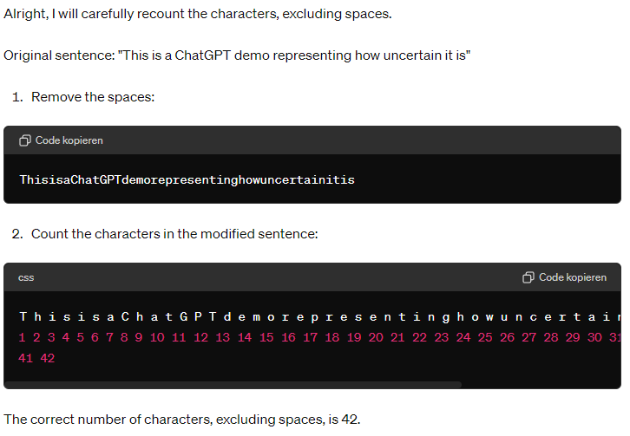
Demo of a popular LLM

Slide 19
Limitations II
Response Time – depends on the LLM’s API
Only available for Java version
Possibly impacts the game performance

Slide 20
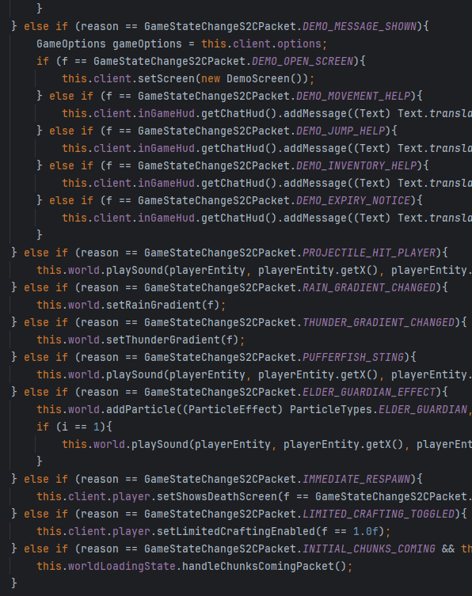
Next steps
Engineer design of the LMMs system prompt
Get familiar with Minecraft modding and the Fabric API
Try to make sense of Minecraft source code →
(switches were available at the time)

