Slide 1
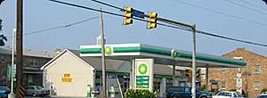

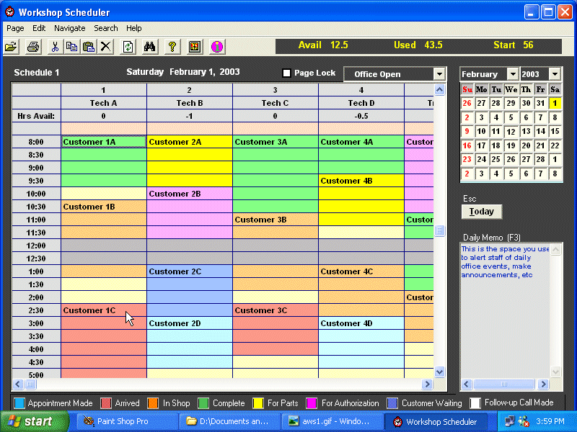

Appointments
Home
Appointments
Social Media
About Us
Links
Bayview
8595 Bayview Boulevard – Norfolk, VA 23503
Video of Owner
On what her customer service focus is?
Address and Contact Information
Address and Contact Information & Hours of Operation
Testimonials

Slide 2

Specials
Home
Appointments
Social Media
About Us
Links
Team Note: The inclusion of the photo banner above reduces the space so that owner is not compelled to fill an entire space with information – only what’s essential
Images here may be placed as a accordian, or on a timed swipe photo presentation
Logo is an animation – would like to look into the possibility of either 1) spinning graphic image or 2) the spinning and horizontal movement of graphic across the bottom of page.
Bayview
8595 Bayview Boulevard – Norfolk, VA 23503
Video of Owner
On what her customer service focus is?
Address and Contact Information
Address and Contact Information & Hours of Operation
Testimonials

Slide 3
Links
Home
Appointments
Social Media
About Us
Specials
Team Note: The inclusion of the photo banner above reduces the space so that owner is not compelled to fill an entire space with information – only what’s essential
Images here may be placed as a accordian, or on a timed swipe photo presentation
Logo is an animation – would like to look into the possibility of either 1) spinning graphic image or 2) the spinning and horizontal movement of graphic across the bottom of page.
Bayview
8595 Bayview Boulevard – Norfolk, VA 23503
Video of Owner
On what her customer service focus is?
Address and Contact Information
Address and Contact Information & Hours of Operation
Testimonials

