Slide 1
Applied Deep Learning HW3
Natural Language Generation
Deadline: 2022/11/30 23:59:59

Slide 2
Change Logs
11/4 Update deadline to 11/30
package updated:
protobuf == 3.20.x

Slide 3
Links
NTU COOL
Data & Evaluation
說明影片
adl-ta@csie.ntu.edu.tw
TA Hours:
Tue. 14:00~15:30 @ Google Meet
Thu. 14:00~15:30 @ Google Meet

Slide 4
Task Description

Slide 5
Chinese News Summarization (Title Generation)
input: news content
從小就很會念書的李悅寧， 在眾人殷殷期盼下，以榜首之姿進入臺大醫學院， 但始終忘不了對天文的熱情。大學四年級一場遠行後，她決心遠赴法國攻讀天文博士。 從小沒想過當老師的她，再度跌破眾人眼鏡返台任教，
output: news title
榜首進台大醫科卻休學 、27歲拿到法國天文博士 李悅寧跌破眾人眼鏡返台任教

Slide 6
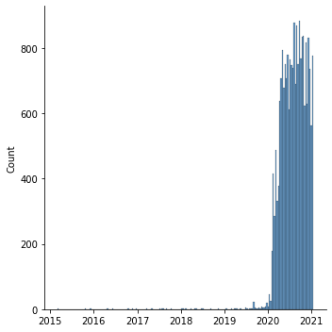
Data
Source: news articles scraped from udn.com
Train: 21710 articles from 2015-03-02 to 2021-01-13
Public: 5494 articles from 2021-01-14 to 2021-04-10
Private: Not released and will include articles after deadline

Slide 7
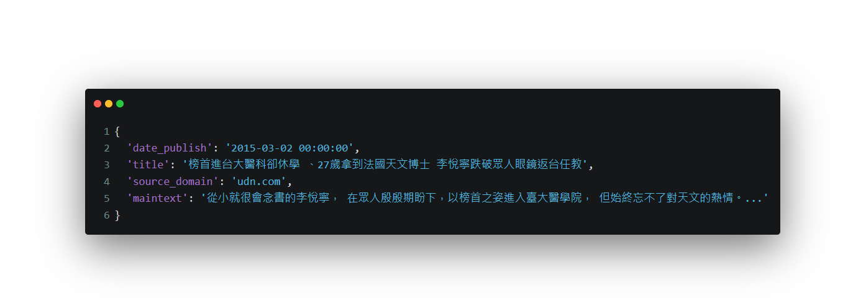
Data (cont.)
Example

Slide 8
Metrics
ROUGE score with chinese word segmentation
What is ROUGE score?
Chinese word segmentation: ckiptagger(github)
Example
candiate: 我 是 人
reference: 我 是 一 個 人
rouge-1: precision=1.0, recall=0.6, f1=0.75
rouge-2: precision=0.5, recall=0.25, f1=0.33
rouge-L: precision=1.0, recall=0.6, f1=0.75

Slide 9
Objective
Fine-tune a pre-trained small multilingual T5 model to pass the baselines
Public baseline
rouge-1: 22.0, rouge-2: 8.5, rouge-L: 20.5 (f1-score * 100)
Private baseline
Will be announced after deadline

Slide 10
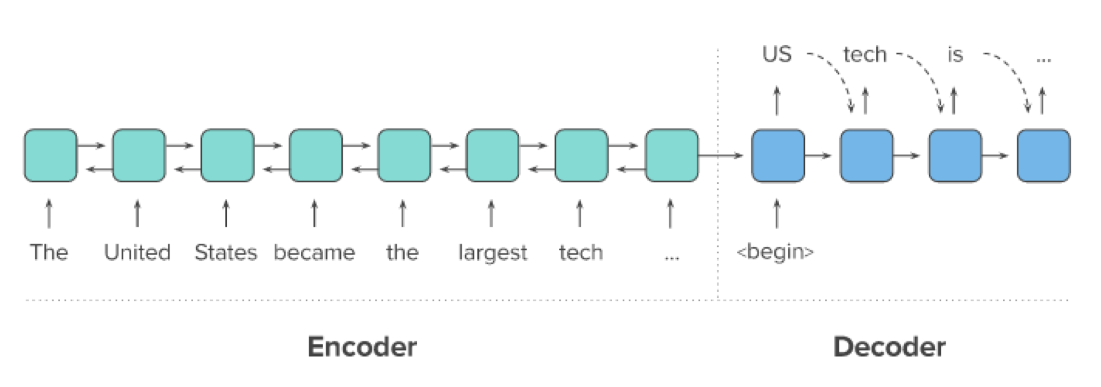
Bonus: Applied RL on Summarization
r=0
r=0
r=0
...
r=ROUGE
Actions
States
t=0
t=1
t=2
...
t=n

Slide 11
Bonus: Applied RL on Summarization (cont.)
You can use any RL algorithms (policy gradient, DQN and etc.)
You can design your own reward function
e.g. ROUGE-L, avg(ROUGE-N) and etc.
You can either directly add RL loss while training or fine-tune from a supervised-learning checkpoint

Slide 12
Report

Slide 13
Q1: Model (2%)
Model (1%)
Describe the model architecture and how it works on text summarization.
Preprocessing (1%)
Describe your preprocessing (e.g. tokenization, data cleaning and etc.)

Slide 14
Q2: Training (2%)
Hyperparameter (1%)
Describe your hyperparameter you use and how you decide it.
Learning Curves (1%)
Plot the learning curves (ROUGE versus training steps)

Slide 15
Q3: Generation Strategies(6%)
Stratgies (2%)
Describe the detail of the following generation strategies:
Greedy
Beam Search
Top-k Sampling
Top-p Sampling
Temperature
Hyperparameters (4%)
Try at least 2 settings of each strategies and compare the result.
What is your final generation strategy? (you can combine any of them)

Slide 16
Bonus: Applied RL on Summarization (2%)
Algorithm (1%)
Describe your RL algorithms, reward function, and hyperparameters.
Compare to Supervised Learning (1%)
Observe the loss, ROUGE score and output texts, what differences can you find?

Slide 17
Rules

Slide 18
What You Can Do
Allowed packages/tools:
Python 3.8 / 3.9 and Python Standard Library
PyTorch 1.12.1, TensorFlow 2.10.0
transformers, datasets, accelerate, sentencepiece
rouge, spacy, nltk, ckiptagger, tqdm, pandas, jsonlines
Dependencies of above packages/tools.
No Network access after we used download.sh
If you want to use other package, mail TA.
You can use any package you want when writing report.

Slide 19
What You Can NOT Do
Use external training data
E.g. scrape news from the internet
Any means of cheating or plagiarism, including but not limited to:
Use other classmates’ published / unpublished code.., including students who took previous ML / ADL / MLDS.
Just copy and past any public available code without modification
Use package or tools not allowed.
Give/get trained model to/from others.
Give/get report answers or plots to/from others.
Publish your code before deadline.
Violation may cause zero/negative score and punishment from school.

Slide 20
Logistics

Slide 21
Grading
Model performance (10%)
Public baseline (5%)
Private baseline (5%)
Report (10% + 2%)
In PDF format!
Score of each problem is shown in the Report section.
Format
You may lose (some or all) of your model performance score if your script is at wrong location, causes any error, etc.

Slide 22
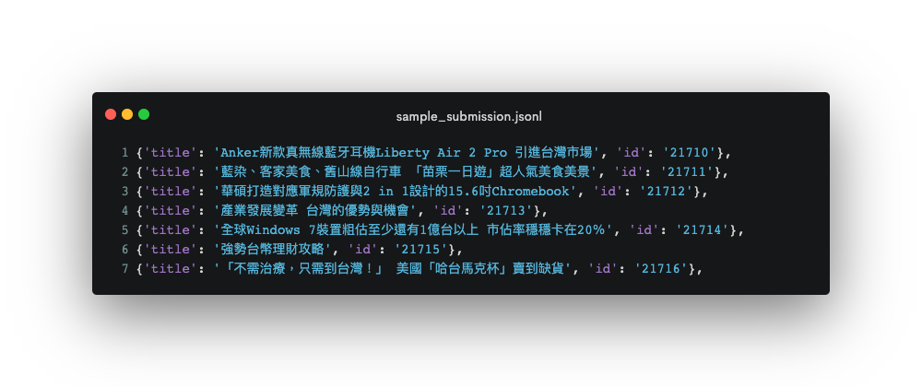
Submission - Format

Slide 23
Submission - File Layout
You are required to submit .zip file to NTU Cool
File structure for the .zip file (case-sensitive):
/[student id (lower-cased)]/ (Brackets not included.)
download.sh
run.sh
README.md
report.pdf
code/all other files you need

Slide 24
Submission - Scripts
download.sh
Do not modify your file after deadline, or it will be seen as cheating.
Keep the URLs in download.sh valid for at least 2 weeks after deadline.
Do not do things more than downloading. Otherwise, your download.sh may be killed.
You can download at most 4G, and download.sh should finish within 1 hour. (At csie dept with maximum 10MB/s bandwidth)
You can upload your model to Dropbox. (see tutorial)
We will execute download.sh before predicting scripts.

Slide 25
Submission - Scripts
run.sh
Arguments:
${1}: path to the input file
${2}: path to the output file
TA will predict testing data as follow:
bash ./download.sh
bash ./run.sh /path/to/input.jsonl /path/to/output.jsonl
Specify the Python version (3.8 or 3.9) in the .sh file.
Default python version would be 3.8
Ex. python3.8 predict.py … / python3.9 predict.py … “python” would be python3.8
Make sure your code works!

Slide 26
Submission - Reproducibility
All the code you used to train, predict, plot figures for the report should be upload.
We will remove the answers in public.jsonl when we reproduce your submission.
README.md
Write down how to train your model with your code/script specifically.
If necessary, you will be required to reproduce your results based on the README.md.
If you cannot reproduce your result, you may lose points.
You will get at least - 2 penalty if you have no or empty README.md.

Slide 27
Execution Environment
Will be run on computer with
Ubuntu 20.04
32 GB RAM, GTX 3070 8G VRAM, 20G disk space available.
the packages we allow only.
python 3.8 / 3.9
Do NOT train with very large model (e.g. mt5-xl) or you will get an out of memory error on 8G VRAM.
Time limit: 1 hours for run.sh in total
No network access when predicting.
You will lose (some or all) your model performance score if your script is at wrong location, or cause any error.

Slide 28
Late Submission Penalty
Late submission of "code and report":
0 day < late submission ≤ 1 day: original score * 0.95
1 day < late submission ≤ 3 day: original score * 0.90
3 day < late submission ≤ 4 day: original score * 0.75
4 day < late submission ≤ 5 day: original score * 0.50
5 day < late submission ≤ 6 day: original score * 0.25
6 day < late submission: original score * 0.00
Late submission is determined by the last submission.
Update your submission after deadline implies that you will get penalty.

Slide 29
Guide

Slide 30
Text-to-Text Transformer (T5)
HW2: BERT
HW3: T5
<input>
<input>
<s>,y1,y2,y3
Q,K,V
Q,K,V
Q
Bi-Encoder
Bi-Encoder
K,V
Decoder
Hidden state
Hidden state
y1,y2,y3,</s>
<output>

Slide 31
Training
Pre-trained mt5-small is very large. (300M parameters, 3x than BERT-base)
Some tips to reduce GPU memory usage:
Reduce batch size + gradient accumulation
Truncate text length (256/64 for input/output can pass the baseline)
fp16 (transformers==4.5.0 has a bug on T5 fp16 training)
adafactor (instead of Adam)
For reference, you can pass the baseline within 4 hours training on single RTX 3070 8G if your code is correct.

Slide 32
How to Fix T5 FP16 Training
https://github.com/huggingface/transformers/pull/10956
Install fixed version transformers library
git clone https://github.com/huggingface/transformers.git
git checkout t5-fp16-no-nans
pip install -e .

Slide 33
Documents
T5
https://huggingface.co/transformers/model_doc/t5.html
https://huggingface.co/transformers/model_doc/mt5.html
Generation:
https://huggingface.co/transformers/main_classes/model.html#generation

Slide 34
Q&A

