Slide 1
Design and Implementation of Autonomous Identity System Based on OurChain
Lin Chun-You
Department of Computer Science and Information Engineering
National Taiwan University
Advisor: CW Hsueh cwhsueh@csie.ntu.edu.tw

Slide 2
Table of contents
01
02
03
Introduction
Background
Design
04
05
06
implement
Conclusion
QA
緒論
研究背景
系統設計
系統實作
結論與未來展望
委員提問

Slide 3
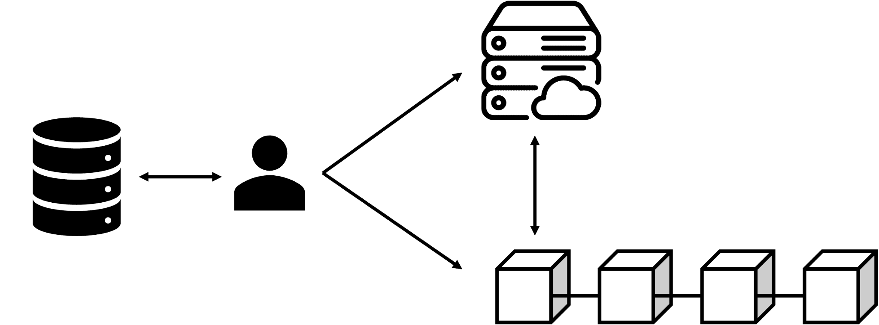
What is the concept of Autonomous identity (AID)?
Lin, Yuxuan :
The Design and Implementation of Autonomous Identity for Social Network
Tze-Nan :
The Design and Implementation of General Autonomous Certification on Blockchain

Slide 4
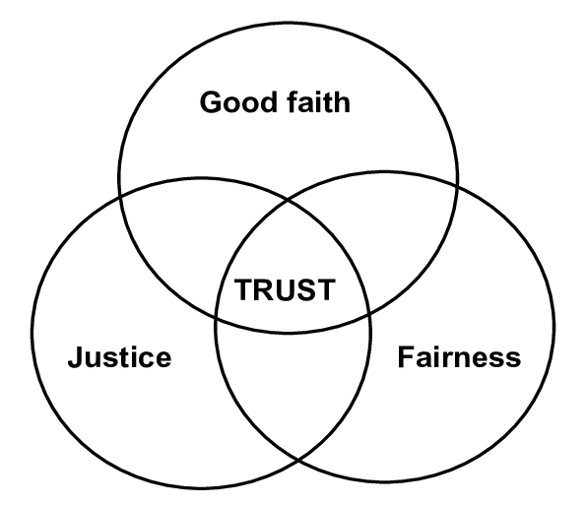

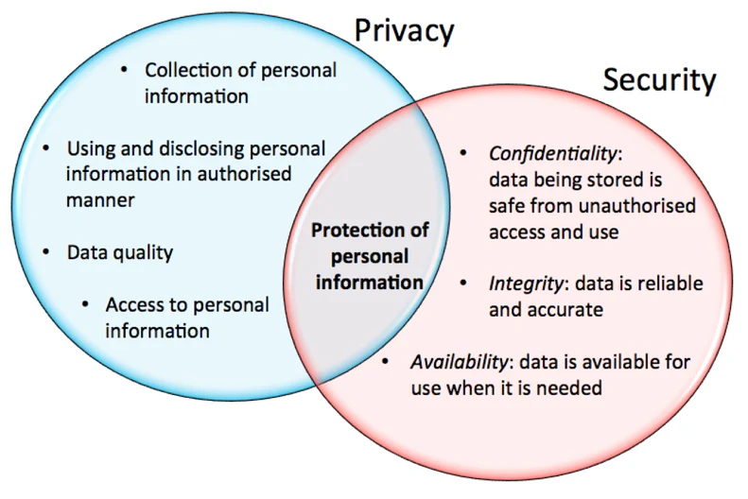
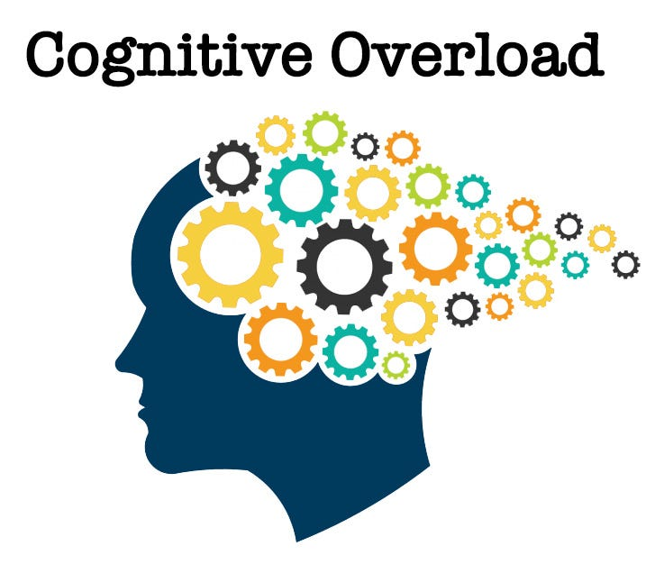
Main contributions
AID

Slide 5
Research motivation
Autonomous:
independent and having the power to make your own decisions — cambridge dictionary
Kant understands autonomy as ‘‘that property of the will by which it [the will] is a law to itself’’ and moral action as ‘‘the subjection of reason to no laws except those it gives itself’’ . — ref
Moral:
Friedrich Nietzsche’s concept of “value creation” is a key component of his philosophical system. It is a complex and nuanced idea, but in essence, it refers to the process by which individuals, through their own power and creativity, establish their own system of values, independent of traditional or societal norms. — ref
the slaves were able to subvert moral authority away from the masters and label the masters as an evil group of people with no redeeming qualities. After the tra svaluation of values, the slaves have the upper hand in the moral sector. No longer were they an oppressed people, rather they have created new values: slave values. — ref
Allowing each user to freely manage themselves in an identity system with dynamic moral standards

Slide 6
Research aims and objectives
Analyze the limitations of existing digital identity systems
Theoretical framework for building AID systems
Design the technical architecture of the AID system
Evaluate the benefits and challenges of AID systems
Conducting a proof-of-concept for an AID system

Slide 7
Table of contents
01
02
03
Introduction
Background
Design
04
05
06
implement
Conclusion
QA
緒論
研究背景
系統設計
系統實作
結論與未來展望
委員提問

Slide 8
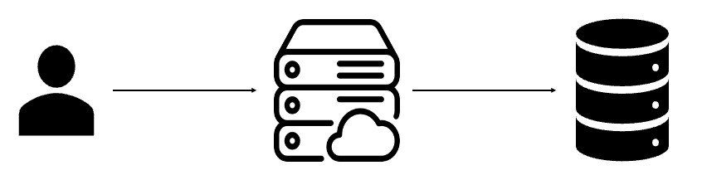
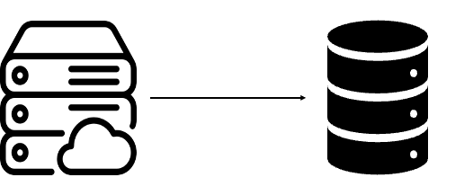
Iteration of the Identity System
Centralized identity
security
migration
cognitive overload
…

Slide 9
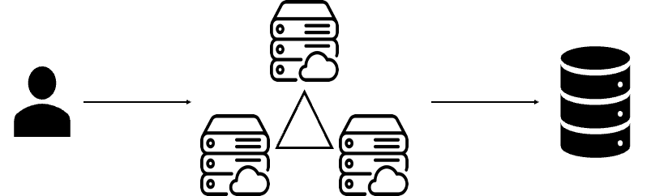
Iteration of the Identity System (cont.)
federated identity
privacy
cost
migration
…

Slide 10
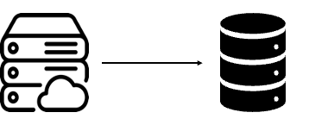

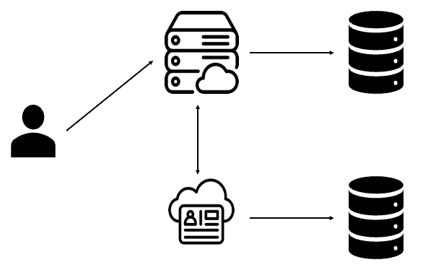
Iteration of the Identity System (cont.)
User-centered identity
data siloing
privacy
cognitive overload
…

Slide 11
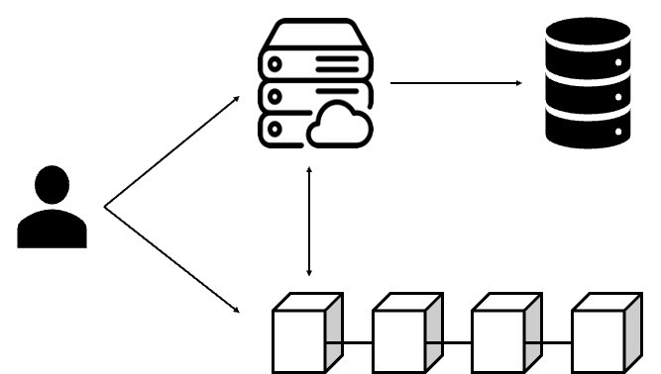
Iteration of the Identity System (cont.)
Self-sovereign Identity
user experience
management
privacy(Law)
…

Slide 12
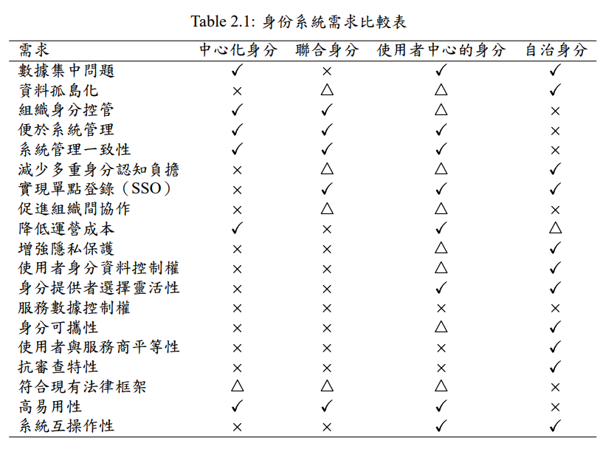
Iteration of the Identity System (cont.)

Slide 13
The Dilemma of the Identity System
User experience
Improve system usability while ensuring privacy and security.
Cognitive overload
Participate in services freely without creating a large number of additional identities.
Privacy and Security
Adopt the "data layer inversion" strategy to migrate user data to the user device.
Trust and Fairness
A decentralized evaluation mechanism was introduced to establish a mechanism for mutual verification and mutual trust.

Slide 14
Assessment of Identity Systems
創新突破
使用者體驗
使用者認知
隱私保護
平等信任
法規遵循
GDPR
NIST
公認原則
身分法則
避免常見缺陷
自治身分
We hope to solve all problems!

Slide 15
Table of contents
01
02
03
Introduction
Background
Design
04
05
06
implement
Conclusion
QA
緒論
研究背景
系統設計
系統實作
結論與未來展望
委員提問

Slide 16
Data structure of AID
Unique Identifier:
UUID-generated for user identification
Credential Operation Private Key:
Corresponding public key recorded in smart contracts, ensuring the operator possesses the actual credential
Simple Identification Methods:
List of user-preferred simple login methods and corresponding identification content, e.g., username/password, IP binding
Multi-Factor Authentication:
List of user-preferred multi-factor authentication methods and corresponding identification content, e.g., SMS verification, hardware key
Personal Information:
Discloses personal information the user is willing to provide, e.g., name, gender
Service Settings:
Records user-defined settings, such as credential permissions and validity period

Slide 17
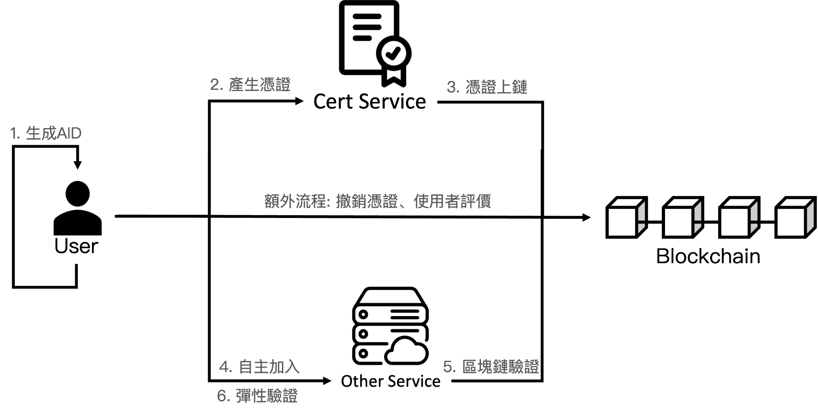
System core mechanism

Slide 18
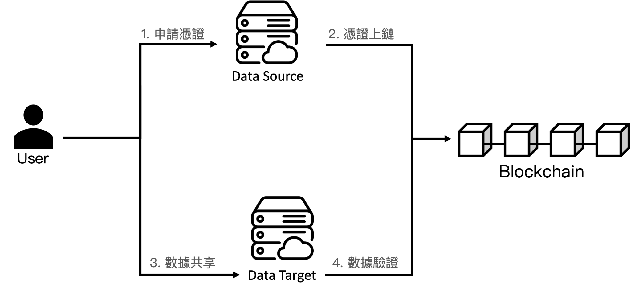
System core mechanism (cont.)

Slide 19
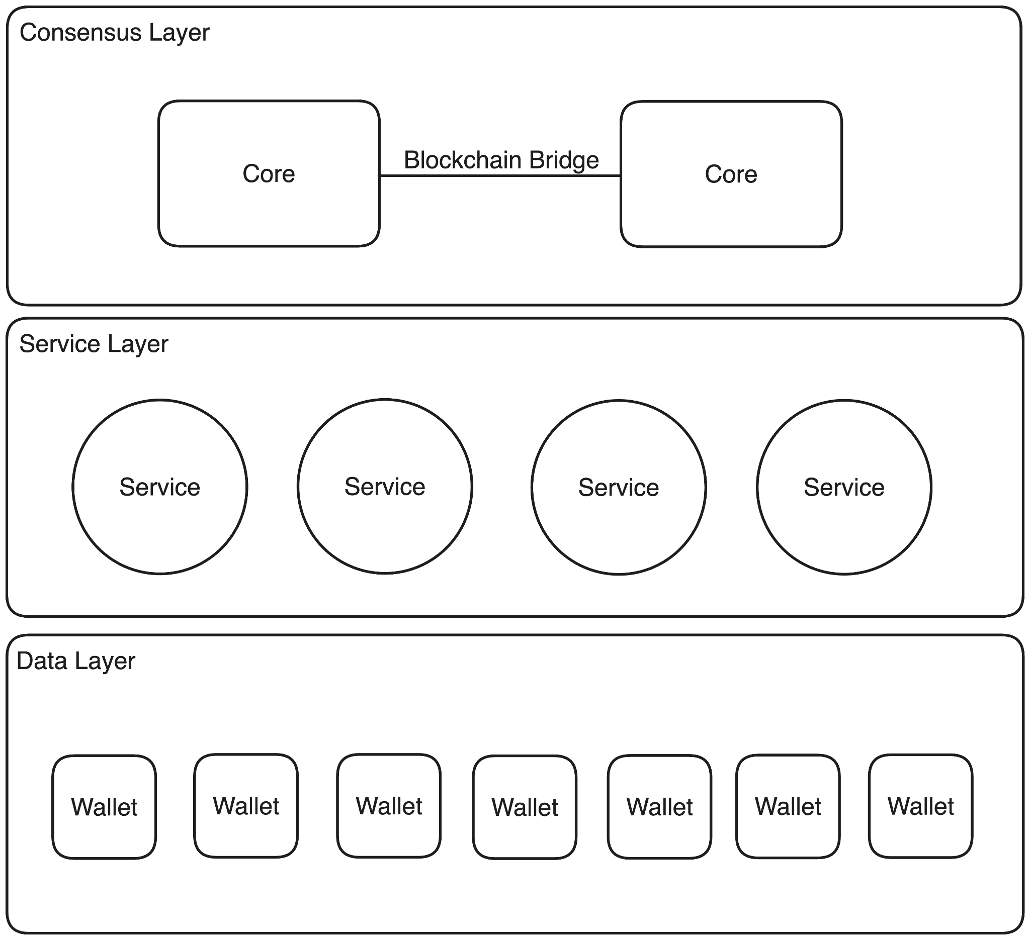
System architecture design
Consensus Core
Service
Wallet

Slide 20
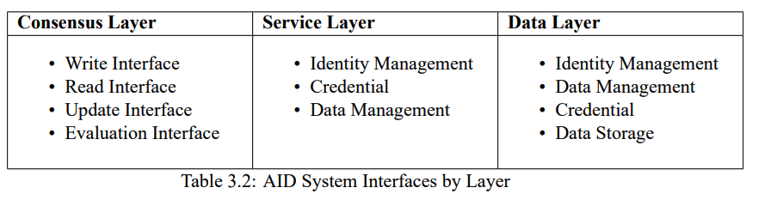
System architecture design (cont.)
Consensus Core: Trusted data reading and writing mechanism
Service: Provide specific services
Wallet: Manage personal data and use services

Slide 21
Solve the problems
Evaluation-Based Moral Mechanism
Blockchain maintenance and operation
Identity Verification Issues
Password rescue
Right to be forgotten
Hybrid data management
Organizational User Management

Slide 22
Evaluation-Based Moral Mechanism
Concept
AID system viewed as a Decentralized Autonomous Organization (DAO)
Each participant sets own standards for judging and receiving evaluations
Process
Certificate Generation
Create data or autonomous certificates
Deploy customized smart contracts on blockchain
Evaluation Production
Evaluate certificates based on smart contract rules
Evaluations must comply with contract specifications
Reputation Conversion
Read evaluation list from smart contracts
Convert evaluations to reputation scores using personal algorithms

Slide 23
Blockchain maintenance and operation
Governance Token & Participation
Gradually increasing supply, used for staking to create AIDs
Each AID (token) can vote on system adjustments and protocols
Lock governance token to create new AIDs, Prevents mass creation of malicious accounts
Incentives, Penalties & User Engagement
Non-redeemable staking: Tokens locked in blockchain
Penalties for untrustworthy users, rewards for infrastructure operation

Slide 24
Identity Verification Issues
Two Login Options
Simple Login
Minimal information required (e.g., alias and password)
Multi-Factor Authentication (MFA) Login
Requires additional information (e.g., email verification, SMS code, private key)
Challenges
Ensuring security in Simple Login without compromising convenience
Determining when to require MFA Login
Proposed Solutions
User Spatiotemporal Analysis
Track information generated during user operations
Use this data to identify users more accurately
Risk-Based Verification Mechanism
Assess the risk level of each operation
Trigger MFA Login for high-risk actions
Simple
Login
MFA
Login
User Space
client
service
Cache: record event
Risk-Based Verification
User Spatiotemporal Analysis

Slide 25
Password rescue
Challenge
Traditional admin password recovery conflicts with AID values
Solution: Extreme Multi-Factor Authentication (EMFA)
Key Features
Multiple verification methods set during credential creation
Includes hard-to-lose or forget methods (e.g., biometrics)
Benefits
Enables identity recovery without centralized management
Core Concept
Each authentication factor is an independent method for users to prove their identity
No single set of factors is the sole path for user login
Servers view each factor as a atonoumous proof of identity

Slide 26
Right to be forgotten
Challenge
User-managed data doesn't guarantee complete data erasure
Interactions and logs may persist beyond user control
Proposed Solution
Allow users to disconnect from their data, not just delete it
Key Concepts
Hash-Only Blockchain Storage
Minimal Data Storage by Services
Unidirectional Identity (Cameron's concept)
Users can prove ownership of their data
Data alone cannot identify the user

Slide 27
Hybrid data management
Hybrid Data Management Concept
Balance between user privacy and service functionality
Based on static applications with Wallet module for data interactions
Key Principles
Clear explanations for data requests
Gradual permission settings
Smooth transition from strict to relaxed security measures
Implementation
Start with maximum privacy and security
Allow users to adjust based on their needs

Slide 28
Organizational User Management
Challenge
Significant differences in identity management needs between organizations and individuals
Traditional solutions often compromise user autonomy or require additional identities
AID Solution: Autonomous Credential Mechanism
Organizations act as credential signers
Control rules explicitly written into AID
Preserves user autonomy while meeting organizational needs
Impact
Innovative approach to identity management
Opens new possibilities for organizational structures and management models

Slide 29
Table of contents
01
02
03
Introduction
Background
Design
04
05
06
implement
Conclusion
QA
緒論
研究背景
系統設計
系統實作
結論與未來展望
委員提問

Slide 30
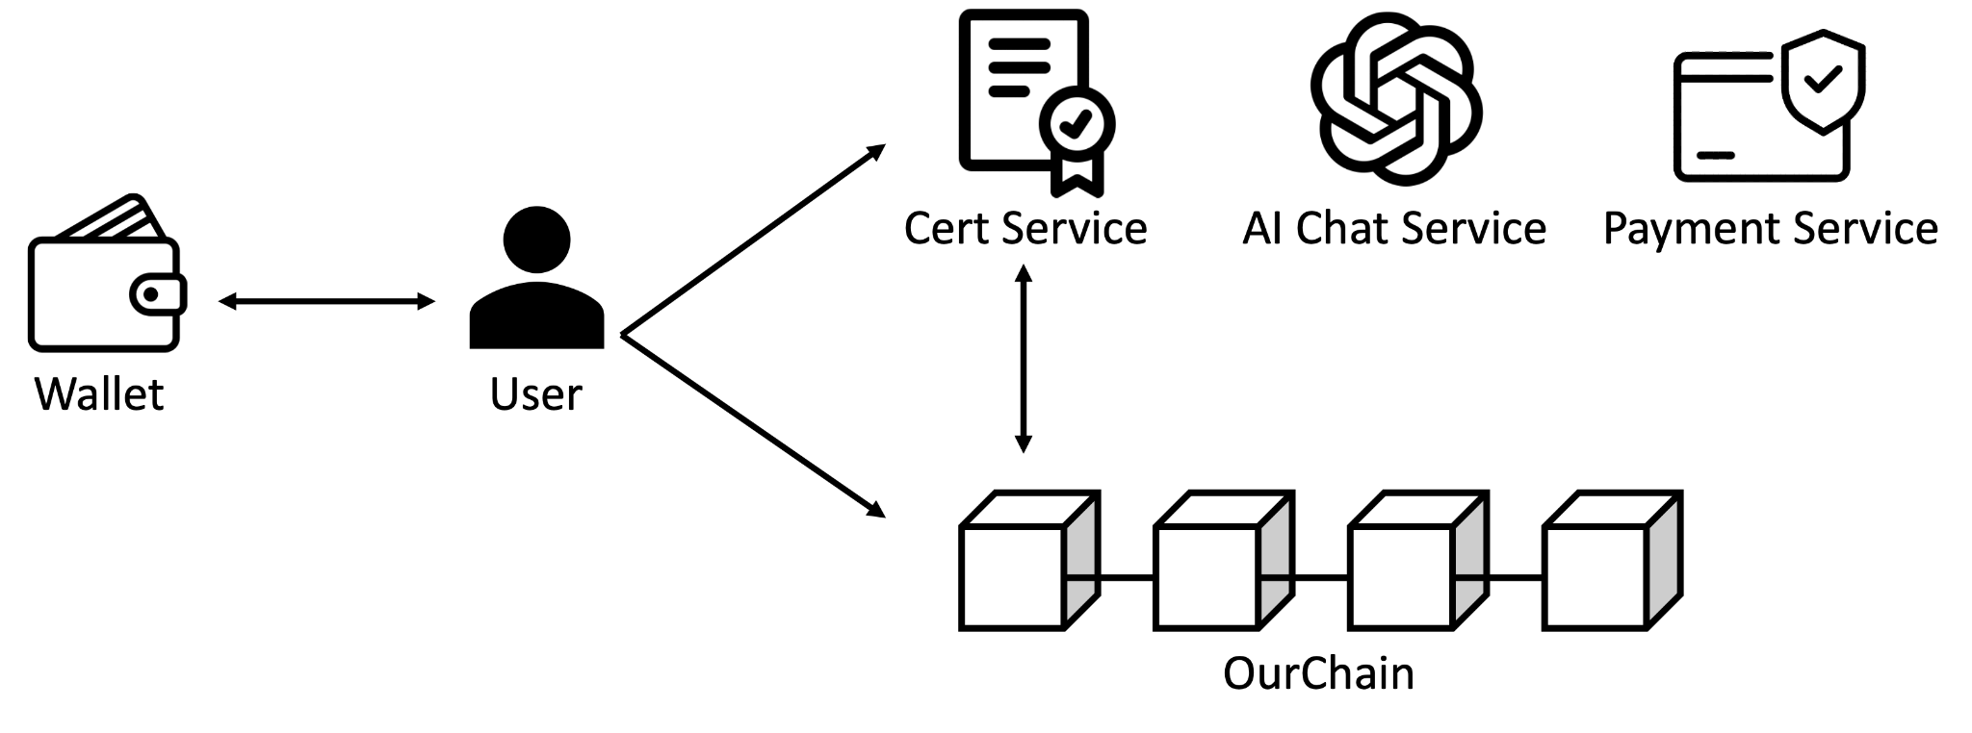
Implementation details

Slide 31
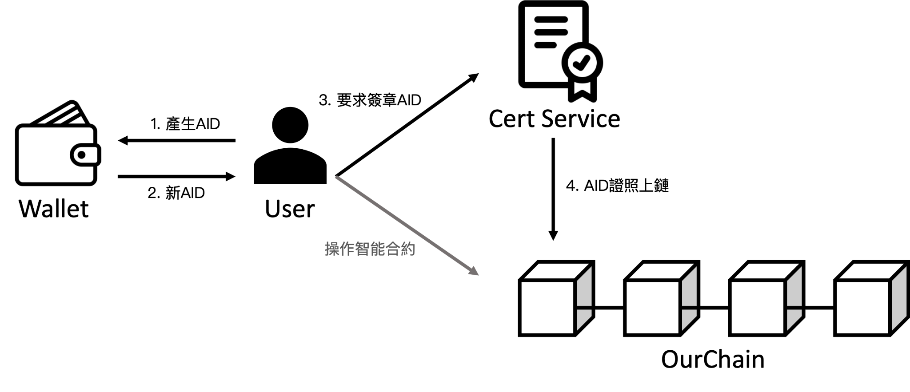
Implementation details (cont.)

Slide 32
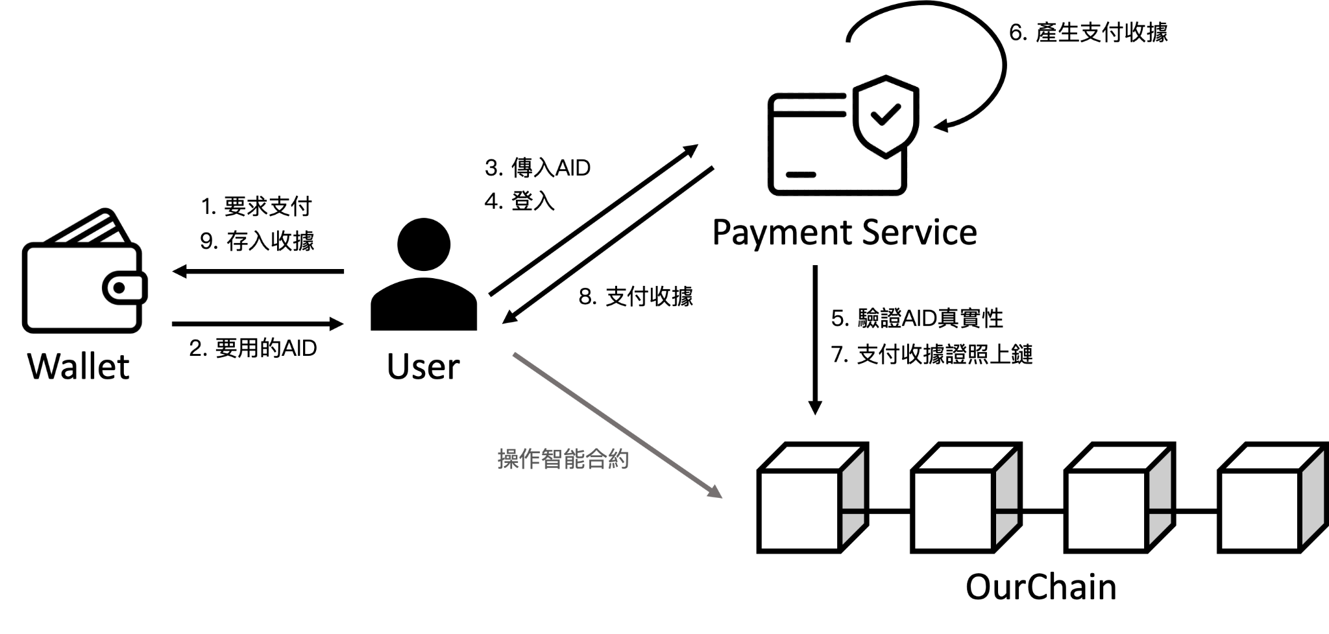
Implementation details (cont.)

Slide 33

Implementation details (cont.)

Slide 34
Table of contents
01
02
03
Introduction
Background
Design
04
05
06
implement
Conclusion
QA
緒論
研究背景
系統設計
系統實作
結論與未來展望
委員提問

Slide 35
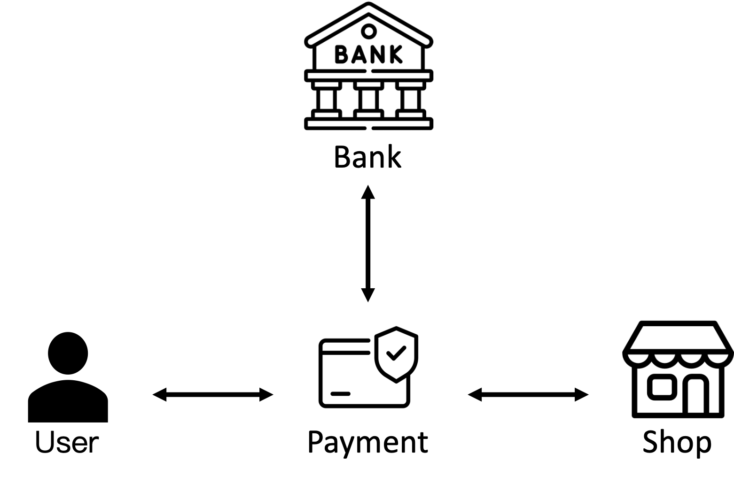
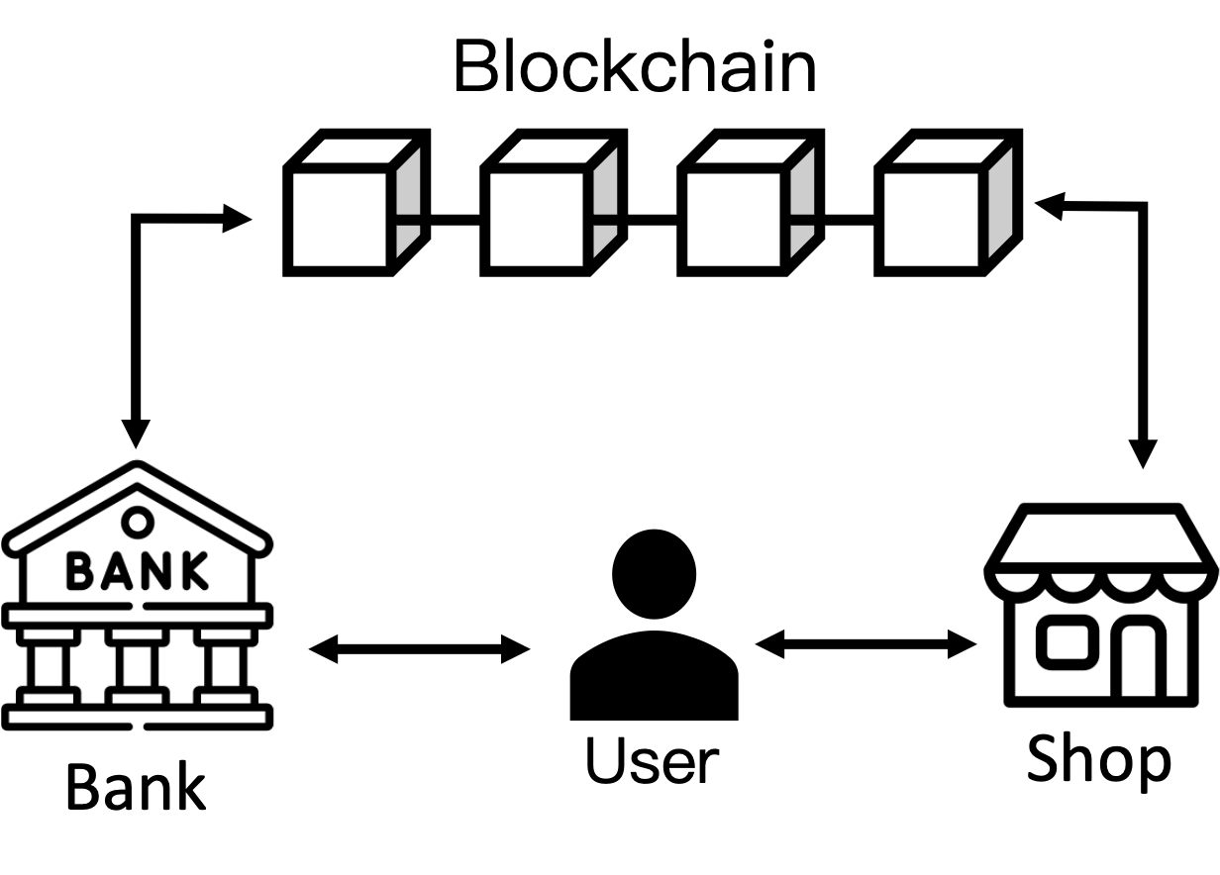
Conclusion
Future challenges:
Difficult promotion task
Higher development difficulty
Large-scale application

Slide 36
Table of contents
01
02
03
Introduction
Background
Design
04
05
06
implement
Conclusion
QA
緒論
研究背景
系統設計
系統實作
結論與未來展望
委員提問

Slide 37
QA
Thanks

