Slide 1
軟體工程設計 final
許庭瑋、陳君翰、洪世彬、劉玠均、楊昕叡、林俊佑
2023/12/21

Slide 2
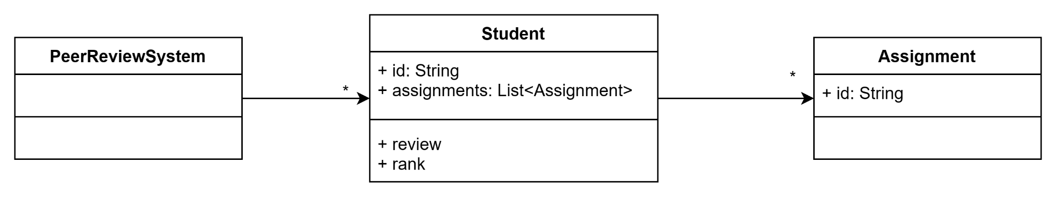
Initial Design
We are developing a peer review system. Students can review and rank other students’ homework.

Slide 3
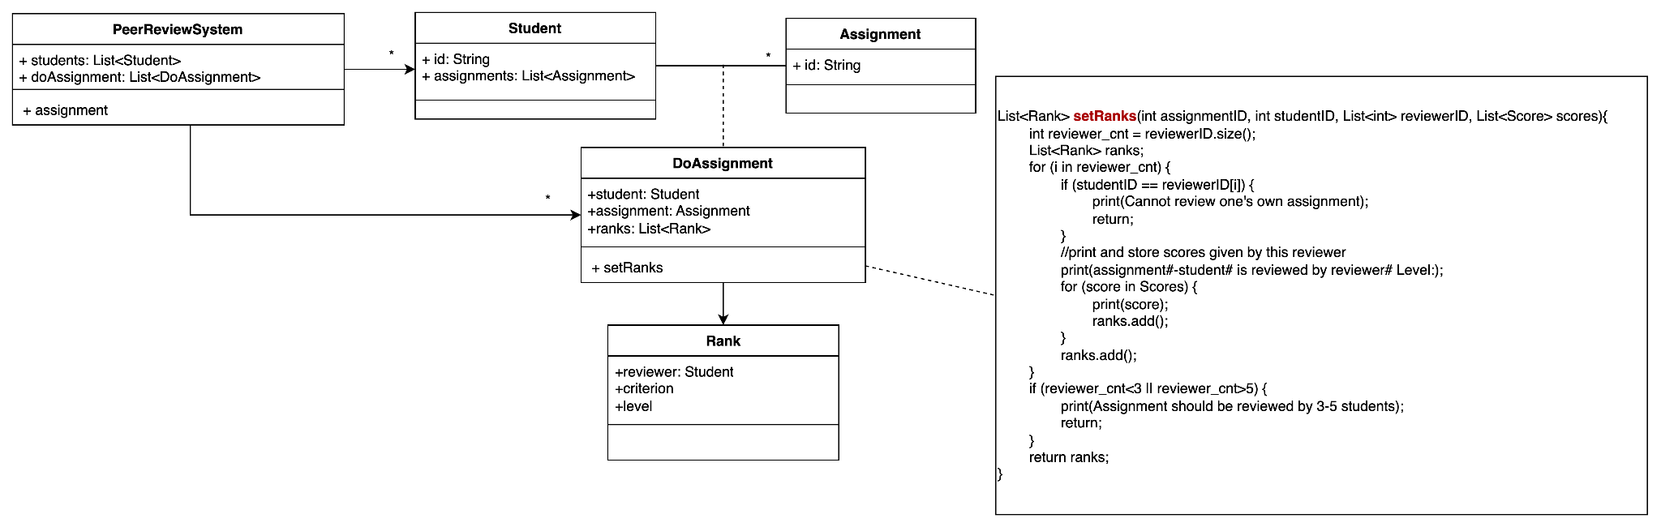
Initial Design (Cont.)
In general, each assignment is reviewed by 3-5 students but can be set by the instructor.

Slide 4
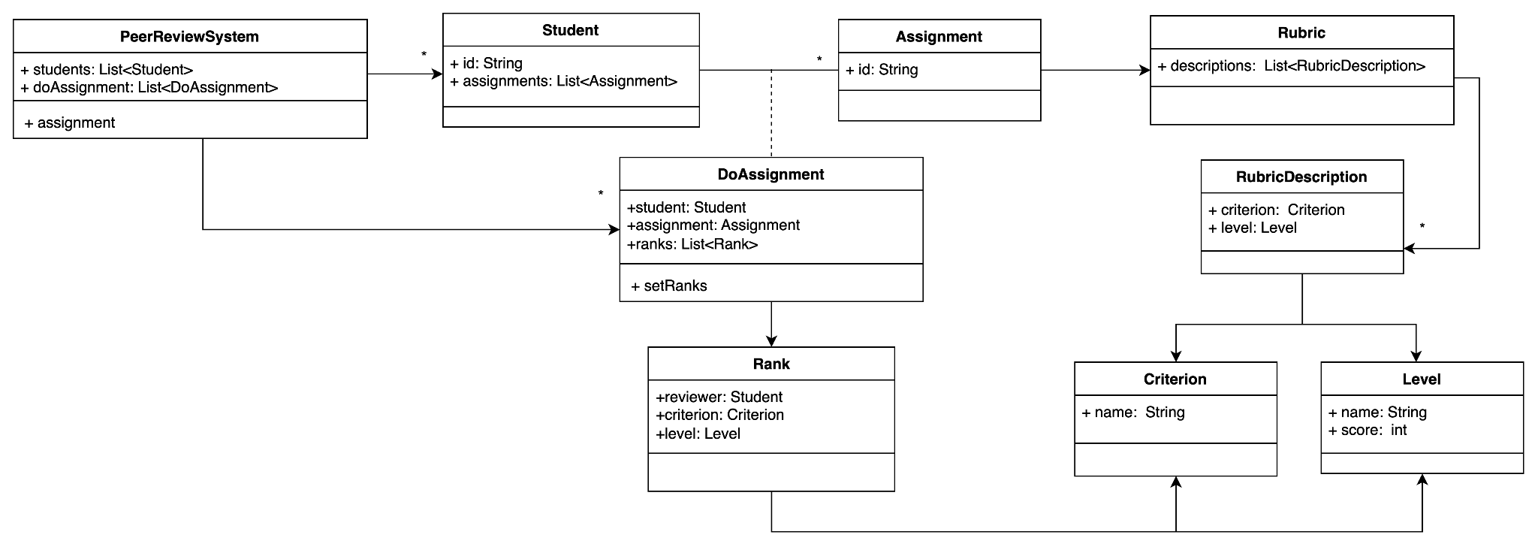
Initial Design (Cont.)
To be more objectively, instructors are required to design a ranking criterion called rubric for each assignment. A rubric includes one or more dimensions on which performance is rated, definitions that illustrate the attribute being measured, and a rating scale for each dimension.
Dimensions are generally referred to as criteria, the rating scale as levels, and definitions as descriptors.

Slide 5
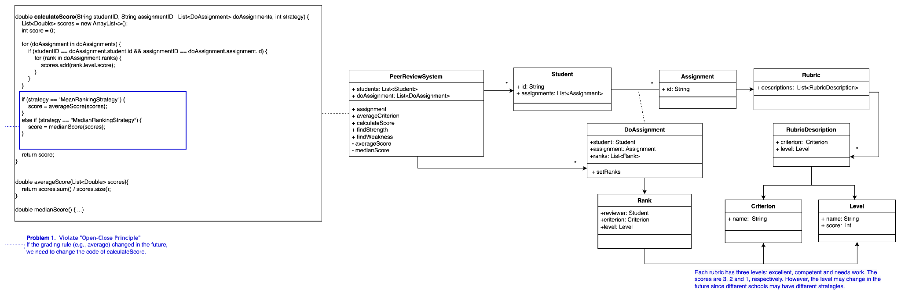
Initial Design (Cont.)
After the peer review, the instructor can see the score of each student, and the average in each criterion.
The score information can help the instructor understand the strength and weakness of each student.

Slide 6
Initial Design

Slide 7
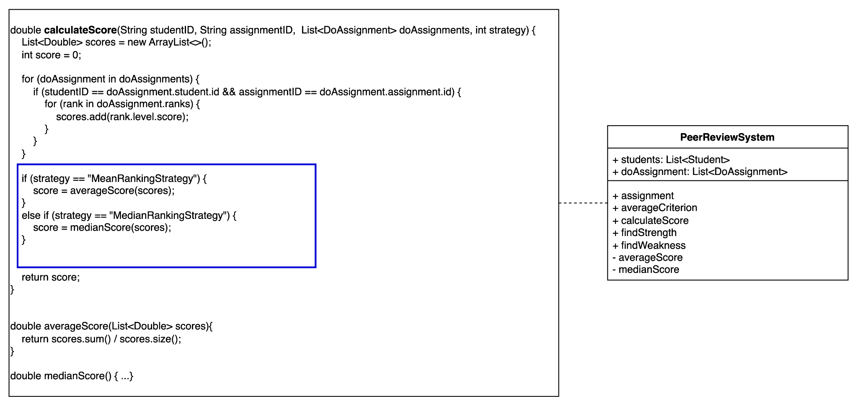
Problems in Initial Design
Function calculateScore() violates Open-Close Principle. If the grading rule (e.g., average) changes in the future, we need to modify the code.

Slide 8
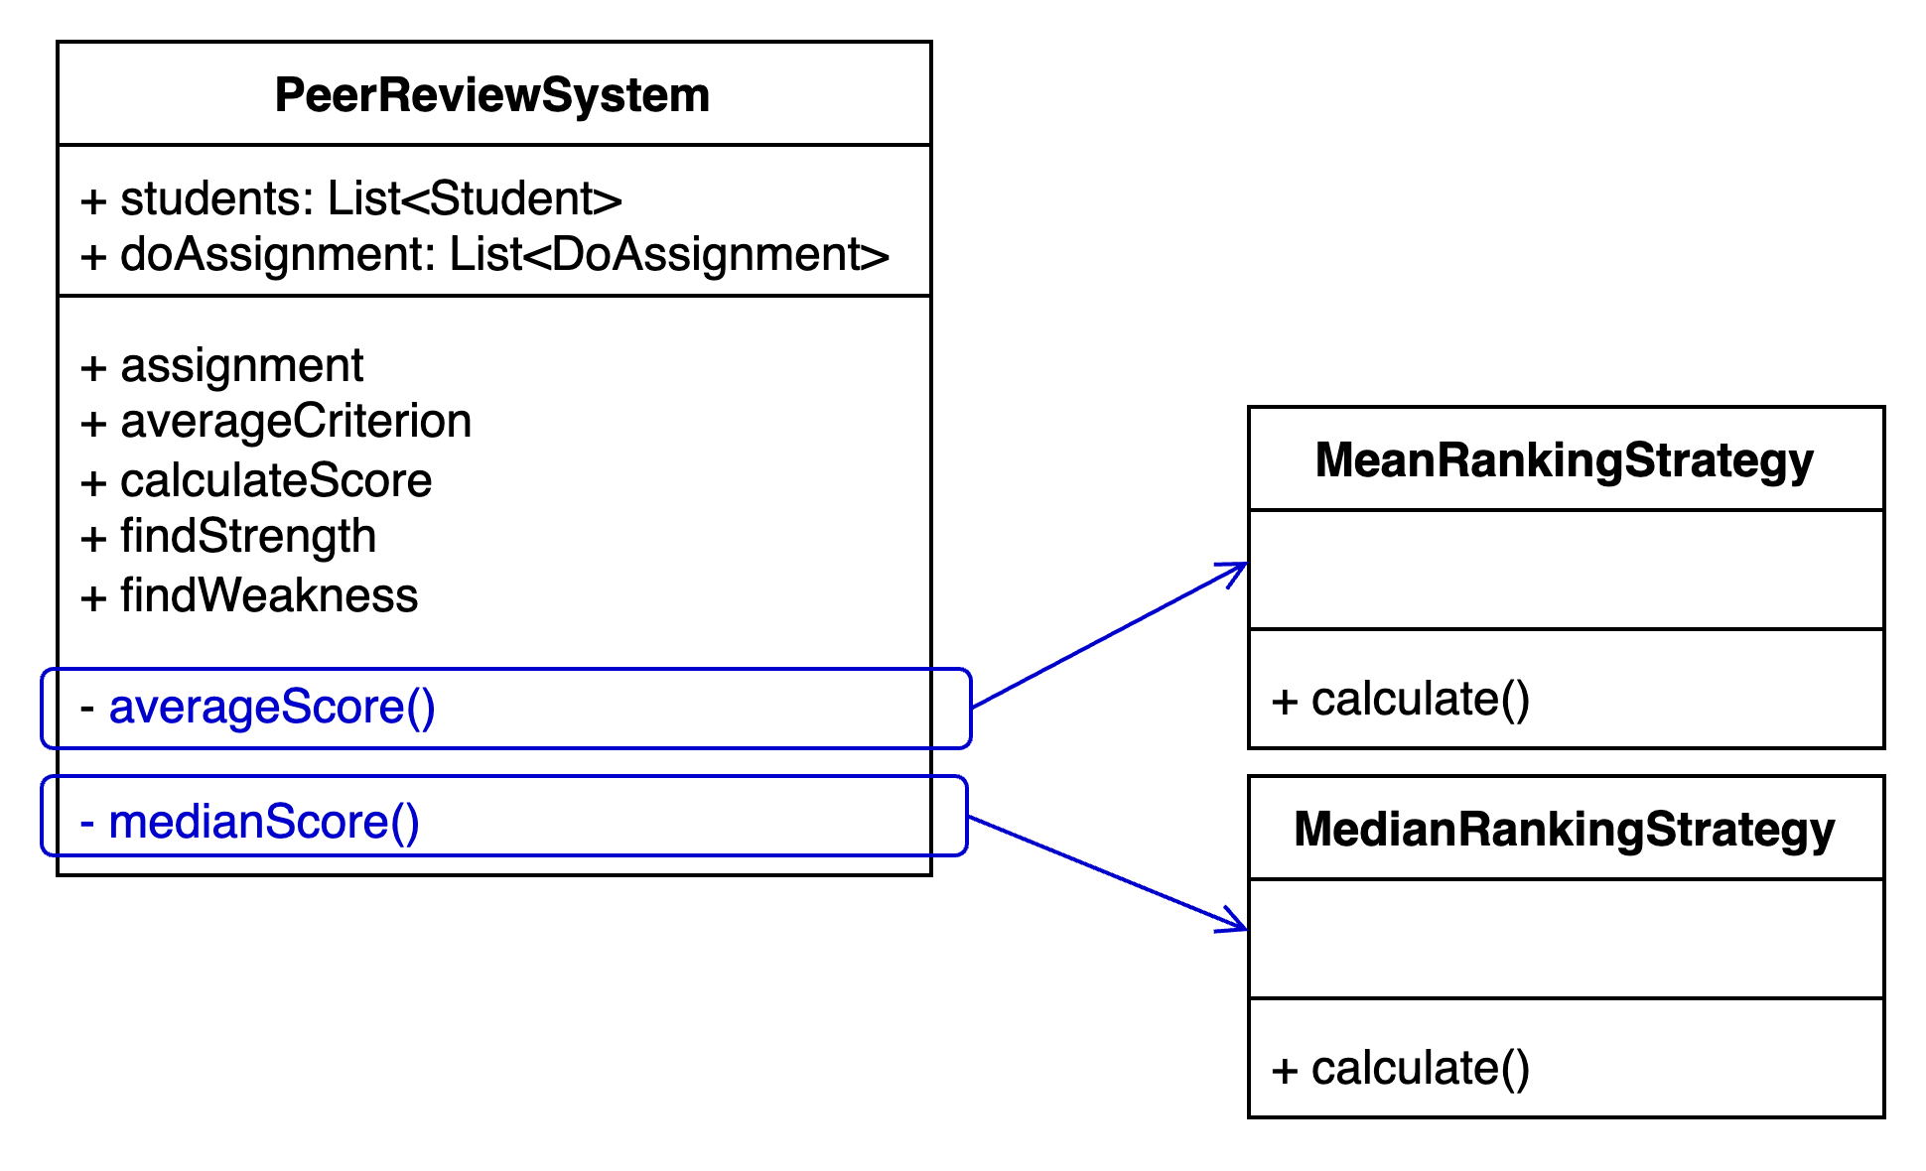
Act 1-1. Encapsulate What Varies

Slide 9
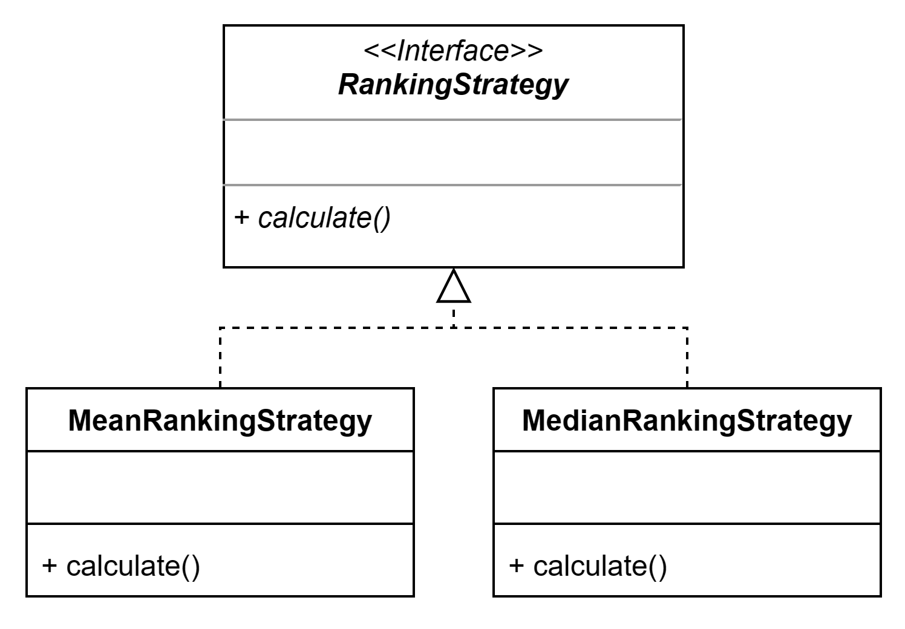
Act 1-2. Abstract Common Behaviors
Abstract RankingStrategy

Slide 10
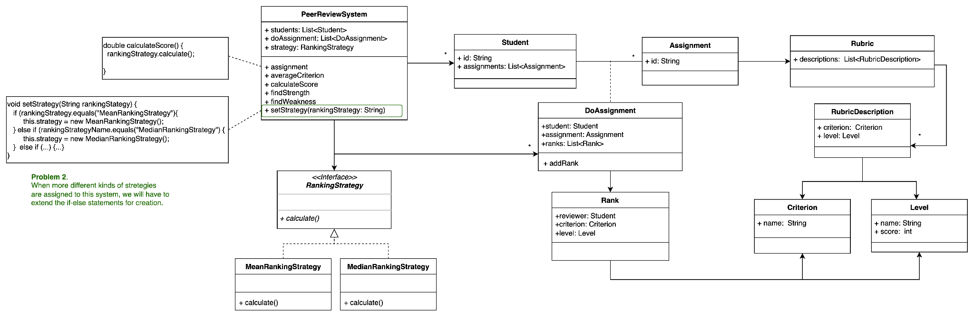
Act 1-3. Compose Abstract Behaviors

Slide 11
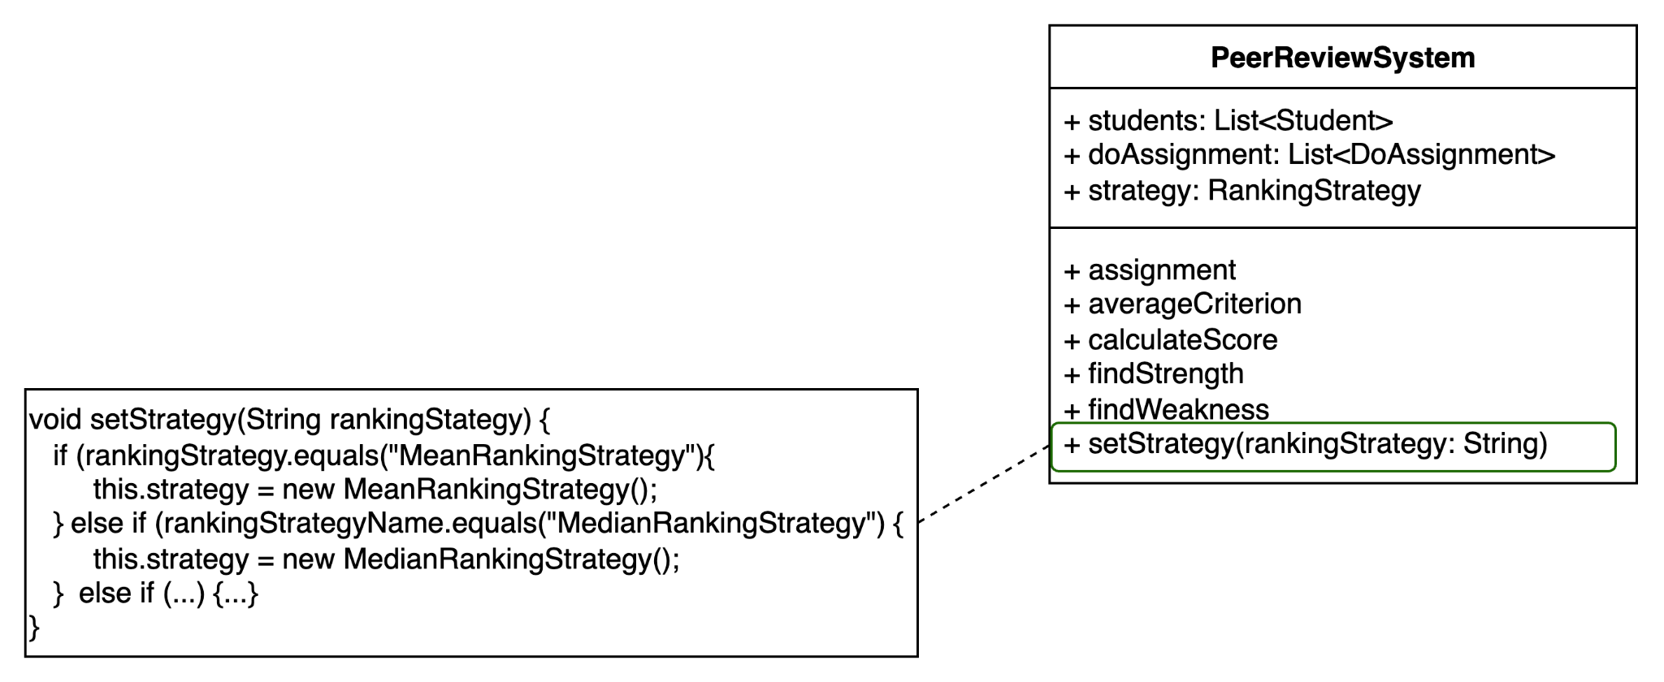
Problem of Current Design
setStrategy(): When more different kinds of strategies are assigned to this system, we will have to open the system code and extend the if-else statements (Green Rectangle)

Slide 12
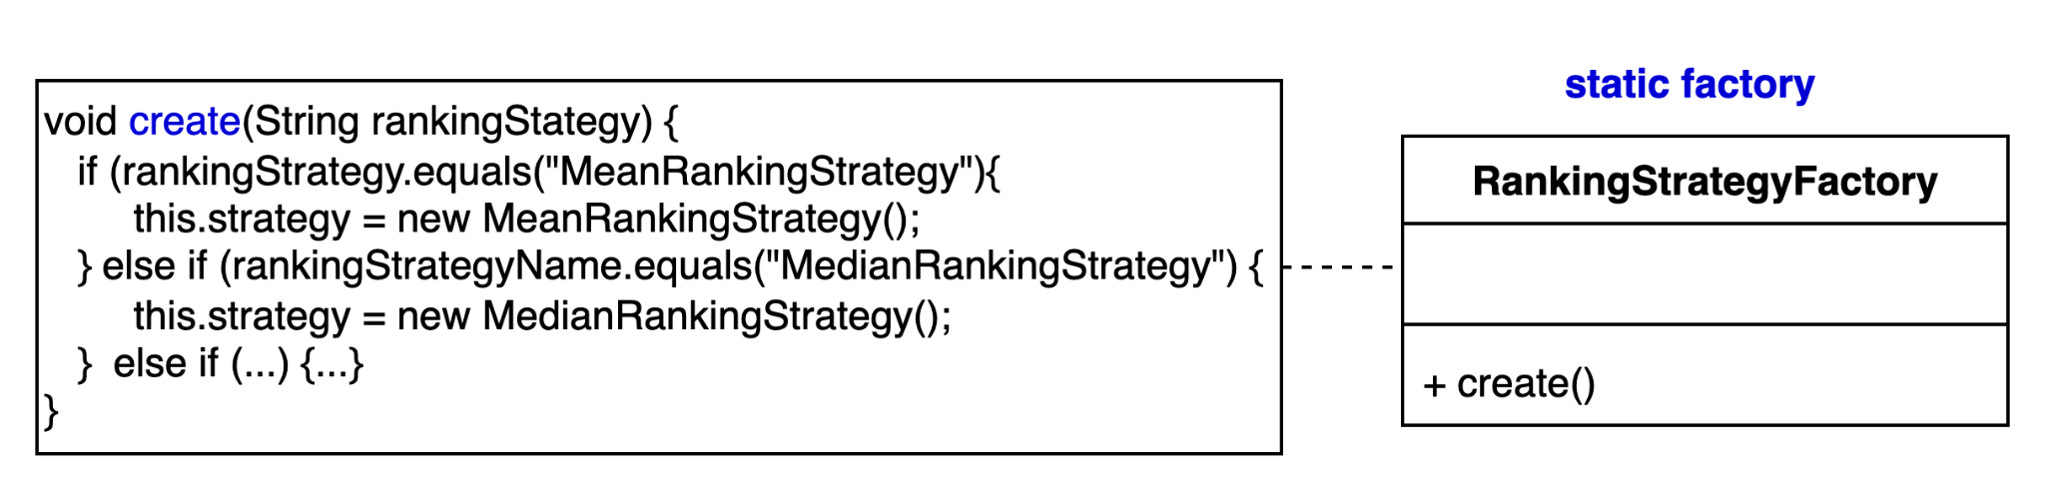
Act 2-1. Encapsulate What Varies
Create RankingStrategy in a static factory.

Slide 13
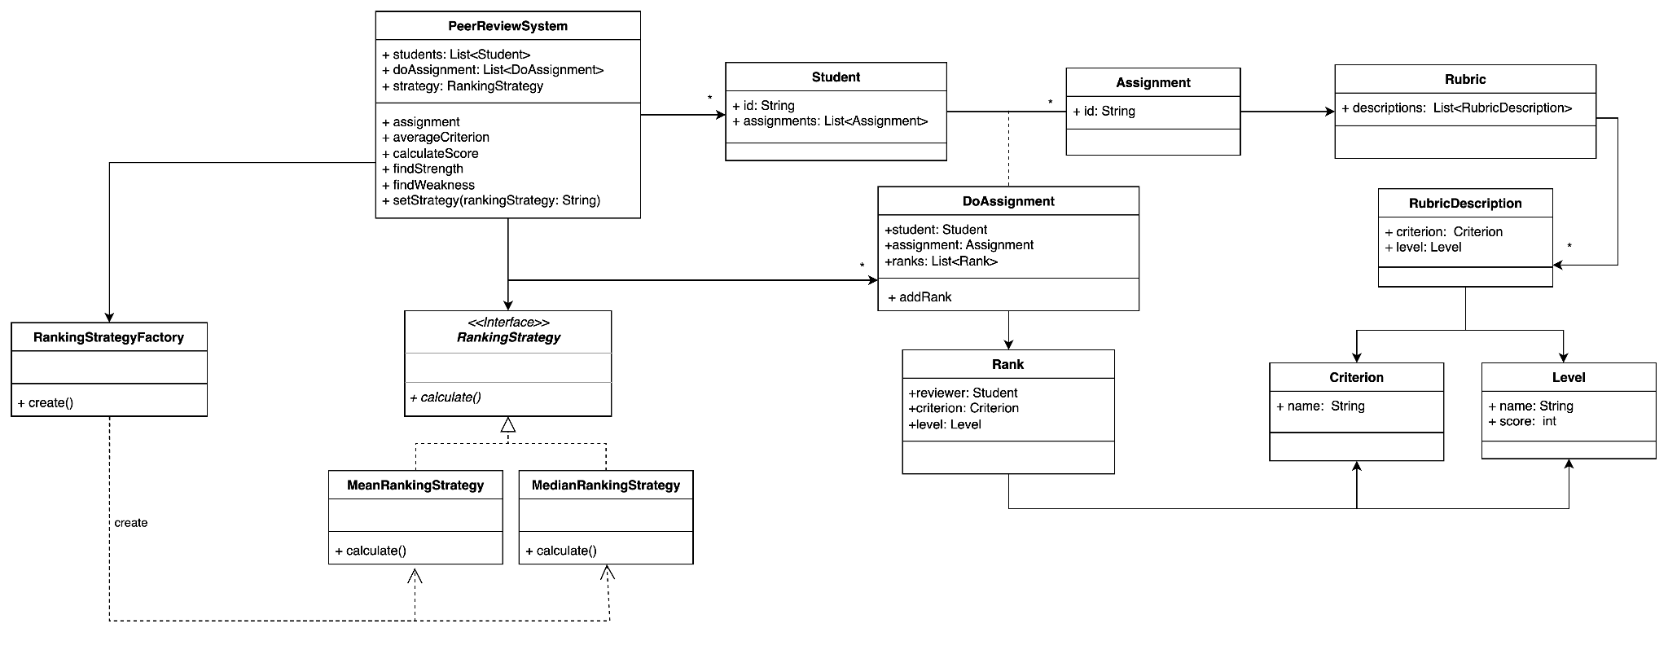
Refactored design

Slide 14
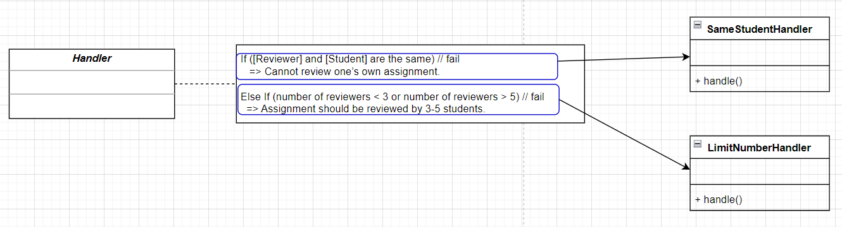
Act 3-1. Encapsulate What Varies

Slide 15
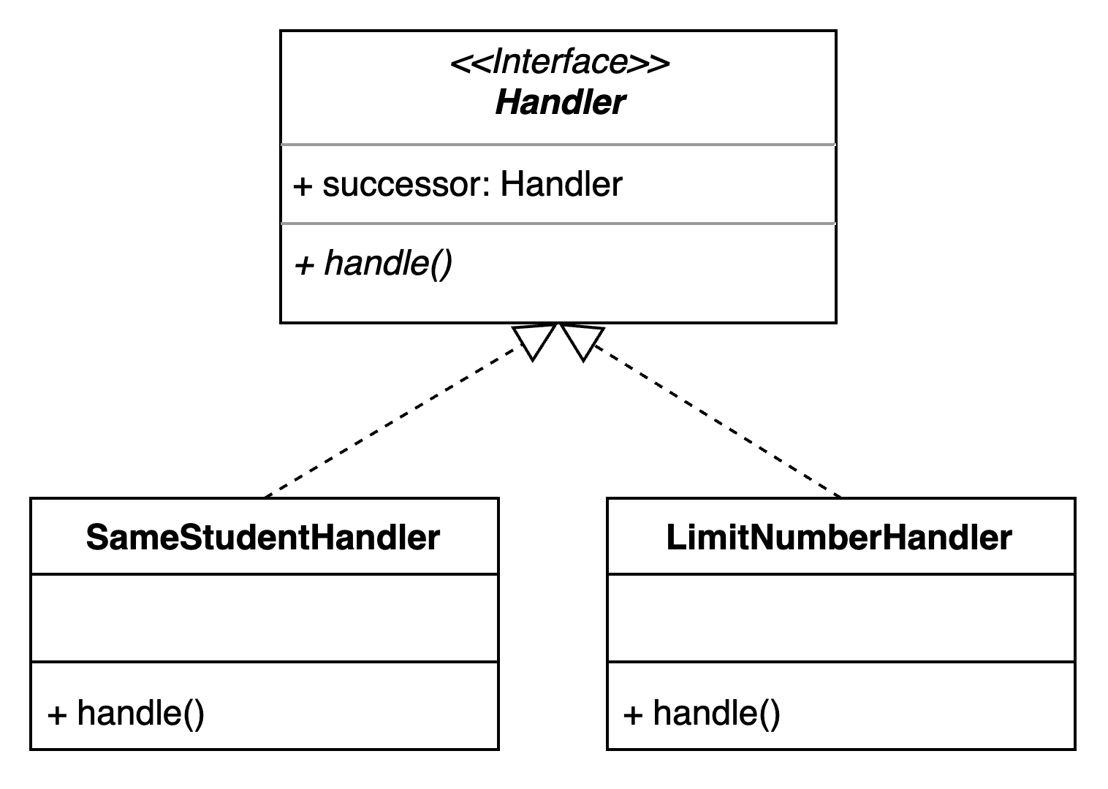
Act 3-2. Abstract Common Behaviors

Slide 16
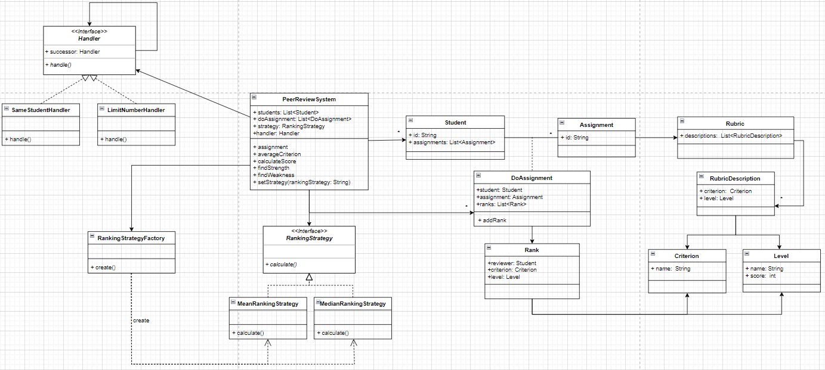
Refactored design - chain of responsibility

