Slide 1
軟體工程設計 Midterm
Library System
許庭瑋、陳君翰、洪世彬、劉玠均、楊昕叡、林俊佑
2023/11/09

Slide 2
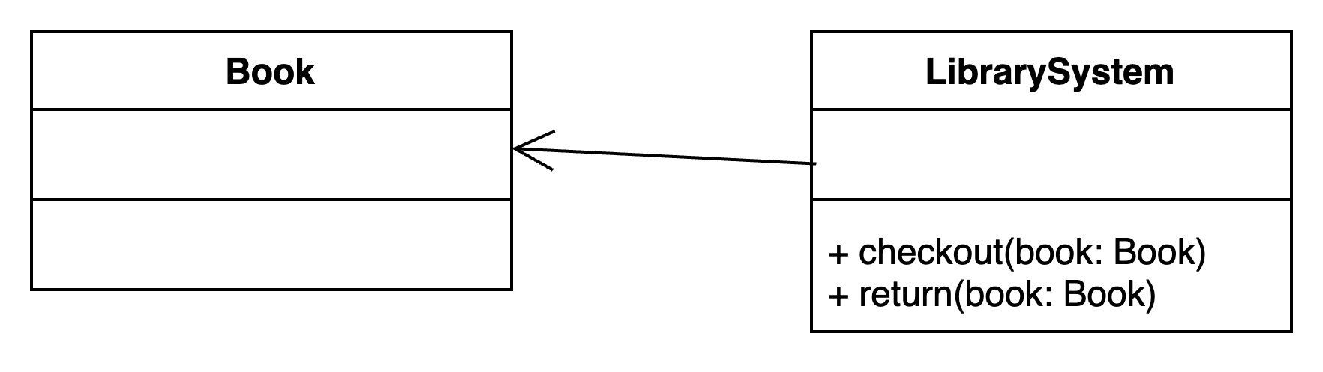
Statement: Transaction 1
Check out a copy of a book/ Return a copy of a book.

Slide 3
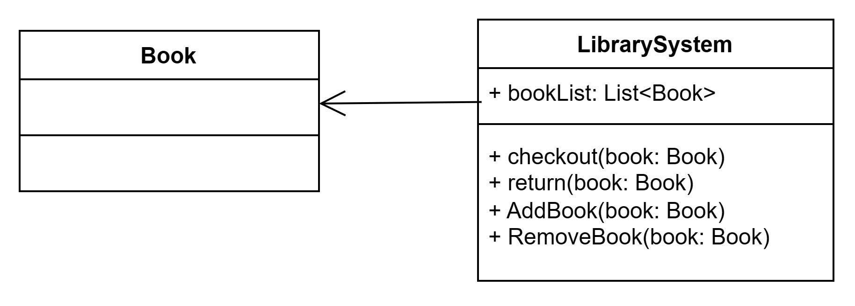
Statement: Transaction 2
Add a copy of a book to/ Remove a copy of a book from the library.

Slide 4
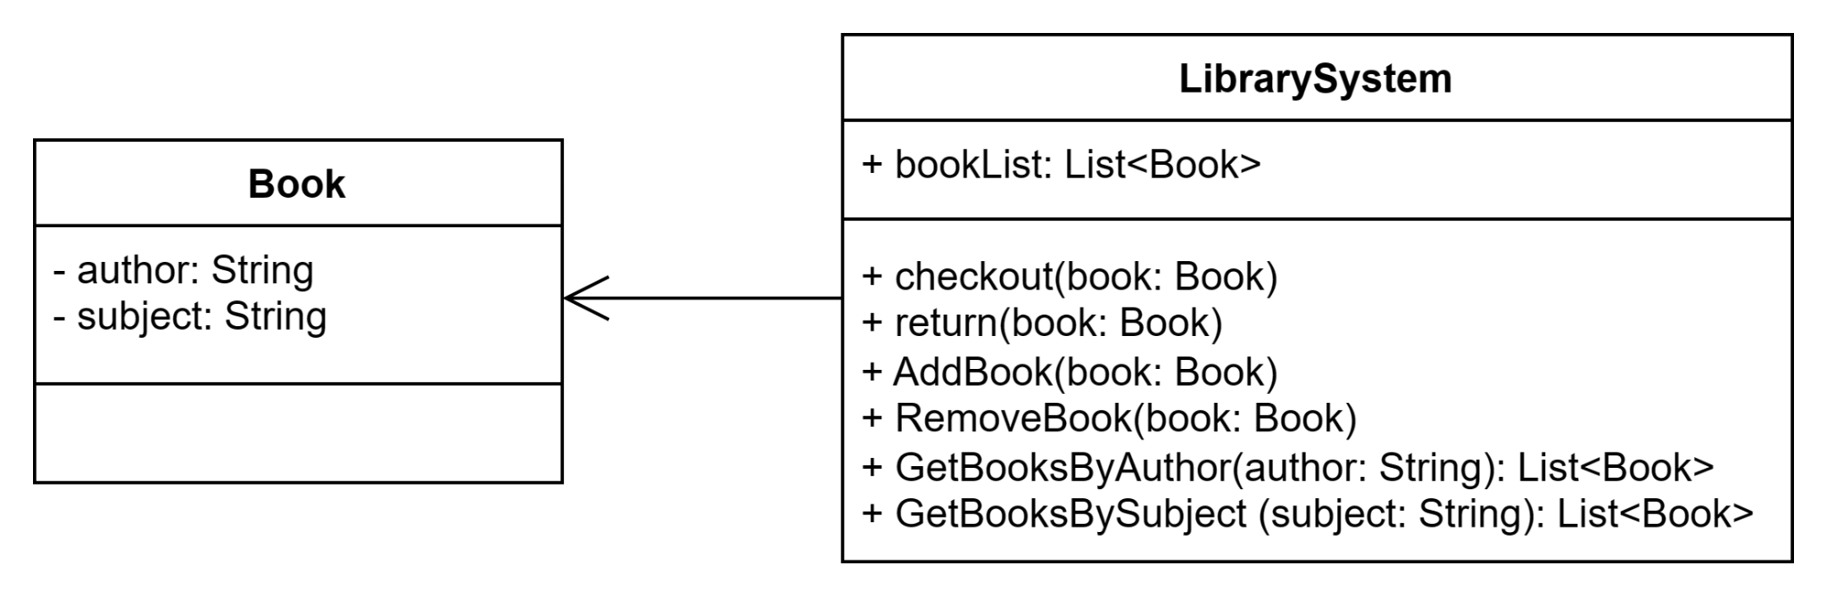
Statement: Transaction 3
Get the list of books by a particular author or in a particular subject area.

Slide 5
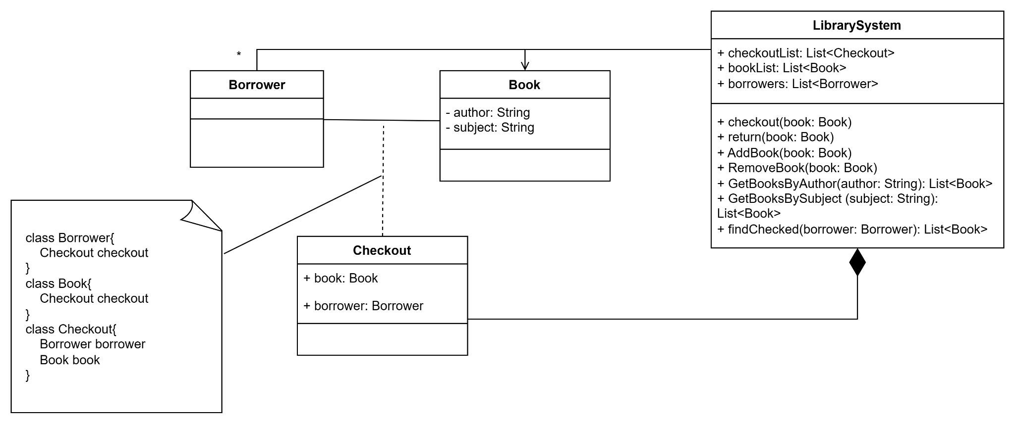
Statement: Transaction 4
Find out the list of books currently checked out by a particular borrower.

Slide 6
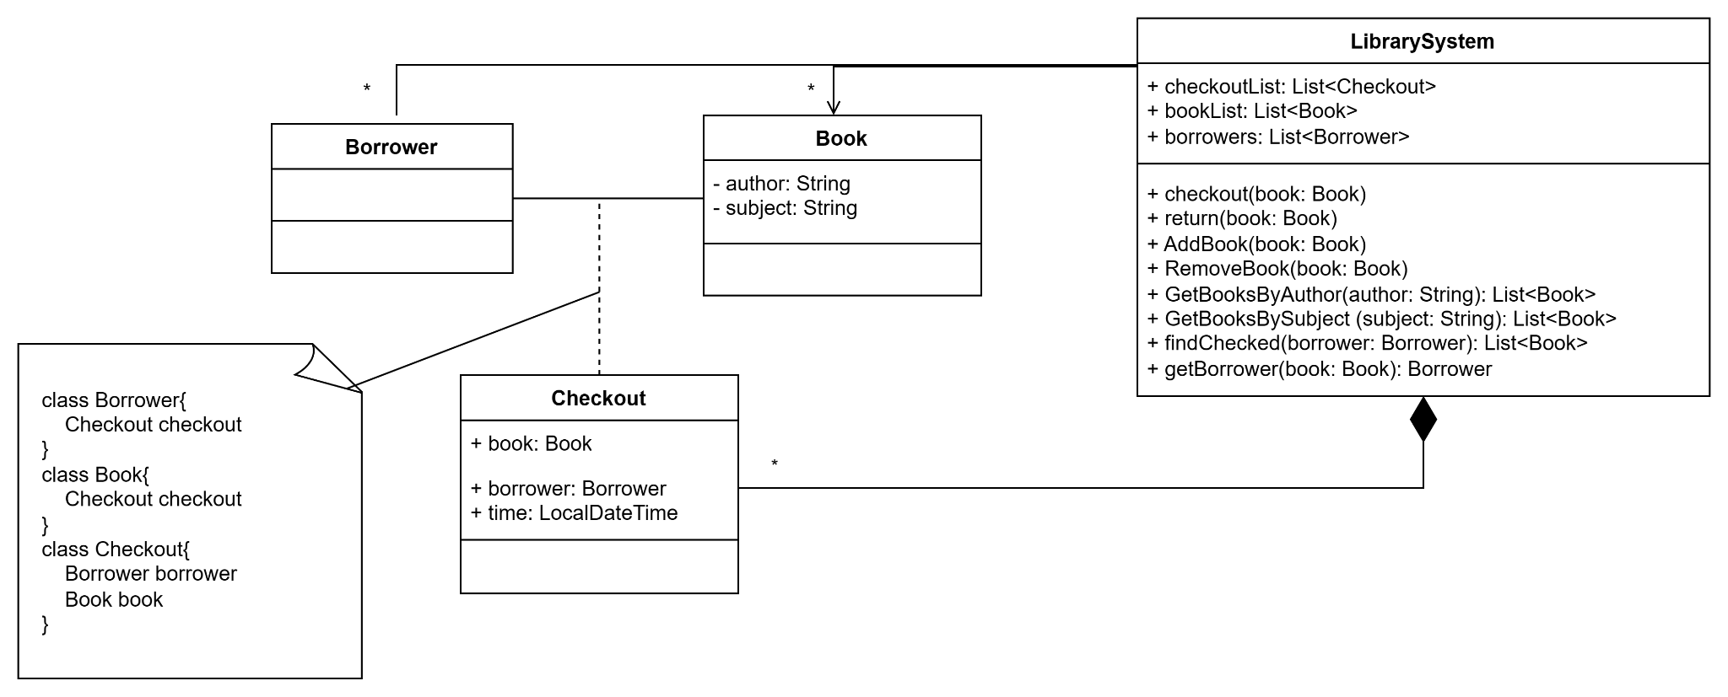
Statement: Transaction 5
Find out what borrower last checked out a particular copy of a book.

Slide 7
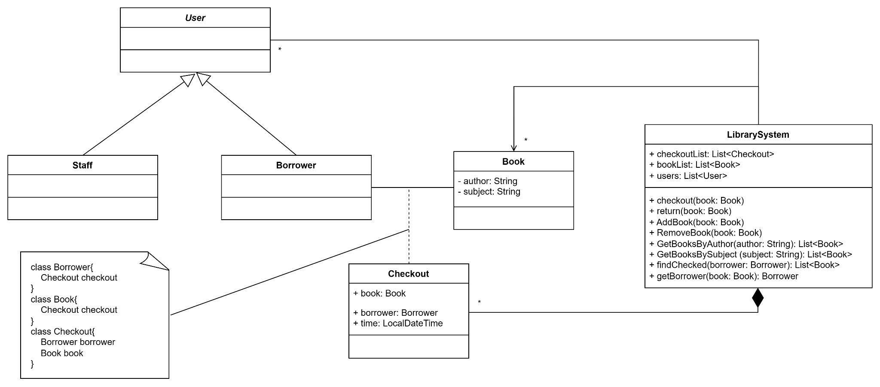
Statement: User Types
There are two types of users: staff users and ordinary borrowers.

Slide 8
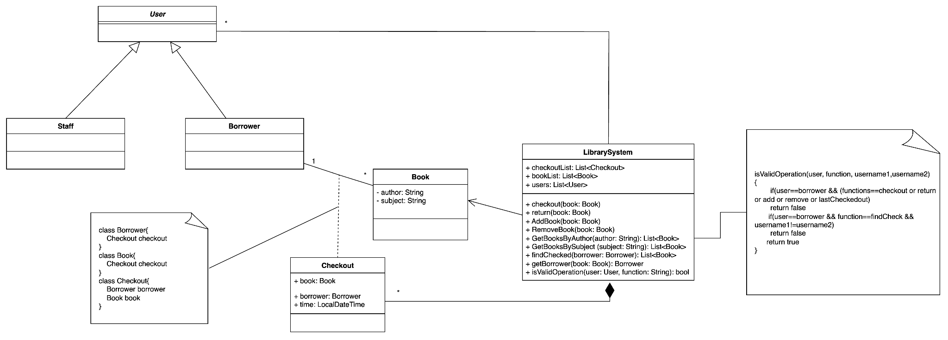
Statement: restricted transaction
Transactions 1, 2, 4 and 5 are restricted to staff users, except that ordinary borrowers can perform transaction 4 to find out the list of books currently borrowed by themselves.

Slide 9
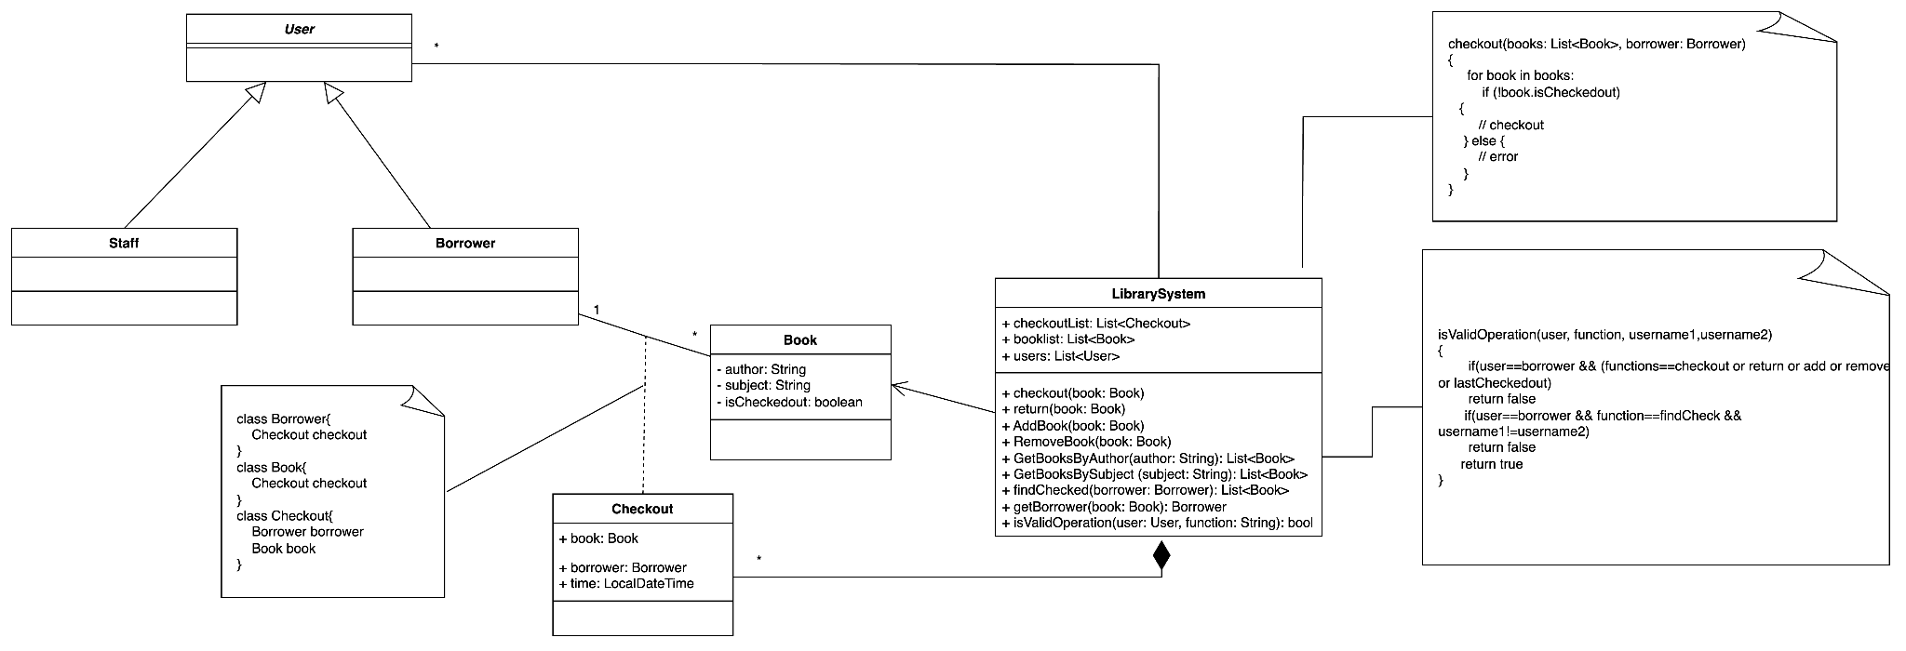
Statement: Constraint 1, 2
The system must also satisfy the following constraints:
1. All copies in the library must be available for check-out or checked out.
2. No copy of a book may be both available and checked out at the same time.

Slide 10
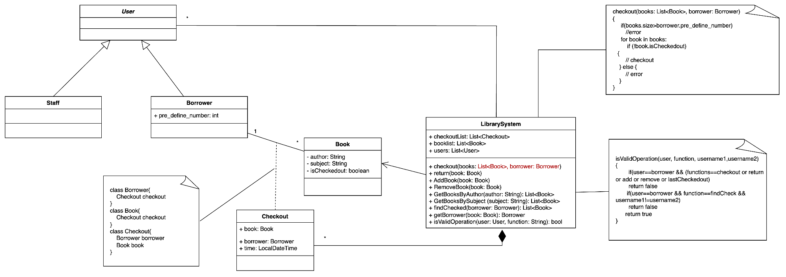
Statement: Constraint 3
A borrower may not have more than a pre-defined number of books checked out at one time (indicate: borrower can check out many books in one time)

Slide 11
Initial Design

Slide 12
Problems in Initial Design
LibrarySystem is too large. It seems that functions for books and functions for users can be encapsulated separately.
All functions check permissions using isValidOperation(). When functionality needs to be added into LibrarySystem, isValidOperation() needs to be changed every time.
Problem 1
Problem 2

Slide 13
Solution
Encapsulate BookService and UserService from LibrarySystem. And LibrarySystem delegate related functions to BookService and UserService.
Using Decorator Pattern, so other can add authority check to each function if necessary.

Slide 14
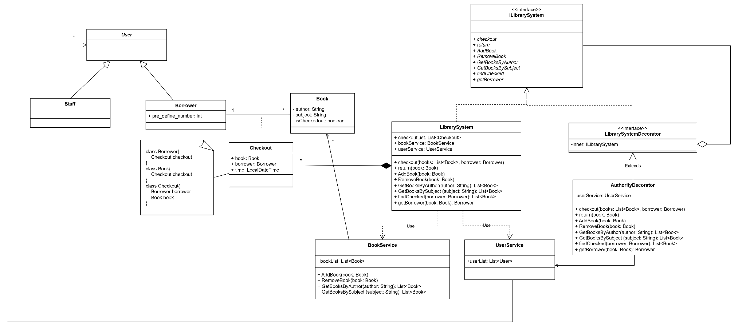
Refactored Design with Actions
Act 1
Act 2. Add authority check to each functions.

Slide 15
Refactored Design

