Slide 1
軟體工程設計
許庭瑋、陳君翰、洪世彬、劉玠均、楊昕叡、林俊佑

Slide 2
What we search
spring boot: can quickly create a Spring-based application
spring cloud: provides tools for developers to quickly build some of the common patterns in distributed systems, which is composed of microservices.
spring web: provide components required to build an MVC architecture
spring data access: provide easy access to multiple data sources
spring core: configure and facilitate the life cycle of objects
spring aop: build separable routines that can be applied applicationwide

Slide 3
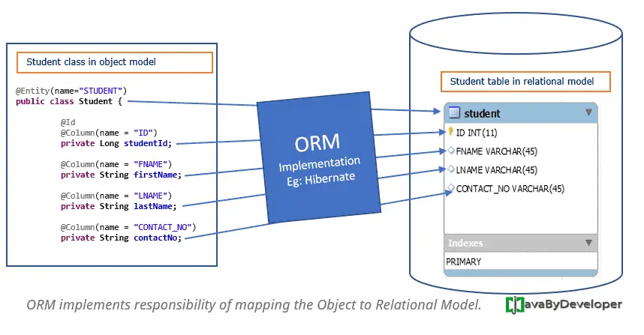
ORM (Object Relational Mapping)
ORM is a technique to map Java objects to database tables.
The module supports integration with Hibernate, JPA and JDO for resource management, DAO implementations.

Slide 4
ORM (Object Relational Mapping)
It has several benefits for developers:
Simplifies database operations
Enhances code readability and maintainability
Easier testing
Common data access exceptions
Integrated transaction management
…

Slide 5
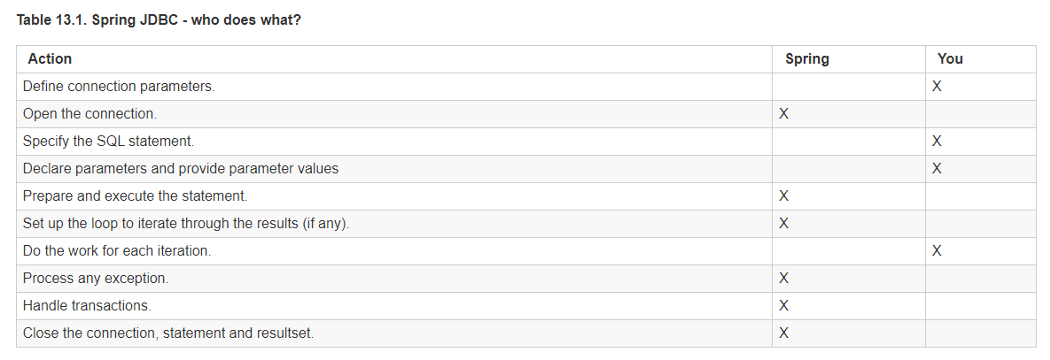
JDBC
JDBC Provides a standardized way to connect to databases. It takes care of all the low-level details of database interaction.

Slide 6
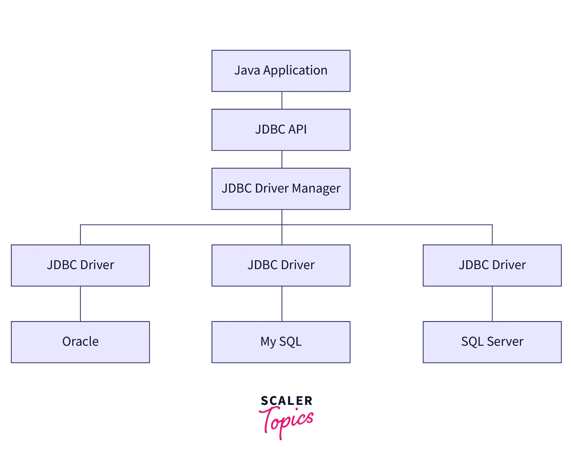
JDBC
It has several benefits for developers:
Simplifies database operations.
Allowing the same code to work with various databases.
Efficient connection management.
…

Slide 7
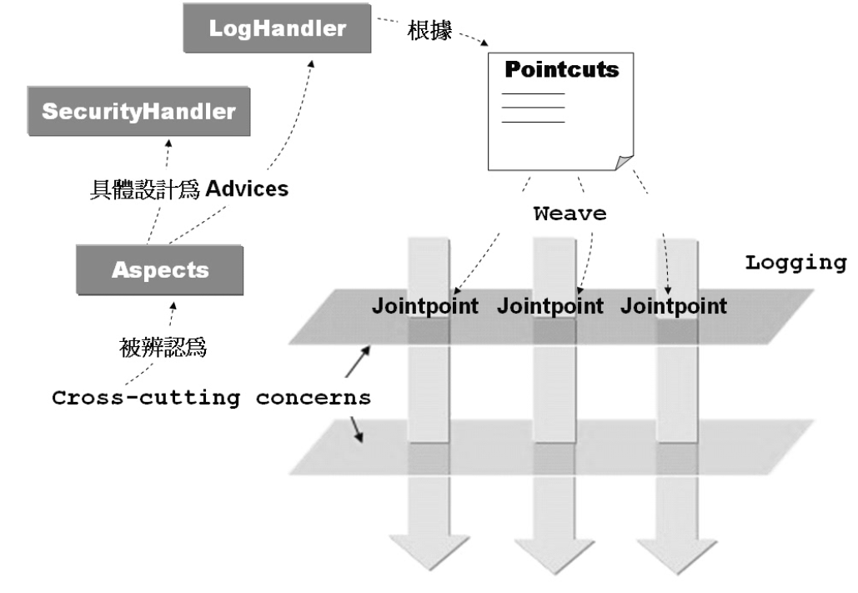
AOP (Aspect-Oriented Programming)

Slide 8
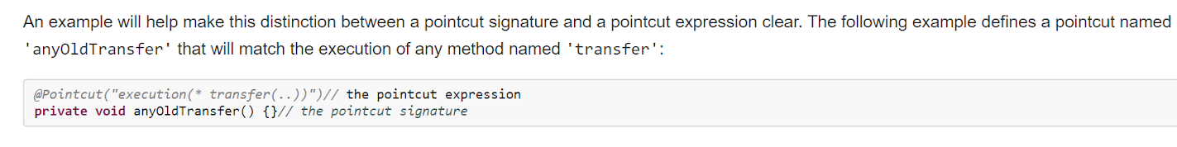
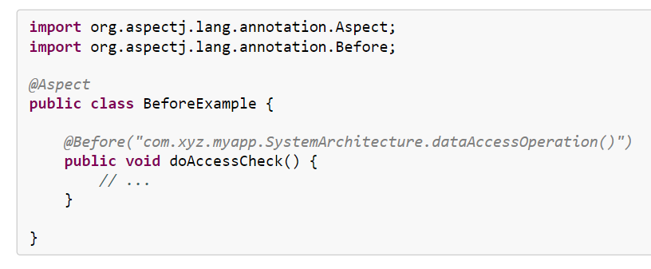
pointcut and advice

Slide 9
Advantage of AOP
1.clean code
2.convenience
3.reusable
4. ...

Slide 10
Reasons for choosing AOP
Understand the design patterns of AOP: proxy, decorator ...
Understand how to organize routine functions (e.g., LogHandler) to make code easy to maintain.

Slide 11
Lines of Code
Module Name | Lines of Code
ORM | 8,480
JDBC | 15,791
AOP | 12,337
Total | 36,608
Avg. for 6 team member | 6,101
Lines of Code: only count the Java code in src/main of each module. Comments, other programming languages and testing code are excluded

Slide 12
References
https://docs.spring.io/spring-framework/docs/4.0.x/spring-framework-reference/html/aop.html#aop-aj-ltw
https://openhome.cc/Gossip/SpringGossip/AOPConcept.html
https://www.tutorialspoint.com/springaop/springaop_advice_types.htm
https://www.baeldung.com/spring-aop-vs-aspectj
https://javabydeveloper.com/orm-object-relational-mapping/
https://www.scaler.com/topics/jdbc-architecture/

