Slide 1
軟體工程設計 W3
許庭瑋、陳君翰、洪世彬、劉玠均、楊昕叡、林俊佑
2023/10/05

Slide 2


Issue Tracking System: JIRA
Jira is an Issue Tracking System developed by Atlassian.
It offers templates for both Scrum and Kanban methodologies and provides a timeline management feature, making it easier for teams to track the progress of various issues.

Slide 3
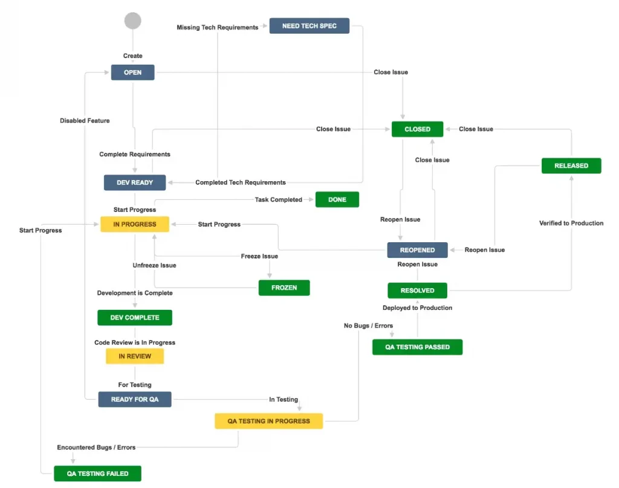
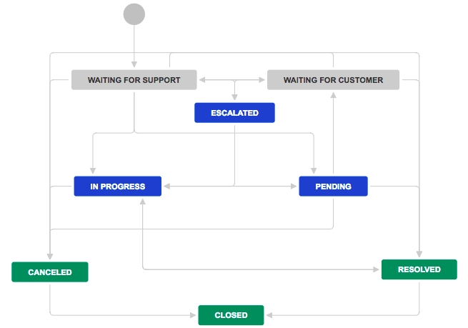
Workflow
One of the core functions of Jira is to provide customizable workflows, allowing teams to align with their actual development processes as closely as possible.

Slide 4
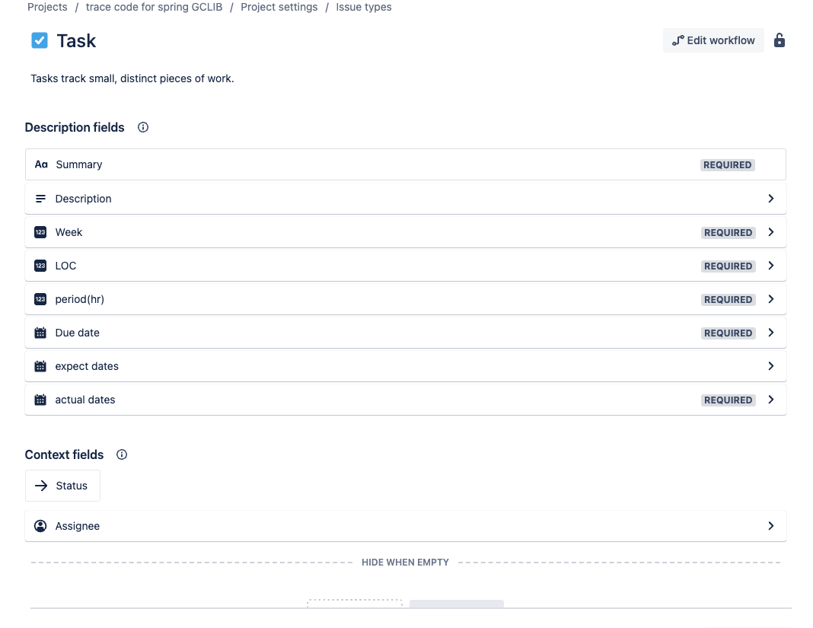
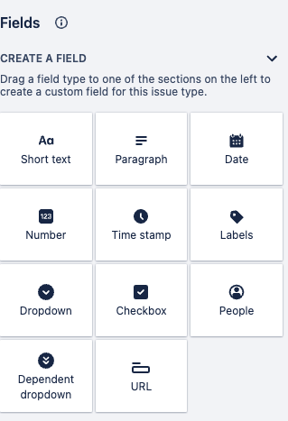
Custom Issue Property

Slide 5
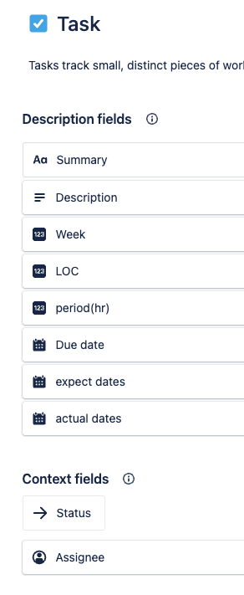
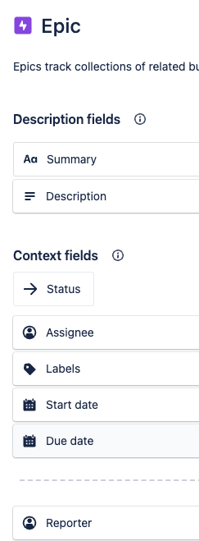
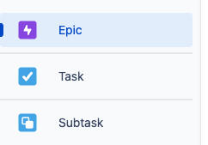
multiple type of issue

Slide 6
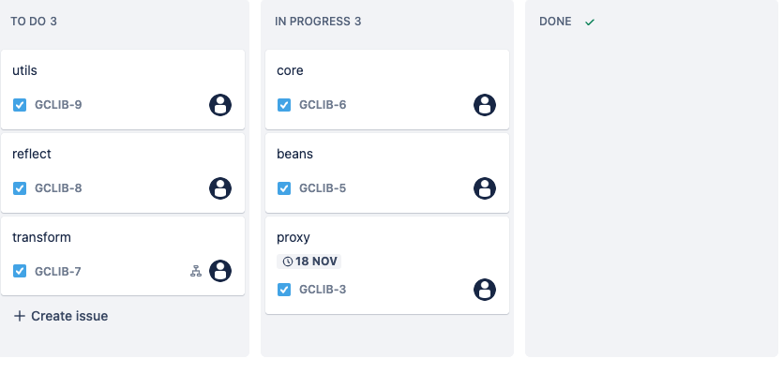
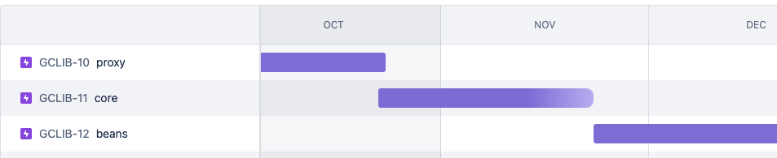
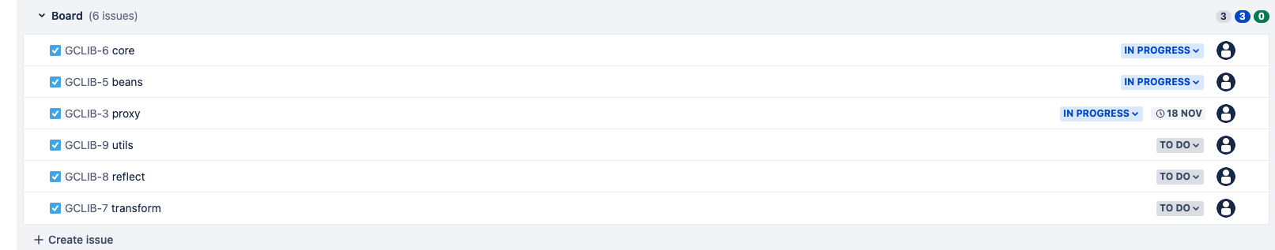
views of issues

Slide 7
Code Tracing

Slide 8
Weekly Code Tracing Progress
 | Part | LOC
spring-core-core
許庭瑋 | io | 527
楊昕叡 | annotation | 497
劉玠均 | support/GenericConversionService.java, convert/* | 543
洪世彬 | org.springframework.core.codec | 523
spring-core-aot, spring-core-cglib
陳君翰 | aot.generate (partial) | 425
林俊佑 | cglib.proxy (partial) | 800

Slide 9
許庭瑋
Resource: Interface for a resource descriptor like a file or a path
WritableResource: support writing
AbstractResource: pre-implementing typical behavior
ByteArrayResource: Resource implementation for a given byte array.
InputStreamResource: Resource implementation for no other specific Resource implementation
FileCopyUtils、StreamUtils: utils for copy data
InpurStreamSource
Resource
WritableResource
AbstractResource
ByteArrayResource
InputStreamResource

Slide 10
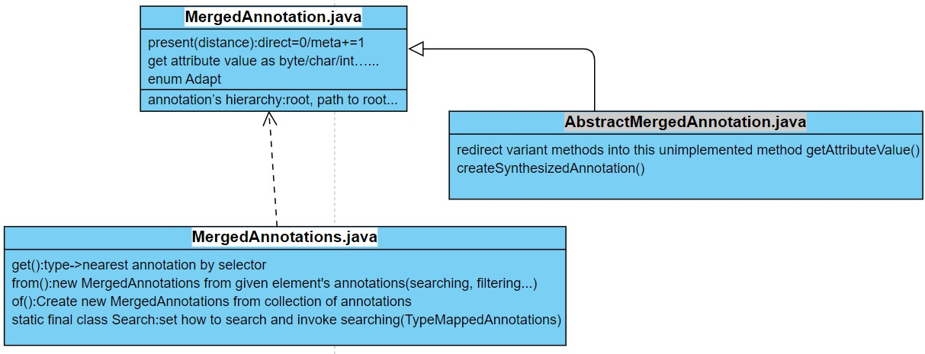
楊昕叡
public interface MergedAnnotation<A extends Annotation>
public interface MergedAnnotations extends Iterable<MergedAnnotation<Annotation>>
abstract class AbstractMergedAnnotation<A extends Annotation> implements MergedAnnotation<A>

Slide 11
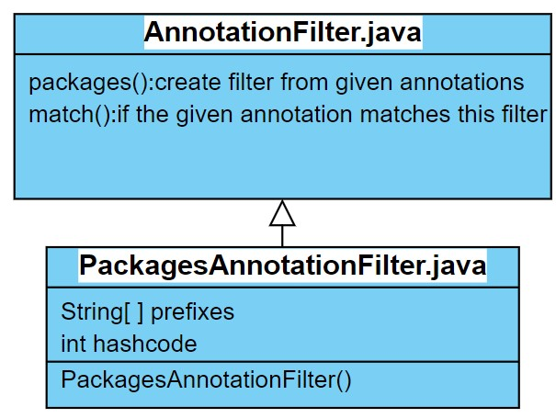
public interface AnnotationFilter
final class PackagesAnnotationFilter implements AnnotationFilter

Slide 12
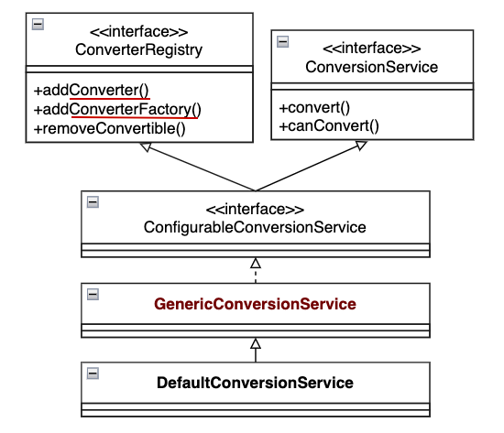
劉玠均
ConversionService (core/convert/support) How to manage converters?
Converter<S, T>: convert source type to target type (type: core.convert.TypeDescriptor)
ConverterFactory<S, R>: T extends R
Notes:
<R> the target range (or base) type converters created by this factory can convert to;
* for example {@link Number} for a set of number subtypes.

Slide 13
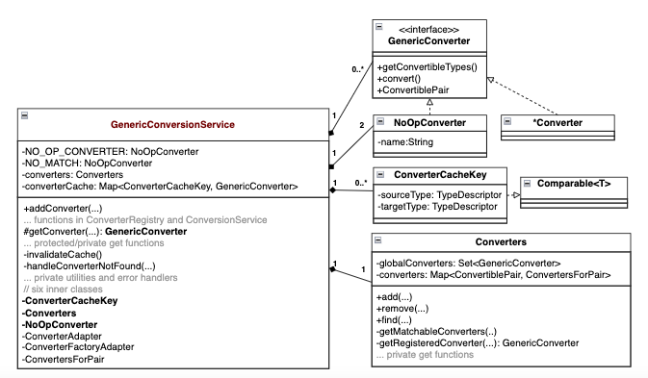
viewpoint: GenericConversionService
(next week, W4)

Slide 14
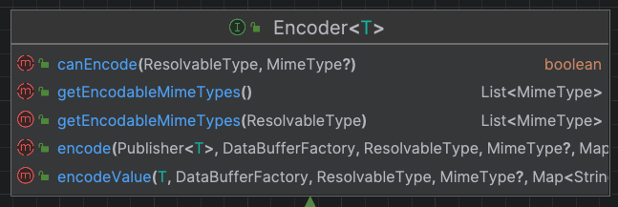
洪世彬
The Encoder<T> defines an interface for encoding a stream of objects into an output stream (DataBuffer).

Slide 15
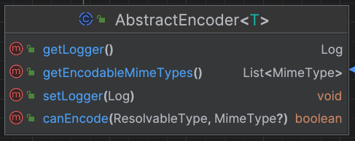
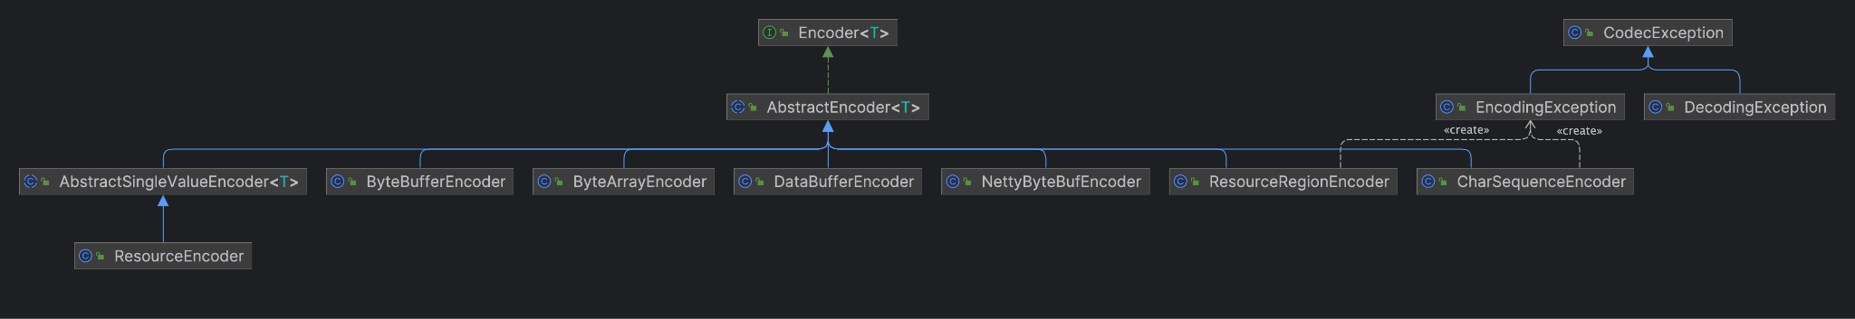
洪世彬
AbstractEncoder<T> Implement Logger and MimeType for all its child classes.

Slide 16
洪世彬
The encoder has various implementations to handle different types of input.

Slide 17
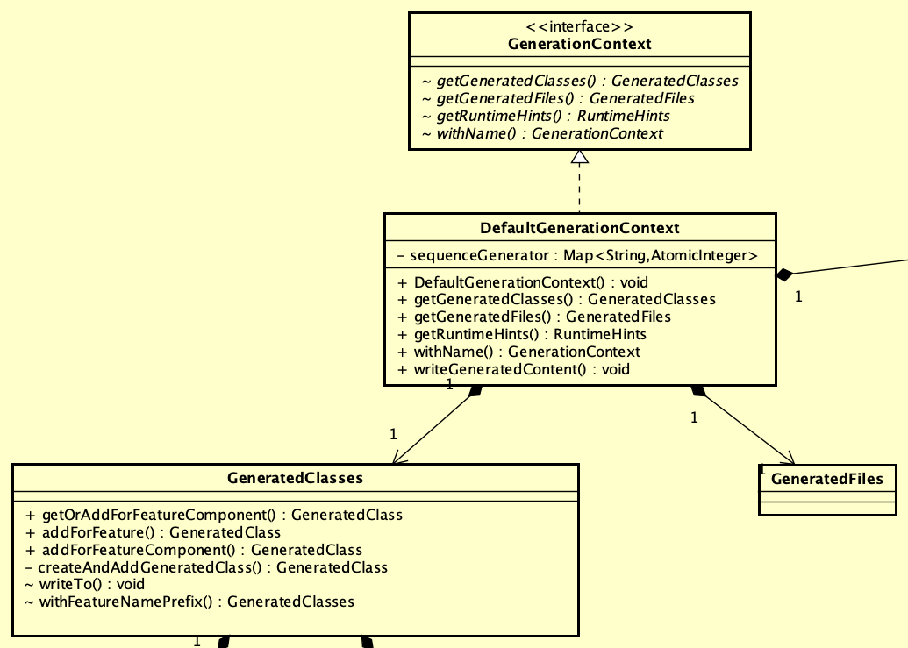
陳君翰

Slide 18
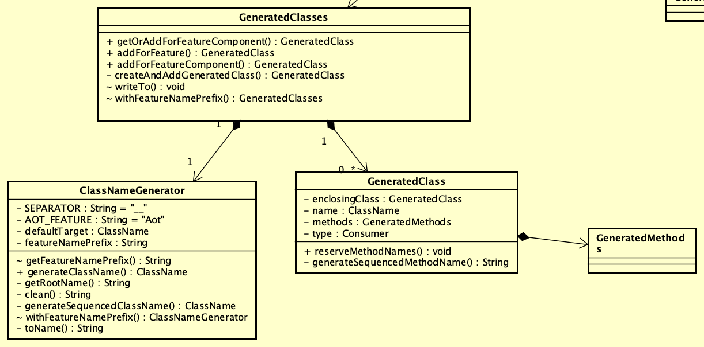
陳君翰

Slide 19
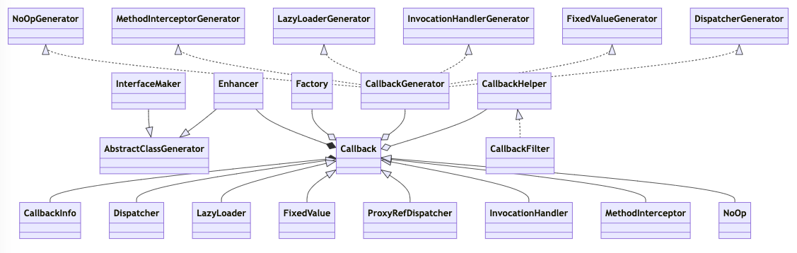
林俊佑
現有理解 for Proxy

Slide 20
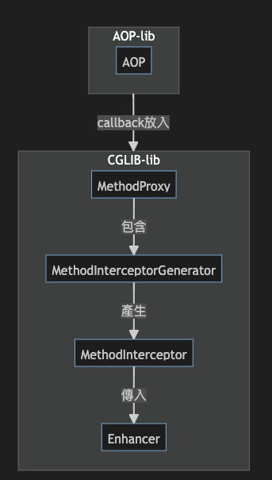
aop 調用
透過上述流程創建函數被 callback 複寫的新物件

