Slide 1

Research and Development about
Voxels
Octrees
Level Of Details

Slide 2
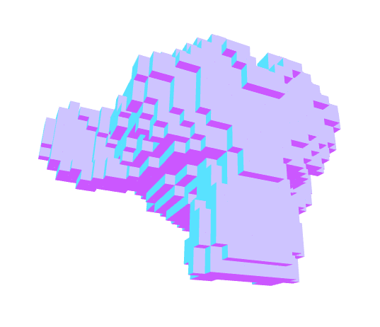
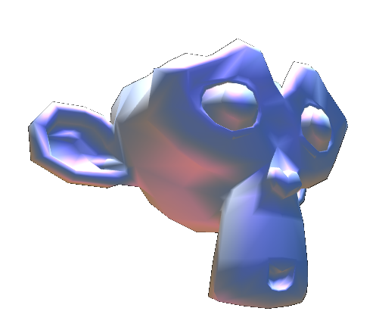
Definitions
Model
  3D mesh made of points and triangles
Voxel
  Volume element
  Unit cell of 3D grid
  A box

Slide 3
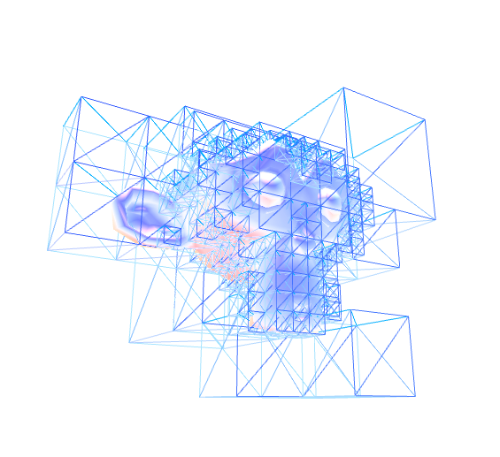
Definitions
Octree
  Recursive tree data structure with 8 nodes
  Store positions, dimensions and data
  An octree leaf is a node without children nodes
Level Of Details
  Amount of informations
Bouding Box
  Minimum and maximum points

Slide 4
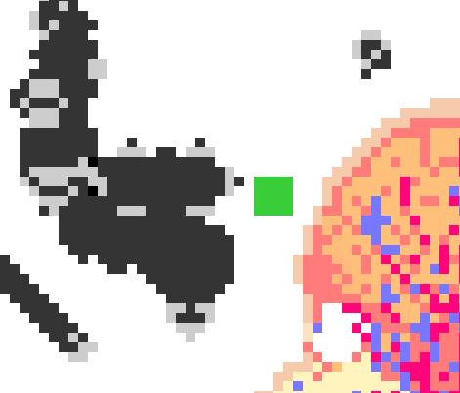
Project Description
Objectives
  Create a voxel world
  Voxelize a mesh
  Recursive level of details
  [Cellular automata]
  [Game]

Slide 5
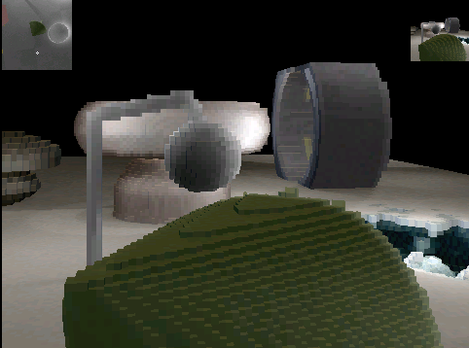
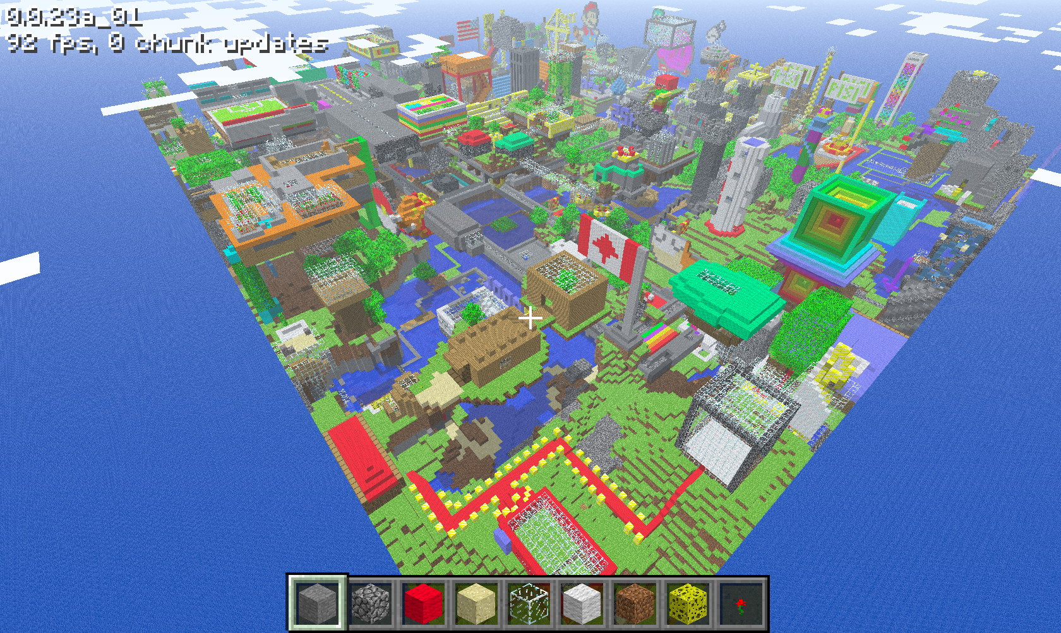
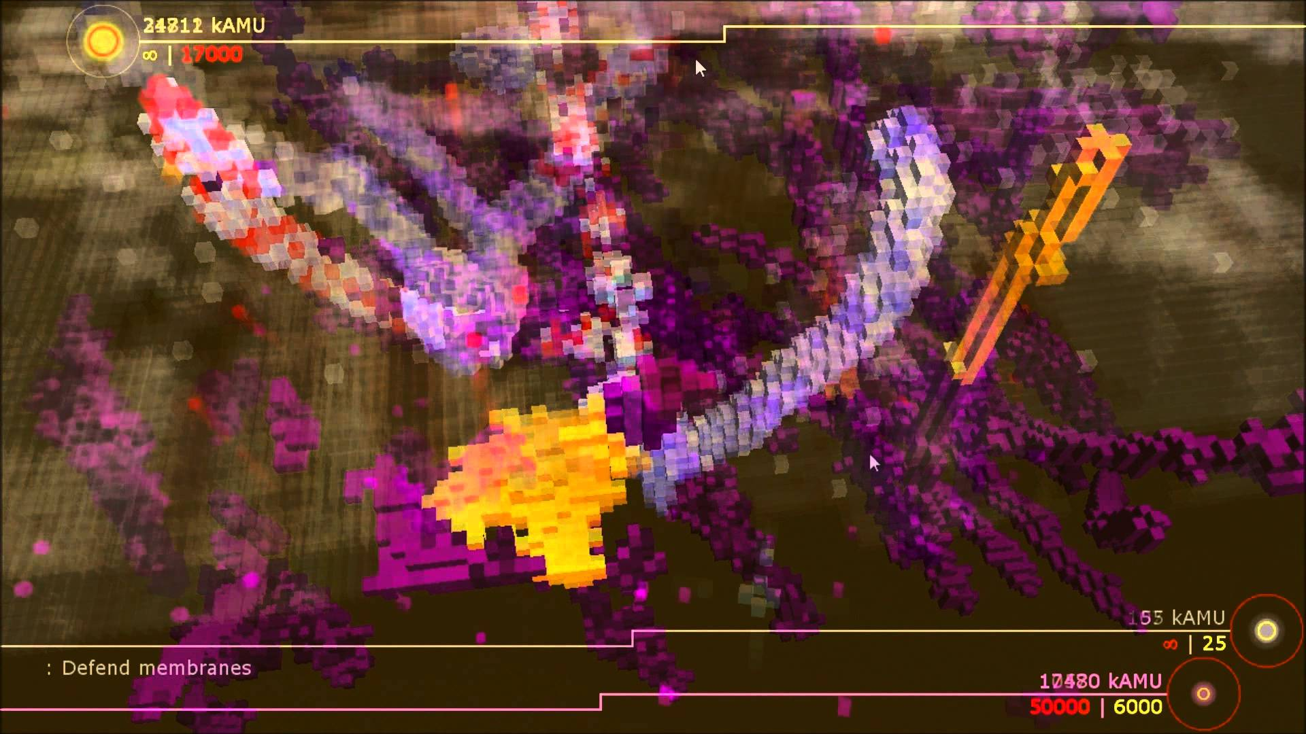
References
Voxlap
Minecraft
Cell Emergence

Slide 6
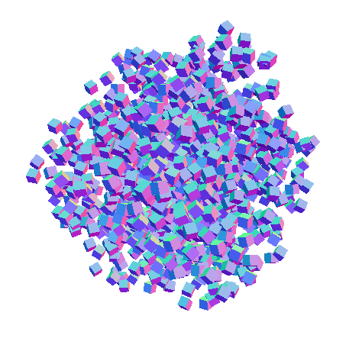
Libraries
WebGL ThreeJS
  Universal Internet browser
  Modern javascript framework
  Easy to use examples

Slide 7
Routine Procedure
Setup
  Voxel Engine
  Mesh Voxelization
  Octree Insertion
Update
  Voxel Raycasting
  Octree Exploration
  Level Of Details Localised

Slide 8
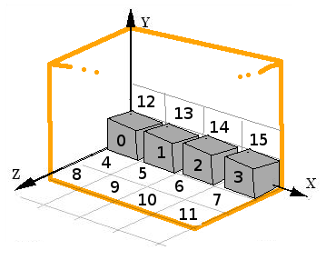
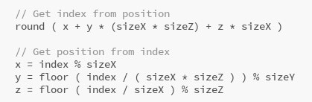
Voxel Engine
Voxel stored in list (size*size*size)
Unique index from space position
3D position from voxel index
8 grids for each octant

Slide 9
Voxel Display Optimisation
Do not
  Create numerous object to render
Do
  Merge geometries into one mesh
Only one draw call to GPU

Slide 10
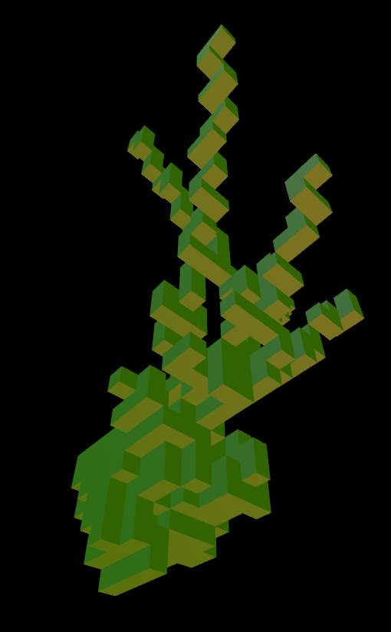
Voxel Raycasting
Picking voxel
  Test raycast on the voxel mesh
  Offset with face normal
  Round space position
Manipulate voxel
  Create
  Clear

Slide 11
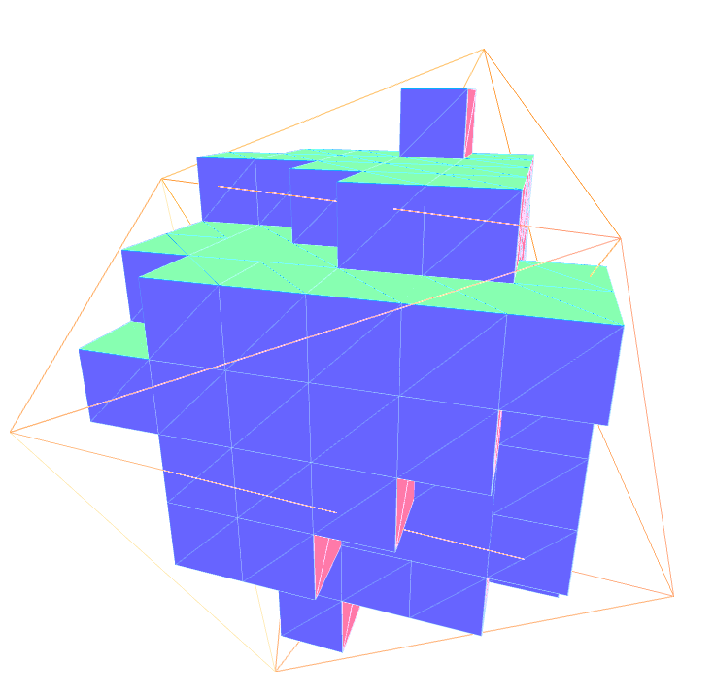
Mesh Voxelization
Iterate mesh triangles
  Iterate voxels in triangle bounding box
    Test overlapping voxel / triangle
Fill volume
  Iterate voxels slice of bounding box
    Iterate voxels columns
      Test triangle normals
      Fill column between two voxels

Slide 12
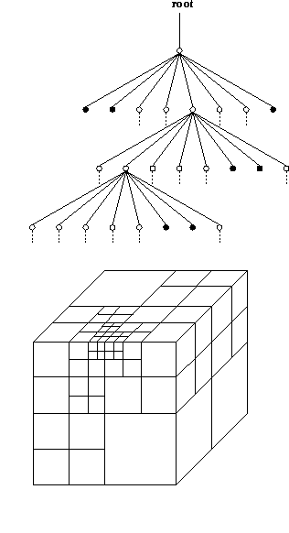
Octree Insertion
Insert point in root node
  Node have children nodes
    Insert point in child node
  Already have a point
    Split node (create children)
    Insert previous point in child node
    Insert new point in child node
  Have no point stored
    Store point in current node

Slide 13
Octree Exploration
Algo
Modes

Slide 14
Local Level Of Details

Slide 15
Generate Depth

Slide 16
Interface
Controls
Parameters

Slide 17
Debriefing
Futur engine
Cellular automata
Game

Slide 18
PLAY

