Slide 1
Air Writing
Andrew Leonard
SEIS 744
Notes:
The project I chose to do is called air writing. The purpose was to use the Nano BLE to collect data of of motion through the on-board sensors to detect digits being draw in the air. Using a model, it would detect the digits I had drawn and then utilize the output to trigger something to happen.

Slide 2
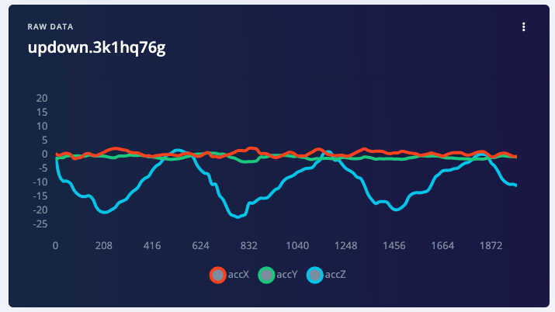
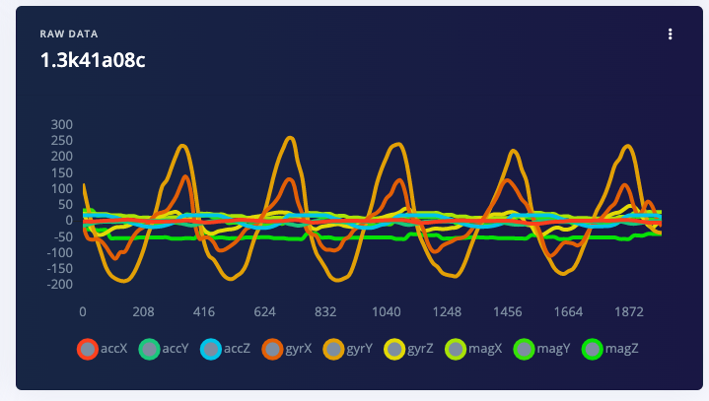
Data Collection
Collection Methods
Phone
Arduino Nano
Data
Phone-Accelerometer(XYZ)
Arduino- Accelerometer, Gyro, and Mag (XYZ)
108 samples collected
Data from phone
Data from Arduino
Notes:
Initially I had used the data from the Arduino to create a model and collected data on digits 0-9. After spending a significant amount of time training and tweaking the model however I was only able to achieve 70% accuracy in the training and that dropped quite drastically when it came to testing the model. I tried removing inputs since the Arduino was able to collect 9 but even with this adjustment, I was not able to improve the results of the model.
In order to simplify things in the hopes to achieve a better result I switched to collecting the data from my phone which gave me a few benefits.
The data collected through the phone was only accelerometer data
The data collected on the phone was more accurate as the accelerometer seemed to be much more sensitive than that of the one on the Arduino
There was still some difficulty with accuracy when it came to air writing digits so to further simplify things, I updated the data collection to up/down, left/right, idle, and unknown.
When I used the data from the phone I was able to achieve significantly better data in both training and testing.

Slide 3
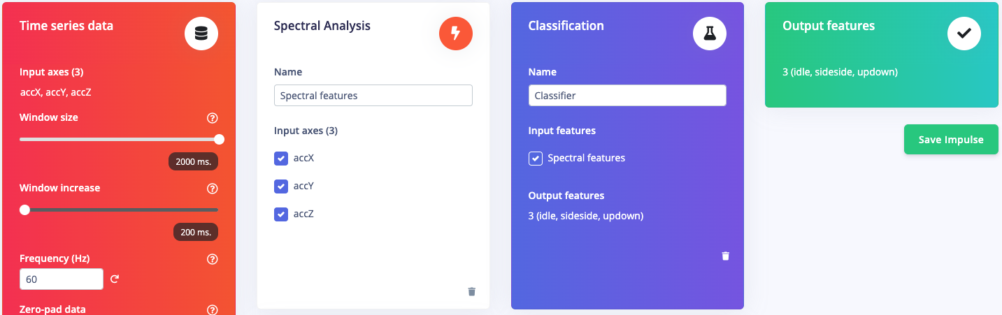
Impulse design
Notes:
Pretty simple creation of impulse design. Because I used the phone data for training there are only 3 spectral features and so 3 output features.

Slide 4
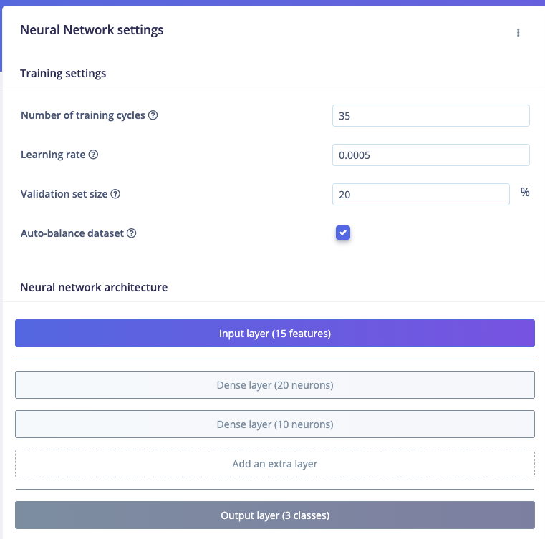
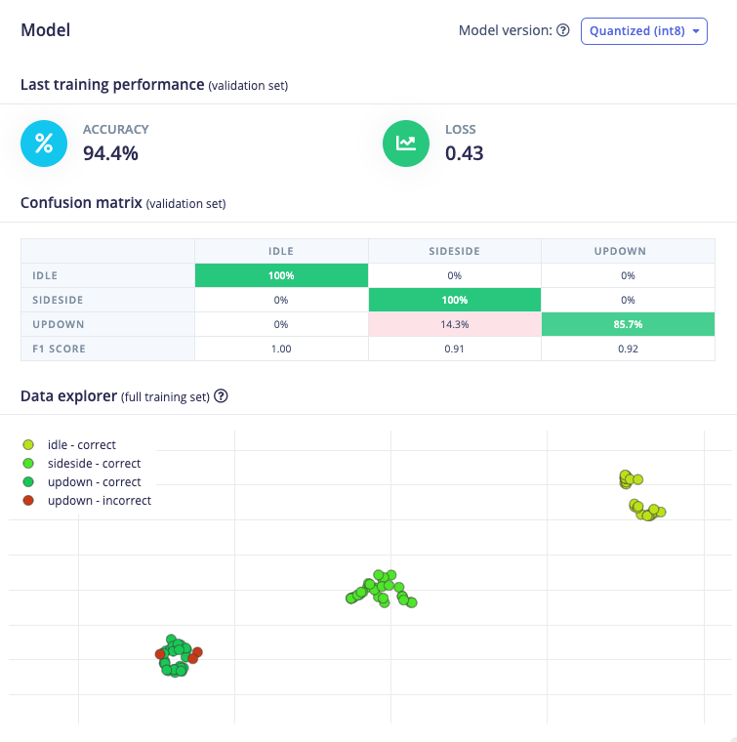
Training the Model
Notes:
With my original model, given that there was more features and more data overall, it required me to add a number of additional dense layers and increase the number of neurons within each one to get a model even close to 70%. As I simplified the model to have fewer inputs it needed to recognize and simplified the inputs, I was able to reduce the layers and neurons and still end up with drastically more accurate predictions.

Slide 5
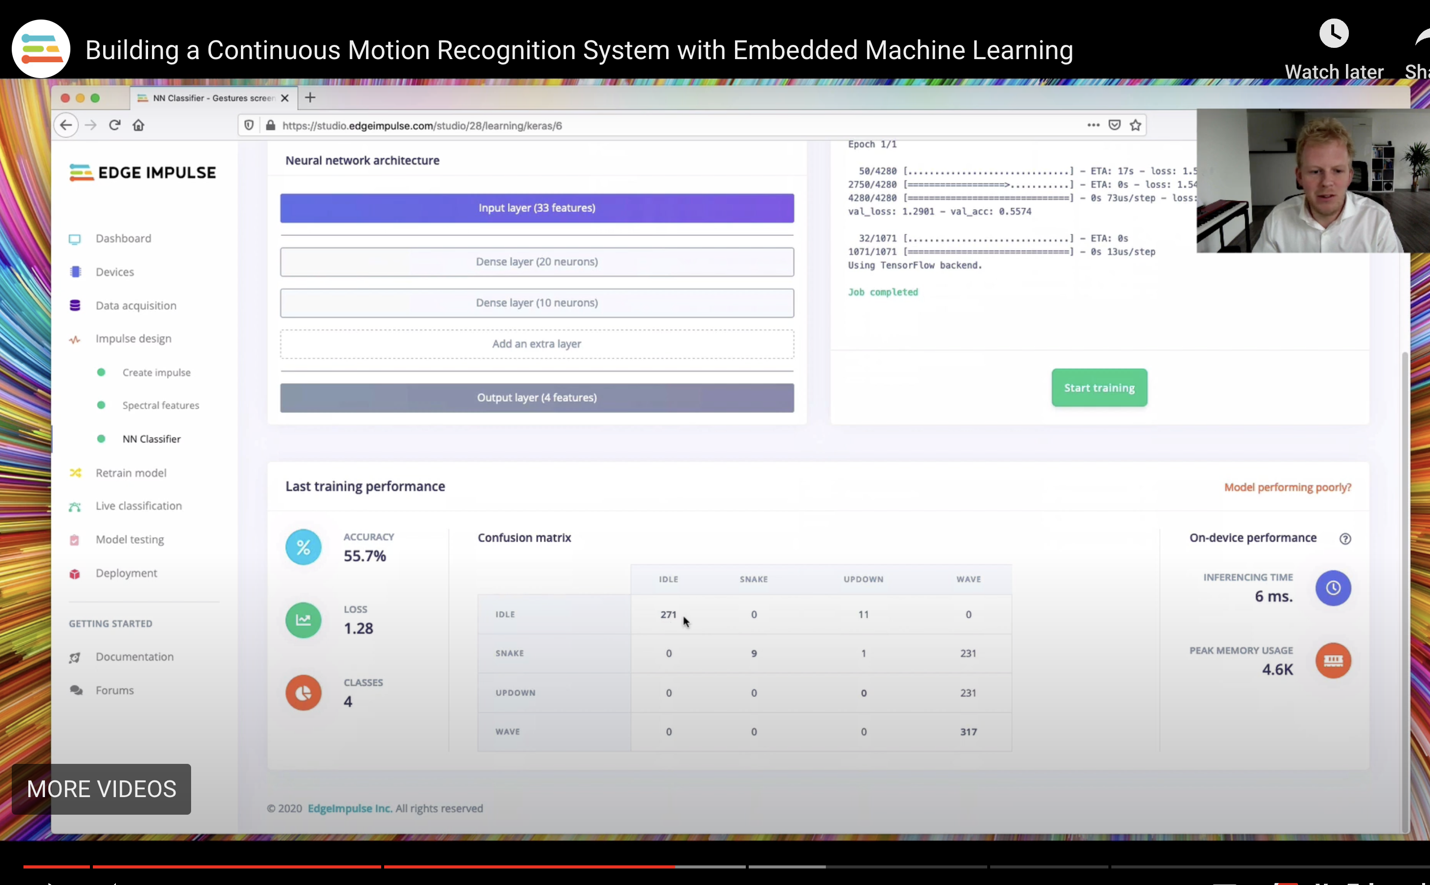
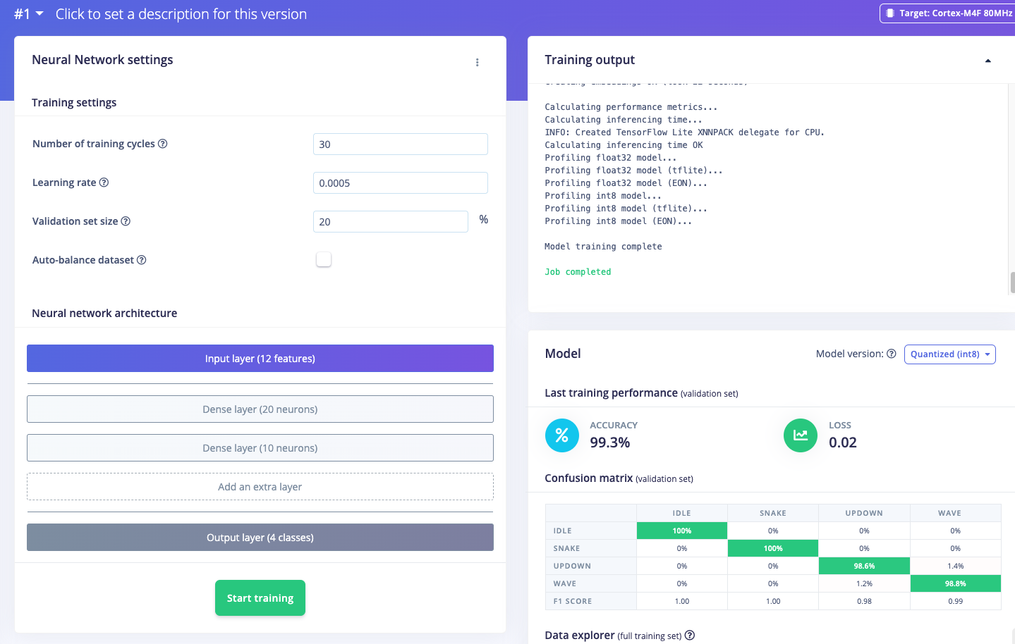
Comparing Model
Notes:
This is a comparison between the initial run of training for a similar program that EI had and mine is on the right. Our settings are more or less the same but you can see a huge difference in the accuracy which I think can be attributed somewhat to better models now and a better quality of data collected

Slide 6
Learnings
Start Simple
Adjust and Then Adjust Again
Use Quality Sensors to Collect Data

Slide 7
What I would change
Different Project Using Different Sensor
Trying a Tool Other Than EI for Model
Leave More Time for Debugging

