Slide 1
Developing A Blockchain-based System For Storing Data From The IoV-like Network Emulation Yile Feng

Slide 2
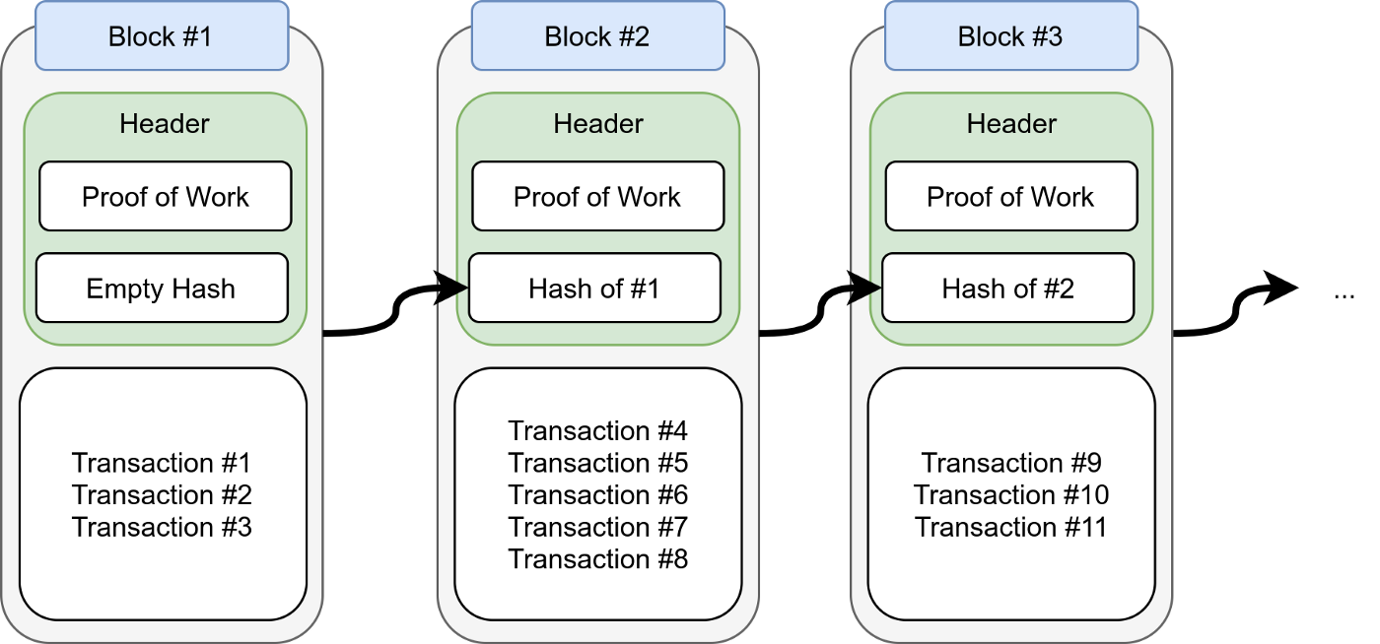
Introduction
Why using blockchain
Safe
Transparent
Difficult to tamper with

Slide 3
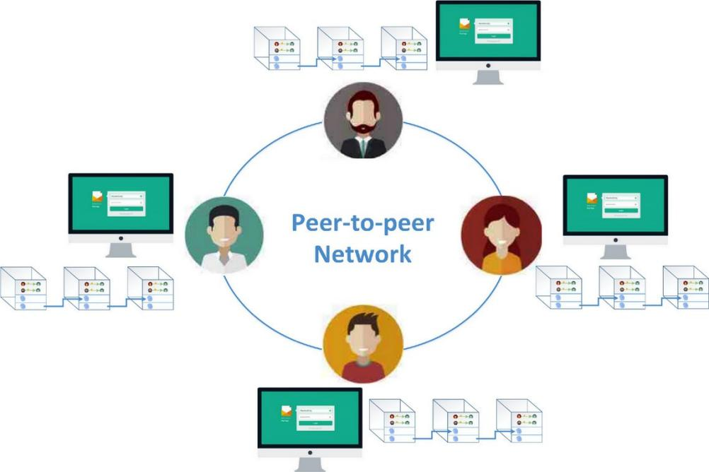
Introduction
Blockchain
Chain structure
P2P (peer to peer)
Consensus algorithms (PoW, PoS ... )

Slide 4
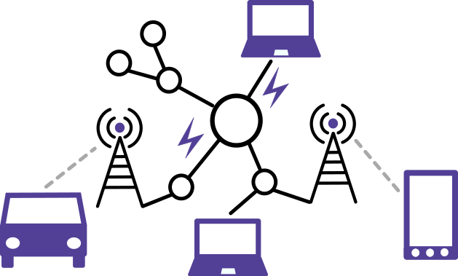
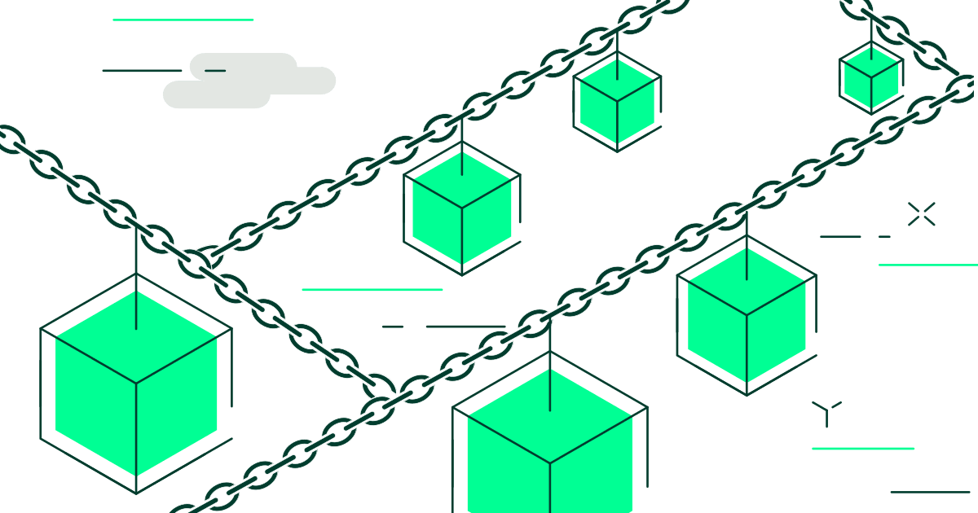
For the Program
transfer data to
Network Emulation
Blockchain System

Slide 5
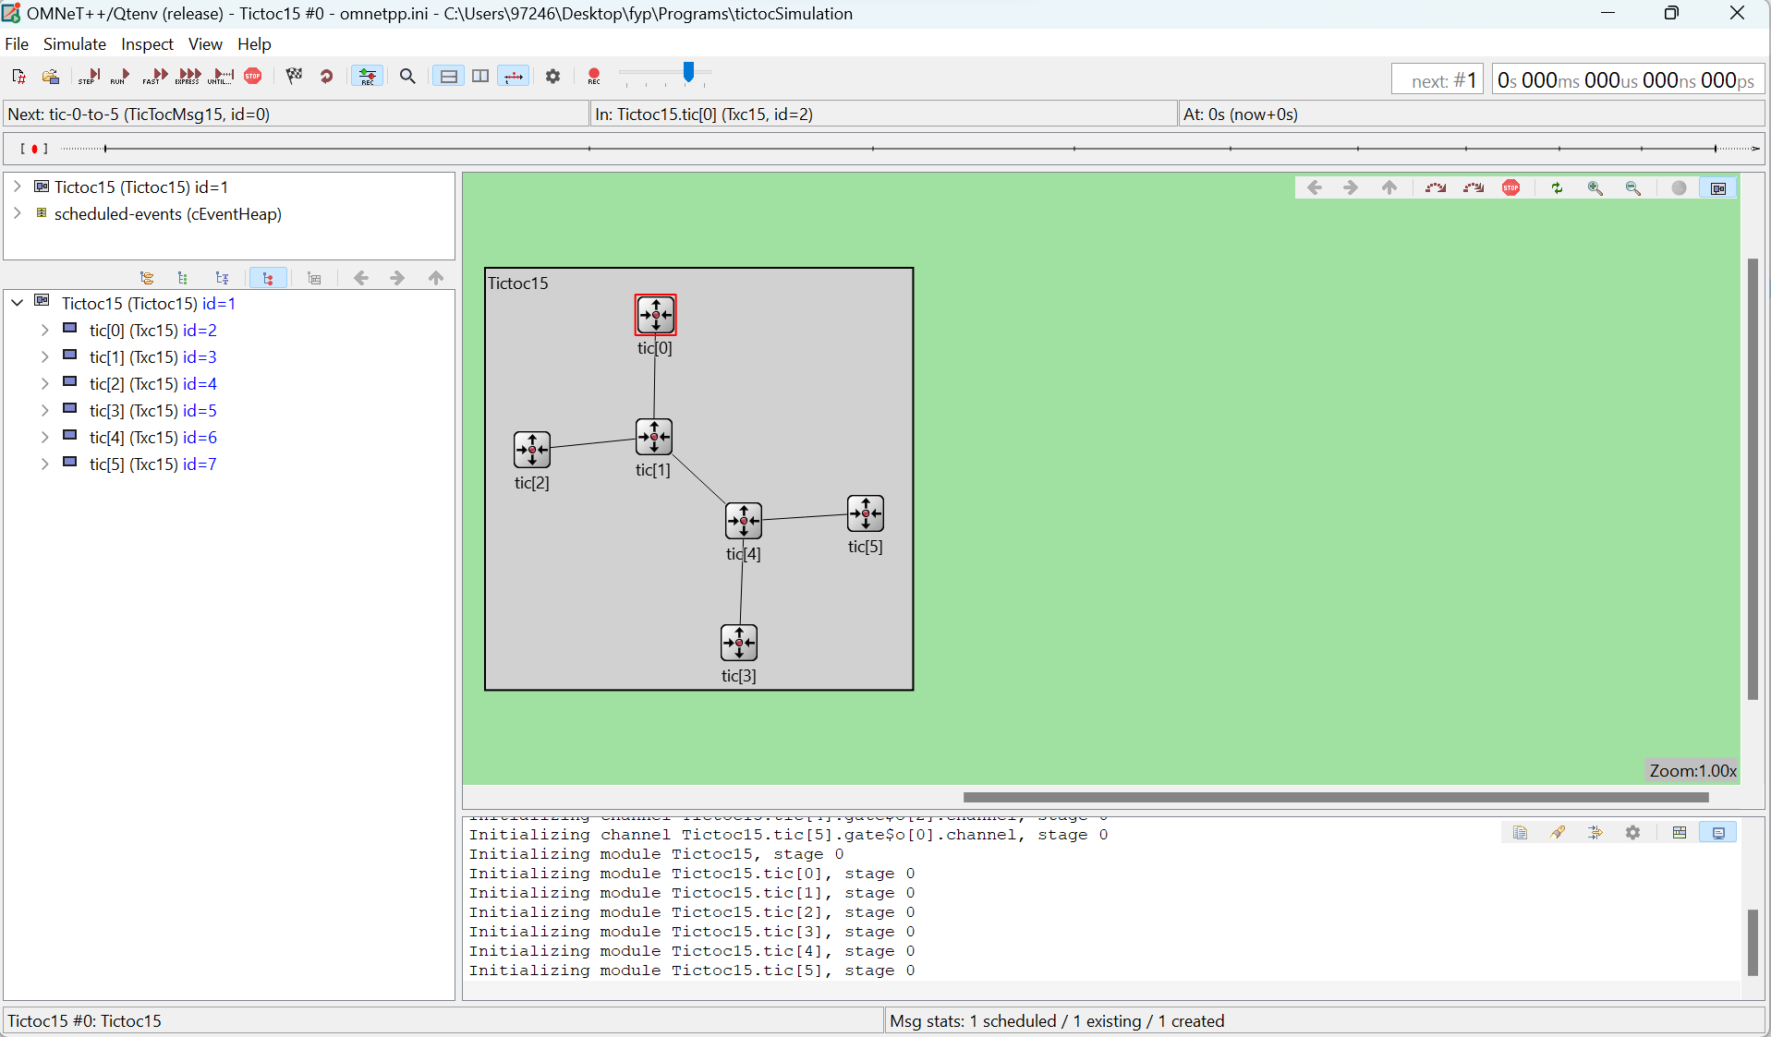
Network Emulation
Tree topology
Random forward / destination
Messages are passed between nodes

Slide 6
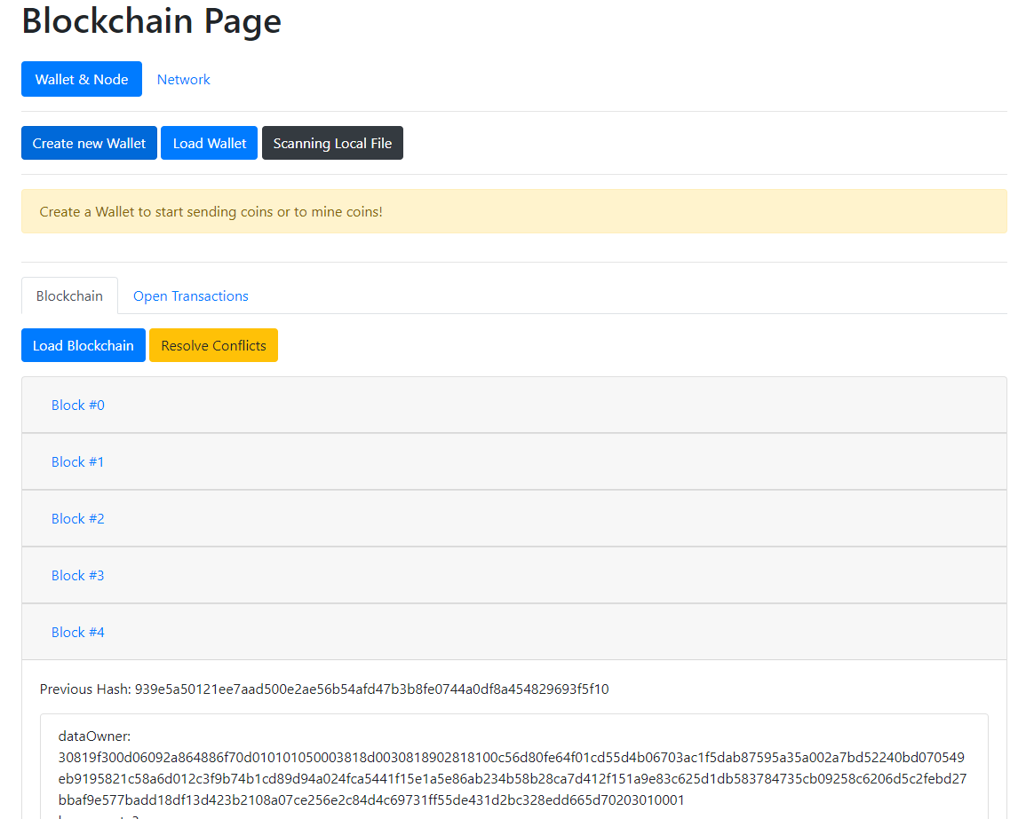
Blockchain System
Functionalities：
Create / Load wallet
Add transaction
Mine block (auto-broadcast)
Add peer nodes
Resolve conflict

Slide 7
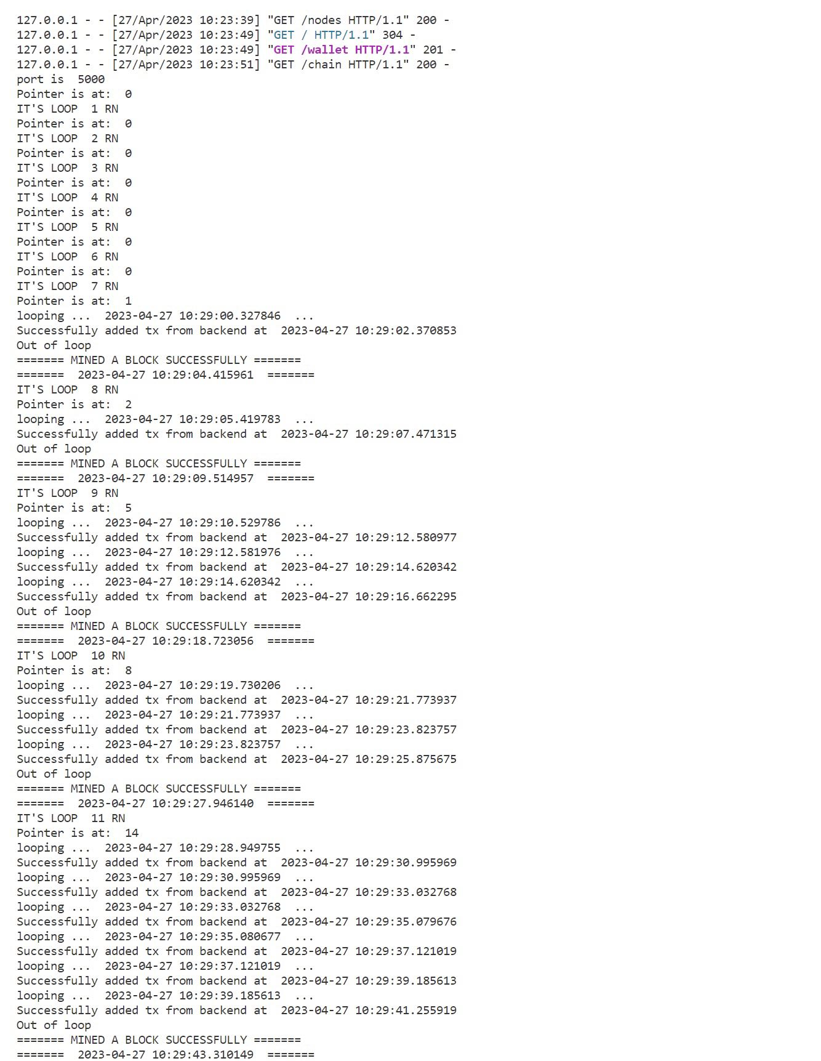
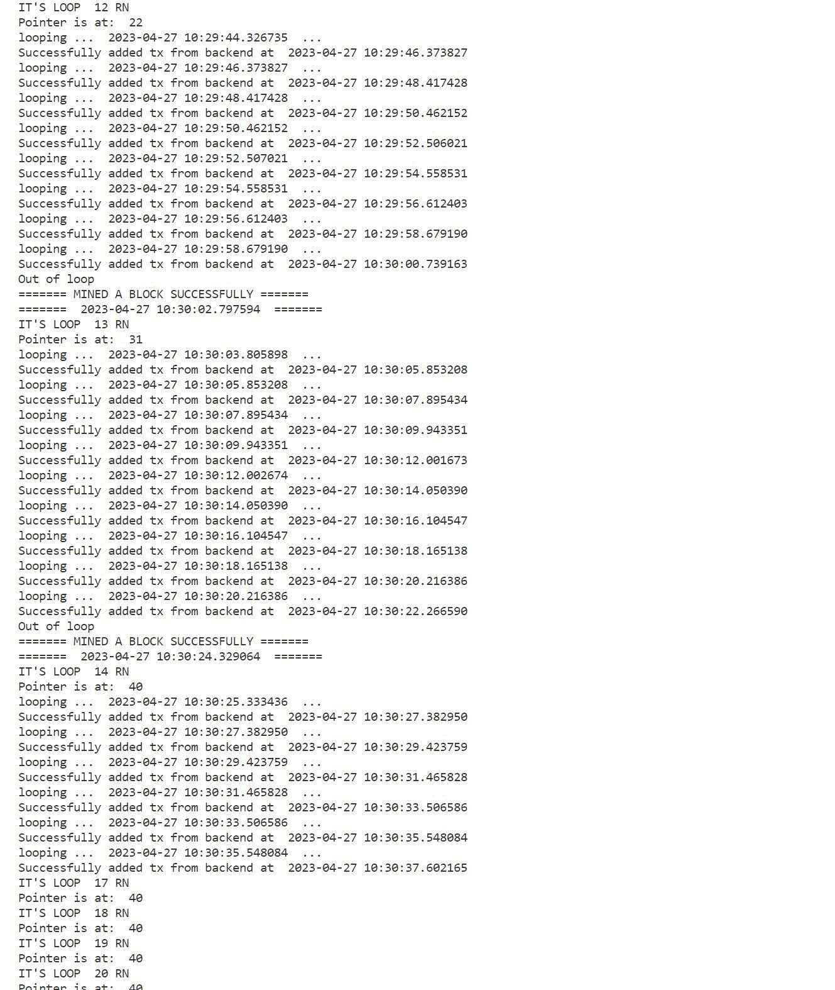
Results
About 800 byte for each transaction
2 secs for mining a new block
Transfer rate is about 3.2 kbps

Slide 8
Further Improvment
Network Emulation
make nodes move when sending messages
Import maps
Blockchain System
Validation function
Resovle conflicts
Consensus algorithm
Transmission rate

