Slide 1
Data4Good – Datathon Dec2014
Team “User Deduplication”
Alex, Marius, Tri, Victor

Slide 2
Goal
Detect Duplicates of Donors Identity
Assign a Global Unique UserID to each Donor
Problems
Same donor recorded as multiple different persons
  Typos (Patirck)
  Error in Postal Code
  Variation in Fitstname spelling (Robert, Rob)

Slide 3
Strategies
Name Clean Up
Pr. Paul A.M. Dirac -> Paul Dirac
Match donors by Name, Postal Code, Party
Paul Dirac,V5V2K5,Green
Try to repair typos & firstname variation by some Fuzzy (funky?) techniques
Try to measure the “damages” caused by false positives caused by fuzziness

Slide 4
Normalize Full Names
Pr. Albert H. Einstein -> Albert Einstein
Original Data
Stage 1
Dedup on KEY1
Full Name, Postal Code, Party
Albert Einstein,V5V2K5,Green
Stage 2
Dedup on KEY2
SoundEx, Postal Code, Party
A4163,V5V2K5,Green
Stage 3
Dedup on KEY3
FN Substitution, Postal Code, Party
Al,V5V2K5,Green
UserID Dedup'ed
With False-Positives !

Slide 5
KEY1 : Full Name, Postal Code, Party
Strength
Very deterministic
Weakness
Sensitive to typos
What to do with middle name?
John A. Bell vs John T. Bell?

Slide 6
KEY2 : SoundEx, Postal Code, Party
Similar sounding algo, US Census, 1911
Remove non-alpha,Keep 1st letter
Substitute similar pronounciation
GH → G, GH → H, KN → N, PH → F, PS → S
Score letters
1 = BFPV 3 = DT 5 = MN
2 = CGJKQSXZ 4 = L 6 = R
Remove vowels, compress duplicated letters, pad with trailing zeroes:
Alexander=A4253, Marius=M6200, Tristan=T6235, Victor=V2360

Slide 7
KEY2 : SoundEx, Postal Code, Party
Strength
Resistant to typos
Philips = Phulpos = F4120
Victor = Viktor = Viuctior = V2360
Weakness
False positive (same Soundex for two totally different words)

Slide 8
KEY3 : FirstName Substitution, PC, Party
“Home made” Similar Firstname Dictionary
Reference Variations
Alexander Alexandre, Alex
Alan Allan,Allen
Daniel Dan
Mary Marie,Maria
Michael Mike,Mikael,Michel
Etc Etc1, Etc2, Etc3, Etc4

Slide 9
KEY3 : FirstName Substitution, PC, Party
Strength
Succeed where Soundex fails
Alexander = A4253 Alex = F4200
Robert = R1630 Rob = R1000
Weakness
Sensitive to typos
False positive (too much substitution)
Pat = Patrick, Patricia

Slide 10
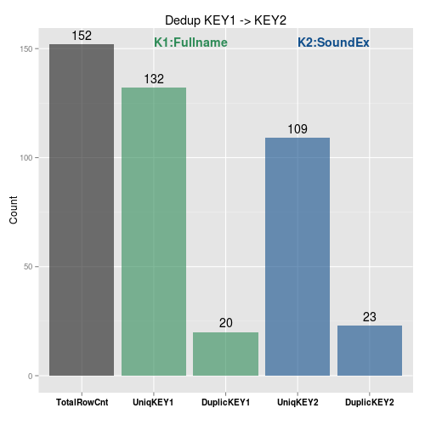
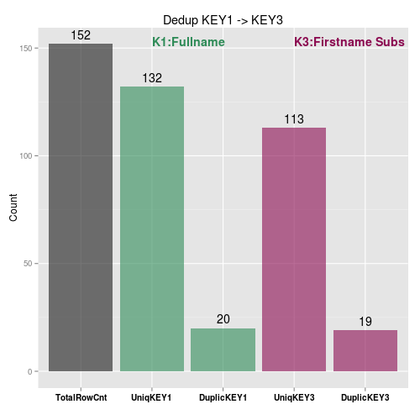
Two Stages Dedup

Slide 11
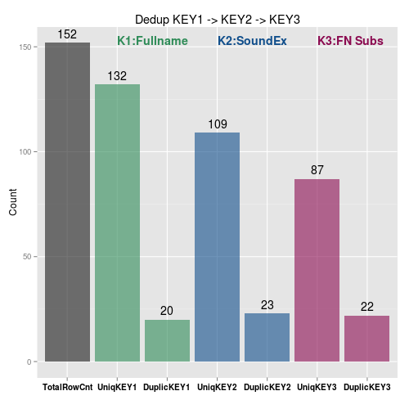
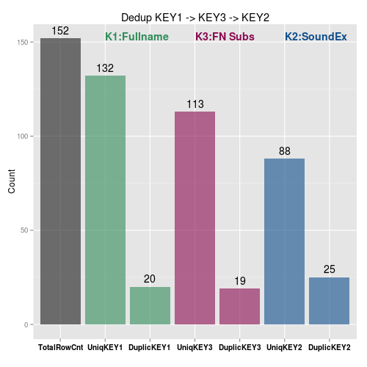
3 Stages Dedup

Slide 12
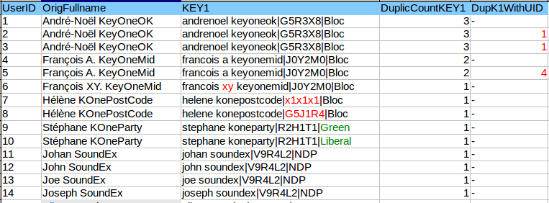
K1 Verif (Good)

Slide 13
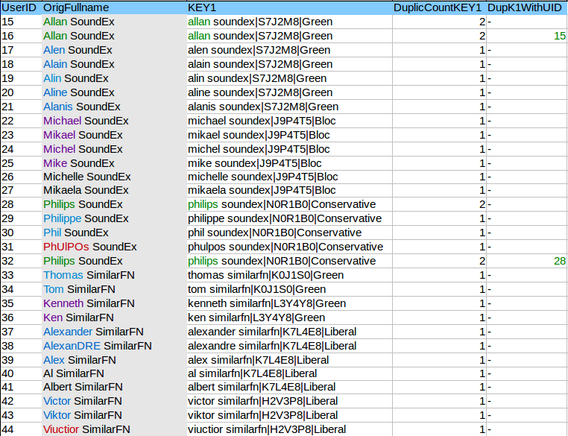
K1 Verif (Bad)

Slide 14
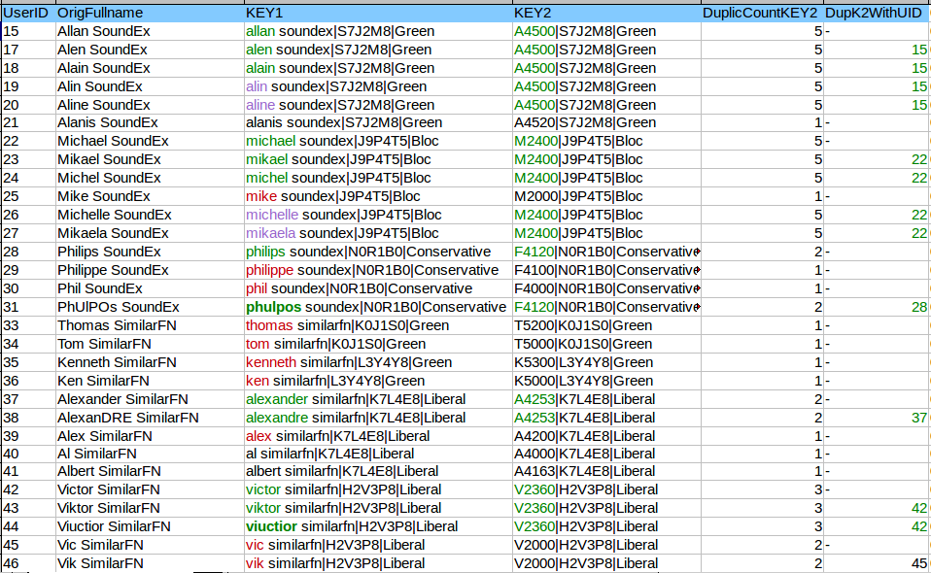
K2 Soundex Verif

Slide 15
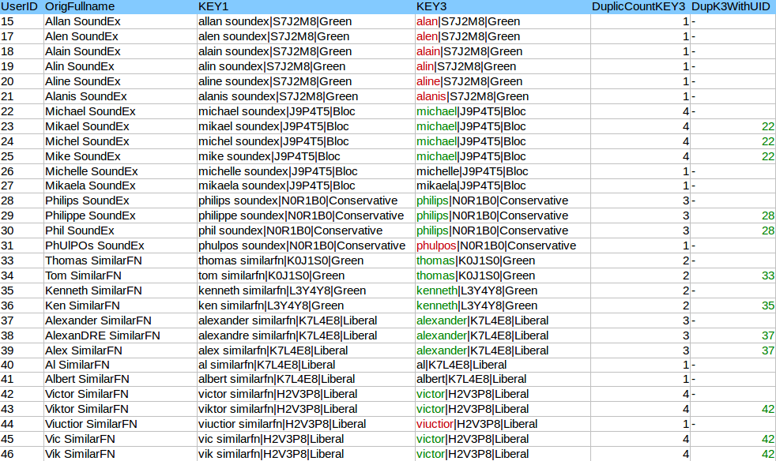
K3 Firstname Subs

