Slide 1

Trajectory Prediction
Xiaoying Xing
Yimin Han
Notes:
Hello. I am XXX. This is my partnerXXX. OUr topic is

Slide 2
Introduction

Slide 3
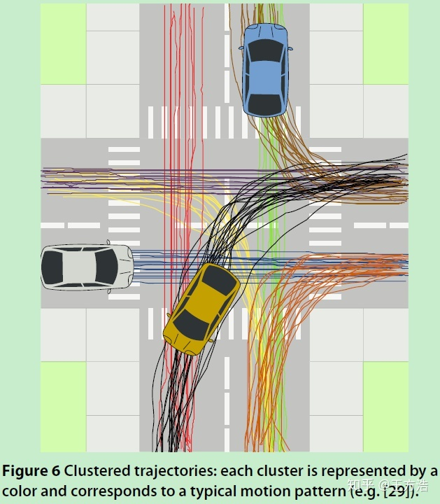
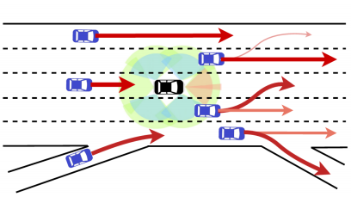
Background
Predicting accurate future trajectories of multiple vehicles is essential for autonomous systems but is challenging due to the complex interaction between vehicles and the uncertainty in each vehicle’s future behavior.
Notes:
Let me introduce the bg of our project. Trajectory prediction or planing is very important in autonomous driving. Intuitively speaking, the work is to infer the future trajectory based on the hist info.

Slide 4
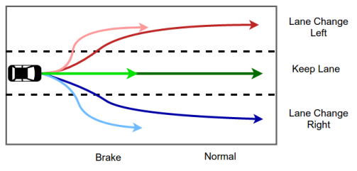
Learn Driving Pattern
Since road situations are changing frequently, it is unreliable to predict only a single trajectory. We want to know how they drive.
Multimodal Pattern
Direction changing & Velocity changing
Notes:
However, in reality, road situations are changing and complex. So it is unreliable to predict only a single trajectory. It is important to learn drivers driving pattern. We want to know how they drive. Moreover, this is a multimodal pattern. Longitudinal and lateral direction are orthogonal. For example: a driver intending to overtake another vehicle may do so by switching to the immediate left or the immediate right lane, while at the same time it can reduce the velocity to wait until another car pass or accelerate to surpass.

Slide 5
Related Work

Slide 6

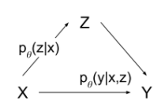



Hidden Markov Model^{[1]}:
$$x_{h}^{i},y_{h}^{i}:$$
x and y locations of vehicle i over the last time h
$$v_{xh}^{i},v_{yh}^{i}:$$
velocity of vehicle i over the last time h
m is the predefined maneuver class
CVAE^{[2]}:
z is the latent variable
[1] Nachiket Deo, Akshay Rangesh, Mohan M. Trivedi. How would surround vehicles move? A Unified Framework for Maneuver Classification and Motion Prediction.
Notes:
HMM: This is the output likelihood of HMM model. Mi is the predifined manuver class k. And theta is the parameters of the HMMs: the state transition probabilities and so on. They are estimated using the Baum-Welch algorithm(EM algorithm). This work inspire us that we can classify vehicles motion into semantically interpretable maneuver classes. For different kinds manuver classes output different likelihood.
CVAE: Conditional Variational Auto-encoder.{x,y} is observed dataset. Z is a latent variable. What we want to learn is the pdf p(y | x). CVAE help us separate the process into 2 steps. So we need to model the pψ(y|x, z) and pθ(z|x). Output of encoder is the pdf of x&z. Use it as decoder’s input together with X. then we can get pdf of x ,y, z. And then fit them to maximize the likelihood of dataset{X,Y}. Got!

Slide 7
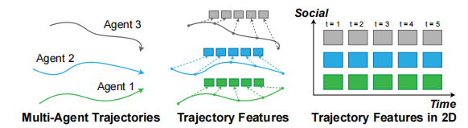
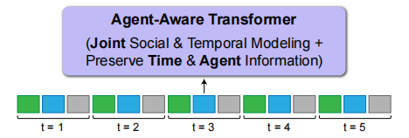
Deep Learning Network
Transformer^{[3]}:
[3]Ye Yuan, Xinshuo Weng, Yanglan Ou, Kris Kitani. AgentFormer: Agent-Aware Transformers for Socio-Temporal Multi-Agent Forecasting
Notes:
This model inspire us on how to solve the interaction between different vehicles. Transformer is a typical seq2seq model. As we can see in the picture, there is a time sequence. t=1~t=5. The different color diagram represent data of different vehicles at the same time. Concat the history trajectory of different vehicles as the input and use their future trajectory as the ground truth

Slide 8
Our approach and design

Slide 9


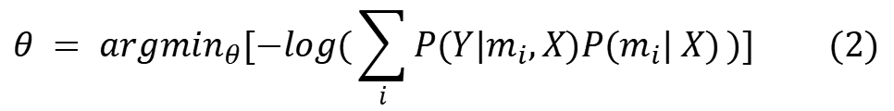

Our Task
Given Dataset
Model a bivariate Gaussian distribution:
$θ$ = ($σ_{x}, σ_{y}, μ_{x}, μ_{y}, ρ$)
Maximum Likelihood:
$$θ = {argmax}_{θ}P(Y|X) (1)$$
$$θ = {argmin}_{θ}[−log(P(Y|X))] (2)$$
$$θ = {argmin}_{θ}[−log(\sum_{i}{P(Y|m_{i},X)P(m_{i}| X)})] (2)$$
Notes:
Given dataset X and Y, which are the history trajectory and future trajectory. X is the input data, and Y is the groundtruth. Because we want to learn the driving pattern. We want to find out the future position distribution. Since x and y are orthogonal. So we model a bivariate Gaussian distribution. theta is the parameters of the Gaussian. It represent the point in the parameter space. It has five dimensions. We want to find out the theta.
Therefore, the learning process can be summarized as formula1. Maximum likelihood. Choose the theta that can maximize the joint distribution of P(Y|X).
Apply negative log to formula (1), we got formula (2)
Based on the structure of multi-lane freeways, 6 maneuver class are adopted to help the prediction process. The preocess is: First, estimate m based on X, and then, based on mi and X, estimate Y. Then sum up the probability, we got the likelihood.
Next step is to how to model p(Ymx) and P(mx)

Slide 10








Our Model
Softmax_{lat}
Network Structure:
P($m_{i} | X$)
Softmax_{lon}
P($Y | m_{i}; X$)
$$θ_{t+1}$$
$$θ_{t+2}$$
$$θ_{t+T}$$
Encoder LSTM
Decoder LSTM
Trajectory Encoding
LSTM
LSTM
...
LSTM
LSTM
LSTM
...
LSTM
EMB
EMB
EMB
Maneuver Encoding
$$x_{t−}$$
$$x_{t−T+1}$$
$$x_{t}$$
concat
Notes:
Describe the network workflow.
We choose the NN.
There are other works also using LSTM. But they separately compute the pmx and pymx. But we think the pmx and pymx should share the same input info. So we merge them together.
We got Encoder and decoder. Manuveur M can act as the latent variables.
Input is the x sequence composed of ego cars and its surroundings. Emb is fully connected layers with relu. Output of the encoder, pass softmax, 2 softmax ouput: lateral means changing right, left or keep the lane. Lon means keep velocity or brake. Their product is the P(mi,x). Based on the output manuveur, we concat the onehot encoding of m with encoder’s output and pass it to decoder LSTM.

Slide 11
Experiment

Slide 12
Dataset
NGSIM US-101 and I-80
trajectories of real freeway traffic
Split into segments of 8 s
use 3s as track history and 5 s prediction horizon
Sample rate: 10Hz
Metrics
Root of the mean squared error (RMSE) of the predicted trajectories
Negative log-likelihood (NLL) of the predictive distributions

Slide 13
Baseline Models
M-LSTM[1]: Multi-Modal Trajectory Prediction of Surrounding Vehicles with Maneuver based LSTMs
CS-LSTM[2]: Convolutional social pooling for vehicle trajectory prediction
[1] Deo, Nachiket, and Mohan M. Trivedi. "Multi-modal trajectory prediction of surrounding vehicles with maneuver based lstms." 2018 IEEE Intelligent Vehicles Symposium (IV). IEEE, 2018.
[2] Deo, Nachiket, and Mohan M. Trivedi. "Convolutional social pooling for vehicle trajectory prediction." Proceedings of the IEEE Conference on Computer Vision and Pattern Recognition Workshops. 2018.

Slide 14
Results
NLL√
RMSE√
Metric | Prediction Horizon (s) | M-LSTM | CS-LSTM | Our model
 | 1 | 0.61 | 0.62 | 0.59
 | 2 | 1.34 | 1.29 | 1.36
RMSE | 3 | 2.28 | 2.13 | 2.26
 | 4 | 3.21 | 3.20 | 3.16
 | 5 | 4.62 | 4.52 | 4.62
 | 1 | 0.49 | 0.58 | 0.45
 | 2 | 1.93 | 2.14 | 1.93
NLL | 3 | 3.02 | 3.03 | 3.15
 | 4 | 3.65 | 3.68 | 3.64
 | 5 | 4.18 | 4.22 | 4.18

Slide 15
In-Depth Studies
Training time
Combining two branches: reduce training time by 82.8%
Pretraining with RMSE loss: reduce training time by 9%
Maneuver Prediction Accuracy
lateral: 0.97
longitude: 0.89

Slide 16
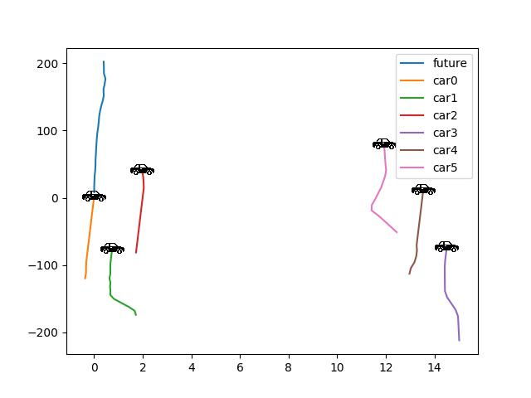
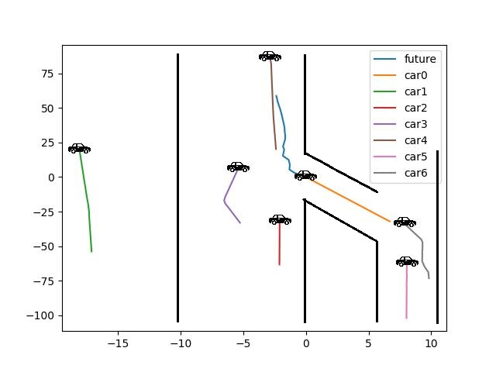

Slide 17
Thanks

