Slide 1
Young HSC
Old HSC
Aging
+++
Self-renewal
Differentiation
Self-renewal
Altered Differentiation

Slide 2
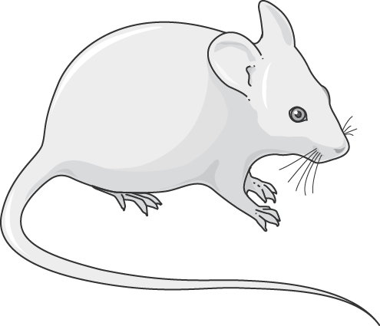
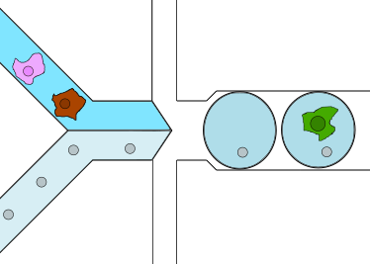
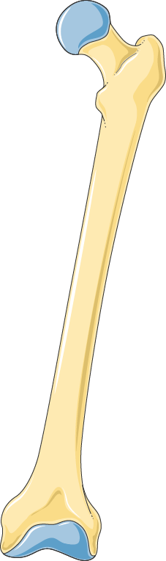

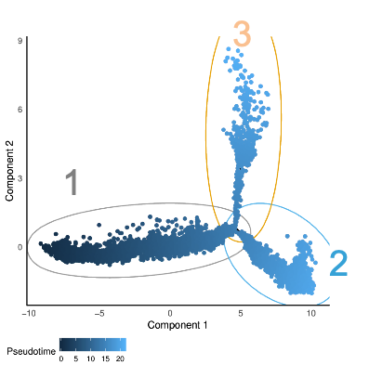
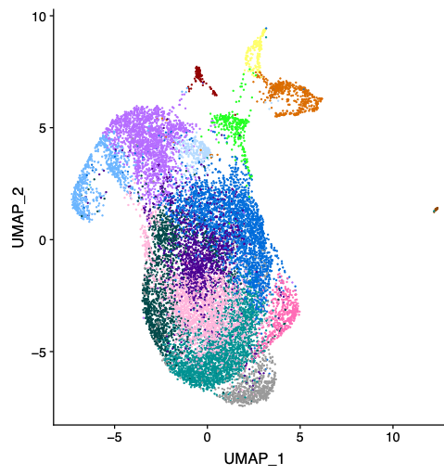
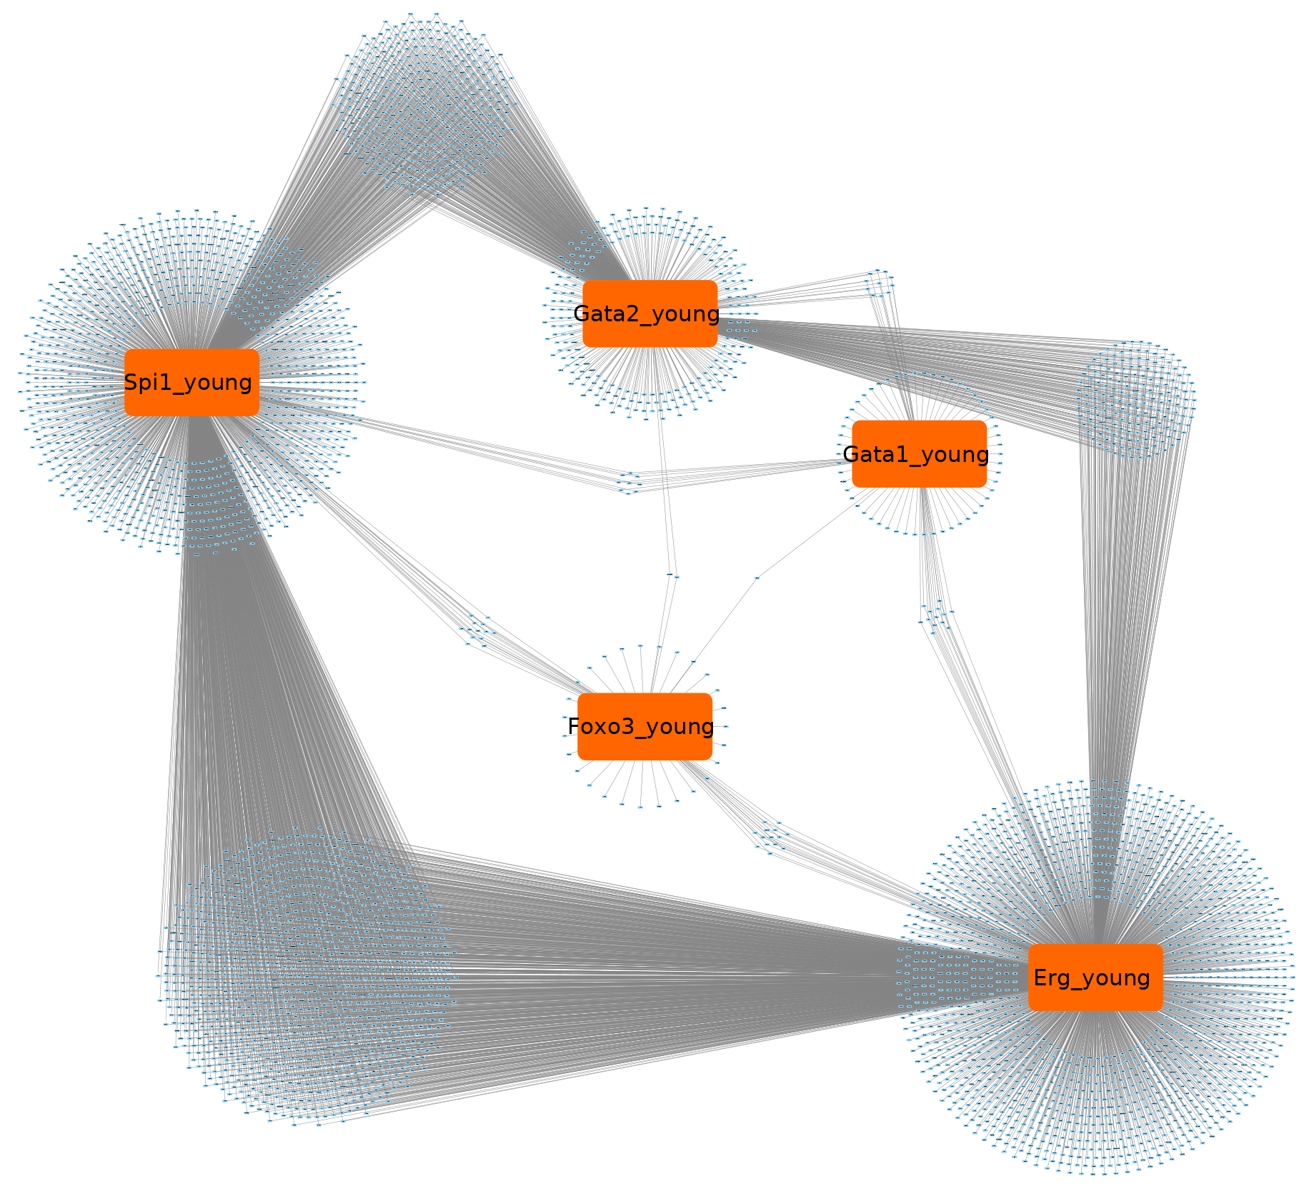
Isolation of total bone marrow cells
HSPC Sorting
LSK, FLT3-
Oil
Single cell capture
Cells
Young mice
Beads
Oil
Barcoding, library construction
NGS (3’-ending mRNA)
Old mice
Sample integration, cell clustering
Pseudotime ordering
Regulon analysis

Slide 3
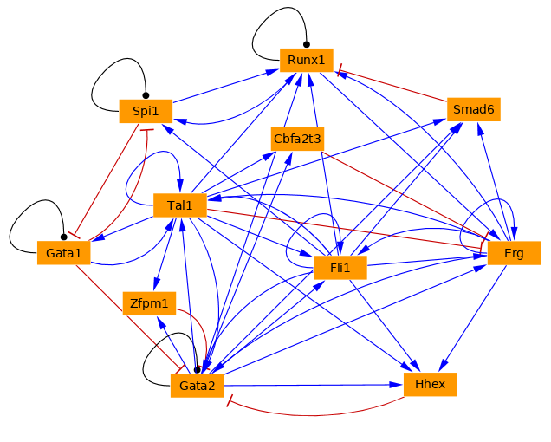
Data state space
Model state space
 | C1 | C2 | Ck | Cn
TF1 | 0 | 1.5 | 0.7 | 3.8
TF2 | 2.3 | 0.9 | 0.4 | 1.1
TFk | 3.2 | 0.1 | 0 | 0
TFn | 0 | 1.6 | 5.1 | 0
 | S1 | S2 | Sk | Sn
TF1 | 0 | 1 | 0 | 1
TF2 | 1 | 1 | 0 | 0
TFk | 1 | 0 | 0 | 0
TFn | 0 | 1 | 1 | 0
Single cell data:
Young/old
Boolean model specification and parameterization
Simulations,
Validation analyzes (aging)
Litterature,
ChIP-seq data
TF1 = !TF2
TF2 = TF1
…
0 0
0 1
TF1
TF2
1 0
1 1
Bonzani et al 2013

Slide 4





Slide 5




