Slide 1

Cryptocurrency Stock Analytics
Date: February 21, 2021
Presenter: Leonard Fernando

Slide 2
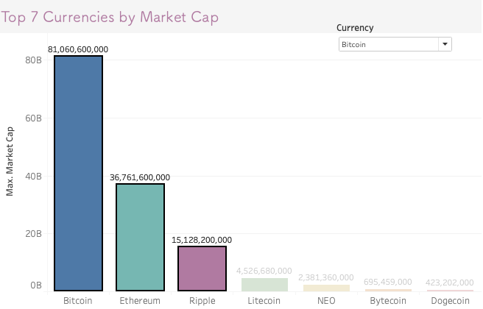



Bitcoin has the highest market cap increasing 290% between 2016 & 2017. However, forecasting shows us a downward trend for Bitcoin closing price in the next month.
How much will Bitcoin, Ethereum, and Ripple’s market value be worth in the last quarter of 2017 using forecasting and SMA?
(currency).csv
Data Cleansing
EDA
Key Insights
The top 3 performing cryptocurrencies are Bitcoin, Ethereum, and Ripple
Insights & Recommendations
Notes:
Combine executive and technical slides

Slide 3
Exploratory Data Analysis
Simple Moving Average(SMA)
Weighted Moving Average(WMA)
Exponential Moving Average(EMA)
What? The simple moving average calculates the average of a selected range of values
Why? SMA is used to forecast future price trends
Where? SMA is used in most of my analysis through Jupyter and Tableau
What? The weighted moving average works like SMA except it gives greater weight to more recent data and less weight for past data
Why? WMA is used to forecast price trends and to verify SMA & EMA
Where? WMA is only used in my Jupyter notebook
What? EMA is like WMA except the weighting decreases exponentially with each previous price point
Why? EMA is used to forecast price trends and to verify SMA & EMA
Where? EMA is only used in my Jupyter notebook
Source: Southern Water Corp Financial Records (SAP) 2013-2015
Source: Open Water Market Data (2013 – 2015)

Slide 4
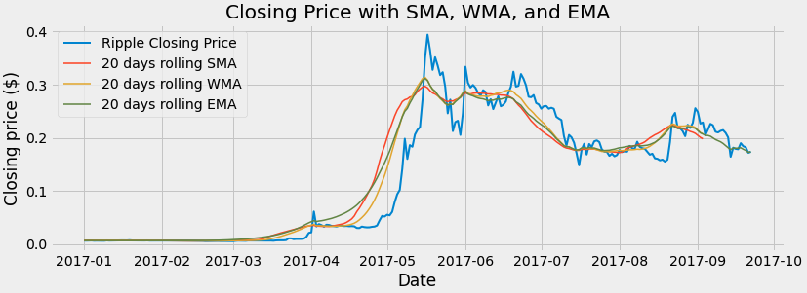
Exploratory Data Analysis
Forecasting
In Python, there are methods for all 3 forms of moving averages unlike Tableau. For this analysis, I will demonstrate how this tool works with SMA and Tableau. However, the purpose of using 3 moving averages is to create a more accurate forecast
Source: Southern Water Corp Financial Records (SAP) 2013-2015
Source: Open Water Market Data (2013 – 2015)

Slide 5
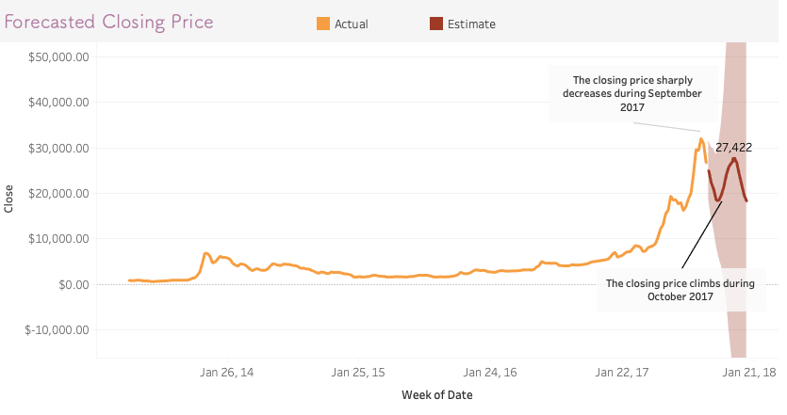
Out of the 7 cryptocurrencies analyzed, Bitcoin has the highest market cap increasing 290% between 2016 & 2017. However, forecasting shows us a downward trend for Bitcoin closing price in the next month.
Key Insights
The closing price for Bitcoin decreases by ~30% in the next month which will cause a loss in investment
After the downward trend, Bitcoin closing price increases by ~30% in the following month which will stabilize investments
Source: Southern Water Corp Financial Records (SAP) 2013-2015
Source: Open Water Market Data (2013 – 2015)

Slide 6
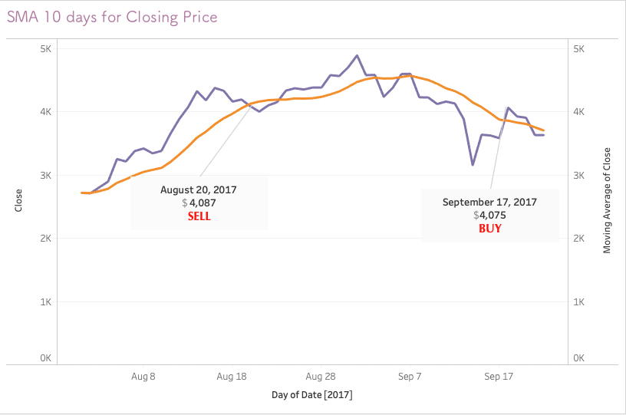
Comparing forecasted and actual closing price gives us an idea where to buy and sell cryptocurrency stock.
Key Insights
There is a selling signal once actual price dips below the forecasted price.
There is a buy signal once the actual price hovers above the forecasted price.
¹ EBIT is calculated as Revenues – COGS – Operational Expenses
Source: Financial and operational data from Exemplar
Notes:
Leverage EBIT slide, then flow into Revenue, COGS and Operational Expenses

Slide 7
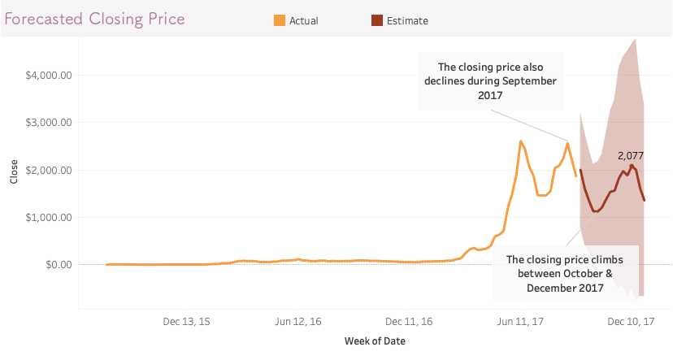
Ethereum has the second highest market cap. However, forecasting shows us a trend like Bitcoin’s during the same time period.
Key Insights
The closing price for Ethereum decreases by ~56% in the next month
After the downward trend, Ethereum’s closing price increases by 46%
Source: Southern Water Corp Financial Records (SAP) 2013-2015

Slide 8
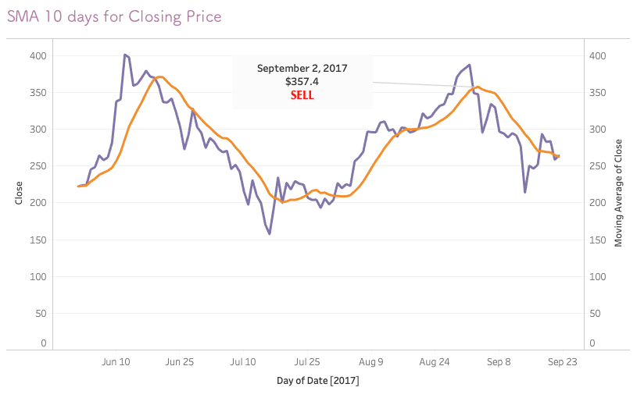
Like Bitcoin, Ethereum experiences a significant dip in its closing price beginning in September 2017.
Key Insights
There is selling signal once the actual closing price of Ethereum dips below the forecasted closing price on 9/2.
¹ EBIT is calculated as Revenues – COGS – Operational Expenses
Source: Financial and operational data from Exemplar
Notes:
Leverage EBIT slide, then flow into Revenue, COGS and Operational Expenses

Slide 9
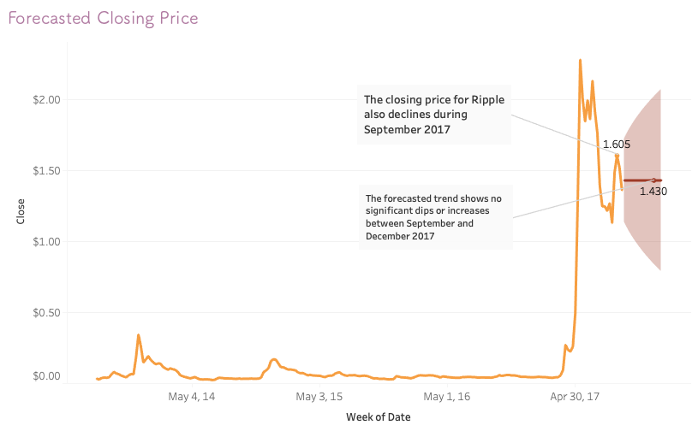
Ripple has the third highest market cap. Forecasting shows us a stagnant trend where there is no increase or decrease in closing price.
Key Insights
The closing price for Ripple decreases by ~11% after August 2017
There is no forecasted upward or downward trend
Source: Southern Water Corp Financial Records (SAP) 2013-2015

Slide 10
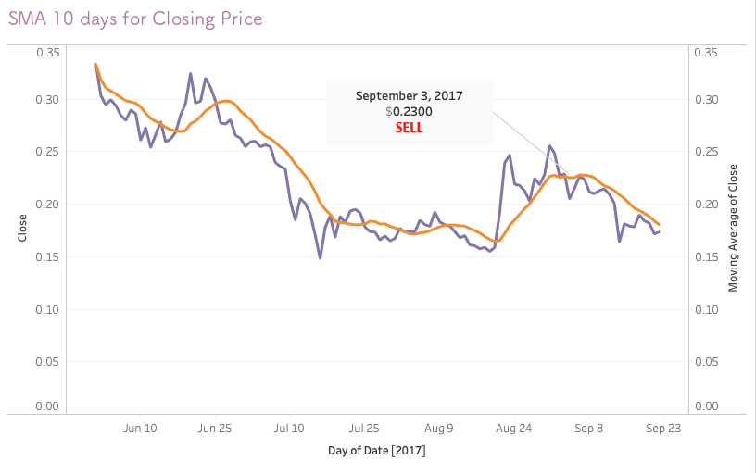
Like Ethereum, Ripple experiences a significant dip in its closing price beginning in September 2017.
Key Insights
There is selling signal once the actual closing price of Ripple dips below the forecasted closing price on 9/3.
¹ EBIT is calculated as Revenues – COGS – Operational Expenses
Source: Financial and operational data from Exemplar
Notes:
Leverage EBIT slide, then flow into Revenue, COGS and Operational Expenses

Slide 11
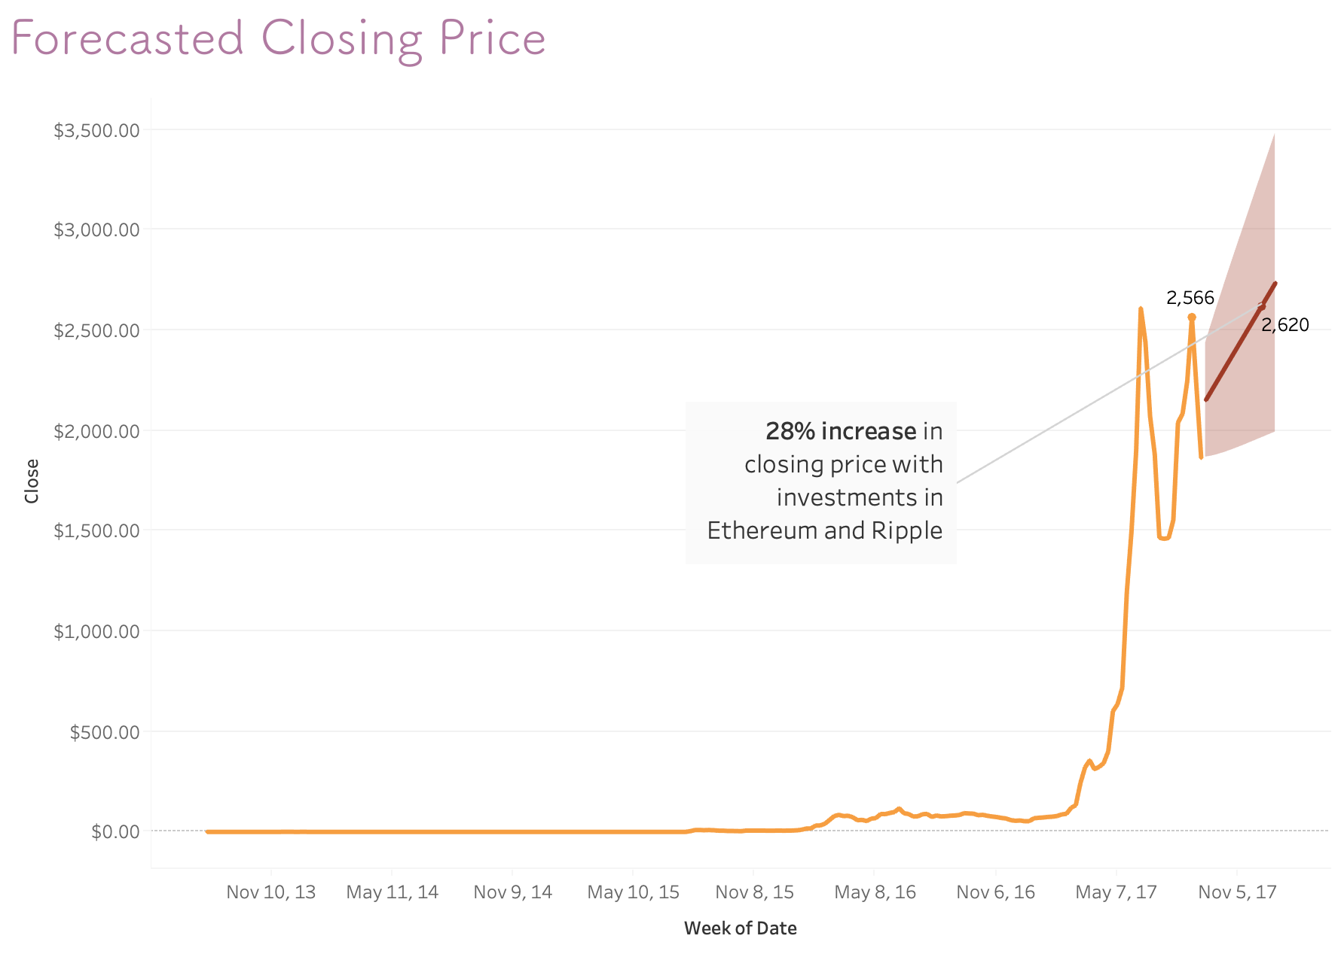
Insights & Recommendations
Insights
Ethereum and Litecoin’s ongoing trend is expected to bring 56% loss from September to January
Ripples forecasted trend will be more linear compared to the previous 2 currencies. There is a 10% loss from September to January
Recommendations
Diversify cryptocurrency investments into Ripple, Litecoin, NEO, and other high performing cryptocurrencies not included in the top 3
Sell cryptocurrency stocks for Ethereum and Litecoin before the dip occurs

