Slide 1
Integration of Imaging Features and Clinical Features for Early Detection of Lung Cancer
Leonard Garcia
Notes:
\

Slide 2
Agenda
Background & Motivation
Project Objectives
Data & Methods
Summary of Results
Conclusions & Future Work

Slide 3
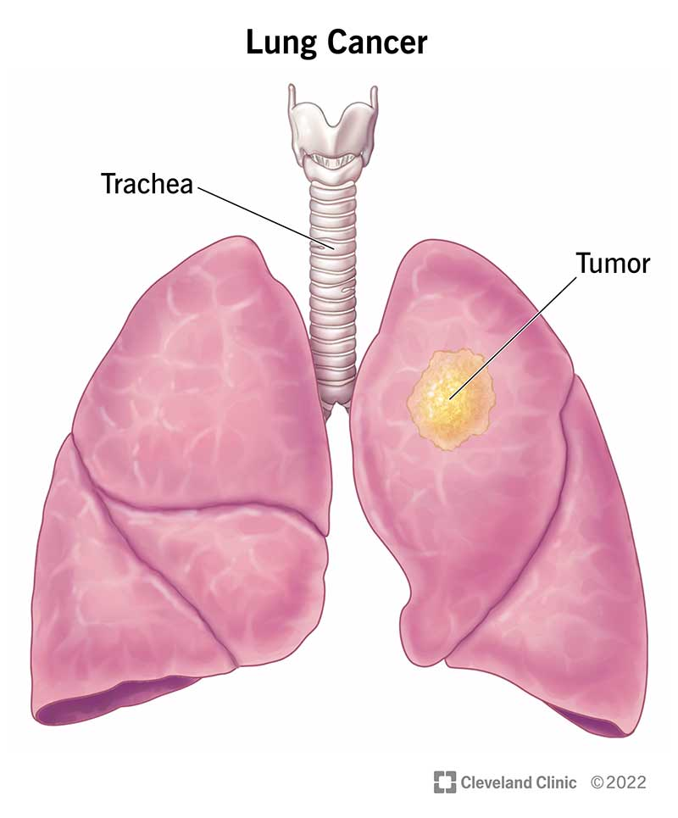
Background
Lung cancer is a condition where cells in the lung grow uncontrollably and form a tumor
Leading cause of cancer death in the United States
22% of all cancer deaths
Early detection important for treatment outcomes
5-year survival rate for early detection about 70%
5-year survival rate when advanced less than 10%
Taken from:
https://my.clevelandclinic.org/health

Slide 4
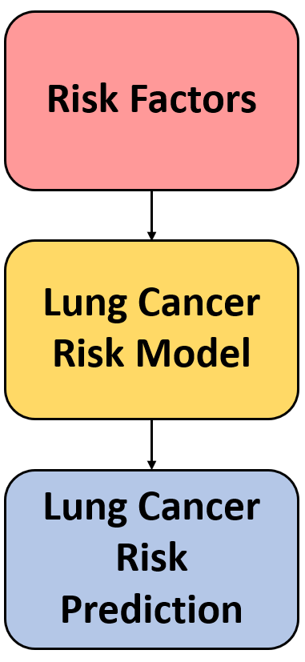
Lung Cancer Risk Prediction Models
Tools to estimate likelihood of developing lung cancer
Clinical risk models
Use personal data (age, smoking history, etc.) to estimate risk
Imaging models
Look directly at lung scans to detect early signs of cancer
A simple lung cancer risk model framework

Slide 5
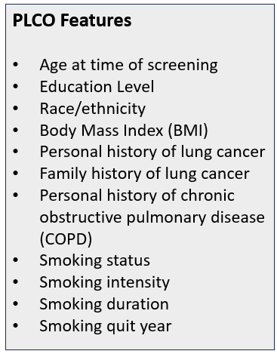
PLCOm2012 Model
Clinical model
Developed by Dr. Martin C. Tammemägi of Brock University [1]
Used data from Prostate, Lung, Colorectal, and Ovarian (PLCO) Cancer Screening Trial
Uses personal and health-related factors to estimate 6-year lung cancer risk
Factors used to calculate lung cancer risk

Slide 6
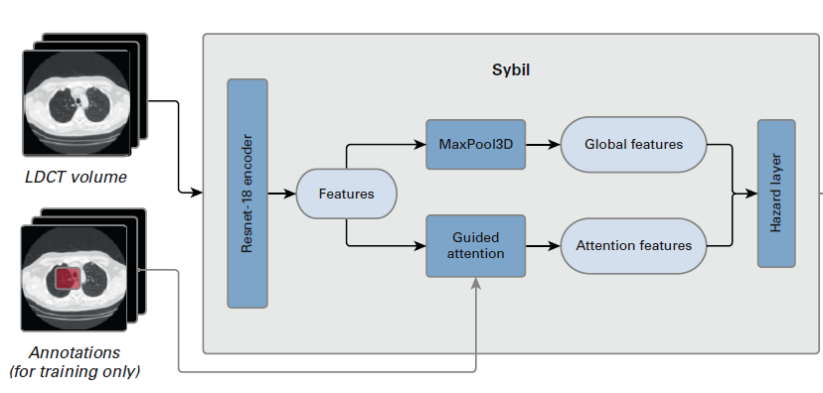
Sybil
Deep learning-based imaging model
Developed by Massachusetts Institute of Technology (MIT) with Massachusetts General Hospital (MGH) in 2022 [2]
Predicts 6-year lung cancer risk from a single low-dose computed tomography (LDCT) scan
Architecture of Sybil [2]

Slide 7
Project Objectives
Develop multimodal machine learning algorithms that integrate both imaging features with clinical features to enhance lung cancer risk prediction
Imaging features extracted using Sybil
Clinical features based on PLCO risk prediction model
Train models to predict risk of developing lung cancer within one year

Slide 8
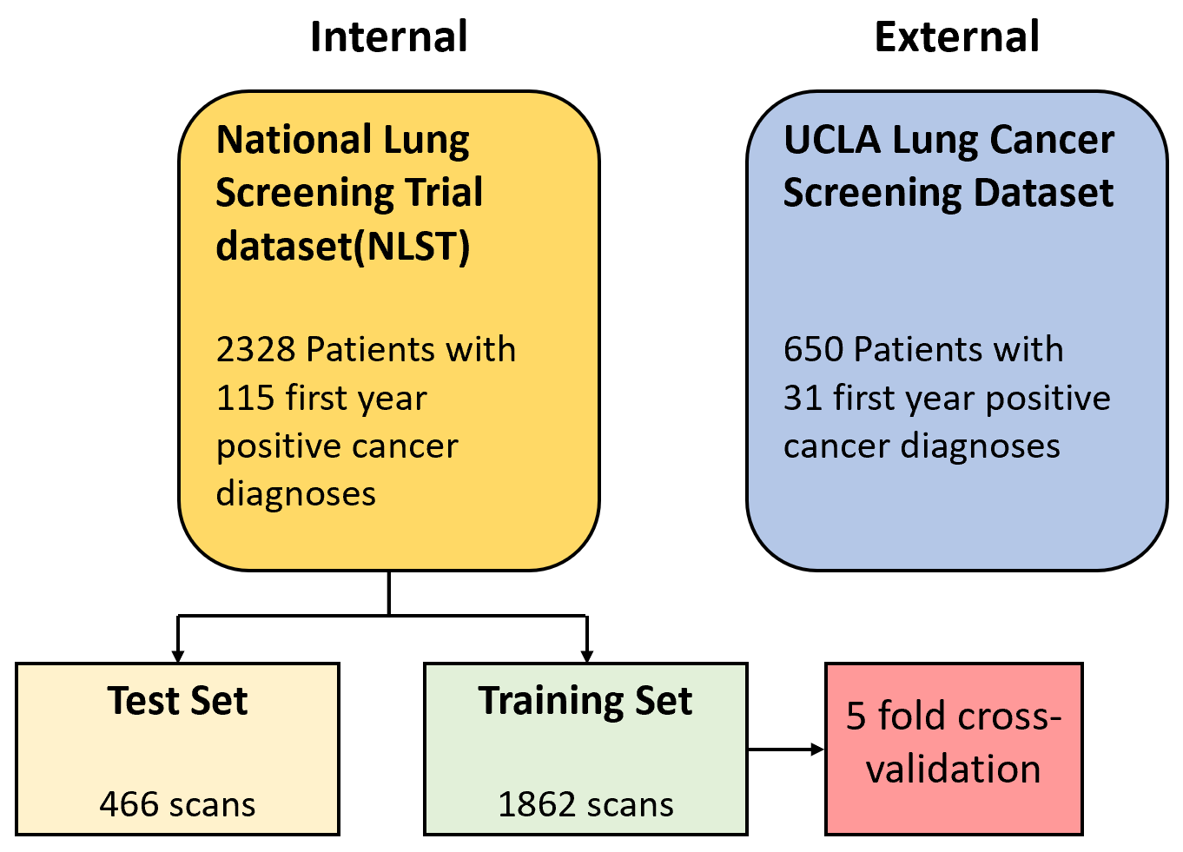
Datasets

Slide 9
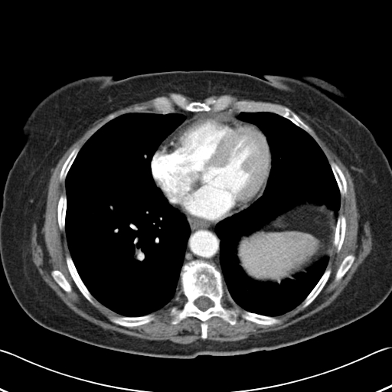
Data: CT Scans
CT (Computed Tomography) scans use X-rays to create detailed cross-sectional images of the body
Physicians use these images to diagnose various conditions
Example of a CT scan of a lung

Slide 10
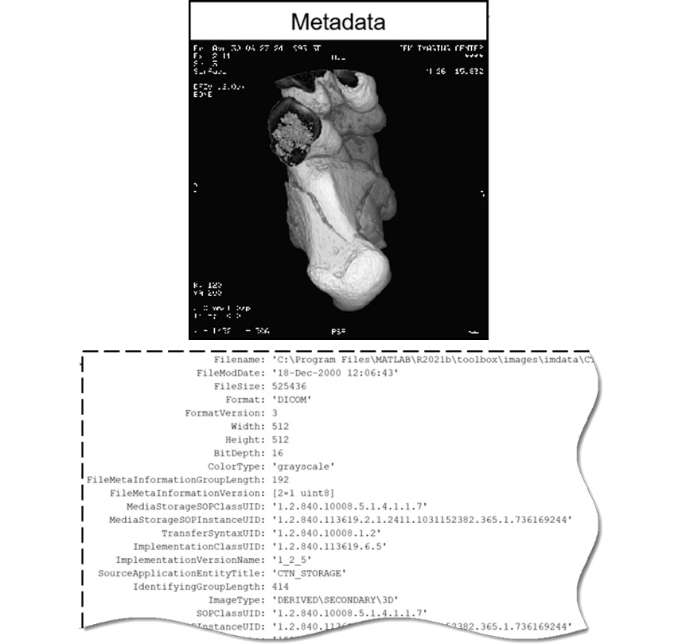
Data: DICOM
DICOM (Digital Imaging and Communications in Medicine)
Standard for medical imaging information
Includes both the medical image and metadata
Pixel data
Structured information about patient and imaging procedure
Example of a DICOM file and associated metadata

Slide 11
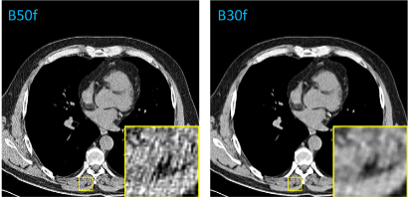
Image Selection
Selected the most recent scan per patient
Chose scans for consistency across parameters
Orientation
Slice Thickness
Convolution Kernal
Ensured standardized imaging inputs for model training
CT images reconstructed with different convolution kernels

Slide 12
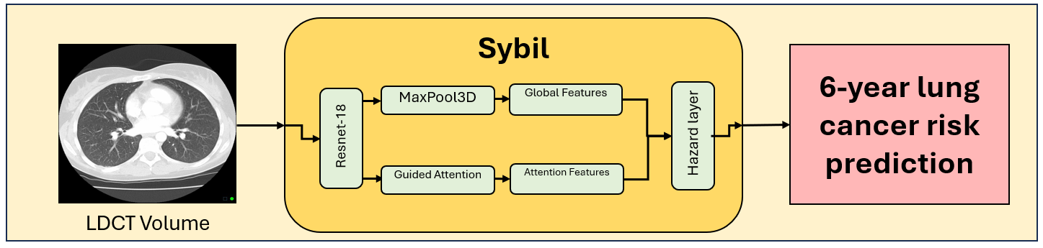
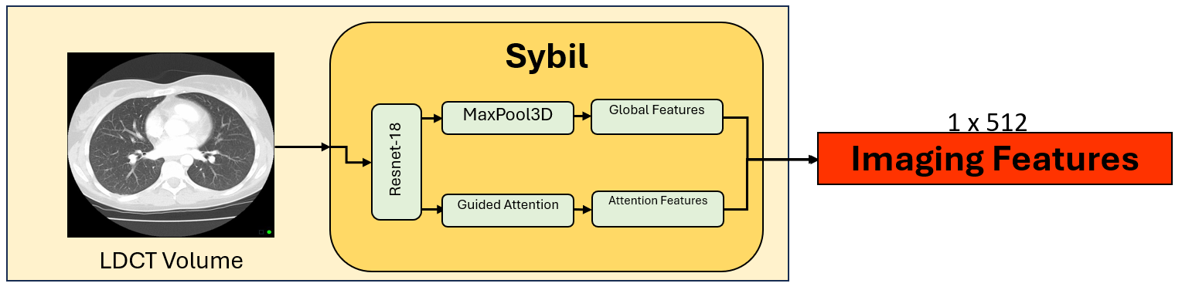
Feature Extraction
Original Sybil architecture
Modified Sybil architecture

Slide 13
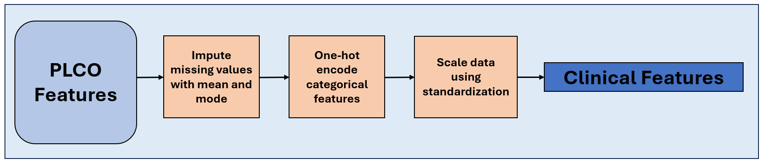
Feature Extraction
Feature engineering
Create new features by combining existing ones
Calculate features from existing features
Pre-process clinical data
Impute missing numerical and categorical data
Encode categorical data into numerical data
Scale data to have mean 0 and standard deviation of 1

Slide 14
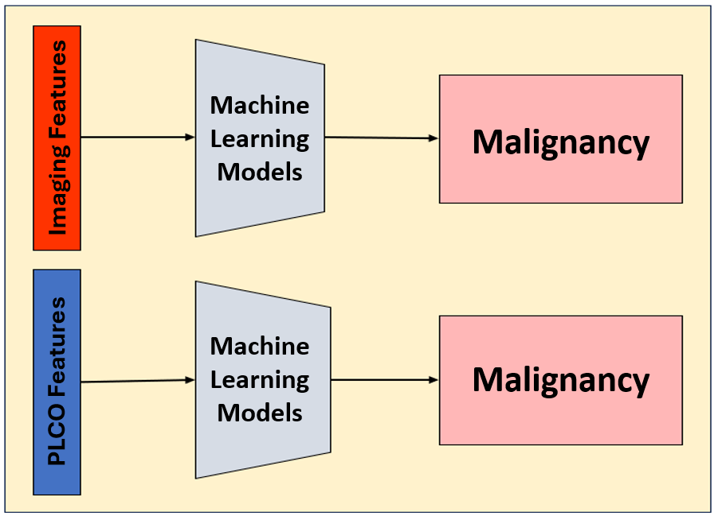
Model Architecture
Unimodal

Slide 15
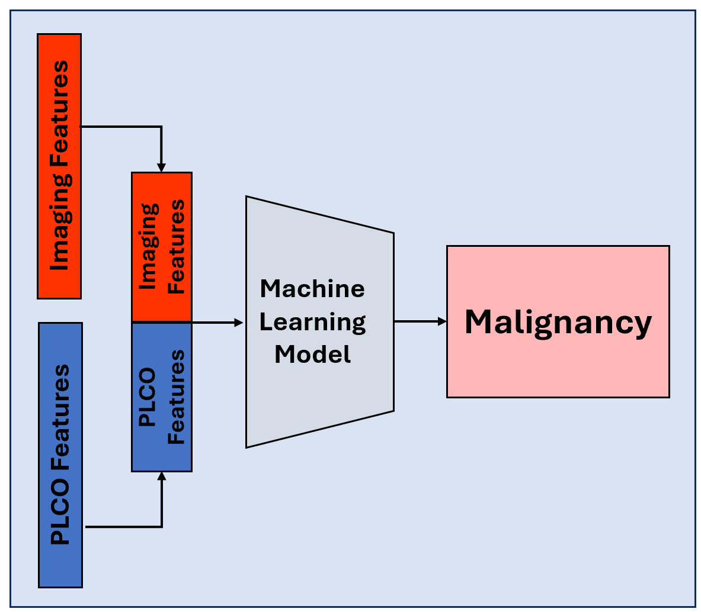
Model Architecture
Multimodal: Early Fusion

Slide 16
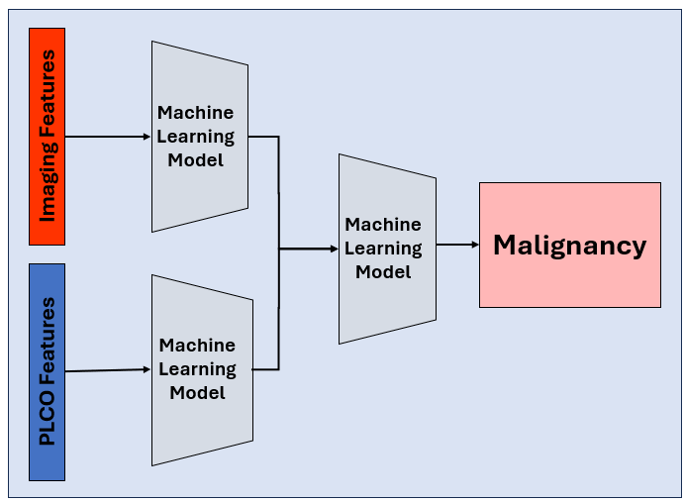
Model Architecture
Multimodal: Late Fusion

Slide 17
Methods
Train machine learning models to predict risk of developing lung cancer within one year
Train and evaluate on NLST dataset
Evaluate on UCLA dataset
Use AUROC and AUPRC as performance metrics
Compare three combinations of features:
Only PLCO clinical features
Only extracted imaging features
PLCO clinical and extracted imaging features together
Early Fusion
Late Fusion

Slide 18
Area Under the Receiver
Operating Characteristic
Curve (AUROC)
Plots: True Positive Rate vs. False Positive Rate
The higher the AUROC, the better the model is at distinguishing between the classes.
Area Under the Precision-Recall Curve
(AUPRC)
Plots: Precision vs. Recall
The higher the AUPRC, the better the model is at capturing true positives with fewer false positives

Slide 19
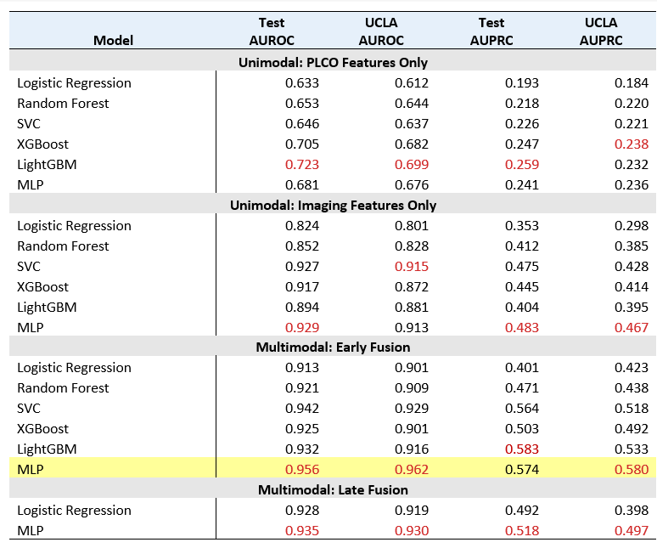
Results

Slide 20
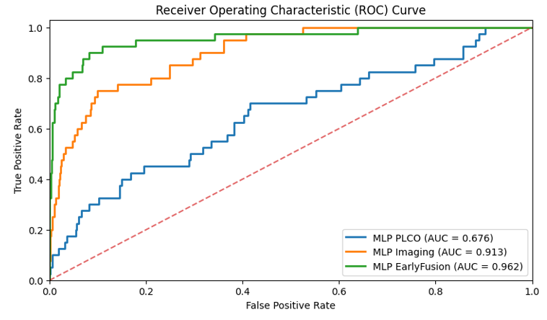
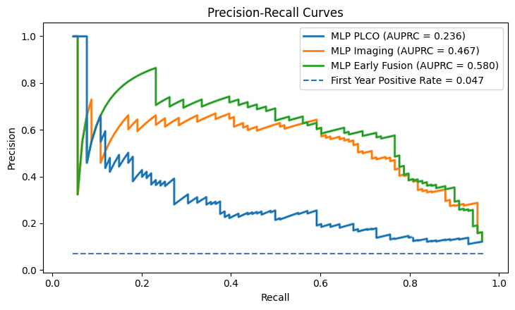
Results
ROC and PR curves for the model that achieved the highest AUROC and AUPRC on the UCLA dataset, MLP
Early Fusion MLP using both imaging and clinical features scored an AUC of 0.962 and AUPRC of 0.580, the best performance between all models and combination of features
Receiver Operating Characteristic (ROC) Curve

Slide 21
Results
Clinical features alone were weak predictors
Best AUROC 0.72, AUPRC 0.26
Imaging features alone were stronger predictors
Best AUROC 0.93, AUPRC 0.48
Multimodal (clinical + imaging) performed best
Early Fusion outperformed Late Fusion
Early Fusion MLP achieved the best results
AUROC 0.96, AUPRC 0.58

Slide 22





Tools and Languages
Pydicom
3DimViewer

Slide 23
Conclusion
The goal was to combine imaging features and clinical features to enhance one year lung cancer risk prediction
Best performing model was MLP trained on both clinical and imaging features using an early fusion approach
Multimodal models generally performed better than unimodal models
Results suggest models utilizing both clinical and imaging features may achieve higher AUROC and AUPRC values compared to models using only one type of feature

Slide 24
Future Work
Incorporate a more robust set of clinical features to enhance model performance
Develop more effective methods of combining clinical and imaging data
Embedding based fusion
Intermediate Fusion with Attention

Slide 25
References
[1] Tammemägi, Martin C., et al. “Selection Criteria for Lung-Cancer Screening.” New England Journal of Medicine, vol. 368, no. 8, 21 Feb. 2013, pp. 728–736, www.nejm.org/doi/full/10.1056/NEJMoa1211776, https://doi.org/10.1056/nejmoa1211776.
[2] Mikhael PG, Wohlwend J, Yala A, Karstens L, Xiang J, Takigami AK, Bourgouin PP, Chan P, Mrah S, Amayri W, Juan YH. Sybil: a validated deep learning model to predict future lung cancer risk from a single low-dose chest computed tomography. Journal of Clinical Oncology. 2023 Apr 20;41(12):2191-200.
[3] Suganyadevi, S., et al. “A review on deep learning in medical image analysis.” International Journal of Multimedia Information Retrieval, vol. 11, no. 1, 4 Sept. 2021, pp. 19–38, https://doi.org/10.1007/s13735-021-00218-1.
[4] Boehm, Kevin M., et al. “Harnessing Multimodal Data Integration to advance precision oncology.” Nature Reviews Cancer, vol. 22, no. 2, 18 Oct. 2021, pp. 114–126, https://doi.org/10.1038/s41568-021-00408-3.
[5] Prosper, Ashley Elizabeth, et al. “Expanding role of advanced image analysis in ct-detected indeterminate pulmonary nodules and early lung cancer characterization.” Radiology, vol. 309, no. 1, 1 Oct. 2023, https://doi.org/10.1148/radiol.222904.
[6] R. Siegel, E. Ward, O. Brawley, A. Jemal, Cancer statistics, 2011, CA A Cancer J.Clin. 61 (4) (Jul. 2011) 212–236, https://doi.org/10.3322/caac.20121.
[7] Ding, R., Yadav, A., Rodriguez, E., Da Silva, A. C. a. L., & Hsu, W. (n.d.). Tailoring pretext tasks to improve self-supervised learning in histopathologic subtype classification of lung adenocarcinomas. Computers in Biology and Medicine, 166, 107484. https://doi.org/10.1016/j.compbiomed.2023.107484.
[8] Gandhi, Zainab, et al. “Artificial Intelligence and lung cancer: Impact on improving patient outcomes.” Cancers, vol. 15, no. 21, 31 Oct. 2023, p. 5236, https://doi.org/10.3390/cancers15215236.

Slide 26
Thank you.

