Slide 1

2024 Dr. Frank Anton Distinguished Lecture in Economics
Department of Economics
Dr. Arindrajit Dube
March 8, 2024 • 3:30pm • Science Theaters 140

Slide 2

2024 Dr. Frank Anton Distinguished Lecture in Economics
The Wage Standard
Dr. Arindrajit Dube
March 8, 2024 3:30pm
Science Theaters 140
. https://arts.ucalgary.ca/economics

Slide 3
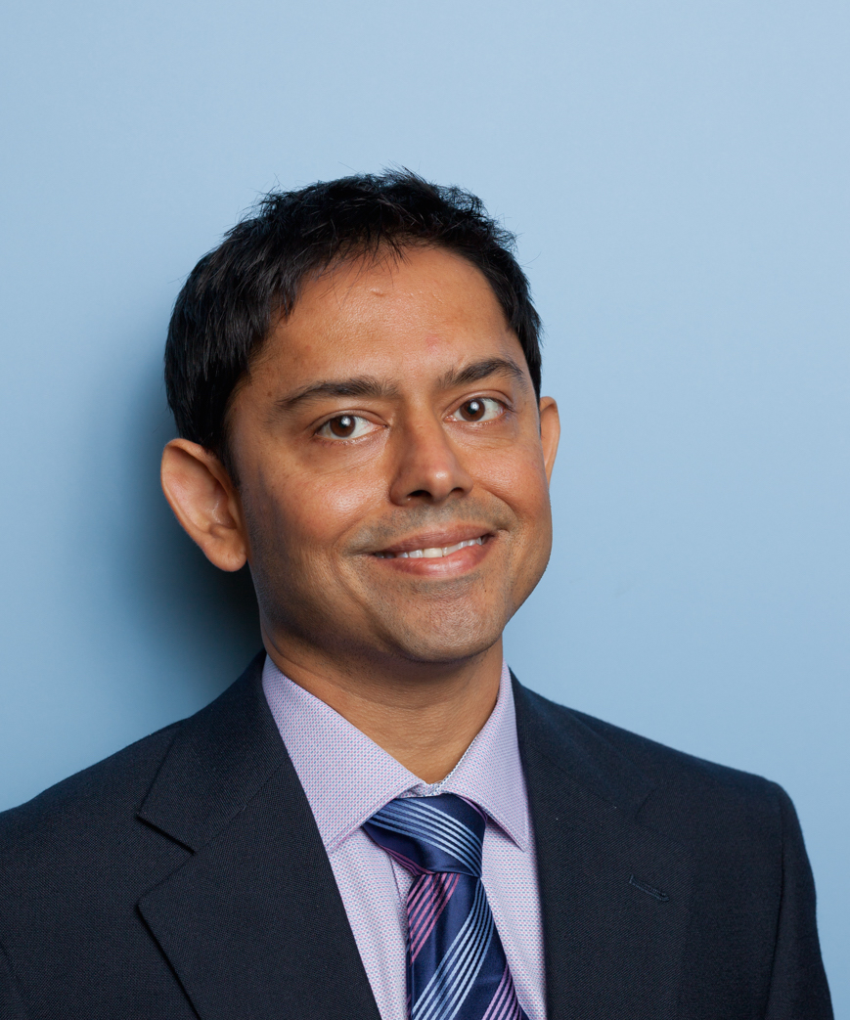
2024 Distinguished Speaker
Provost Professor of Economics, University of Massachusetts Amherst.
He’s got several other titles: Research Associate of the National Bureau of Economic Research, research Fellow at the IZA Institute of Labor Economics, and Research Affiliate of the MIT Shaping the Future of Work Initiative
International expert on effects of the minimum wage
Dr. Dube was commissioned by the UK government to study the effects of minimum wage increases, has testified on Capitol Hill, etc.
Has also worked on unemployment benefits, pandemic relief, labor market inequality, unions, and gun violence.
Dr. Arindrajit (Arin) Dube

Slide 4

2024 Topic: The Wage Standard
Many of the biggest recent debates in Canadian public policy revolve around the ability for everyday folks to afford life’s primary expenses.
One big factor of course is how much those everyday folks earn!
There have been big changes in recent years in how economists understand what determines the wages that workers can command in the labour market, highlighting the roles of competition and labour-market power.
Professor Dube has been at the forefront of this paradigm-shift and what it means for affordability and inequality. He’ll be discussing how he weaves it all together in a forthcoming book entitled The Wage Standard.

Slide 5
Dr. Frank Anton Distinguished Lecture in Economics
The Dr. Frank Anton Distinguished Lecture Series in Economics brings some of the world’s top economists to Calgary to lecture on important public policy topics.
Every year, we invite a distinguished public scholar to speak on a salient issue at the forefront of current events.
This annual series sparks thought-provoking discourse between undergraduate and graduate students, university faculty, and alumni.

Slide 6
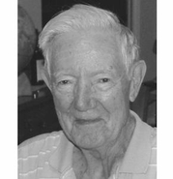
Dr. Frank Anton
This distinguished speaker lecture series was named in honour of Dr. Frank Anton, the first department head of UCalgary’s Department of Economics and a tremendous leader, mentor, and economist.
From Ireland to Poland, England to Canada
Frank Anton was born in June 1920 in Strabally, Ireland
At 20, in 1940, he joined the Royal Air Force as an observer and navigator
In February 1943, he was shot down over Nuremberg and imprisoned in Poland. In the prison camp, he learned languages, advanced his education, and developed a keen interest in economics
After WWII, he achieved a BSc (1950) and PhD (1962) from the London School of Economics, and in 1967, he became the first department head of the UCalgary Department of Economics
He was instrumental in building our department and contributed his wisdom and integrity to the development of the university

