Slide 1

Selectable Module Build Build components, separately

Slide 2
Tool Description
Selectable Module Build
Speed up time spent for testing planned changes by building only the necessary components
SMB way
standard way
BC: A
~10..30min
~10 .. 30 min
SC: B
~10..30min
~20 .. 60 min
Build only these
~60 .. 150 min
FC: C
~10..30min
~10 .. 30 min
...
~30..60min
3
Internal | Bosch Engineering |
© Robert Bosch AG 2017. All rights reserved, also regarding any disposal, exploitation, reproduction, editing, distribution, as well as in the event of applications for industrial property rights.

Slide 3
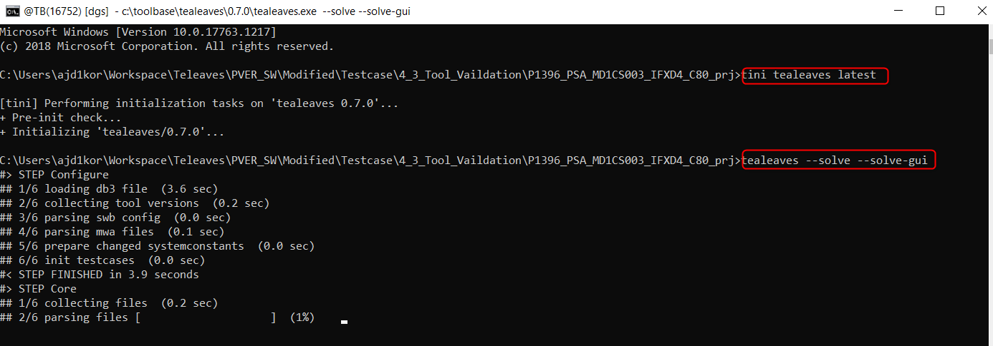
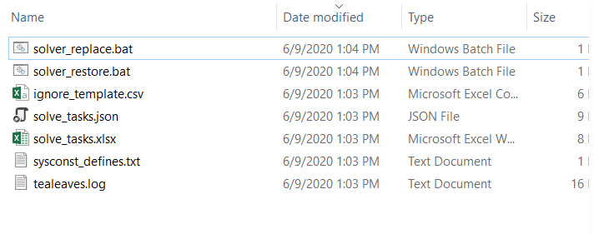

Tealeaves commands and files

Slide 4
Files Generated in Tealeaves process

Slide 5
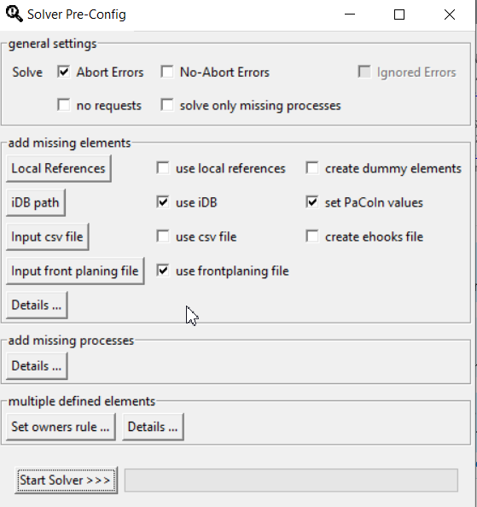
Tealeaves UI
2
Internal | Bosch Engineering | BEG-PT/ENC6-Wi | 3/6/2018
© Robert Bosch AG 2017. All rights reserved, also regarding any disposal, exploitation, reproduction, editing, distribution, as well as in the event of applications for industrial property rights.

Slide 6
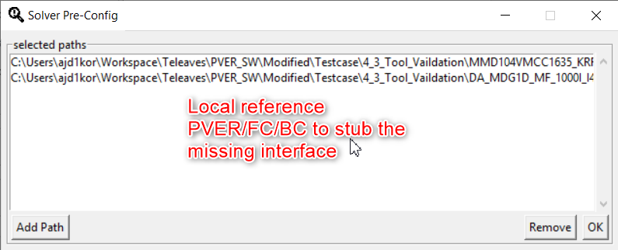
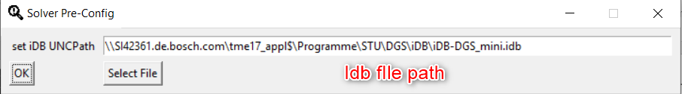
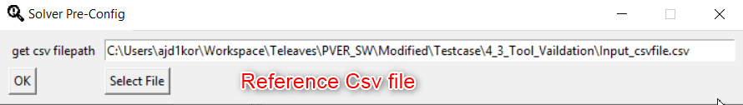
Different ways to stub the missing element

Slide 7
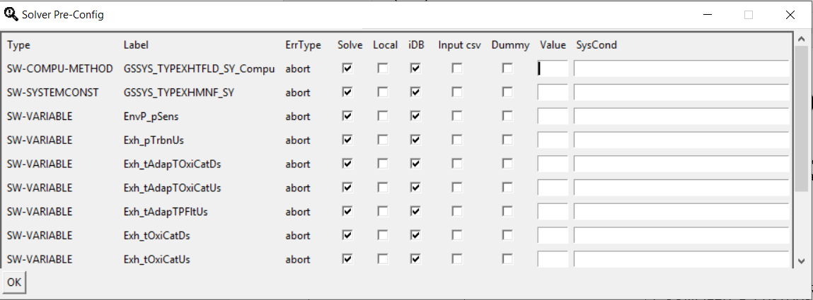
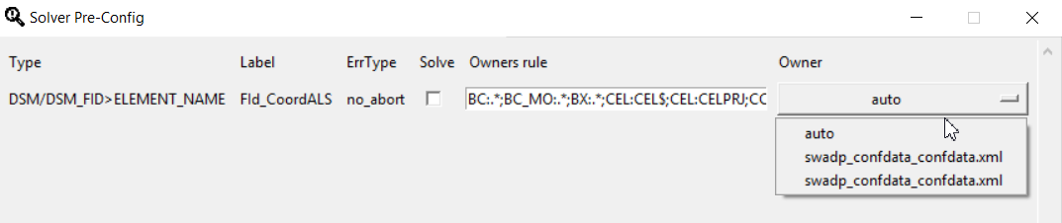
Solver Mode options

Slide 8
Reference Documents
Front Planning ref: PVER : Bx8T1_SP2013 / R2C2L856B_NUA1COB_TEST; 0 cc:conf/Misc
Csv file format
https://inside-docupedia.bosch.com/confluence/pages/viewpage.action?pageId=288638730#teaLeaves-Output
C:\toolbase\tealeaves\<VER>\doc\Documentation_teaLeaves.pdf

Slide 9



Overview / Workflow
teaLeaves
Local PVER DGSB / MDGB
SWB Execution Log Parser
teaLeaves GUI
teaLeaves CLI
Testcase Checker
Testcase Descriptions
File Collector
Testcase Collector
Output solve
suggestions
Parsers
MultiCore Tools
SWB Tasks Coordinator
Post Tasks
iDb Parser Generator
Core Script Package
Source Generator
Analysers
Automated Interactive SWB Solver
Generators
LWS Manager
Mergers Resolvers
= check for errors (linked with Testcase Description)
4
Internal | Bosch Engineering | BEG-PT/ENC6-Wi | 3/6/2018
© Robert Bosch AG 2017. All rights reserved, also regarding any disposal, exploitation, reproduction, editing, distribution, as well as in the event of applications for industrial property rights.

Slide 10
detected vs. reported errors
tealeaves
During early development stage of this tool it turned out, that detected errors by this tool, does not lead to a build abort in every project, i.e.:
due to different tool versions in SWB between projects
due to internal buggy code / erroneous specifications
due to a bug in the SWBuild itself
Standardized errors (test cases) had to be created manually for several projects, to check if detected errors were false-positive or not, before deploying a new version of this tool.
In order to deal with these facts and to keep a clean architecture, an interface between "detecting" and "reporting" errors was necessary.
5
Internal | Bosch Engineering | BEG-PT/ENC6-Wi | 3/6/2018
© Robert Bosch AG 2017. All rights reserved, also regarding any disposal, exploitation, reproduction, editing, distribution, as well as in the event of applications for industrial property rights.

Slide 11
detected vs. reported errors
tealeaves
This interface is done by a module, which
handles detected errors
filters inherited errors
generates different report files and
is able to reproduce/generate detectable errors on different local SW projects
Each “standardized” error is stored in a built-in database, which is called “testcase”
6
Internal | Bosch Engineering | BEG-PT/ENC6-Wi | 3/6/2018
© Robert Bosch AG 2017. All rights reserved, also regarding any disposal, exploitation, reproduction, editing, distribution, as well as in the event of applications for industrial property rights.

Slide 12
Testcases
tealeaves
Execution of teaLeaves
SW Version Conditions
Name / ID
Tool Version Conditions
Check Condition for Testcase
Label Exclusions
Testcase
Mark Testcase ID
Special Function Calls (i.e. Damos Severity)
Error Generation
Output of Errors
Hints / Solutions
7
Internal | Bosch Engineering | BEG-PT/ENC6-Wi | 3/6/2018
© Robert Bosch AG 2017. All rights reserved, also regarding any disposal, exploitation, reproduction, editing, distribution, as well as in the event of applications for industrial property rights.

Slide 13
Testcases used in 0.7.x
tealeaves
Core / BCT Step
Errors in system conditions (EcucValues/ConfData)
EEP (MEDC17): missing subblock
EcuCValues (MDG1): max. multiplicity check
DFC multiple defined
Further more possible …
Data Step
45 Testcases implemented for DAMOS
50 additional Testcases for Classes / Class Instances are deactivated
Since MSR generator for Class / Class Instances is missing
Build Step (not implemented yet)
Open interfaces detected in Data Step which are ignored, due to Damos Severity list
Label references, derived by Core / BCT Step
8
Internal | Bosch Engineering | BEG-PT/ENC6-Wi | 3/6/2018
© Robert Bosch AG 2017. All rights reserved, also regarding any disposal, exploitation, reproduction, editing, distribution, as well as in the event of applications for industrial property rights.

Slide 14
Output (projectfolder/_tealeaves)
teaLeaves
“sysconst_defines.txt”
Add values to missing systemconstants (automatically listed)
Add systemconstant to get values changed virtually
“tealeaves.log”
List of found errors (inherited errors not filtered)
“solve_tasks.json” / “solve_tasks.xlsx”
Grouped tasks for solving errors (inherited errors filtered)
“tealeaves.idb”
Labeldatabase (Idb) of parsed project (available from 0.4.4 on)
“ignore_template.csv”
If this file is renamed to “tealeaves_ignore.csv“, unwanted reported errors, which are listed in this file, will be ignored by teaLeaves.
9
Internal | Bosch Engineering | BEG-PT/ENC6-Wi | 3/6/2018
© Robert Bosch AG 2017. All rights reserved, also regarding any disposal, exploitation, reproduction, editing, distribution, as well as in the event of applications for industrial property rights.

Slide 15
Notes for first time usage in a project
teaLeaves
Check latest version
At best copy latest delivered unbuilt PVER with no errors to your local workspace folder
Start tealeaves (see next slides)
Check output for wrong errors
if “debug.log” file exists in “_tealeaves” folder ( > tool intern error occurred)
Check slide “T&R and Bug Reports”
If false positive errors were found
Short-term:
rename “ignore_template.csv“ to “tealeaves_ignore.csv“
it is not necessary to register the file in LWS
file has to be somewhere under the project root folder
Long-term:
Check slide “T&R and Bug Reports”
11
Internal | Bosch Engineering | BEG-PT/ENC6-Wi Zoltan Varga | 3/6/2018
© Robert Bosch AG 2017. All rights reserved, also regarding any disposal, exploitation, reproduction, editing, distribution, as well as in the event of applications for industrial property rights.

Slide 16
Use Case Integration / Test Integration
teaLeaves
In Command Shell
Type “tealeaves” if current directory is PVER root path
.. or type “tealeaves -r PVERPATH”
In SWB-Shell (dgs environment)
Type “tinit tealeaves=latest && tealeaves”
12
Internal | Bosch Engineering | BEG-PT/ENC6-Wi | 3/6/2018
© Robert Bosch AG 2017. All rights reserved, also regarding any disposal, exploitation, reproduction, editing, distribution, as well as in the event of applications for industrial property rights.

Slide 17
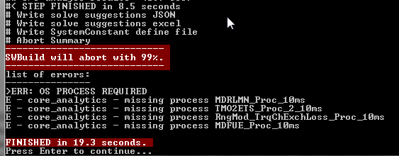
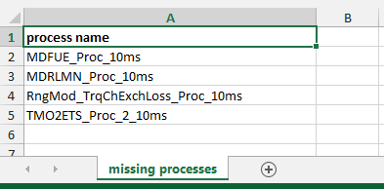
Use Case Integration / Test Integration
teaLeaves
If one or more errors were found ( = RED background color)
Check “solve_tasks.xlsx” for getting help
Solve errors
Restart teaLeaves
13
Internal | Bosch Engineering | BEG-PT/ENC6-Wi | 3/6/2018
© Robert Bosch AG 2017. All rights reserved, also regarding any disposal, exploitation, reproduction, editing, distribution, as well as in the event of applications for industrial property rights.

Slide 18
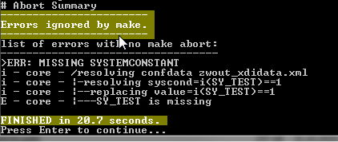

Use Case Integration / Test Integration
teaLeaves
Errors with no make abort ( = YELLOW background color)
Missing systemconstants should
be checked by project
No errors ( = GREEN background color)
14
Internal | Bosch Engineering | BEG-PT/ENC6-Wi | 3/6/2018
© Robert Bosch AG 2017. All rights reserved, also regarding any disposal, exploitation, reproduction, editing, distribution, as well as in the event of applications for industrial property rights.

Slide 19
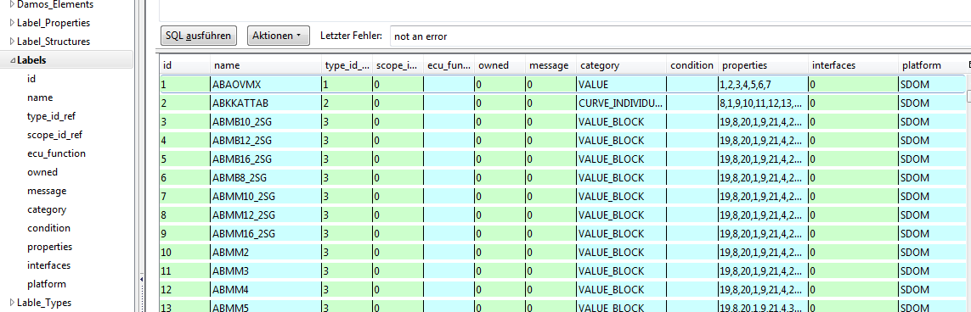
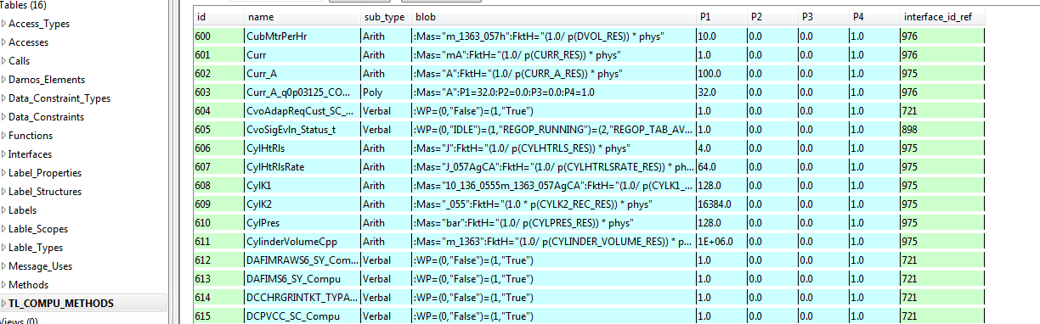
Use Case Analysis
teaLeaves
For creating label db file of target project (from version 0.4.4 on)
use option --create-idb in command prompt
“tealeaves --create-idb”
15
Internal | Bosch Engineering | BEG-PT/ENC6-Wi | 3/6/2018
© Robert Bosch AG 2017. All rights reserved, also regarding any disposal, exploitation, reproduction, editing, distribution, as well as in the event of applications for industrial property rights.

Slide 20
Availability / Installation / Links
teaLeaves
Setup Installer at Bosch Tool Catalog
Will create “tealeaves” in explorer context menu
Will add installation path to user environment PATH
Available at ToolBase (“dgs” environment under ALL TOOLS)
Docupedia
BoschConnect (for DGS)
Issue Tracking / Bug Report
17
Internal | Bosch Engineering | BEG-PT/ENC6-Wi | 3/6/2018
© Robert Bosch AG 2017. All rights reserved, also regarding any disposal, exploitation, reproduction, editing, distribution, as well as in the event of applications for industrial property rights.

Slide 21
Support / Maintenance / Limitations
teaLeaves
This tool is a BEG SISC project
One developer with 20% ( 1 week per month ) is planned for this project
Proxy user for tool responsibility and maintenance is not provided
Therefore:
Tasks and incoming bug reports are prioritized by tool responsible and by SISC members
One week per month is blocked for tool development
Lists of actual tasks sorted according to priority (06.03.2018):
Major Bugs
CI Support
OaW scripts
iDb support (label database)
Minor Bugs
SWB solve suggestions / ISO26262
Generator for Class / Class instances (activation of additional 50 Testcases)
Code Rework / Code Maintenance / Performance optimizations
GUI
Documentation
18
Internal | Bosch Engineering | BEG-PT/ENC6-Wi | 3/6/2018
© Robert Bosch AG 2017. All rights reserved, also regarding any disposal, exploitation, reproduction, editing, distribution, as well as in the event of applications for industrial property rights.

Slide 22
Bug Reports
teaLeaves
Place your local zipped project to a shared folder, like
\\bosch.com\dfsrb\DfsDE\DIV\BEG\DGP\60_Ext\Temp_exch
Report bug here
… or by sending a mail
19
Internal | Bosch Engineering | BEG-PT/ENC6-Wi | 3/6/2018
© Robert Bosch AG 2017. All rights reserved, also regarding any disposal, exploitation, reproduction, editing, distribution, as well as in the event of applications for industrial property rights.

Slide 23
Planned Features
teaLeaves
Build Step implementation
Parsing c files for not configured labels like dsm labels, calibration labels, etc
GUI
Better usability for test integration
Deeper analysis options for specific FC/BCs
Add/remove/replace FC/BCs virtually
Test impact of changes in MSR elements, i.e. Systemconstants /Computation Methods on local level
…
Interface for user specific analysis / error detections
20
Internal | Bosch Engineering | BEG-PT/ENC6-Wi | 3/6/2018
© Robert Bosch AG 2017. All rights reserved, also regarding any disposal, exploitation, reproduction, editing, distribution, as well as in the event of applications for industrial property rights.

Slide 24
Discussions / Feedback / Ideas
teaLeaves
Finding more typical / annoying errors
Other / better adapted output styles (e.g. HTML)
For integration workflow
For analysis
New features expected
CLI
GUI
???
21
Internal | Bosch Engineering | BEG-PT/ENC6-Wi | 3/6/2018
© Robert Bosch AG 2017. All rights reserved, also regarding any disposal, exploitation, reproduction, editing, distribution, as well as in the event of applications for industrial property rights.

Slide 25

Thank you

