Slide 1


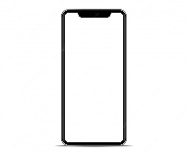


AmbrosiaAlert Arhitectură
Web Api
.NET Core
User
Mobile App
Java/React/Flatter
Async comm (Azure queue)
SQL Database
Azure
Web Job
Azure

