Slide 2
Beverage

Slide 3
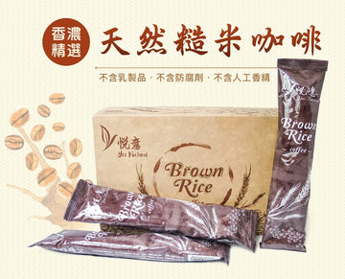
Organic Purple Rice Congee (320ml) 有机紫米八宝粥
Organic Purple Rice Congee (320ml) 有机紫米八宝粥
Organic Purple Rice Congee (320ml) 有机紫米八宝粥
Organic Purple Rice Congee (320ml) 有机紫米八宝粥
RM9.90MYR
RM9.90MYR
RM9.90MYR
RM9.90MYR
Organic Purple Rice Congee (320ml) 有机紫米八宝粥
Organic Purple Rice Congee (320ml) 有机紫米八宝粥
Organic Purple Rice Congee (320ml) 有机紫米八宝粥
Organic Purple Rice Congee (320ml) 有机紫米八宝粥
RM9.90MYR
RM9.90MYR
RM9.90MYR
RM9.90MYR

