Slide 1
PHIL 343
Dewey, “By Nature and by Art”

Slide 2
Identify the main advantages and the
main disadvantages of allowing the use
of science and technology in society to
be determined by free-market forces (as
opposed to planning how science and
technology are to be used in society?)

Slide 3
By Nature and by Art (1944)
Two related arguments:
The role of technology in science has not been sufficiently recognized
(2) The traditional ideal of ‘knowledge by nature’ (knowledge by theory) should be replaced by the ideal of ‘knowledge by art’ (knowledge by practice)

Slide 4
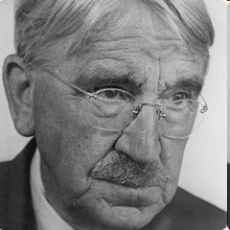
The Scientific Revolution
“[The scientific] revolution may
be said to be [a transition] from
knowledge that is such ‘by
nature’ [by theorizing] to
scientific subject-matter which is what it is
because it is ‘by art’ [by experimenting]” (372)

Slide 5
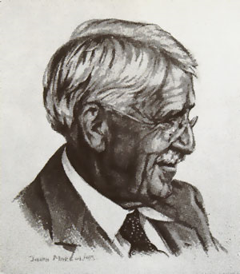


Dewey on Knowledge
‘knowledge by nature’: knowledge obtained by theorizing
‘knowledge by art’: knowledge obtained by ‘experimenting’ (i.e., with the aid of tools)

Slide 6
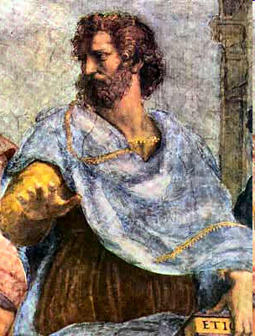
“The classic scheme, following
Aristotle, held that the subject
matter of science…. is what it is
because of certain inherent forms, essences, or
natures. These… natures…are eternal, immutable,
and necessary” (372)

Slide 7
“Other forms of knowledge, such as were
called sense-perception and opinion, were
… what they were [non-eternal and
changeable] by the nature of their inherent
Beings…. Sense-knowledge and opinion are
inferior forms of knowledge concerned with
things which by their natures are so mutable
that knowledge of them is itself unstable and
shifting—as in the case of things touched,
heard, seen” (372)

Slide 8
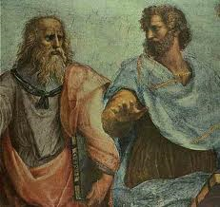
For the Greeks…
Knowledge obtained through Reason of unchanging essences (‘kn. by nature’) is superior
Knowledge obtained through the senses (‘kn. by art’) is inferior

Slide 9
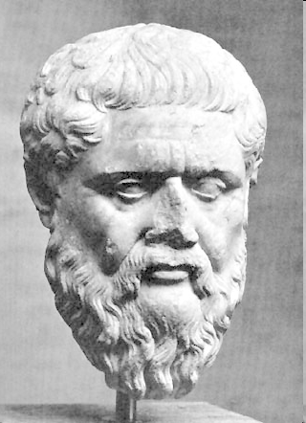
Plato’s Theory of Forms
Two worlds: (1) appearances, and (2) forms
Forms: non-physical, non-spatial, non-temporal – eternal and unchanging objects (abstract objects)
Particular objects in the world of appearance correspond to one general form

Slide 10
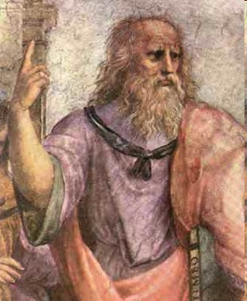
Plato on Knowledge
Knowledge provided by senses (of appearances) is unreliable: particular, changing, unstable
Knowledge provided by reason (of forms) is reliable: general, unchanging, eternal

Slide 11
“The Classic [Greek] ideal” = ‘knowledge by nature’
Dewey’s ideal: ‘knowledge by art’

Slide 12
“The arts are concerned with production, with
generation, with doing and making. They fall ….
within the domain of things which in the classic
scheme are mutable…. While this … marks a
departure from the classic view, it does not suffice …
to justify calling scientific knowledge an art, though it
provides a condition without which that designation is
not warranted for it completely breaks down the
grounds upon within which a fixed and impassable
line was originally drawn between the subject-matters
of science and of art. For it connects science with
change.” (Dewey, p. 373)

Slide 13
“Science is now the product of operations
deliberately undertaken in conformity with a plan or
project that has the properties of a working
hypothesis. The value or validity of the latter is tested,
as in the case of any art, by what happens in
consequence of the operations it instigates and
directs. Moreover, science is assimilated to the
conditions defining an art by the fact that, as in the
case of any industrial art, production of relevant and
effective consequences depends upon the use of
artificially designed appliances and apparatus as a
means of execution of the plan….” (373)

Slide 14
“Knowledge by art”
Knowledge about effective consequences/ practical consequences/ regularities
Gained through experimenting
Requires the aid of tools/ artifacts (e.g., telescopes)

Slide 15
“The scientific revolution may be said to have been
initiated when investigators borrowed apparatus and
processes from the industrial arts and used them as
means of obtaining dependable scientific data. The
use of the [telescopic] lens was of itself enough to
revolutionize the science of astronomy… [T]he bulk of
early knowledge was in fact built up through the
pursuit of industrial and mechanical arts. The low
status of artisans… was ‘rationalized’ in the doctrine of
the inherently inferior state of all knowledge of this
kind. At best, it was ‘empirical’ in the disparaging
sense of that word. Fundamentally, the scientific
revolution consisted of the transformation of ‘empirical’
into experimental.” (374)

Slide 16
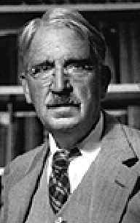
“After a period in which natural
knowledge progressed by borrowing
from the industrial crafts, science
entered upon a period of steady and
ever-accelerated growth by means of
deliberate invention of such appliances on its own
account. In order to mark this differential feature of
the art which is science, I shall use the word
‘technology’” (375)

Slide 17
By Nature and by Art (1944)
Two related arguments:
The role of technology in science has not been sufficiently recognized
(2) The traditional ideal of ‘knowledge by nature’ (knowledge by theory) should be replaced by the ideal of ‘knowledge by art’ (knowledge by practice)

Slide 18
“‘[N]ature is a word of many senses. One of its
senses has been mentioned…. the nature of that
which is undergoing investigation, say combustion,
electricity, or whatever, is the subject-matter of
scientific generalizations. We still use the expression
‘the nature’ of something or other in this sense…. But
when we do use it…, its meaning is radically different
from that possessed by the same expression in the
classic scheme. For it no longer designates a fixed
and inherent essence, or Being, that makes facts to
be what they are. Instead, it signifies an order of
connected changes, an order which is found to be
fruitfully effective in understanding and dealing
with particular changes. The difference is radical”
(373)

Slide 19
By Nature and by Art
Knowledge by Nature
result of theorizing
Relies on reason, rather than sense experience
Aim: obtain knowledge of essences
Theoretical knowledge

Slide 20
By Nature and by Art
Knowledge by Nature
result of theorizing
Relies on reason, rather than sense experience
Aim: obtain knowledge of essences
Theoretical knowledge
Knowledge by Art
result of experimenting
Relies on production and generation
Aim: obtain knowledge of prac. consequences
Practical knowledge

Slide 21
Q1: Identify 2-3 examples of knowledge that are obtained through practice in the sense of Dewey’s ‘knowledge by art.’ Indicate how this knowledge is obtained through practice.
(e.g., knowledge of the planets)
Q2: Dewey rejects the ideal of ‘knowledge by nature,’ or knowledge obtained through ‘pure theorizing.’ Identify instances of knowledge that seem to be obtained through theory?

