Slide 1
Exam Tips
DO
Be clear and succinct
Use your own words
Stay focused on answering the question
Develop/ articulate ideas in sufficient depth
Provide examples
Engage your analysis with the texts
Demonstrate your understanding of the texts!!
DON’T
Give long intros
Just repeat things said in lecture/ power-points
Go off on tangents
State something without explaining it
Mischaracterize the views you discuss

Slide 2
In “The Scientific Conception of the World: The Vienna Circle,” the logical positivists articulate a view that they call the ‘scientific world conception.’ What are the main features of scientific knowledge associated with the scientific world conception? Explain the positivists’ view that science is a value-neutral instrument that should be applied in order to achieve benefits for society. How is it similar to Dewey’s view in “Science and Society.”

Slide 3
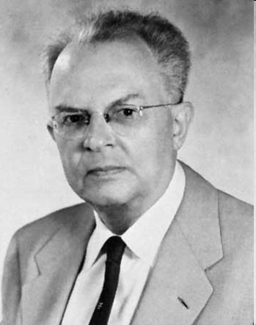
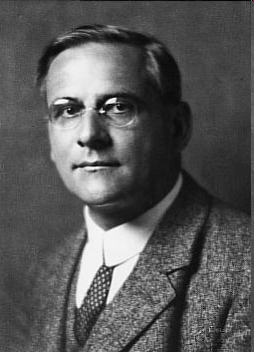
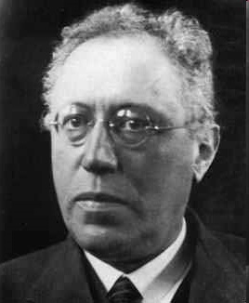
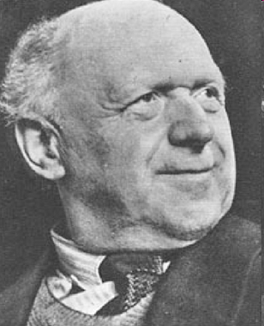
The Logical Positivists’ Empiricist View of Science
genuine scientific knowledge is empirically testable/ verifiable in experience
Science should be applied in society

Slide 4
The Logical Positivists’ View of Science
(1) Anti-metaphysical: Free of metaphysics (negative thesis)
(2) Empirical: Empirically based, or relatable to experience (positive thesis)

Slide 5
Science Should be Free of Metaphysics
Metaphysics = theory of what exists
Theories of existence go beyond the observable (e.g., existence of God)
Metaphysical statements are meaningless because they go beyond the empirical

Slide 6
Logical Positivism & Technology
Technology is applied science
Broad view of science (and tech.) – includes not only logic and mathematics, but also the “new philosophy” (logical analysis)
Science should be applied for the benefit of society (social engineering)

Slide 7
“The attitudes toward questions of life also showed a
noteworthy agreement, although these questions were not
in the foreground of themes discussed within the Circle.
These attitudes are more clearly related to the scientific
world-conception than it might at first glance appear from a
purely theoretical point of view. For instance, endeavors
toward a new organization of economic and social
relations, toward the unification of mankind, toward a
reform of school and education, all show an inner link with
the scientific world-conception… these endeavors are
welcomed and regarded with sympathy by members of the
Circle” (p. 304)

Slide 8
Benefits of a Non-Metaphysical & Logical Attitude
“the logical clarification of scientific concepts,
statements, and methods liberates one from
inhibiting prejudices”(316)
Metaphysics → encourages prejudice and
discourages social change
Scientific World Conception → eliminates
prejudice and encourages social change

Slide 9
Instrumentalism about Technology (Logical Positivism, Dewey)
Technology is a value-neutral instrument
Technology can and should be applied in society to facilitate human goals
Society should deliberately plan how technologies will be implemented in society

Slide 10
Science and Society (1931)
Main argument: concerns the role of technology in society
The application of science and technology in society should be self-consciously planned

Slide 11
The “Great Contradiction”
Careful planning in gaining scientific knowledge
No planning in applying this knowledge

Slide 12
In his paper, “By Nature and by Art,” John Dewey articulates a distinction between ‘knowledge by nature’ and ‘knowledge by art.’ Explain Dewey’s distinction and its significance for his views on technology. In particular, explain why Dewey thinks the traditional ideal of ‘knowledge by nature’ should be replaced by the ideal of ‘knowledge by art’ and the role that technology plays in Dewey’s preferred ideal of knowledge.

Slide 13
By Nature and by Art (1944)
Two related arguments:
The role of technology in science has not been sufficiently recognized
(2) The traditional ideal of ‘knowledge by nature’ (knowledge by theory) should be replaced by the ideal of ‘knowledge by art’ (knowledge by practice)

Slide 14
By Nature and by Art
Knowledge by Nature
result of theorizing
Relies on reason, rather than sense experience
Aim: obtain knowledge of essences
Theoretical knowledge
Knowledge by Art
result of experimenting
Relies on production and generation
Aim: obtain knowledge of prac. consequences
Practical knowledge

Slide 15
“Knowledge by art”
Knowledge about effective consequences/ practical consequences/ regularities
Gained through experimenting
Requires the aid of tools/ artifacts (e.g., telescopes)

Slide 16
In “The Question Concerning Technology,” Martin Heidegger articulates a critical perspective on technology. What does Heidegger think is the essence of technology? Explain what Heidegger means when he claims that technology is a “way of revealing” (p. 12). In addressing these questions, make sure that you explain Heidegger’s concepts of ‘revealing,’ ‘challenging,’ ‘standing-reserve,’ and ‘enframing.’

Slide 17
QCT
essence of technology is a basic desire to control nature (‘enframing’)
Mode of perception (‘revealing’) associated with this essence = views nature as resource to be effectively used (‘challenging’)
Nature = a resource to be extracted and stored (‘standing reserve’)

Slide 18
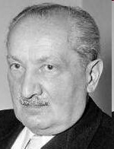
“Revealing”
A certain way of perceiving the world
Different ‘modes of revealing’ = different ways of perceiving/ understanding
Different modes of revealing (e.g., poiesis vs. challenging) are limited in what they can reveal

Slide 19
Two modes of revealing
Poeisis
Pre-modern; associated with poetry and the crafts
Reveals the particularity of things
Challenging
Modern; associated with modern technology
Reveals how something can be used as a resource

Slide 20
“Challenging”
mode of revealing associated with modern tech
views things in terms of how they can be effectively used, or as resources
(p. 14) “The revealing that rules in modern technology is a challenging, which puts to nature the unreasonable demand that it supply energy that can be extracted and stored”
Challenging = an industrialist/ capitalist way of viewing nature

Slide 21
“Enframing”
basic mood or attitude characteristic of the technological age
“Framework” or “value-orientation” towards the world
Desire for precise, ordered, controllable knowledge of nature

Slide 22

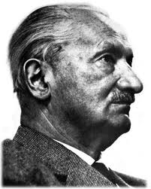
The Dilemma
Drive to control nature (enframing)
way of perceiving nature (challenging)
H: how can humanity move into a “free
relationship” with technology?

