Slide 1

Data Science Talent Acquisition
Global Salary Benchmarking & Strategic Hiring Roadmap

Slide 2
The Challenge
● Title: Strategic Talent Acquisition: Data Science
● Subtitle: Salary Benchmarking & Competitive Hiring Recommendation
● Presented to: Executive Team

Slide 3
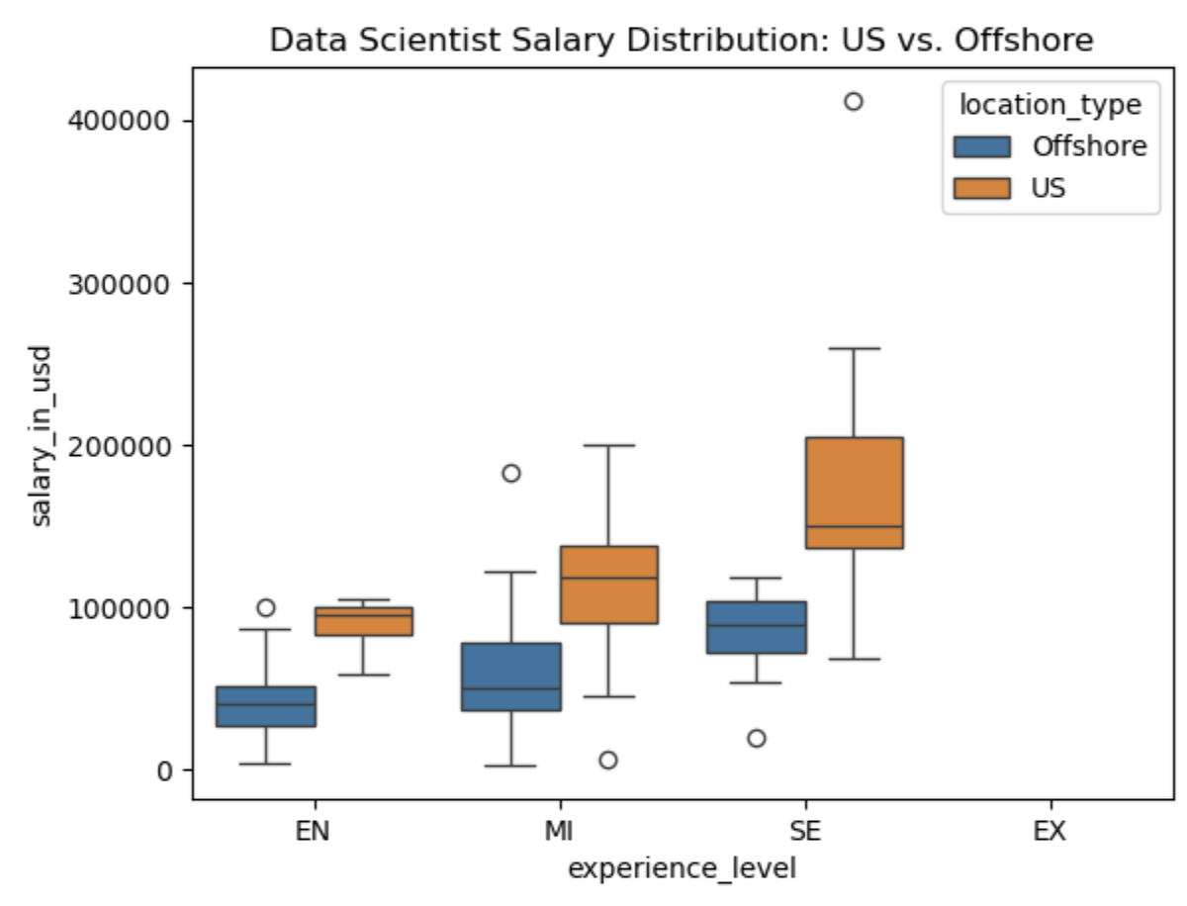
Market Analysis (U.S. vs. Offshore)
● Significant salary premium for U.S.-based roles compared to global offshore market.
● Offshore hiring offers cost savings but increases logistical/management complexity.

Slide 4
Salary by Experience Level (U.S.)
Experience Level | Average Salary (USD)
Entry-Level | $61,643.32
Junior Mid-Level | $87,996.06
Intermediate Senior-Level | $138,617.29
Expert Executive-level/Director | $199,392.04
Insight: Hiring a Senior-level candidate is a higher upfront cost but essential for independent strategic leadership.

Slide 5
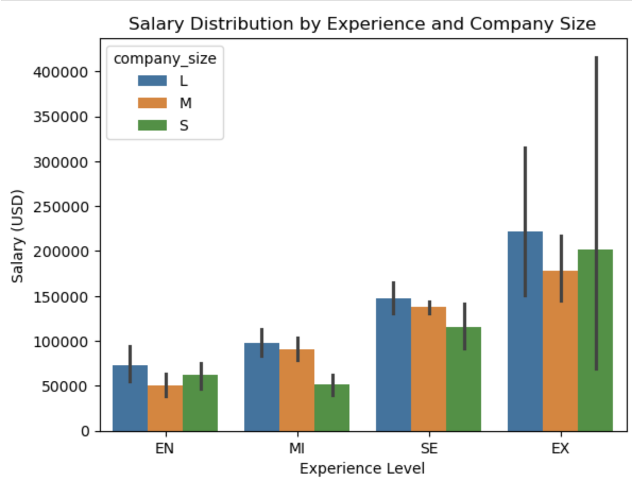

Slide 6
Recommendation
● Proposed Range: $120,000 – $150,000 (U.S.-based).
● Rationale: This range secures mid-to-senior level talent capable of leading our data science capabilities during this expansion phase.

