Slide 1
高等計算機網路期末專題
Reporter: 林子安

Slide 2
Outline
Basic way
My way
Speed
Space

Slide 3
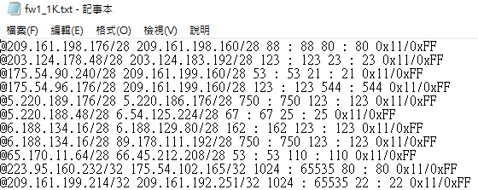
Basic way
1079733050 4225952233 0 65535 255 82
priority

Slide 4
My way
Use parallel processing to simulate more than one routers deal with a request at the same time.
Fw1_1K.txt
Fw1_250.txt
Fw1_250.txt
Fw1_250.txt
Fw1_250.txt

Slide 5
My way
1th Fw1_250.txt
2th Fw1_250.txt
3th Fw1_250.txt
4th Fw1_250.txt
No answer
answer
answer
answer
Final answer

Slide 6
My way
Advantage:
improve the worst case because the search time will be share by different device
Improve the average case while cut>2 (assume the average search time of basic way is N/2 | N=number of rules)
Disadvantage:
Increase the best case search time because once somebody find the correct rule it have to wait until every device finish searching
Notes:
最差
平均
Best case

Slide 7
Speed in different rule
 | Basic_acl_100 | My_acl_ 100 | Basic_acl_1K | My_acl_ 1K | Basic_acl_5K | My_acl_ 5K | Basic_acl_10K | My_acl_ 10K
Cut=8 | 50.08 | 11.39 | 451.1 | 106.97 | 2175.7 | 517.95 | 4939.2 | 1143.2
Cut=64 | 50.08 | 2 | 451.1 | 13.91 | 2175.7 | 67.55 | 4939.2 | 149.5
Average search time

Slide 8
Speed in different rule
 | Basic_fw_100 | My_fw_ 100 | Basic_fw_1K | My_fw_ 1K | Basic_fw_5K | My_fw_ 5K | Basic_fw_10K | My_fw_ 10K
Cut=8 | 42.06 | 10.5 | 399.96 | 92.32 | 2334.13 | 545.2 | 4607.4 | 1096
Cut=64 | 42.06 | 2 | 399.96 | 19.02 | 2334.13 | 68.15 | 4607.4 | 144.4
Average search time

Slide 9
Speed in different cut on one case(fw1_1K)
 | Cut=1 | Cut=2 | Cut=4 | Cut=8 | Cut=16
Total search time | 3219645 | 2394543 | 1392970 | 743143 | 383899
Average search time | 399.96 | 297.46 | 173.04 | 92.32 | 47.69

Slide 10
Space analysis
Use parallel processing to simulate more than one routers deal with a request at the same time.
Fw1_1K.txt
Fw1_250.txt
Fw1_250.txt
Fw1_250.txt
Fw1_250.txt
Advantage: each server don’t need to be so good especially memory

