Slide 1

Web Application Development
COMP-229
Fall 2023

Slide 2
COMPONENTS
A Component is one of the core building blocks of React.
We can say that every application you will develop in React will be made up of pieces called components.
Components make the task of building UIs much easier.
You can see a UI broken down into multiple individual pieces called components and work on them independently and merge them all in a parent component which will be your final UI.
Components in React basically return a piece of JSX code that tells what should be rendered on the screen.

Slide 3
Types of components in ReactJS
In React, we mainly have two types of components:
Functional Components: Functional components are simply Javascript functions.
We can create a functional component in React by writing a Javascript function.
These functions may or may not receive data as parameters,

Slide 4
The below example shows a valid functional component in React:
function demoComponent() { return (<h1> Welcome Message! </h1>); }

Slide 5
Class Components: The class components are a little more complex than the functional components.
The functional components are not aware of the other components in your program whereas the class components can work with each other.
We can pass data from one class component to another class component.
We can use JavaScript ES6 classes to create class-based components in React.

Slide 6
The below example shows a valid class-based component in React:
class Democomponent extends React.Component { render() { return <h1>Welcome Message!</h1>; } }

Slide 7
Rendering Components in ReactJS
const elementName = <ComponentName />;
React is also capable of rendering user-defined components.
To render a component in React we can initialize an element with a user-defined component and pass this element as the first parameter to ReactDOM.render() or directly pass the component as the first argument to the ReactDOM.render() method.
The below syntax shows how to initialize a component to an element:
const elementName = <ComponentName />;

Slide 8
In the above syntax, the ComponentName is the name of the user-defined component.
Note: The name of a component should always start with a capital letter. This is done to differentiate a component tag from HTML tags.
The below example renders a component named Welcome to the Screen:

Slide 9
At the terminal of your vscode create a new react app with the following command:
npx create-react-app my-react-app
my-react-app is the name of your app
Next cd to the my-react-app
Navigate to the App.js file replace the existing code with the following code:

Slide 10
import React from 'react';
import ReactDOM from 'react-dom';
// This is a functional component
const Welcome = () => {
return <h1>Hello World!</h1>;
}
ReactDOM.render(
<Welcome />, // Use <Welcome /> instead of <welcome>
document.getElementById("root")
);
export default Welcome;

Slide 11
Navigate to the src/index.js file replace the existing code with the following code:
import React from 'react';
import ReactDOM from 'react-dom/client';
//import './index.css';
import App from './App';
//import reportWebVitals from './reportWebVitals';
const root = ReactDOM.createRoot(document.getElementById('root'));
root.render(
<React.StrictMode>
<App />
</React.StrictMode>
);

Slide 12
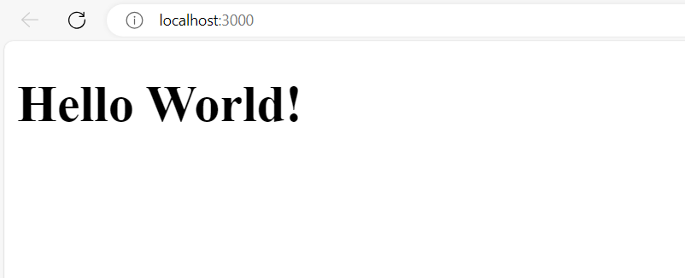
At the terminal run your code with the following command:
npm start
Output is as follows:

Slide 13
Let us see step-wise what is happening in the above example:
We call the ReactDOM.render() as the first parameter.
React then calls the component Welcome, which returns <h1>Hello World!</h1>; as the result.
Then the ReactDOM efficiently updates the DOM to match with the returned element and renders that element to the DOM element with id as “root”.

Slide 14
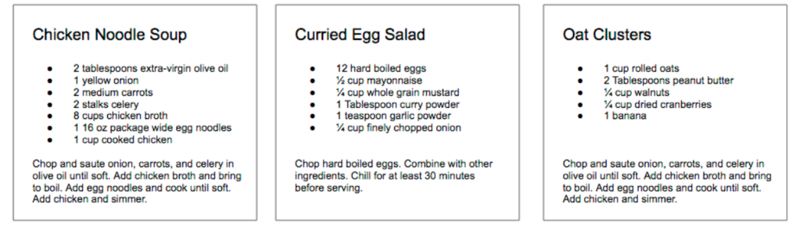
React Component contd.
No matter its size, its contents, or what technologies are used to create it, a user interface is made up of parts. Buttons. Lists. Headings. All of these parts, when put together, make up a user interface.
Consider a recipe application with three different recipes. The data is different in each box, but the parts needed to create a recipe are the same.

Slide 15
In React, we describe each of these parts as a component.
Components allow us to reuse the same structure and then we can populate those structures with different sets of data.
When considering a user interface that you want to build with React, look for opportunities to break down your elements into reusable pieces.
For example, the recipes in each have a title, ingredients list, and instructions. All are part of a larger recipe or app component. We could create a component for each of the highlighted parts: ingredients, instructions, and so on.

Slide 16
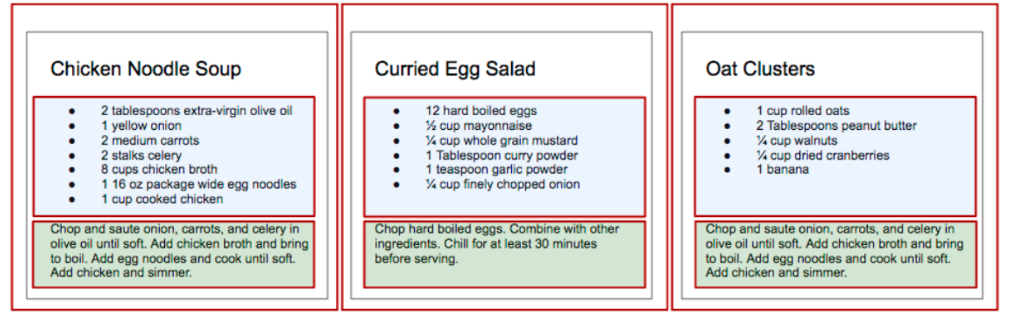

Slide 17
Each component is outlined: App, IngredientsList
We’ll create a component by writing a function. That function will return a reusable part of a user interface.
EXAMPLE I
Let’s create a function that returns an unordered list of ingredients dessert with a function called IngredientsList

Slide 18
Modify the App.js in the existing application(Hello World) as follows i.e replace with the following code:
import React from 'react';
import ReactDOM from 'react-dom';
function IngredientsList() {
return React.createElement(
"ul",
{ className: "ingredients" },
React.createElement("li", null, "1 cup unsalted butter"),
React.createElement("li", null, "1 cup crunchy peanut butter"),
React.createElement("li", null, "1 cup brown sugar"),
React.createElement("li", null, "1 cup white sugar"),
React.createElement("li", null, "2 eggs"),
React.createElement("li", null, "2.5 cups all purpose flour"),
React.createElement("li", null, "1 teaspoon baking powder"),
React.createElement("li", null, "0.5 teaspoon salt")
);
}
ReactDOM.render(
React.createElement(IngredientsList, null, null),
document.getElementById("root")
);
export default IngredientsList;

Slide 19
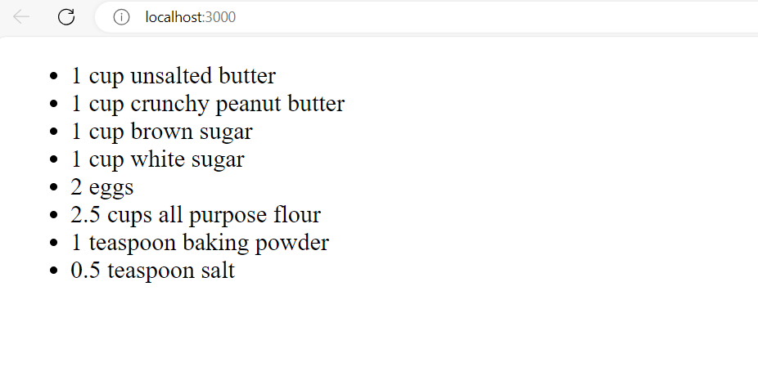

Slide 20
we’ve hardcoded this data into the component.
What if we could build one component and then we could pass data into that component as properties? And then what if that component could render the data dynamically? Here’s an array of items needed to put together a recipe:
code
const items = [ "1 cup unsalted butter", "1 cup crunchy peanut butter", "1 cup brown sugar", "1 cup white sugar", "2 eggs", "2.5 cups all purpose flour", "1 teaspoon baking powder", "0.5 teaspoon salt" ];

Slide 21
Then we’ll adjust the IngredientsList component to map over these items, constructing a li for however many items are in the items array:
code
function IngredientsList() { return React.createElement( "ul", { className: "ingredients" }, items.map((ingredient, i) => React.createElement("li", { key: i }, ingredient) ) ); }

Slide 22
Then we’ll pass those items as the second property of the createElement call in ReactDOM.render:
code
ReactDOM.render( React.createElement(IngredientsList, { items }, null), document.getElementById("root") );

Slide 23
Updated App.js file.
import React from 'react';
import ReactDOM from 'react-dom';
const items = [
"1 cup unsalted butter",
"1 cup crunchy peanut butter",
"1 cup brown sugar",
"1 cup white sugar",
"2 eggs",
"2.5 cups all purpose flour",
"1 teaspoon baking powder",
"0.5 teaspoon salt"
];
function IngredientsList() {
return React.createElement("ul", { className: "ingredients" }, items.map((ingredient, i) => React.createElement("li", { key: i }, ingredient)));
}
ReactDOM.render(
React.createElement(IngredientsList, { items }, null),
document.getElementById("root")
);
export default IngredientsList;

Slide 24
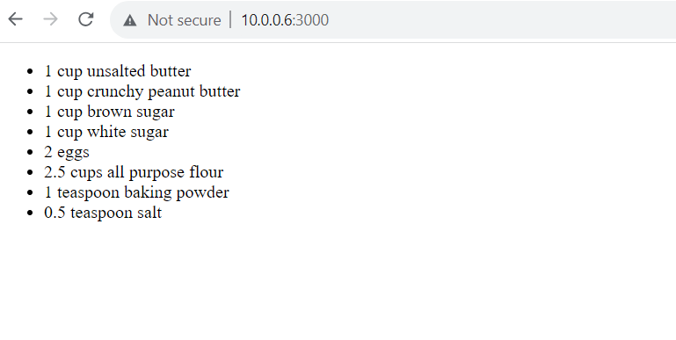
Output

Slide 25
Looking at the DOM. The data property items is an array with eight ingredients. Because we made the li tags using a loop, we were able to add a unique key using the index of the loop:
code
<IngredientsList items="[...]"> <ul className="ingredients"> <li key="0">1 cup unsalted butter</li> <li key="1">1 cup crunchy peanut butter</li> <li key="2">1 cup brown sugar</li> <li key="3">1 cup white sugar</li> <li key="4">2 eggs</li> <li key="5">2.5 cups all purpose flour</li> <li key="6">1 teaspoon baking powder</li> <li key="7">0.5 teaspoon salt</li> </ul> </IngredientsList>

Slide 26
Creating our component this way will make the component more flexible.
Whether the items array is 1 item or 100 items long, the component will render each as a list item.
Another adjustment we can make here to reference the items array from React props.
Instead of mapping over the global items, we will make items available on the props object.
Start by passing props to the function then mapping over props.items:

Slide 27
code
function IngredientsList(props) { return React.createElement( "ul", { className: "ingredients" }, props.items.map((ingredient, i) => React.createElement("li", { key: i }, ingredient) ) ); }

Slide 28
Updated App.js
import React from 'react';
//import ReactDOM from 'react-dom';
function IngredientsList(props){
return React.createElement(
"ul",
{className: "ingredients" },
props.items.map((ingredient, i) =>
React.createElement("li", {key: i }, ingredient)
)
);
}
export default IngredientsList;

Slide 29
Updated index.js
import React from 'react';
import ReactDOM from 'react-dom/client';
//import './index.css';
import App from './App';
//import reportWebVitals from './reportWebVitals';
const root = ReactDOM.createRoot(document.getElementById('root'));
const items = [
"1 cup unsalted butter",
"1 cup crunchy peanut butter",
"1 cup brown sugar",
"1 cup white sugar",
"2 eggs",
"2.5 cups all purpose flour",
"1 teaspoon baking powder",
"0.5 teaspoon salt"
];
root.render(
<React.StrictMode>
<App items={items} />
</React.StrictMode>
);

Slide 30
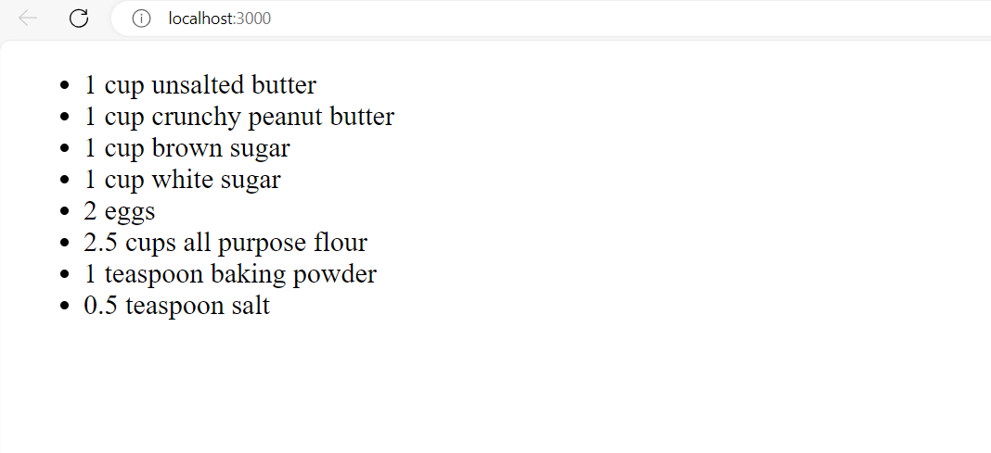

Slide 31
We could also clean up the code a bit by destructuring items from props:

Slide 32
Updated App.js
import React from 'react';
//import ReactDOM from 'react-dom';
function IngredientsList({ items }) {
return React.createElement(
"ul",
{ className: "ingredients" },
items.map((ingredient, i) =>
React.createElement("li", { key: i }, ingredient)
)
);
}
export default IngredientsList;

Slide 33
Updated index.js
import React from 'react';
import ReactDOM from 'react-dom/client';
//import './index.css';
import App from './App';
//import reportWebVitals from './reportWebVitals';
const root = ReactDOM.createRoot(document.getElementById('root'));
const items = [
"1 cup unsalted butter",
"1 cup crunchy peanut butter",
"1 cup brown sugar",
"1 cup white sugar",
"2 eggs",
"2.5 cups all purpose flour",
"1 teaspoon baking powder",
"0.5 teaspoon salt"
];
root.render(
<React.StrictMode>
<App items={items} />
</React.StrictMode>
);

Slide 34
