Slide 1
Sometimes what you need is chaos

Slide 2





MESSAGE FROM
LEO MATTOS
Technical Acceleration Coach
Developer
Soccer coach
Adventurer
IT Services
Principal Consultant
20+ years
In the industry
Licensed for kids
U10 - U14
Meyers Briggs
abbreviated test

Slide 3
Today’s Objectives
1
Review the five phases of chaos engineering
3
Plan your first chaos engineering experiment
Understand how the experiments are structured
Review what is required and how to select the first experiment
2
Define what can go wrong and how to test it
4
Future…
Lean in the conversation and create the future of fun
Reflect on where the issues can happen on distributed systems

Slide 4
How chaos engineering will guarantee the resilience of your services
Notes:
There’s a fact: sometimes, something goes wrong. Are your services prepared for this moment? It isn’t only about to predict any kind of failure, but how to deal with the unpredictable. Ask yourself: my services are resilient?
Chaos Engineering is a disciplined approach to identifying failures before they become outages. By proactively testing how a system responds under stress, you can identify and fix failures before they end up in the news.
Chaos Engineering lets you compare what you think will happen to what actually happens in your systems. You literally “break things on purpose” to learn how to build more resilient systems.

Slide 5
“Chaos Engineering is the discipline of experimenting on a system in order to build confidence in the system’s capability to withstand turbulent conditions in production”
Notes:
This is the “official definition”
This definition came from the "Principles of Chaos Engineering" (1) website, a collaborative set of definitions and thoughts about this discipline.
It's helpful to think of a vaccine or a flu shot where you inject yourself with a small amount of a potentially harmful foreign body in order to prevent illness. Chaos Engineering is a tool we use to build such an immunity in our technical systems by injecting harm (like latency, CPU failure, or network black holes) in order to find and mitigate potential weaknesses.
These experiments have the added benefit of helping teams build muscle memory in resolving outages, akin to a fire drill (or changing a flat tire, in the Netflix analogy). By breaking things on purpose we surface unknown issues that could impact our systems and customers.

Slide 6
“Resilience is the ability of a system to adapt itself due to changes, failures, and anomalies”
Notes:
A good example of resilience is when your Gmail works in classic mode. You can't use a lot of its features, but it's still working. It's using graceful degradation to provide resilience to the application.

Slide 7
“Sometimes something will fail. Even with the best systems.”
Notes:
You can build the best infrastructure. You can code the best code. Even then, something will go wrong at some point.
What's the role of Chaos Engineering in distributed systems?
Distributed systems are inherently more complex than monolithic systems, so it’s hard to predict all the ways they might fail. The eight fallacies of distributed systems shared by Peter Deutsch and others at Sun Microsystems describe false assumptions that programmers new to distributed applications invariably make.
Fallacies of Distributed Systems:
The network is reliable
Latency is zero
Bandwidth is infinite
The network is secure
Topology doesn't change
There is one administrator
Transport cost is zero
The network is homogeneous
Many of these fallacies drive the design of Chaos Engineering experiments such as “packet-loss attacks” and “latency attacks”. For example, network outages can cause a range of failures for applications that severely impact customers. Applications may stall while they wait endlessly for a packet. Applications may permanently consume memory or other Linux system resources. And even after a network outage has passed, applications may fail to retry stalled operations, or may retry too aggressively. Applications may even require a manual restart. Each of these examples need to be tested and prepared for.
What are the customer, business, and technical benefits of Chaos Engineering?
Customer: the increased availability and durability of service means no outages disrupt their day-to-day lives.
Business: Chaos Engineering can help prevent extremely large losses in revenue and maintenance costs, create happier and more engaged engineers, improve in on-call training for engineering teams, and improve the SEV (incident) Management Program for the entire company.
Technical: the insights from chaos experiments can mean a reduction in incidents, reduction in on-call burden, increased understanding of system failure modes, improved system design, faster mean time to detection for SEVs, and reduction in repeated SEVs.

Slide 8
“Inject failures on purpose before they happen unexpectedly. Find the weaknesses and fix them.”
Notes:
If failures will happen anyway, why not use it to improve your services capabilities to face them?
Where should I inject chaos?
Usually, our services are a set of different technologies, environments, and resources. All of them have different roles and, usually, all of them can fail. So if you want to start trying them, there are some suggestions where you could start.
Application layer
Your code has features, behaviors, and flows. Try them.
Cache layer
Modern applications rely more and more on caches. What if a cache isn't available? What if it's been building while you are trying to access it? Is there any alternative repository in case of failure?
Database layer
Shutdown the database, take your popcorn, sit down, and watch it.
Cloud layer
In the Cloud Native age, are your Cloud Native applications ready to… cloud issues? What if an instance goes down? What if a policy is changed by someone else? What a whole datacenter just die?

Slide 9
Principles of Chaos Engineering
Build a Hypothesis around Steady State Behavior
Vary Real-world Events
The harder it is to disrupt the steady state, the more confidence we have in the behavior of the system. If a weakness is uncovered, we now have a target for improvement before that behavior manifests in the system at large.
Run Experiments in Production
Minimize Blast Radius
Automate Experiments to Run Continuously
Notes:
ADVANCED PRINCIPLES
The following principles describe an ideal application of Chaos Engineering, applied to the processes of experimentation described above. The degree to which these principles are pursued strongly correlates to the confidence we can have in a distributed system at scale.
Build a Hypothesis around Steady State Behavior
Focus on the measurable output of a system, rather than internal attributes of the system. Measurements of that output over a short period of time constitute a proxy for the system’s steady state. The overall system’s throughput, error rates, latency percentiles, etc. could all be metrics of interest representing steady state behavior. By focusing on systemic behavior patterns during experiments, Chaos verifies that the system does work, rather than trying to validate how it works.
Vary Real-world Events
Chaos variables reflect real-world events. Prioritize events either by potential impact or estimated frequency. Consider events that correspond to hardware failures like servers dying, software failures like malformed responses, and non-failure events like a spike in traffic or a scaling event. Any event capable of disrupting steady state is a potential variable in a Chaos experiment.
Run Experiments in Production
Systems behave differently depending on environment and traffic patterns. Since the behavior of utilization can change at any time, sampling real traffic is the only way to reliably capture the request path. To guarantee both authenticity of the way in which the system is exercised and relevance to the current deployed system, Chaos strongly prefers to experiment directly on production traffic.
Automate Experiments to Run Continuously
Running experiments manually is labor-intensive and ultimately unsustainable. Automate experiments and run them continuously. Chaos Engineering builds automation into the system to drive both orchestration and analysis.
Minimize Blast Radius
Experimenting in production has the potential to cause unnecessary customer pain. While there must be an allowance for some short-term negative impact, it is the responsibility and obligation of the Chaos Engineer to ensure the fallout from experiments are minimized and contained.

Slide 10
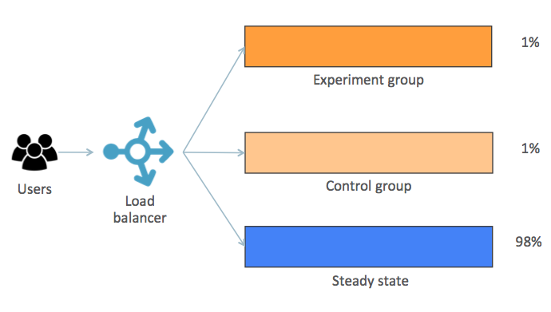

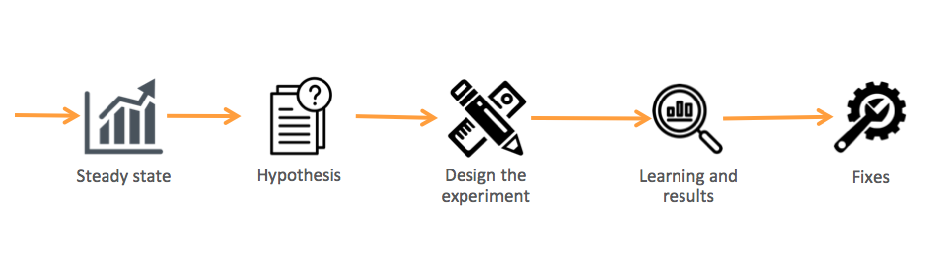
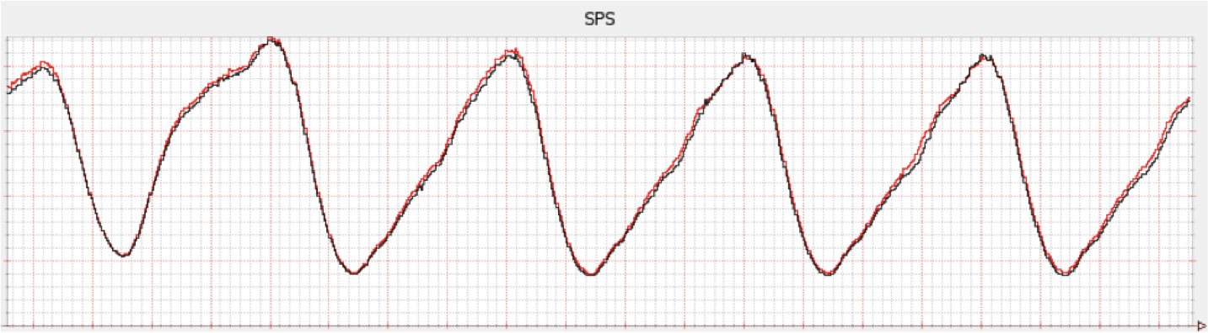
The 5 phases of Chaos Engineering
Phase 1: Steady-state
Phase 2: Hypothesis
Phase 3: Design the experiment
Phase 4: Learning and result
Phase 5: Fixes
Notes:
Phase 1: Steady-state
It's the regular behavior of your service based on its business metric.
Business metric it *the* metric! Is that metric that shows you the real experience that your end users have with your system.
The example below is taken from an article (2) from Netflix:
Steady-state of SPS at NetflixThe graphic shows the steady-state of SPS (Streams Per Second) at Netflix. This is their business metric. So they can track its behavior week after week until they find its regular usage. That's a steady-state.
So whenever you are monitoring your system or, in our case, planning and executing your fail injections, all your tracking will be based on the business metric.
Phase 2: Hypothesis
After you have your business metric defined and know your steady-state, then it's time to start asking questions.
What if:
A service return 404?
Database stops working?
Requests increases unexpectedly?
Latency increases by 100%?
A container stops working?
A port becomes inaccessible?
Of course, these are just examples. The important part is: make questions that you really don't know the answer (this should be obvious, right?). So, for example, if you already know that your service doesn't have a high availability environment, doesn't make any sense to test it. First, build it, then try possibilities around it.
Phase 3: Design the experiment
Now that you have a hypothesis that you don't know the answer and are worthy of trying, start designing your experiments.
Some best practices around it are:
Start small
Make it closest possible to the production environment
Minimize the blast radius
Have an emergency stop button
One way to implement it is by using a kind of canary deployment approach:
Minimize the blast radiousUnderstand what is going on in the image:
Steady-state: regular behavior
Control group: a small set of users that are under the same conditions of the steady-state
Experiment group: has the same size as the Control group, but it's where the chaos will be injected
We have the Control and Experiment groups with the same size for the sake of comparative results at the end of the experiment.
To separate both groups from the steady-state flow you can, for example, include a property in the request header and use it. It can be done in the load balancer without any changes in the application itself.
Phase 4: Learning and results
At the end of the experiments, it's time to collect the results and get the lessons learned. So here you will evaluate:
How much time to detect the failure?
How much time to someone be notified?
How much time to start the graceful degradation?
How much time to recovery (partial and full)?
How much time to be back to a steady-state?
Phase 5: Fixes
Well… this is the self-explanatory part!
Keep in mind that when working in a chaos engineering approach, it's all about learning from failure. That's why you create them on purpose, in a controlled and managed environment.

Slide 11
My Chaos Engineering Story
Regional to global application
Re platforming
Architecture re evaluation
How resilient is our app
Knowing our core values and features
Notes:
This slide to tell the story of the scaling the regional application to global and having to support a much higher resiliency requirements.
We had a regional application, running in proprietary servers ( shared but dedicated )

Slide 12
Planning your First Experiment
Creating a Hypothesis
One of the most powerful questions in Chaos Engineering is “What could go wrong?”. By asking this question about our services and environments, we can review potential weaknesses and discuss expected outcomes. Similar to a risk assessment, this informs priorities about which scenarios are more likely (or more frightening) and should be tested first.
Measuring the Impact
Have a rollback plan
Go for it!
Have fun!!
Notes:
Discuss in pairs after we present the content one hypothesis with what go wrong, the type of failure to inject and what would be the expected outcome of the experiment. Not what you wish it would.
By sitting down as a team and whiteboarding your service(s), dependencies (both internal and external), and data stores, you can formulate a picture of “What could go wrong?”. When in doubt, injecting a failure or a delay into each of your dependencies is a great place to start.
Creating a Hypothesis
You have an idea of what can go wrong. You have chosen the exact failure to inject. What happens next? This is an excellent thought exercise to work through as a team. By discussing the scenario, you can hypothesize on the expected outcome before running it live. What will be the impact to customers, to your service, or to your dependencies?
Measuring the Impact
To understand how your system behaves under stress, you need to measure your system’s availability and durability. It is good to have a key performance metric that correlates to customer success (such as orders per minute, or stream starts per second). As a rule of thumb, if you ever see an impact to these metrics, you want to halt the experiment immediately. Next is measuring the failure itself where you want to verify (or disprove) your hypothesis. This could be the impact on latency, requests per second, or system resources. Lastly, you want to survey your dashboards and alarms for unintended side effects.
Have a Rollback Plan
Always have a backup plan in case things go wrong, but accept that sometimes even the backup plan can fail. Talk through how you’re going to revert the impact. If you’re running commands by hand, be thoughtful not to break ssh or control plane access to your instances. One of the core aspects of Gremlin is safety. All of our attacks can be reverted immediately, allowing you to safely abort and return to steady state if things go wrong.
Go fix it!
After running your first experiment, hopefully, there is one of two outcomes: either you’ve verified that your system is resilient to the failure you introduced, or you’ve found a problem you need to fix. Both of these are good outcomes. On one hand, you’ve increased your confidence in the system and its behavior, and on the other you’ve found a problem before it caused an outage.
Have Fun
Chaos Engineering is a tool to make your job easier. By proactively testing and validating your system’s failure modes you will reduce your operational burden, increase your availability, and sleep better at night. Gremlin makes it safe and simple to get started—email us to get started today!

Slide 13
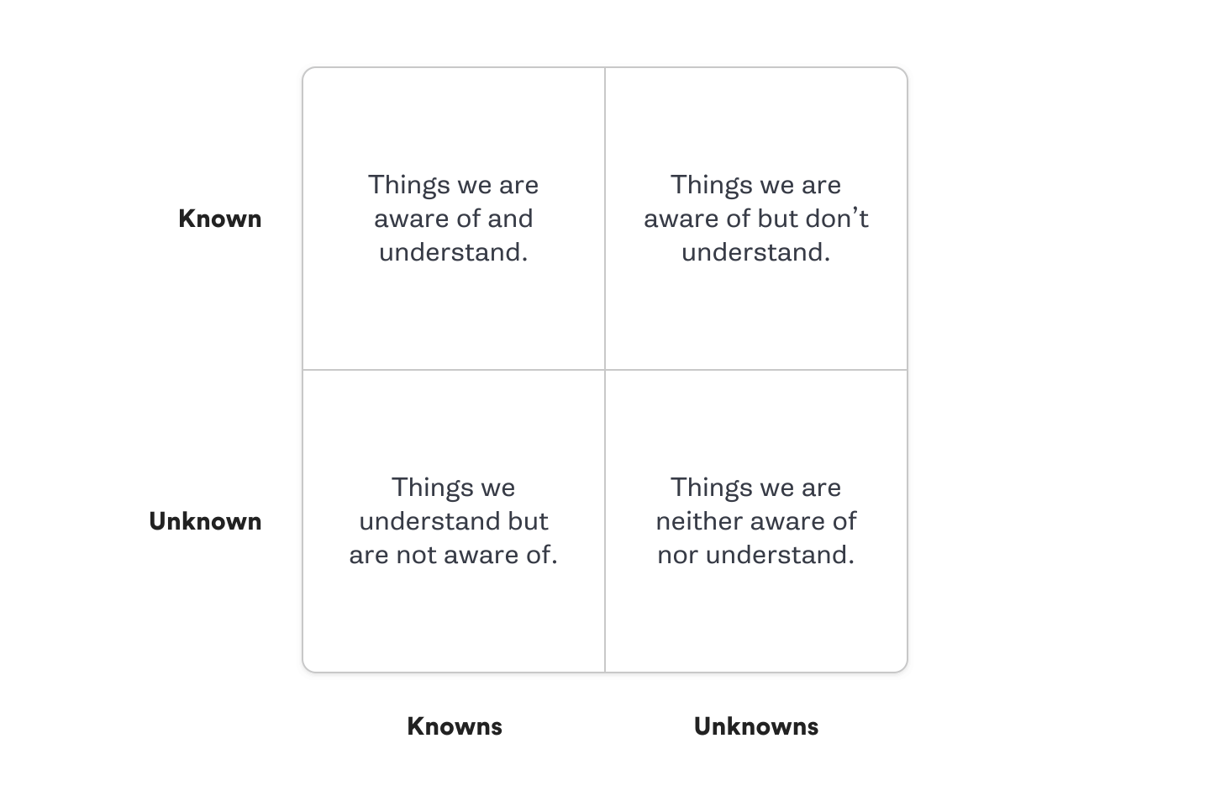
Which Chaos Engineering experiments do you perform first?
Notes:
We argue that you should perform your experiments in the following order:
Known Knowns - Things you are aware of and understand
Known Unknowns - Things you are aware of but don’t fully understand
Unknown Knowns - Things you understand but are not aware of
Unknown Unknowns - Things you are neither aware of nor fully understand
To illustrate this in practice with examples, we will demonstrate how to select experiments based on a sharded MySQL Database. In this example, we have a cluster of 100 MySQL hosts with multiple shards per host.
In one region, we have a primary database host with two replicas and we use semi-sync replication. We also have a pseudo primary and two pseudo replicas in a different region.
Known-Knowns
We know that when a replica shuts down it will be removed from the cluster. We know that a new replica will then be cloned from the primary and added back to the cluster.
Known-Unknowns
We know that the clone will occur, as we have logs that confirm if it succeeds or fails, but we don’t know the weekly average of the mean time it takes from experiencing a failure to adding a clone back to the cluster effectively.
We know we will get an alert that the cluster has only one replica after 5 minutes but we don’t know if our alerting threshold should be adjusted to more effectively prevent incidents.
Unknown-Knowns
If we shutdown the two replicas for a cluster at the same time, we don’t know exactly the mean time during a Monday morning it would take us to clone two new replicas off the existing primary. But we do know we have a pseudo primary and two replicas which will also have the transactions.
Unknown-Unknowns
We don’t know exactly what would happen if we shutdown an entire cluster in our main region, and we don’t know if the pseudo region would be able to failover effectively because we have not yet run this scenario.
We would create the following chaos experiments, working through them in order:
Known-Knowns: shut down one replica and measure the time it takes for the shutdown to be detected, the replica to be removed, the clone to kick-off, the clone to be completed, and the clone to be added back to the cluster. Before you kick off this experiment increase replicas from two to three. Run the shutdown experiment at a regular frequency but aim to avoid the experiment resulting in 0 replicas at any time. Report on the mean total time to recovery for a replica shutdown failure and break this down by day and time to account for peak hours.
Known-Unknowns: Use the results and data of the known-known experiment to answer questions which would currently be “known-unknowns”. You will now be able to know the impact the weekly average of the mean time it takes from experiencing a failure to adding a clone back to the cluster effectively. You will also know if 5 minutes is an appropriate alerting threshold to prevent SEVs.
Unknown-Knowns: Increase the number of replicas to four before conducting this experiment. Shutdown two replicas for a cluster at the same time, collect the mean time during a Monday morning over several months to determine how long it would take us to clone two new replicas off the existing primary. This experiment may identify unknown issues, for example, the primary cannot handle the load from cloning and backups at the same time and you need to make better use of the replicas.
Unknown-Unknowns: Shut down of an entire cluster (primary and two replicas) would require engineering work to make this possible. This failure may occur unexpectedly in the wild, but you are not yet ready to handle it. Prioritize the engineering work to handle this failure scenario before you perform chaos experiments.

Slide 14
How we did it story
Workshop to gather hypothesis and behaviors
Aligned a team to build experiments
Continual technical tools evaluations
Kubernetes ( containerized components to reuse technology )
Notes:
Here to tell we created a dedicated Chaos Engineering team, by enabling the DevOps/ Delivery team into this/
Kubernetes & Chaos Engineering
Makes sense to use Kubernetes to talk about chaos engineering for a couple of reasons:
K8s has some natives features for resilience
It manages pods status and performs restarts based on it
K8s clusters can have nodes — and so pods — distributed in different regions/AZs/ADs
So it's a great environment to play around with chaos!
Also, there is a good set of tools that you can use to apply chaos using Kubernetes. Some of them are:
Istio
Chaos Toolkit
Chaos Monkey
Kube Monkey
Let's briefly check them.
Istio
Istio has pretty nice features to help inject failures into your service just by working on its YAML file. For example:
Causes a 7s delay for user "jason"
Returns a HTTP 500 to user "jason"There's a whole doc provided by Istio team regarding fault injection at (3).
Chaos Toolkit
It has a set of drivers to a lot of cloud providers and platforms as shown in the image below:
Chaos Toolkit integrationsThe good part is that it's fully based on the 5 Phases of Chaos Engineering covered in this post.
And it also has specific support for Kubernetes (5) based on YAML files:
Chaos Toolkit configured to randomly kill podsYou can check for more information on it’s Github repository at (4).
Chaos Monkey
It kills containers and/or virtual machines in the production environment. If you are using Spinnaker (6), it's already integrated out of the box.
You can check for more information on it’s Github repository at (7).
Kube Monkey
It's based on Kube Monkey but made specifically for Kubernetes. Your service needs to opt-in for its pods being killed:
Enables your deployment to have pods killed by Kube MonkeyYou can also schedule it to execute accordingly to your needs:
Schedule configurationIt's important also to define the namespaces that are blacklisted (as in the image above). So, for example, you won't run into a risk to kill the management pods of your cluster (even if some nuts opt them in).
Check more details about it at (8).
Your turn!
Getting started into chaos engineering world is all about… starting! As mentioned in this post, start small… baby steps for the win.
Choose the smallest and easiest possible part of your services and apply the principles covered here. If you need any help, just say it!

Slide 15
Your turn!
Getting started into chaos engineering world is all about… starting! Start small… baby steps for the win.
Choose the smallest and easiest possible part of your services and apply the principles covered here. If you need any help, just say it!
Notes:
There’s a fact: sometimes, something goes wrong. Are your services prepared for this moment? It isn’t only about to predict any kind of failure, but how to deal with the unpredictable. Ask yourself: my services are resilient?
Chaos Engineering is a disciplined approach to identifying failures before they become outages. By proactively testing how a system responds under stress, you can identify and fix failures before they end up in the news.
Chaos Engineering lets you compare what you think will happen to what actually happens in your systems. You literally “break things on purpose” to learn how to build more resilient systems.

Slide 16
“We learn from failure, not from success” — Dracula, Bram Stoker
@mattos_leonardo Leonardo.mattos@gmail.com

Slide 17
