Slide 1
Aha
New Car rental service
Professor – Obinna Kalu
Leonardo S. T. Contreras
Gustavo do Rego Souza
BON NGUYEN
SON Nguyen

Slide 2
Contents
Problem Statement
Aha Approach
Use Case Model (implementation)
Aha Solution
Static model (Main class diagram)
Database design model (E-R diagram)
Sequence diagram for your main use-case.
Q&A

Slide 3
Problem statement
Car rental prices are normally decided by Car Rental Services.
You do not know what to do when you have unused or less used cars.
You do not want to be a taxi driver like Uber, Grab, Didi

Slide 4
Project introduction
Aha is the solution to balance car rental needs of buyers (customers) and sellers (car owners):
Online web application (24/7).
Like a traditional way but with low investment.
Efficiently managing vehicles by maximizing the utilization of un-used or less-used cars
Create better services and balance car rental prices
Better managing users or customers

Slide 5
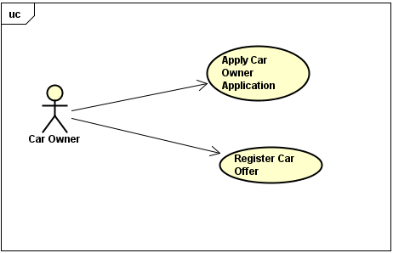
Use case model – Car owner

Slide 6
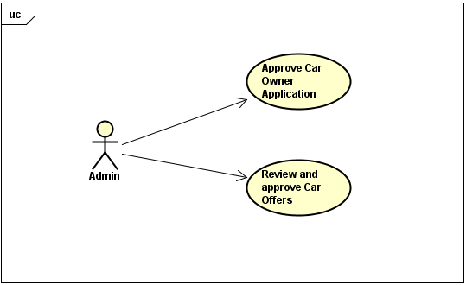
Use case model – Admin

Slide 7
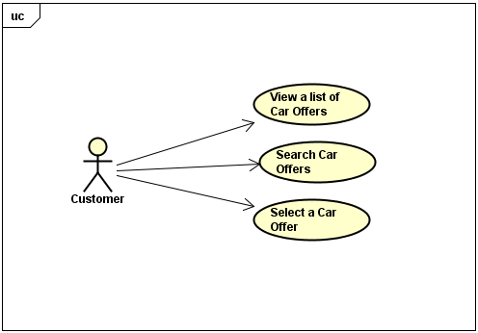
Use case model – Customer

Slide 8
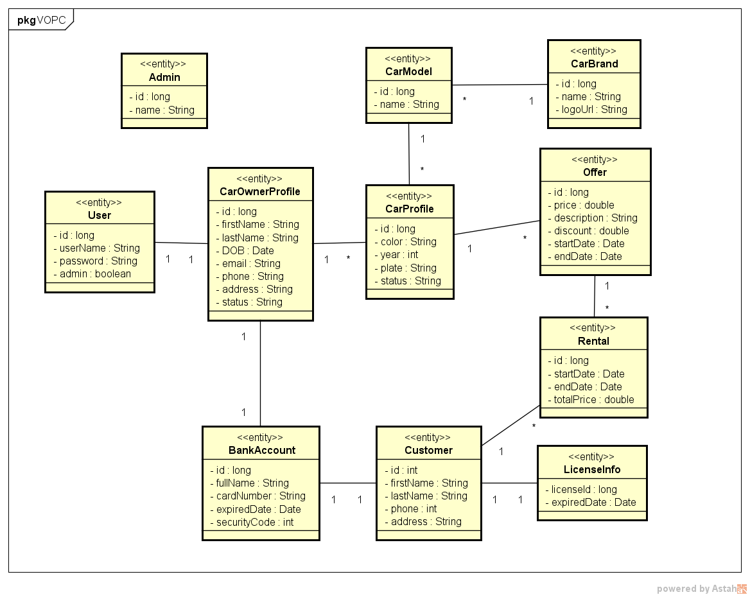
Static model (main class diagram)

Slide 9
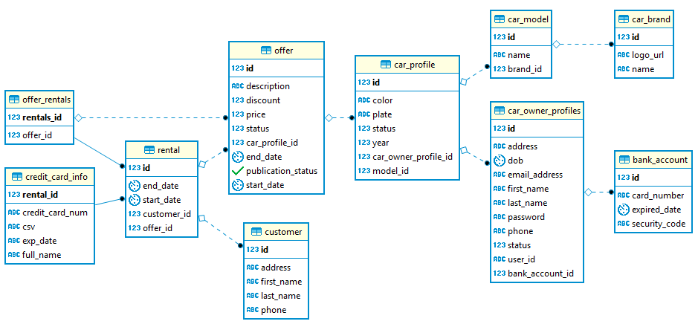
E-R diagrams

Slide 10
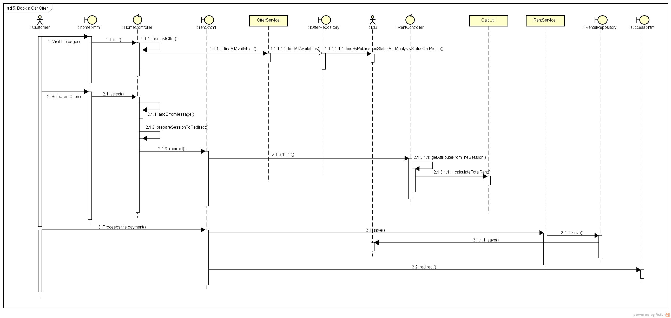
Main sequence diagram

Slide 11
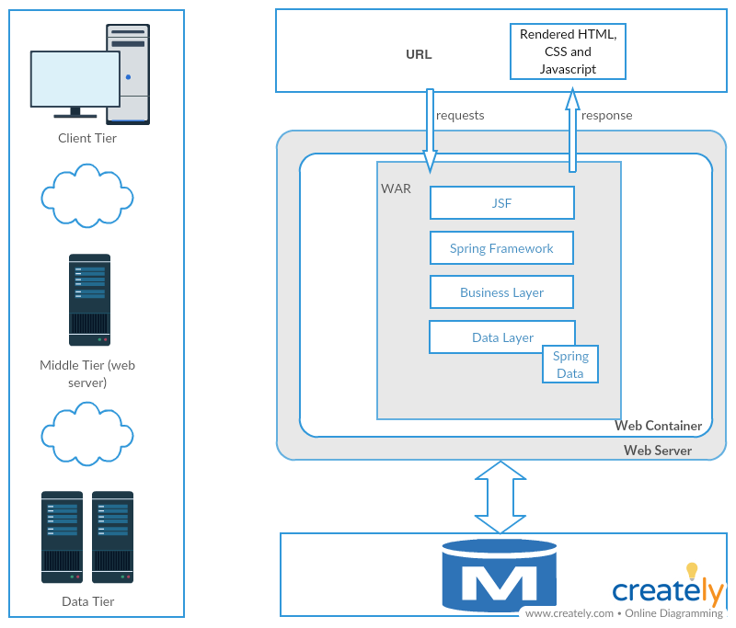
System architecture

Slide 12
Thank you
Questions and Answers

