Slide 1
Aha
New Car rental service
Professor – Obinna Kalu
Leonardo S. T. Contreras
Gustavo do Rego Souza
BON NGUYEN
SON Nguyen

Slide 2
Contents
Statement of Problem
Aha Solution
Some Comparisons
Use Case Model
Use Case Descriptions
System Architecture Diagram
Key Abstractions

Slide 3
Statement of problem
Have you ever thought that Uber, Grab, or Didi has many successes and competes with the traditional taxi services?
And have you ever rented a car and thought that rental prices are too high?
The prices must be a bargain of market needs between buyers and sellers → Aha is born to bring benefits of both sides.

Slide 4
Aha solution
Online web application (24/7)
Like a traditional way but with low investment
Efficiency managing vehicles by maximizing the utilization of un-used or less-used cars
Create better services and reduce rental cost
By improving rental process
Better managing users or customer

Slide 5
Some comparisons
 | Aha | Traditional Car Rental
Strength | Low rental cost Low initial investment Easier and flexible | Have market
Weakness | Not market yet | Hight rental cost High initial investment

Slide 6
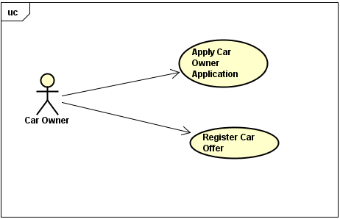
Use case model – Car owner

Slide 7
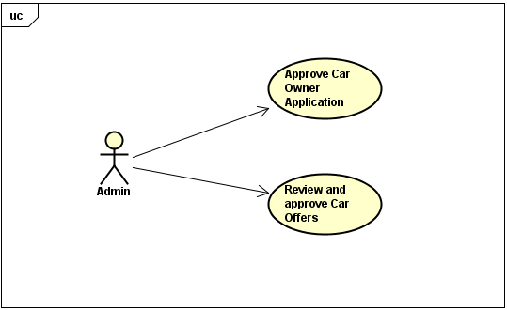
Use case model – Admin

Slide 8
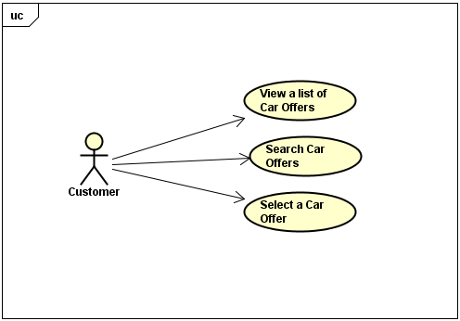
Use case model – Customer

Slide 9
Use case descriptions – Car owner
No | Use Case | Priority | Description
1 | Apply Car Owner Application | 1 | Any user can apply the application to become a partner (Car Owner)
2 | Register a car and offer a rental price | 1 | Car Owner can register their car and offer an appropriate rental price

Slide 10
Use case descriptions – Admin
No | Use Case | Priority | Description
1 | View and Approve Car Owner application | 1 | Admin can view and approve pending Car Owner application
2 | View and approve Car registration and Car rental price offer | 1 | Car Owner can view and approve Car and rental price offer of Car Owner

Slide 11
Use case descriptions – Customer
No | Use Case | Priority | Description
1 | View available cars and their offers | 1 | Any user can view available cars and offers
2 | Search/filter cars and rental price offer that match with Customer’s need | 2 | User can do searches to find available cars
3 | Book a car | 1 | User can then book a car for usage duration

Slide 12
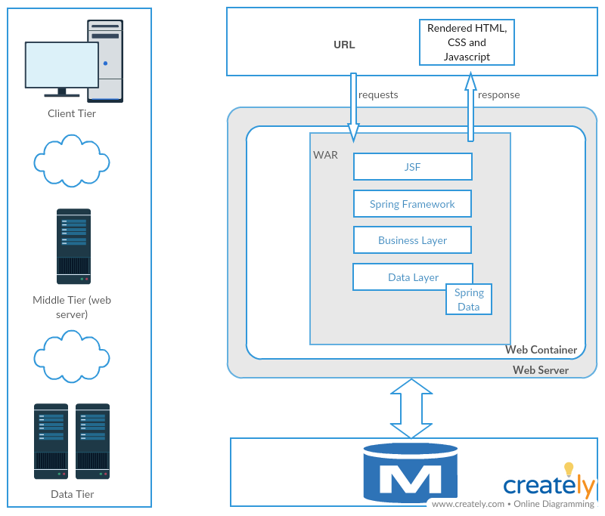
System architecture

Slide 13
Key Abstractions
Admin
CarOwnerProfile
CarProfile
Offer
CreditCardInfo
Customer
LicenseInfo
Rental/Payment

Slide 14
Thank you
Questions and Answers

