Slide 1

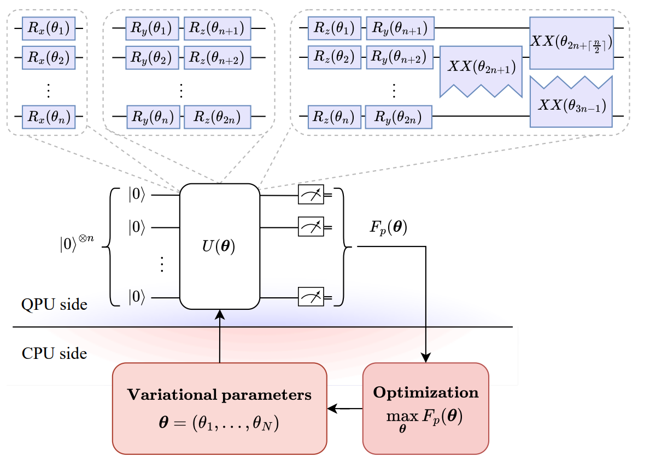
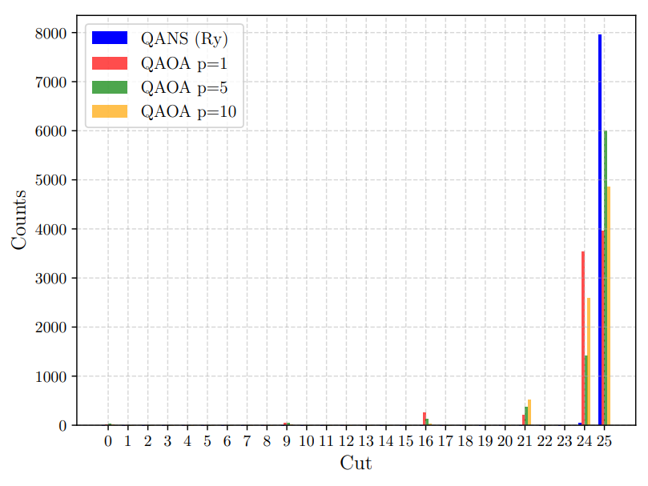
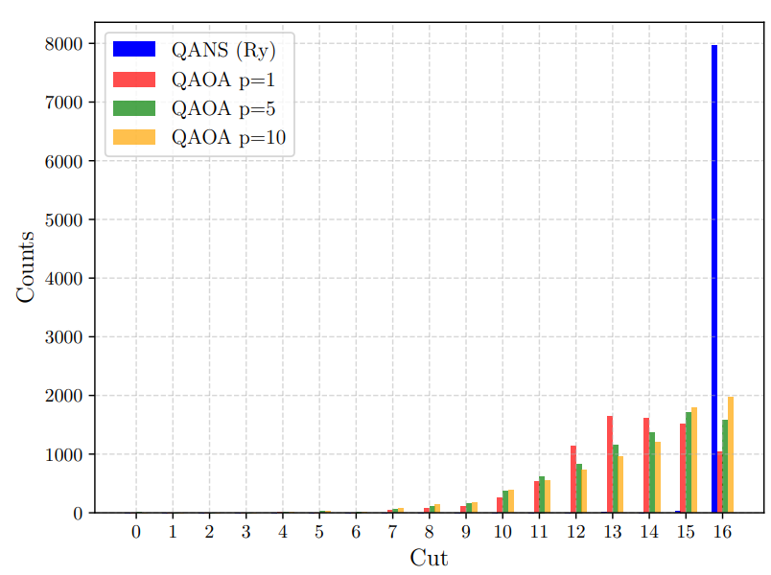
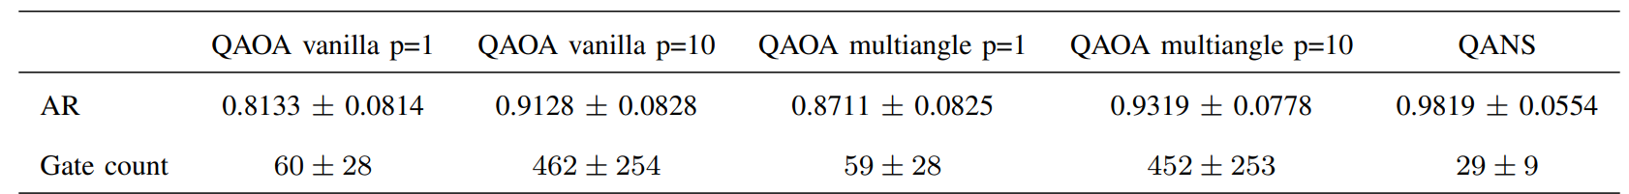

Is QAOA the Ultimate Solution for the MaxCut problem?
Leonardo Lavagna¹, Francesca De Falco¹, Massimo Panella¹
1. Dept. of Information Engineering, Electronics and Telecommunications (DIET), University of Rome “La Sapienza”, Italy
Framework
- QAOA [1] is a prominent variational algorithm designed to tackle combinatorial optimization problems.
- Since its practical performance on NISQ devices is often limited by circuit depth and complex parameter landscapes, several variants have been introduced [2].
Analysis
- Analysis of the MaxCut problem using four different types of graphs, considering the approximation ratio as the metric.
- Comparison with vanilla QAOA and multiangle QAOA with varying numbers of layers p.
OVERVIEW
Technique
- The QANS is a quantum neural networks proposed for solving the MaxCut problem and represents an alternative approach to QAOA.
Novelties and findings
- QANS outperforms both vanilla QAOA and multiangle QAOA in terms of approximation ratio.
- QANS achieves excellent results even with a very low gate count, making it particularly suitable for NISQ devices.
networks (QLSTM) and classical networks (Bi-LSTM, LSTM, GRU).
Quantum neural network framework: QANS is a quantum neural network-based approach inspired by variational quantum algorithms [3] for solving the MaxCut problem.
Initialization: Given an $n$-qubit register, the system is initialized in the computational basis state $ψ_{0}=∣0{\left.⟩\right.}^{⊗n}$.
Parameterized evolution: The state evolves under a parameterized unitary $U\left(θ\right)$, resulting in $ψ\left(θ\right)=U\left(θ\right)ψ_{0}$.
Cost function: The cost function is defined as the expectation value of the cost Hamiltonian $H_{C}$:
$$F\left(θ\right):=\left\langle H_{C}{\left.⟩\right.}_{θ}=\left\langle ψ\left(θ\right)∣H_{C}∣ψ\left(θ\right)\right\rangle \right.$$
The goal is to find parameters $θ^{∗}$that maximize $F\left(θ\right)$.
Key difference from QAOA: Unlike QAOA, QANS does not explicitly encode the cost Hamiltonian $H_{C}$or the mixer Hamiltonian $H_{M}$. Instead, it employs alternative ansatz included both rotation-only (Rx, Ry, Rz) and universal ansatz with a single layer (p = 1), maintaining a structure shallow enough to avoid barren plateaus [4].
ARCHITECTURE
Fig. 2: Architecture of QANS
The proposed QANS model was validated through a series of experiments on different graph categories (complete graphs, Erdős–Rényi graphs, complete binary trees, and random regular graphs) considering instances with up to 10 nodes. Tests included both rotation-only (Rx, Ry, Rz) and universal ansatz with a single layer (p = 1).
The performance of QANS was compared with vanilla QAOA and multiangle QAOA, each tested up to p = 10 layers. QANS consistently outperformed both baselines, achieving an average 7% improvement over vanilla QAOA with p=10 and more than 5% over multiangle QAOA with p=10.
Analysis of the measurement outcomes (Fig. 2 and Fig.3) for Erdős–Rényi and complete graphs with n = 10 nodes shows that QANS identifies the optimal solution with significantly higher frequency. Moreover, it requires less than one tenth of the gate counts of QAOA vanilla and QAOA multiangle, confirming that QANS not only delivers strong performance but also maintains a compact, NISQ-compatible structure.
RESULTS
Fig. 2: Comparison of measurements outcomes for a complete graph with n=10.
• If the model’s performance on the testing set gets worse than on the training set over the iterations, it probably indicates overfitting
• A model is likely to overfit if it is overparametrized
Table 1: Performances of the tested architectures.
Fig. 3: Comparison of measurements outcomes for an Erdős–Rényi graph with n=10.
REFERENCES
[1] E. Farhi, J. Goldstone, and S. Gutmann, «A quantum approximate optimization algorithm», 2014.
[2] K. Blekos,et al., « A review on quantum approximateoptimization algorithm and its variants», Physics Reports, 2023.
[3] M. Cerezo, A. Arrasmith, et al., «Variational quantum algorithms», Nature Rev.Phys. v. 3, no. 9, pp. 625-644, 2021
[4] M. Larocca, S. Thanasilp, et al., «Barren Plateaus in Variational Quantum Computing», Nature Reviews Physics 1-16, 2025.

