Slide 1

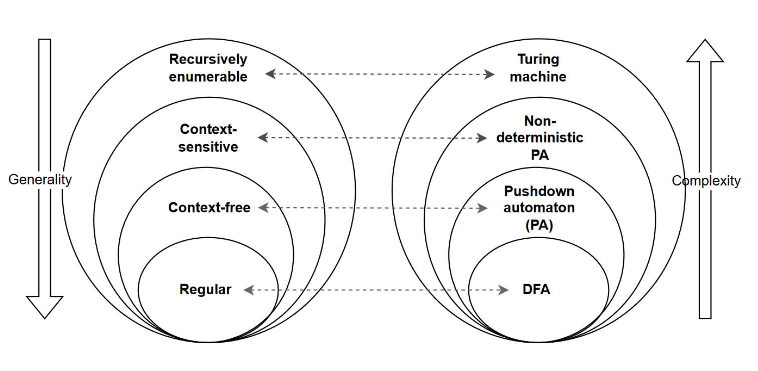
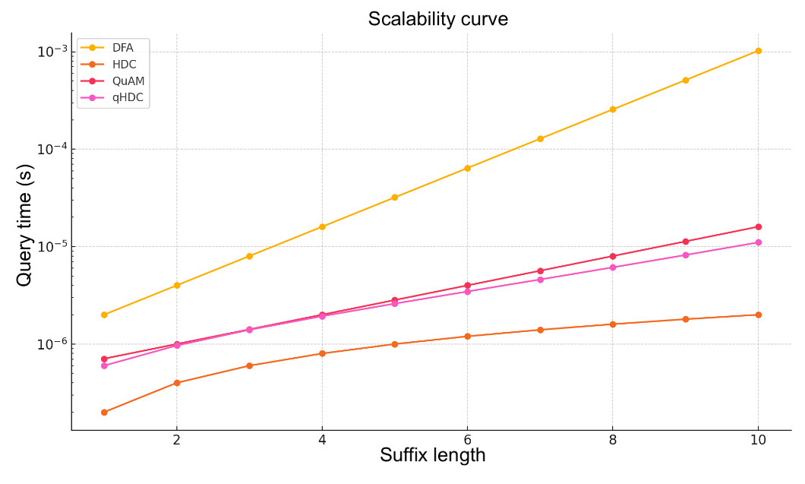
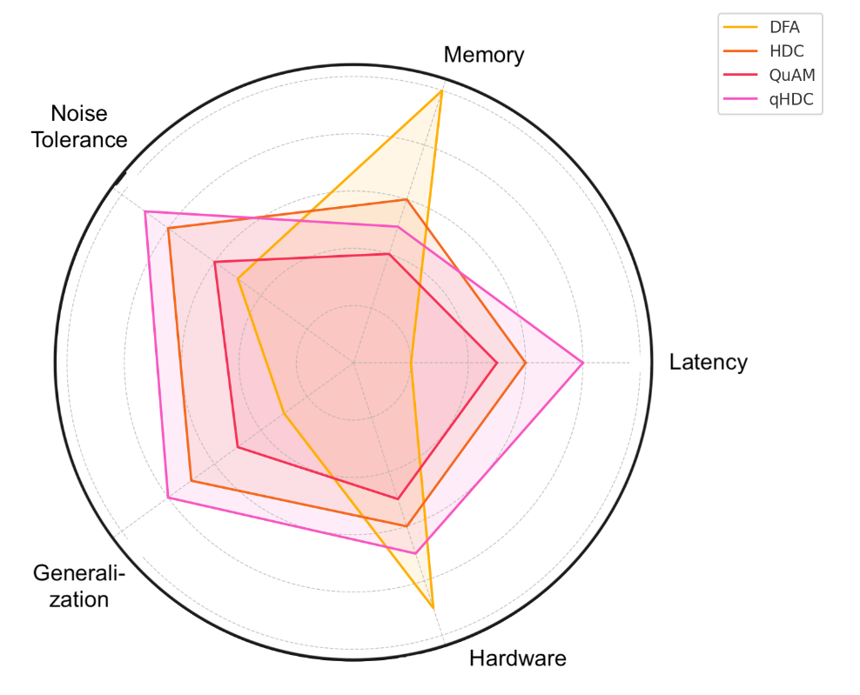
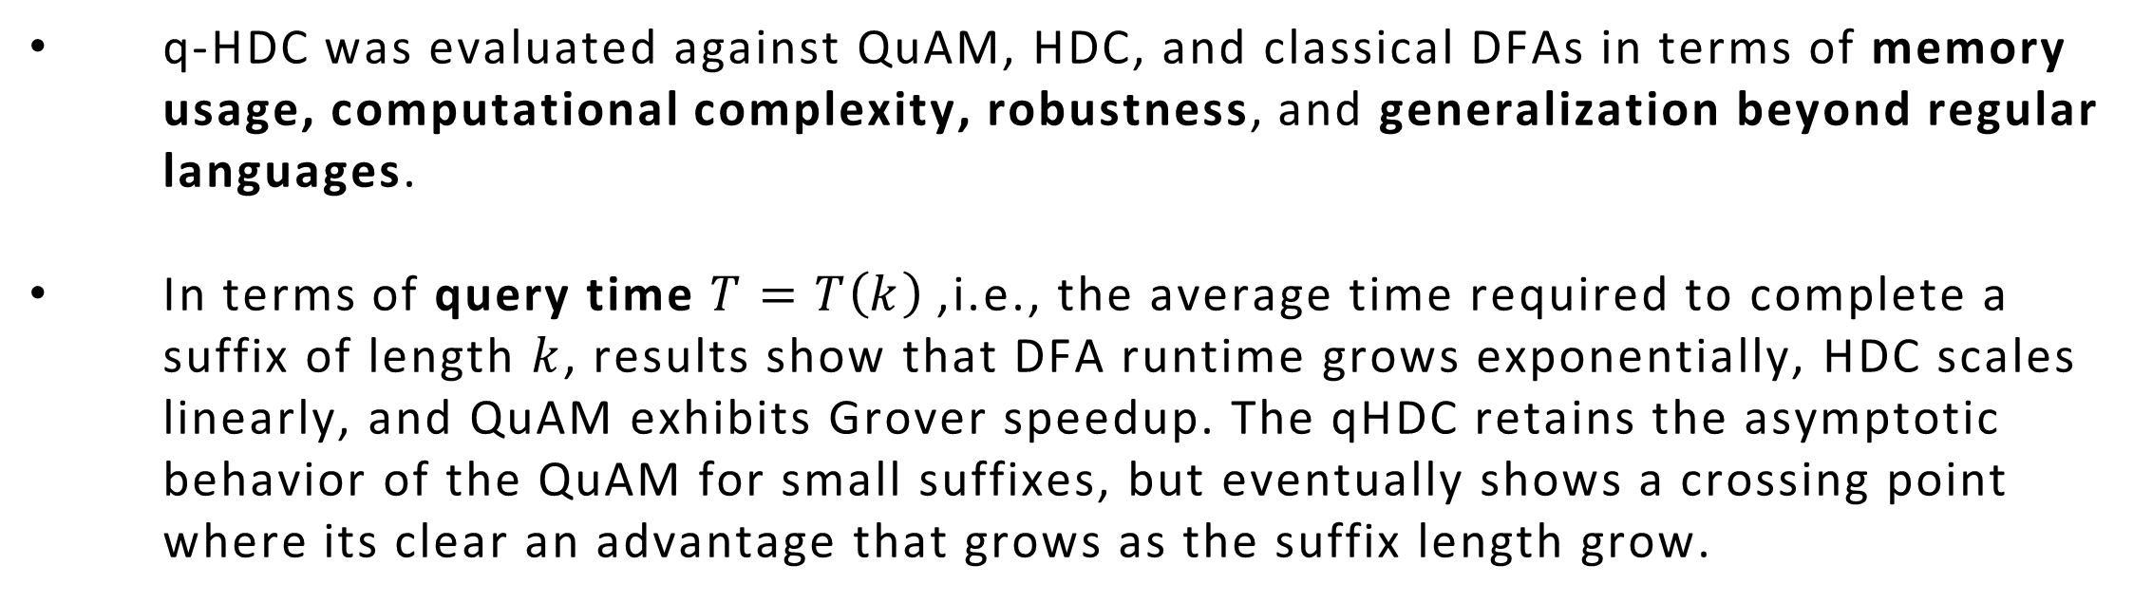

Quantum Hyperdimensional Computing for Pattern Completion
Leonardo Lavagna¹, Francesca De Falco¹, Massimo Panella¹
1. Dept. of Information Engineering, Electronics and Telecommunications (DIET), University of Rome “La Sapienza”, Italy
Framework
- Pattern completion is a key task in computational learning and symbolic reasoning, involving the inference of missing parts of a structured input under certain constraints [1]
- Classical methods work well for regular patterns but lose effectiveness as pattern structures become more complex or irregular.
Analysis
- Quantum hyperdimensional computing is investigated for solving binary pattern completion under regular and non regular constraints. The problem is formally defined and analyzed using classical automata, hyperdimensional computing and quantum memory models.
OVERVIEW
Technique
- Quantum hyperdimensional computing models [2] represent a promising approach for addressing the pattern completion problem from a novel perspective.
Novelties and findings
- Quantum hyperdimensional computing combines distributed encoding with quantum associative search, providing efficient, approximate solutions with noise tolerance and scalable capacity.
multivariate time series forecasting was conducted using datasets es, and a comparison was made with quantum networks (QLSTM) and classical networks (Bi-LSTM, LSTM, GRU).
Binary Pattern Completion [1] problem aims to reconstruct a sequence $z=yω$ from a partial observation $y$under a set of constraints $C$, such as belonging to a regular language $L$. When formulated with a deterministic finite automaton $M=\left(Q , Σ , δ , q_{0} , F\right)$, it corresponds to finding paths from $\hat{δ}\left(q_{0} , y\right)$to an accepting state. Real-world scenarios, however, often require models beyond regularity, extending up to other levels of the Chomsky hierarchy.
High-Dimensional Computing (HDC) [3] encodes sequences as high-dimensional hypervectors and performs completion by constructing a bundled representation $d$of valid examples. The missing pattern is inferred by finding the completion closest to $d$. Despite its efficiency and robustness, HDC suffers from high memory demands when scaling to large datasets.
Quantum Associative Memory (QuAM) [4] prepares a superposition of all possible states, marks those matching a prefix through an oracle $U_{y}$, and amplifies them using Grover’s algorithm. The qHDC [2] framework integrates HDC operations directly within the quantum oracle, merging HDC’s symbolic manipulation capabilities with quantum amplitude amplification.
FRAMEWORK
Fig 1: Chomsky hierarchy.
q-HDC was evaluated against QuAM, HDC, and classical DFAs in terms of memory usage, computational complexity, robustness, and generalization beyond regular languages.
In terms of query time $T=T\left(k\right)$, i.e., the average time required to complete a suffix of length $k$, results show that DFA runtime grows exponentially, HDC scales linearly, and QuAM exhibits Grover speedup. The qHDC retains the asymptotic behavior of the QuAM for small suffixes, but eventually shows a crossing point where its clear an advantage that grows as the suffix length grow.
RESULTS
• If the model’s performance on the testing set gets worse than on the training set over the iterations, it probably indicates overfitting
• A model is likely to overfit if it is overparametrized
Fig 2: Query-time scalability as suffix lenght grows.
Regarding memory usage and latency, q-HDC achieves both low latency and reduced memory consumption. DFAs are memory-efficient but suffer from rapidly increasing latency, HDC is fast yet memory-intensive, and QuAM reduces memory requirements but remains slower than q-HDC.
In terms of robustness, q-HDC maintains high accuracy under noise for structured patterns and outperforms both DFA and HDC on unstructured datasets, where all models experience greater degradation.
Fig 3: Performance comparison across models (spider chart)
REFERENCES
[1] E.T. Roll, et al., “The mechanism for patter completion and pattern separation in the hippocampus” in Frontiers in System Neuroscience, 2013.
[2] L. Lavagna, et al. ‘Novel quantum approaches to hyperdimensional computing for neural networks”, Proceeding of the International Joint Conference on Neural Networks, 2025.
[3] D. Kleyko, et al. “A survey on hyperdimensional computing aka vector symbolic architectures, part i: Models and data transformations”, ACM Computing Surveys, 2023.
[4] D. Ventura et al, “ Quantum associative memory”, Information Sciences, 2000.

