Slide 1

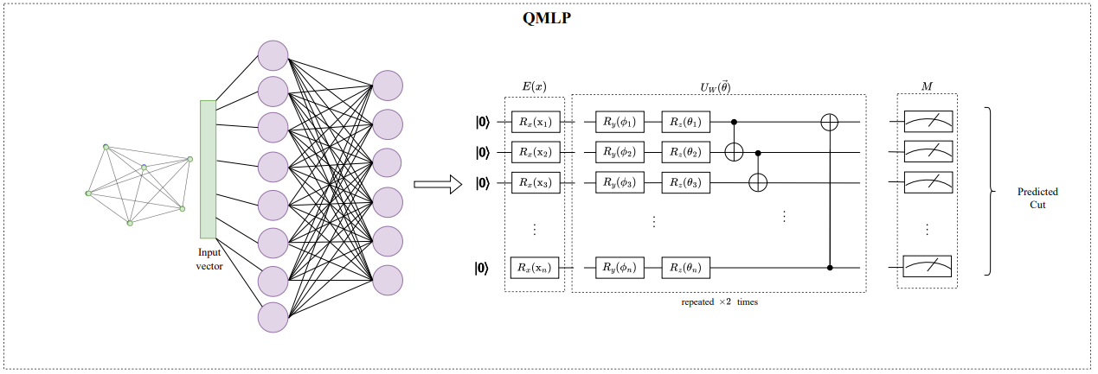
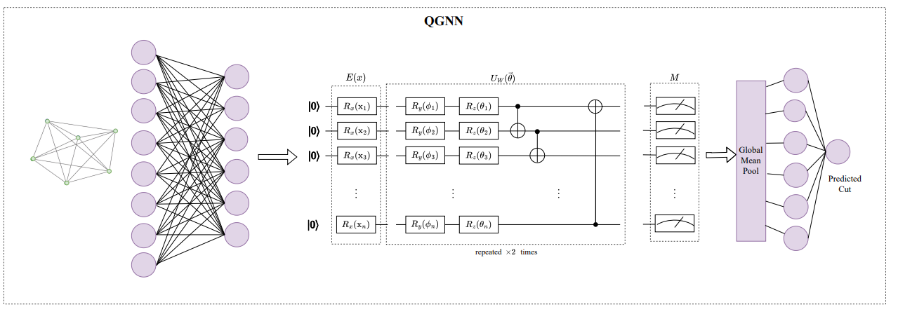
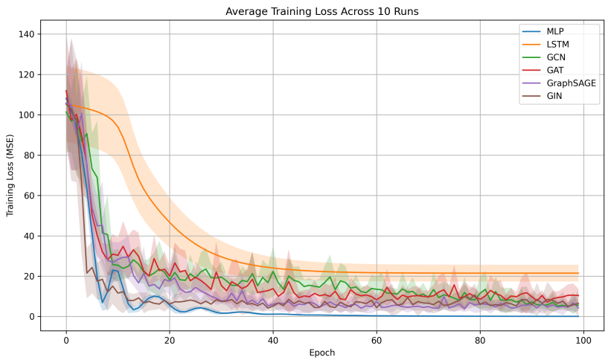
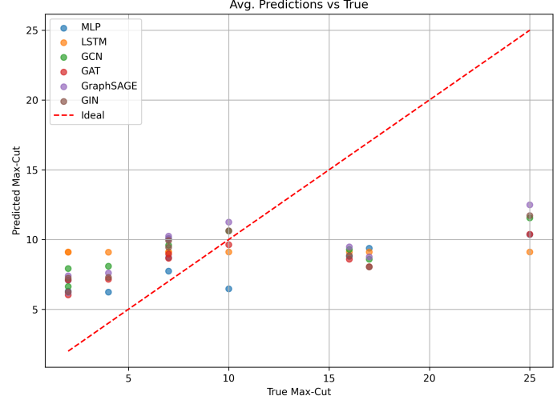
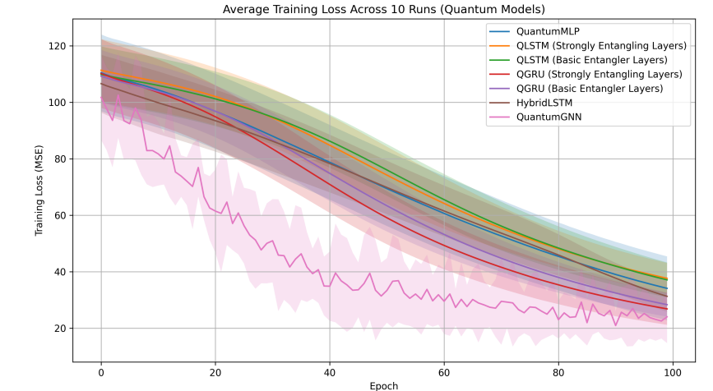
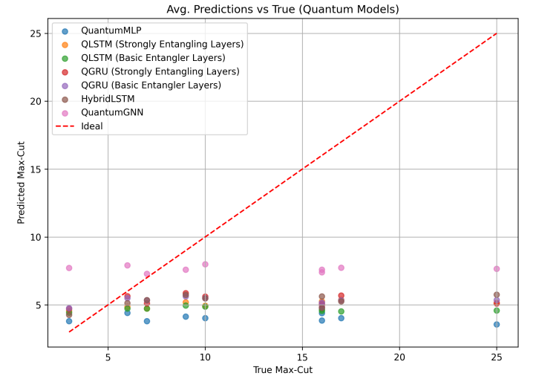
The Effectiveness of Classical and Hybrid Models for MaxCut problem
Leonardo Lavagna¹, Francesca De Falco¹, Massimo Panella¹
1. Dept. of Information Engineering, Electronics and Telecommunications (DIET), University of Rome “La Sapienza”, Italy
Framework
- The MaxCut problem is a canonical NP-hard graph partitioning task, which also plays a significant role in various neural network applications.
- QAOA [1] has emerged as the leading quantum approach for solving MaxCut, though it faces practical limitations on real quantum hardware.
Analysis
- Analysis on 2 different datasets and using 3 different figure of merits for a quantitative assessment.
- Comparison with different architectures, both quantum (QMLP, QGRU, QLSTM, QGNN) and classical (MLP, LSTM, GNN) models.
OVERVIEW
Technique
- The behavior and performance of various classical and quantum neural network models are analyzed to assess whether they can match QAOA-type algorithms while reducing computational cost and avoiding extensive pre- and post-processing.
Novelties and findings
- Classical neural network models achieve approximation ratios close to unity, while quantum-enhanced models consistently underperform, confirming the superiority of QAOA.
multivariate time series forecasting was conducted using datasets es, and a comparison was made with quantum networks (QLSTM) and classical networks (Bi-LSTM, LSTM, GRU).
Classical neural networks have evolved from using techniques developed for MaxCut to directly learning MaxCut solutions, providing a flexible, data-driven framework that captures patterns and heuristics efficiently [2]. Our study includes vector-based models (MLP, LSTM) and graph-based models (GCN, GAT, GraphSAGE, GIN).
To explore quantum-enhanced learning, we designed hybrid architectures combining classical preprocessing with variational quantum circuits. Tested models include QMLP (quantum MLP), Hybrid LSTM, QGRU and QLSTM [3] (quantum recurrent units), and QGNN [4] (quantum graph neural network).
Each quantum-enhanced model employs from 4 up to 6 qubits and uses an ansatz of alternating RY–RZ rotations followed by a CNOT ring entangler, repeated twice. The variational state is measured through the expectation value of Pauli-Z, used either for direct cut-size prediction or within classical post-processing.
FRAMEWORK
Fig. 1: Architecture of QMLP.
Fig. 2: Architecture of QGNN.
Two datasets were used:
1. Mixed graphs (4–10 nodes), including Erdos–Rényi, random 3- regular, complete graphs, and binary trees.
2. Synthetic small graphs, generated by sampling adjacency matrices from a uniform distribution δ ∼ Uniform([−5, 5]).
Performance was assessed through training loss (MSE, MAE) and approximation ratio as a measure of final prediction accuracy.
Classical models showed fast and stable convergence, with MSE and MAE up to 50% lower than in quantum-enhanced models. Their approximation ratios were close to 1 (e.g., GIN ≈ 0.93) but predictions remained tightly clustered, showing limited generalization across graph sizes.
Quantum-enhanced models achieved smoother convergence but required longer runtimes and yielded lower approximation ratios (well below unity). Overall, they did not surpass classical baselines or shallow QAOA in predictive performance.
RESULTS
Fig. 3: Training loss of classical models (left); Predicted MaxCut versus real MaxCut for classical models (right)
• If the model’s performance on the testing set gets worse than on the training set over the iterations, it probably indicates overfitting
• A model is likely to overfit if it is overparametrized
Fig. 4: Training loss of quantum models (left); Predicted MaxCut versus real MaxCut for quantum models (right)
REFERENCES
[1] E. Farhi, J. Goldstone, and S. Gutmann, “A quantum approximate optimization algorithm”, 2014.
[2] S. Gu and Y. Yang, “A deep learning algorithm for the max-cut problem based on pointer network structure with supervised learning and reinforcement learning strategies”, Mathematics, 2020.
[3] Y. Chen et al. “Quantum Recurrent Neural Networks: Predicting the Dynamics of Oscillatory and Chaotic Systems”, Algorithms, 2024.
[4] A. Ceschini, et al. “ From Graphs to Qubits: A Critical Review of Quantum Neural Networks”, 2024

