Slide 1
B ND
EASY SMART CONTRACTS

Slide 2
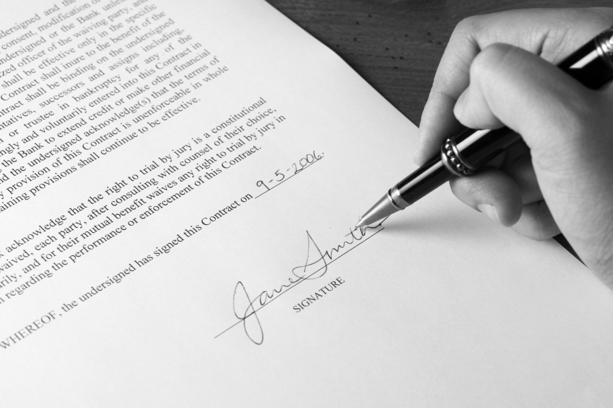
B ND
Easy creation
Easy administration
Based upon uPort
Safe

Slide 3
B ND
Ready-made templates
Automatic processing of existing paper contracts
Highly personalizeable

