Slide 1

Calculator Project
git repository: https://github.com/leonardocalil/ezo-assessment.git
Ezo - Assessment

Slide 2
Summary
Pre-requirements
Project structure
Running the project
Front-end
Going deeper

Slide 3
Pre-requirements
Java JDK 8
Maven 3.5
Eclipse (Oxygen)
Git (Windows version 2.31)

Slide 4
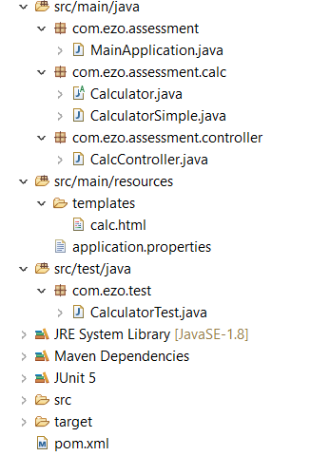
Project structure
MainApplication: Spring-boot initializer. Starts the webapplication in 8080 port.
Calculator: abstract class containing common methods of calculation.
CalculatorSimple: class of simple calculator which extends Calculator
CalcController: class bean which controls Calc.html
CalculatorTest: class contains some basic Junit tests
Calc.html: webpage presented for user in order to use the calculator features
Pom.xml: contains the main spring-boot dependencies

Slide 5
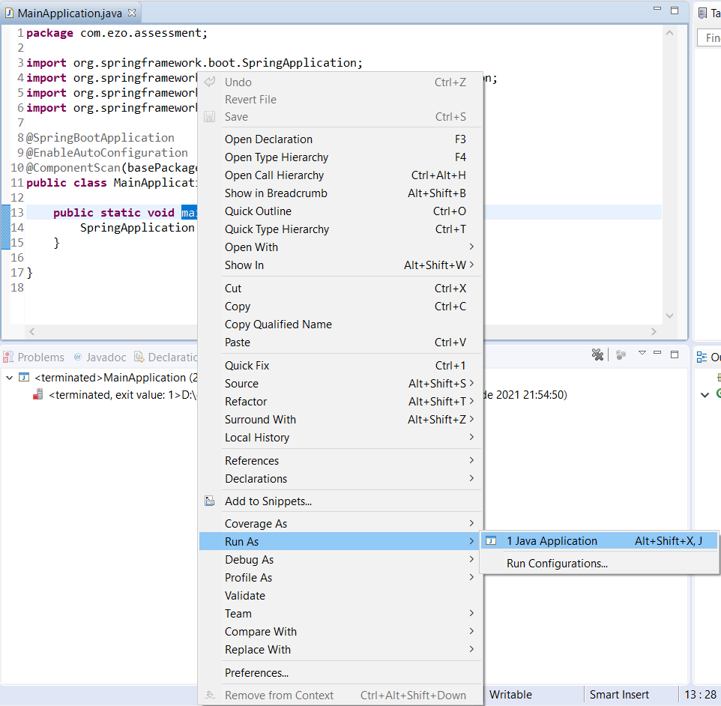
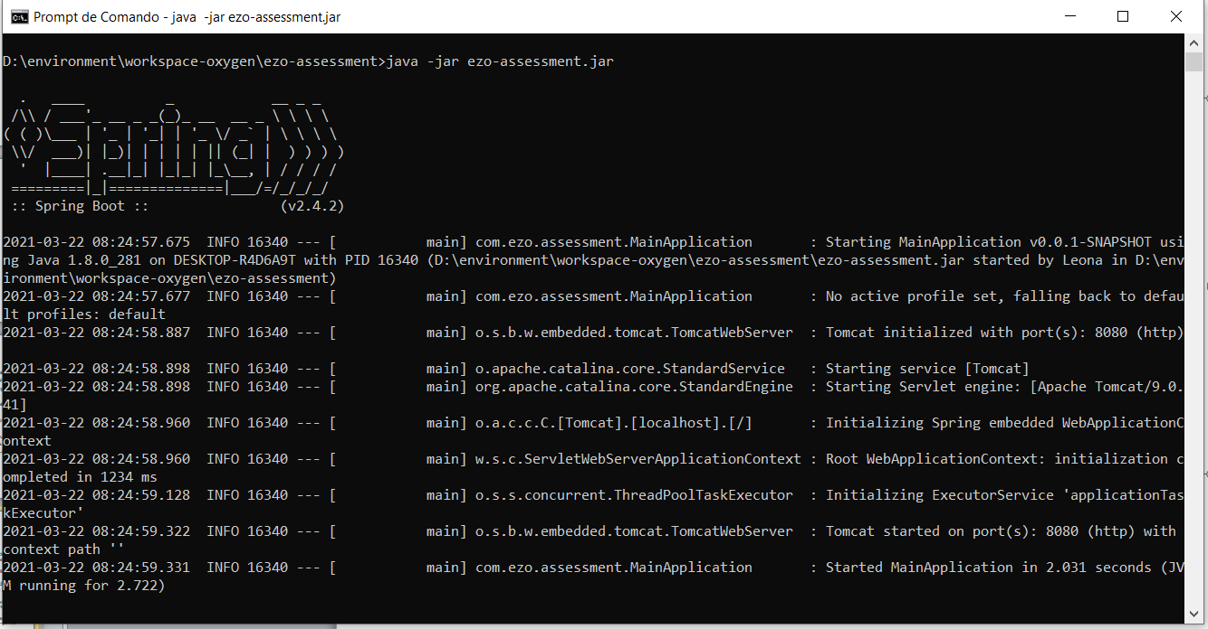
Running the project
Using the eclipse:
Open class MainApplication
Click the main method with right-button mouse;
Click Run As -> Java Application
Using the package already generated and available in github (ezo-assessment.jar)
Download ezo-assessment.jar from https://github.com/leonardocalil/ezo-assessment
Using prompt of command / terminal, execute: java –jar ezo-assessment.jar

Slide 6
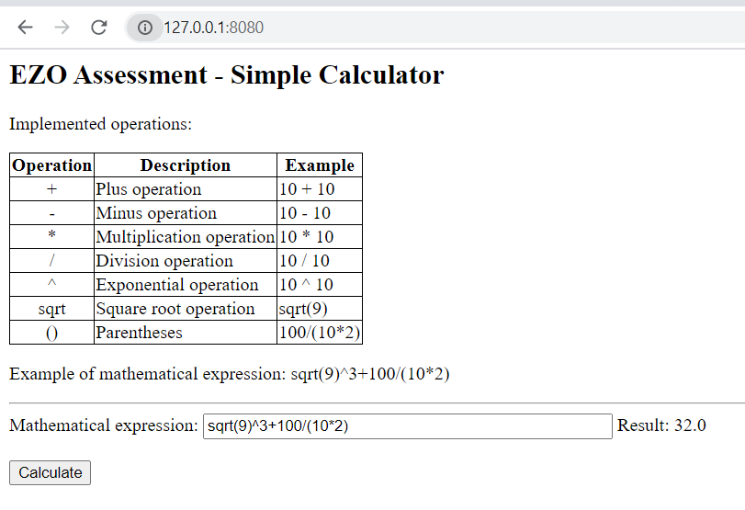
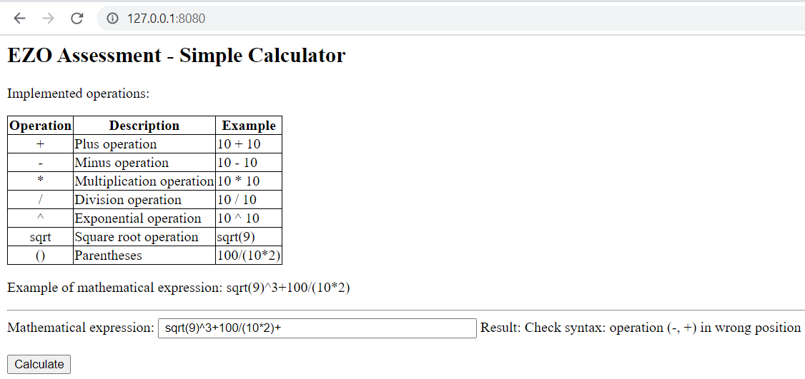
Front-end
Image-1
Image-2
After the project is running, in your preferable web browser, type http://127.0.0.1:8080 (or http://localhost:8080) and you can see the web page like the Image-1 presented.
Use the ‘Mathematical Expression’ input field for type your equation and click and ‘Calculate’ button
Either result of calculation or some syntax mistake going to be shown in ‘Result’ field.

Slide 7
Going deeper
Eclipse
calculationEngine:
100 + 6/(sqrt(121)*2 - 20) - 2
6/(sqrt(121)*2 - 20)
(sqrt(121)*2 - 20)
sqrt(121)*2
11
11
11*2 = 22
22 - 20 = 2
6/2 = 3
100 + 3 - 2 = 1

Slide 8
Questions?
Thank you!

