Slide 1

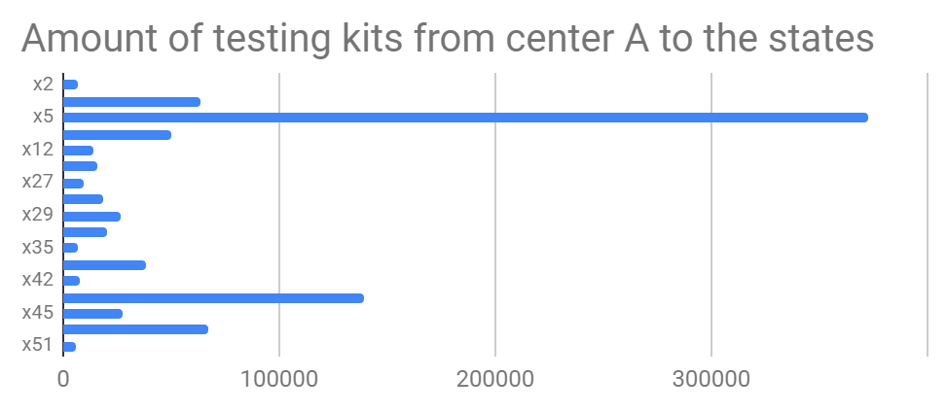
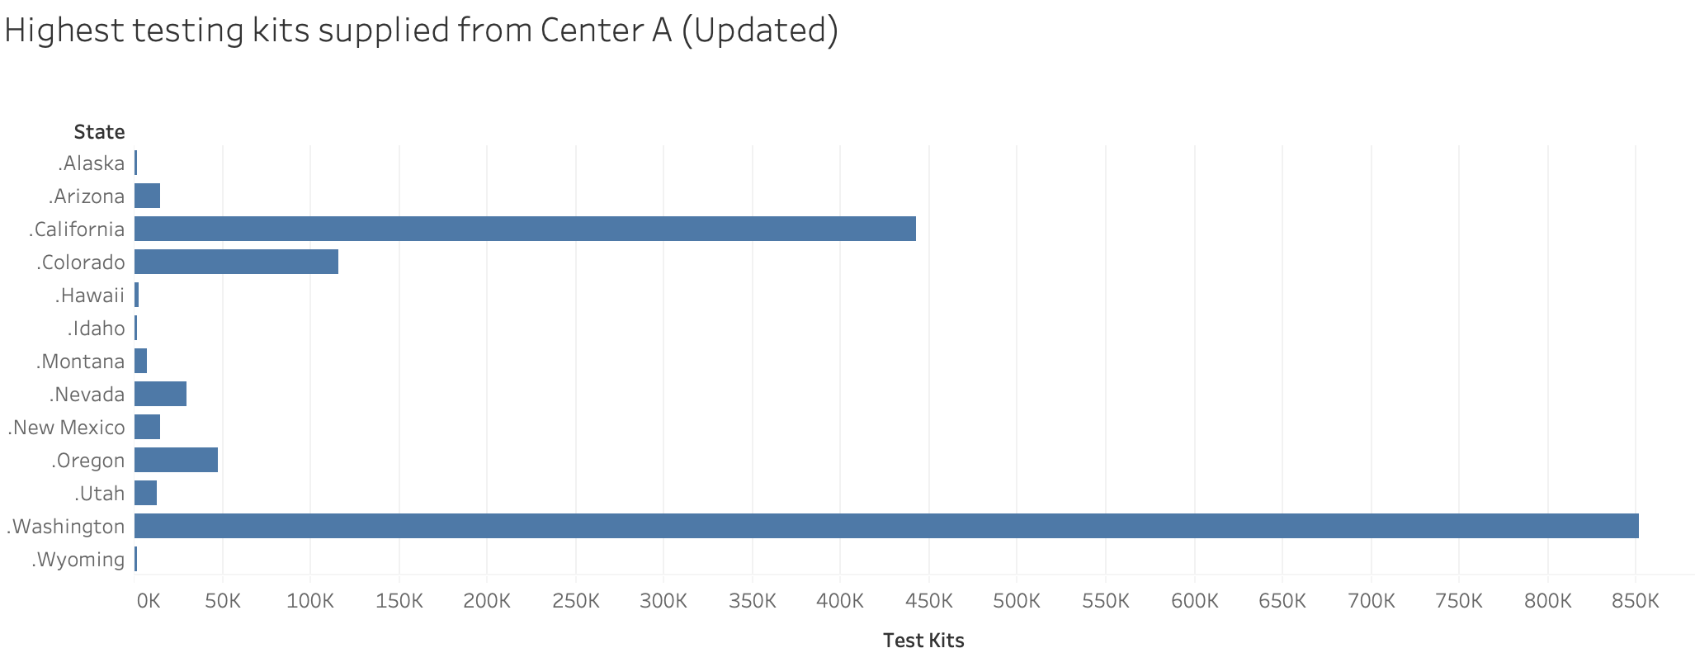
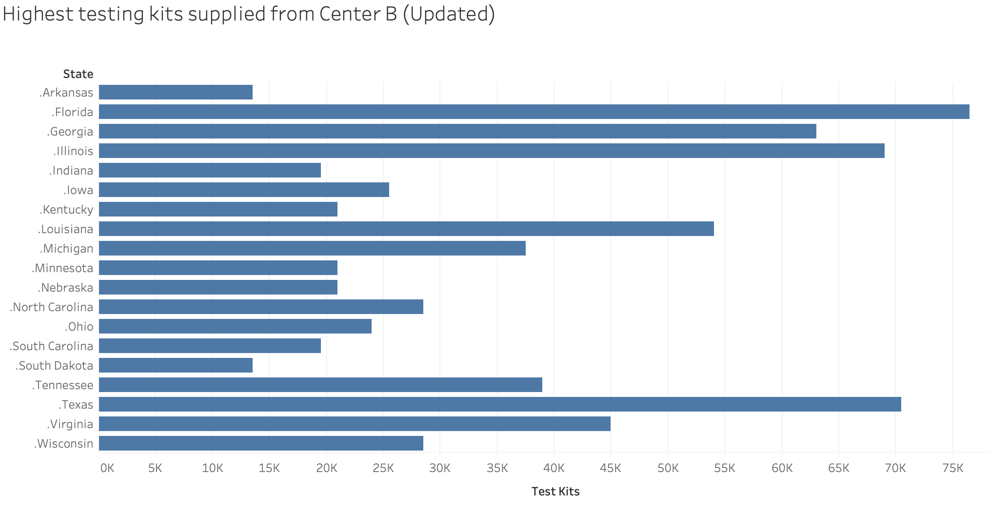
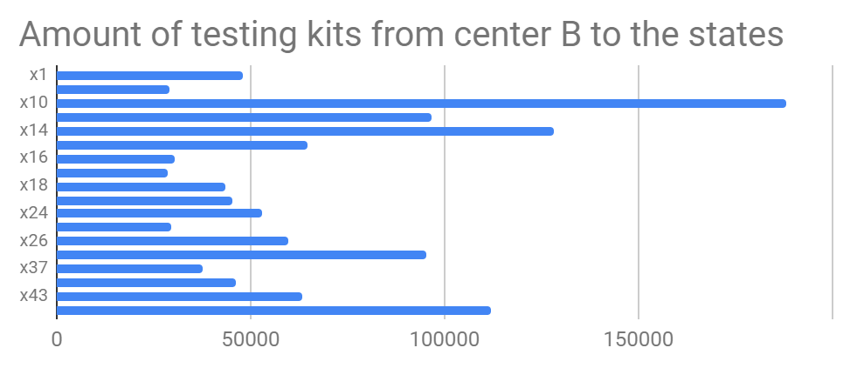
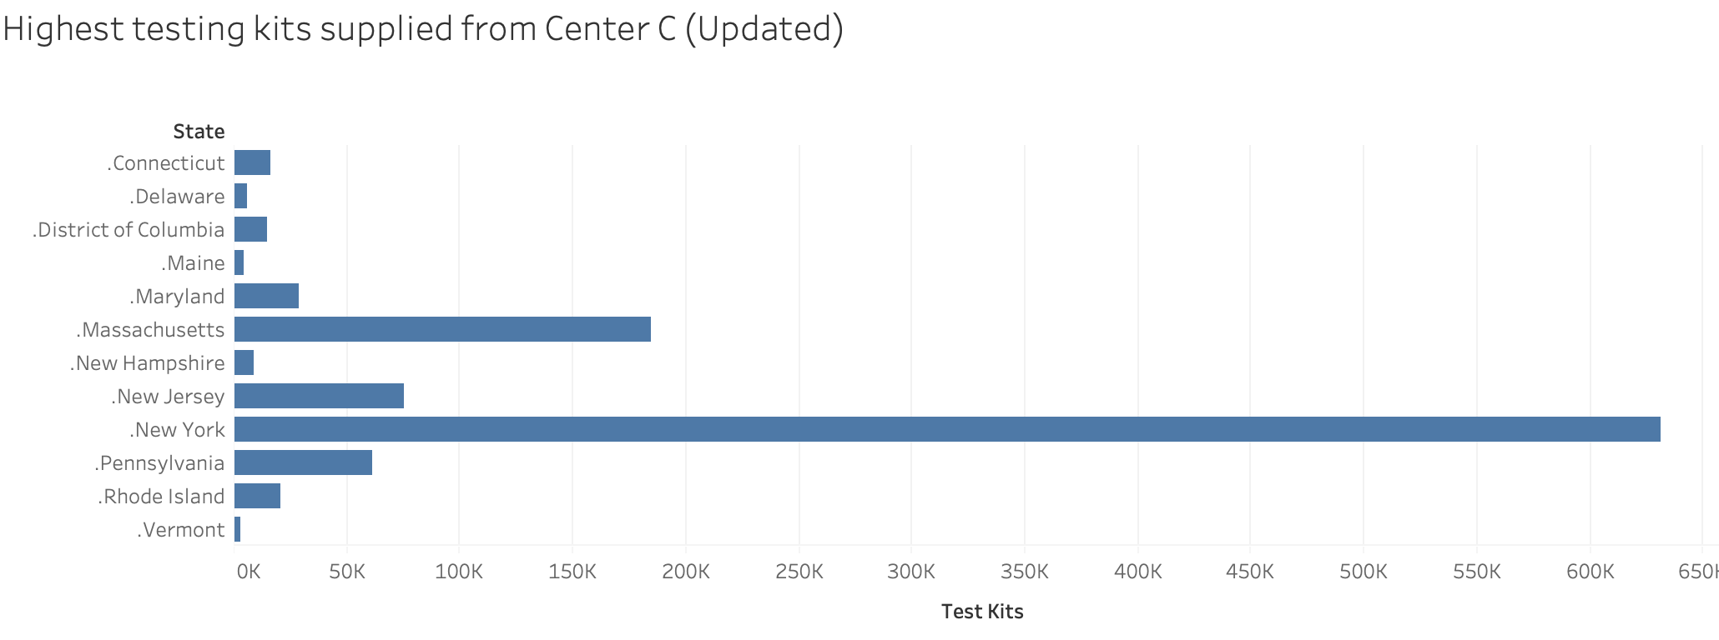
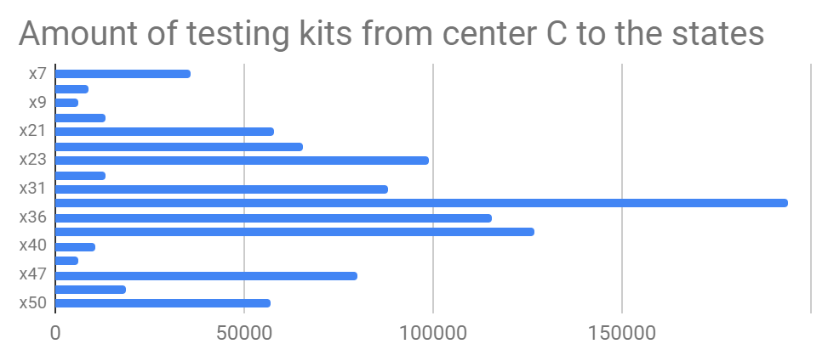
Testing Kits Production for Coronavirus(COVID-19) in the U.S.
By : Yuxing Zhang, Leonardo Calizaya, Patrick Sampson and Lingyu Li
Virginia Tech, Grado Department of Industrial and Systems Engineering
Abstract
Results (Original Data)
Conclusion
Conclusion (Updated Data)
a) After the linear programing is solved, the optimal solution of Z, which is the minimum of total transportation cost, is $ 4 775 913.75.
b)The tolerance for increase of transportation cost from Kansas state to manufacturing center B is 0.002834 dollars per mile. The tolerance for increase of transportation cost from Pennsylvania state to manufacturing center B is 0.00126 dollars per mile.
c) If we need to send 500000 more test kits to Washington state, the current solution is still optimal because allowable increase is greater than 500000, and the new optimal value of total cost would be $ 5 619 413.75.
d) A foreign company is offering $300000 for 1 million testing kits. For the first iteration, the result shows that by purchasing foreign testing kits to center 2 we save money. However, only when the amount purchased is less than 139363, so 1 million is too much. For the second iteration, situation is similar to the first one, but the amount we need is still much less than 1 million. By the third iteration, it’s only worthwhile to purchase 196232 kits from the foreign company since after that, what we save in money is less than what we buy. In conclusion, it is not worthwhile to purchase from the company
This project uses transportation network, linear program, excel and other deterministic operation research related knowledge to solve the problem of test kit production and transportation. At the time of this epidemic, the country needed three production centers to produce enough test kits to ensure that one percent of people in each state completed the test. The cost of transportation should be reduced as much as possible, and the demand can be met by considering the method of purchasing from foreign companies.
Introduction
In January 2020, coronavirus spread worldwide, and the CDC announced that it will prepare for testing COVID-19. It is estimated that each state may need to test the virus for 1% of each state. We got the transportation distance from each production center to each state and the total production possible. In addition, according to CDC statistics, the production cost of each test kit is $ 1, and the transportation cost of each kit is $ 0.001 per mile. However, and updated data is given and the production cost rises to $1.5, and the transportation cost per kit rises $0.002 per mile. Also, new estimated required testing kits per state is given, we will give solutions to both scenarios and analyze which one adapts better to the reality.
Results (Updated Data)
a) After the linear programing is solved, the optimal solution of Z, which is the minimum of total transportation cost, is $ 8 060 778
b)The tolerance for increase of transportation cost from Kansas state to manufacturing center B is 0.002834 dollars per mile The tolerance for increase of transportation cost from Pennsylvania state to manufacturing center B is 0.00096 dollars per mile. .
c) The current optimal dual solution will no longer be optimal if we add 500 000 extra testing kits to Washington State.
d) A foreign company is offering $300000 for 1 million testing kits. For the first iteration, the result shows that by purchasing foreign testing kits to center 2 we save money. However, only when the amount purchased is less than 31 500, so 1 million is too much. For the second iteration, situation is similar to the first one, but the amount we need is still much less than 1 million. By the third iteration, it’s only worthwhile to purchase 46 499 kits from the foreign company since after that, what we save in money is less than what we buy. In conclusion, it is not worthwhile to purchase from the company
Total Cost = $ 8 060 778
In terms of comparison to the actual data on the confirmed cases of Coronavirus in each state and the number of tests that have been performed so far, Table 1 more accurately represents the distribution of people that have been tested, while Table 3 is far closer to the distribution of confirmed cases.
The graphs show the optimal amount of testing kits send to each states from center A, B and C. The total cost is 4775913.75 dollars for current situation. Transportation cost from center B to Kansas state can increase by 0.002834 dollars per mile so the current solution is still optimal. If 500000 more testing kits need to be send to Washington state, new total cost of optimal value would be 5619413.75 dollars. It is not worthwhile to purchase testing kit from the foreign company.

