Slide 1

Programación concurrente y distribuida
Leonardo Camargo Forero, M.Sc
Sesión III

Slide 2
Contacto
Leonardo Camargo Forero, M.Sc
Administrador HPC Centro de Bioinformática y Biología Computacional. Ecoparque los Yarumos - Ed. BIOS
leonardo.camargo@bios.co

Slide 3
Agenda
Grid computing
What to share
Grid layers and the hourglass model
Grid elements
Virtual organizations
Some grids
Some applications
Questions

Slide 4
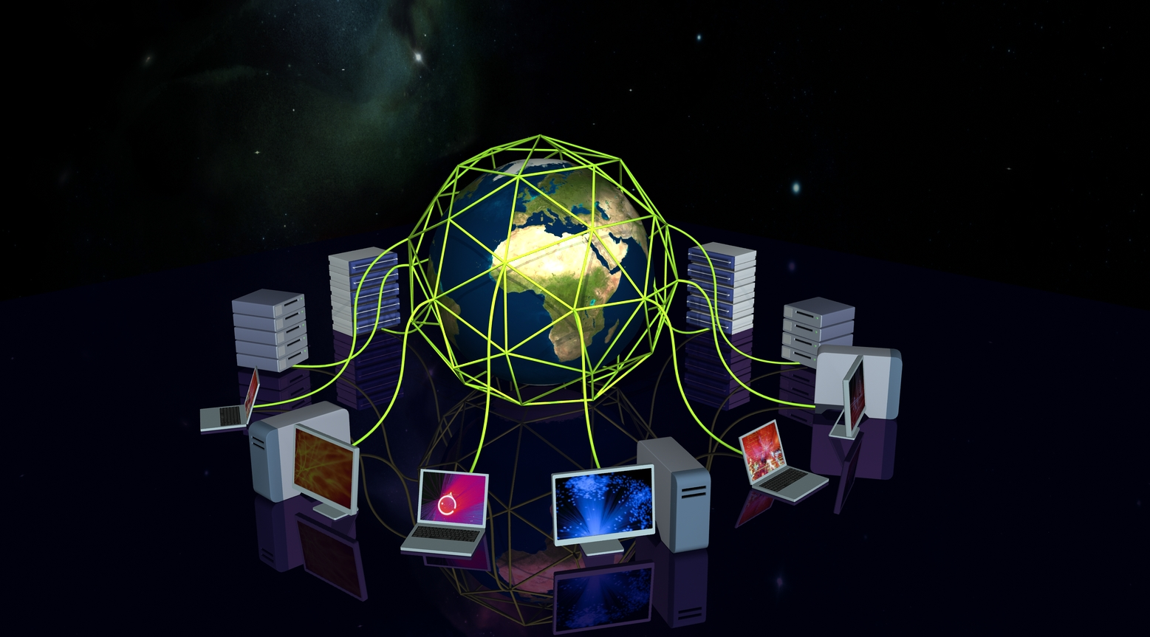
http://www.ep.ph.bham.ac.uk/DiscoveringParticles/lhc/analysis/images/grid-computing.jpg
Grid Computing

Slide 5
Definición
Computational, scientific and data resources shared between different organization geographically distributed.

Slide 6
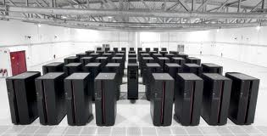
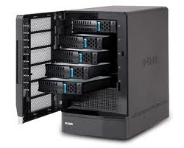
What to share?
http://thegenesisblock.com/wp-content/uploads/2013/05/super-computer-room.jpg
https://encrypted-tbn2.gstatic.com/images?q=tbn:ANd9GcQrhOy58-7FZURZ9mNHWpampmnyR8-dO_09-Nll-rm-w7ZWwZpzg4xWnO9F

Slide 7
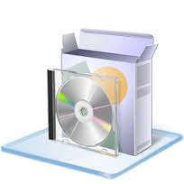

What to share?
https://encrypted-tbn3.gstatic.com/images?q=tbn:ANd9GcS6GF8IZRI5FfDcsBhLW64y6ZTwV7ZXIrGBERtG2-kbBQYkyzQ53dmmByjF
https://www.wbginvestmentclimate.org/advisory-services/regulatory-simplification/business-regulation/images/network_1.jpg

Slide 8
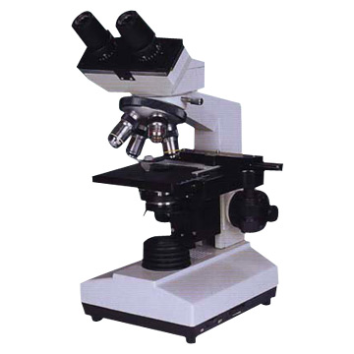
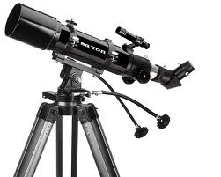
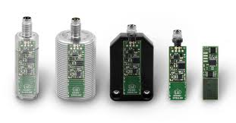
What to share?
http://www.scopetekk.com/sitebuildercontent/sitebuilderpictures/webassets/Microscope.jpg
https://encrypted-tbn0.gstatic.com/images?q=tbn:ANd9GcSPZJxbBmnEjuXFnORXg1pB-cBy_VEf9FoHQieImoie0RjKe4fq
http://www.opticscentral.com.au/media/catalog/product/s/a/saxon_novo_705_az3_refractor_telescope_705az3_1.jpg

Slide 9
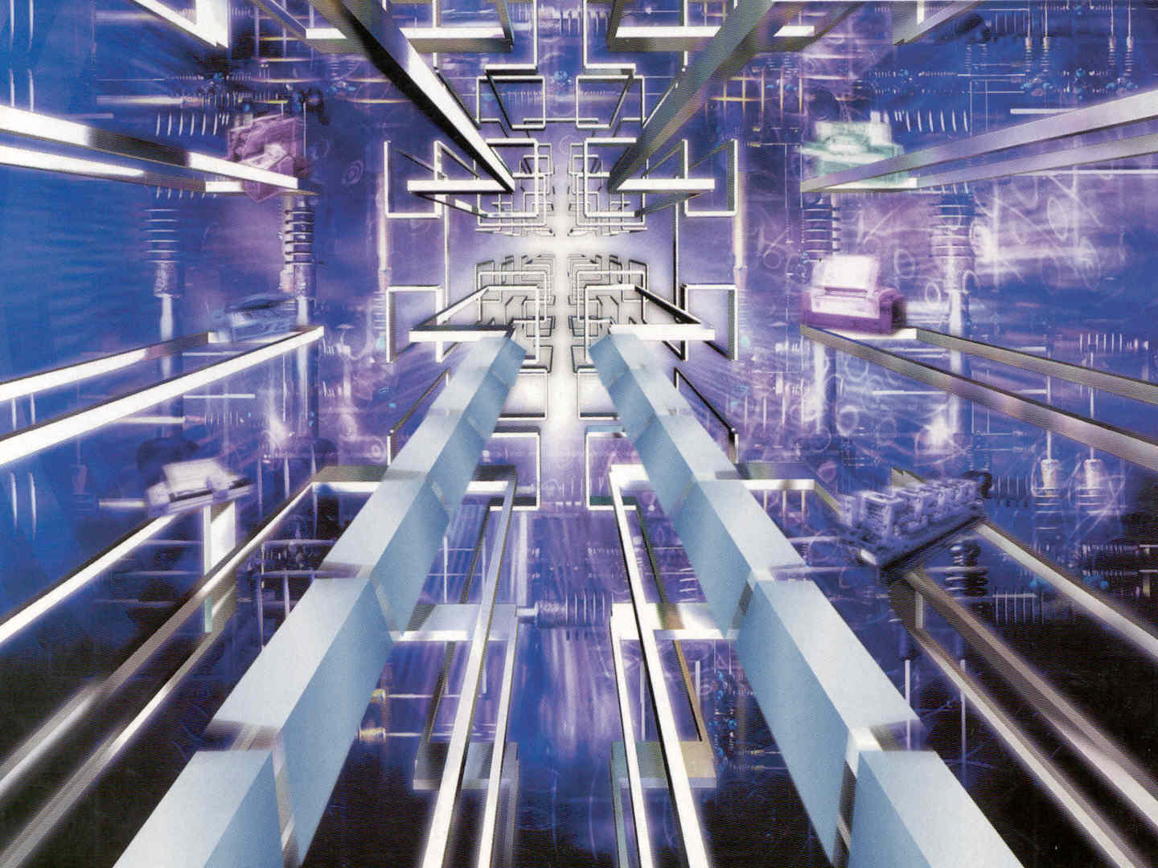
http://2.bp.blogspot.com/_pZAalKBvaN4/TDc6tUGzUYI/AAAAAAAAABg/q-aL0TY-3eo/s1600/print1.jpg
Grid Layers and the hourglass Model

Slide 10
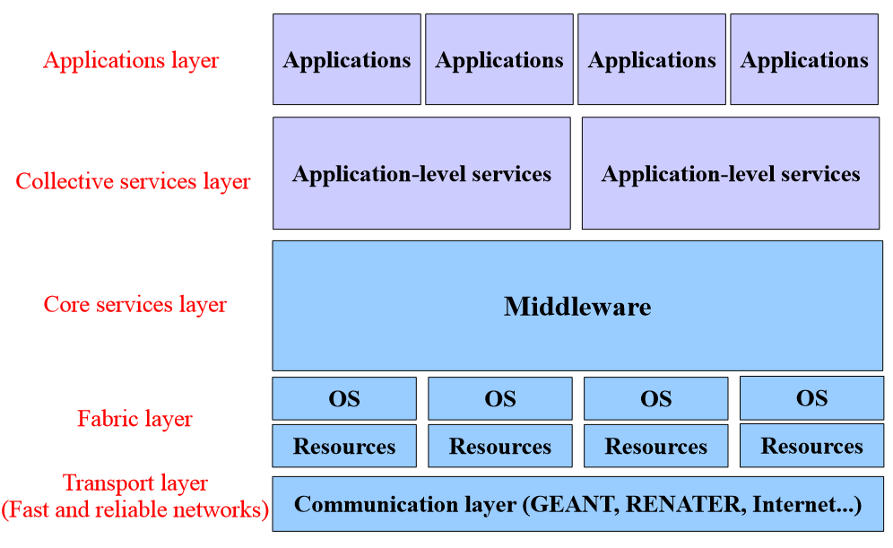
Grid Layers
Taken from Johan Montagnat’s Lectures in Master IFI Ubinet 2011 - 2012

Slide 11
Transport layer (i.e. Network Connectivity)
Inside computing resources:
Same as Cluster Computing
Between different organizations:
Renata (Colombia), Renater (France), Internet

Slide 12
Fabric layer (i.e. Computing resources)
Cluster Computing
Data storage
Sensor Access
Etc.

Slide 13
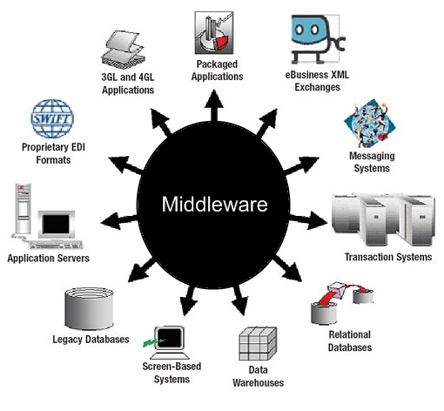
Core service layer - Middleware

Slide 14
Middleware
Connects applications (i.e. distributed, parallel, sequential, etc.) with distributed resources
Some features:
Transparency
Heterogeneity
Reliability
Performance
Security
Scalability

Slide 15




Famous middlewares
http://www.mcs.anl.gov/uploads/cels/images/research/globus_logo.gif
http://glite.web.cern.ch/glite/images/gLite_top_left_big.jpg
http://avalon.ens-lyon.fr/software/diet-1/image_mini
http://www.liv.ac.uk/csd/csd_images/escience/CondorTitle.gif

Slide 16
Cluster of computers
Opportunistic computing
Grid computing
Focused on High throughput Computing (24/7/365)

Slide 17


Collective services layer and applications layer
http://www.uhm.org.mt/wp-content/uploads/2013/06/www.jpg
http://deterritorialsupportgroup.files.wordpress.com/2011/07/napster.jpg

Slide 18
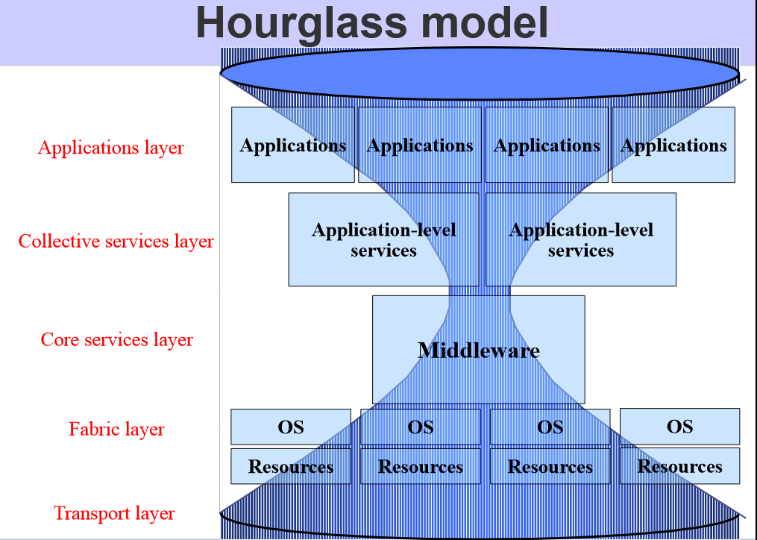
Taken from Johan Montagnat’s Lectures in Master IFI Ubinet 2011 - 2012

Slide 19
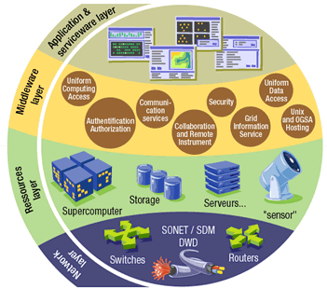
http://net.cs.uni-bonn.de/uploads/pics/logo_grid_04.gif
Grid Elements

Slide 20

http://stephenmarkus.files.wordpress.com/2011/06/virtual-team.jpg
Virtual organizations

Slide 21
Virtual organizations
Gathering of people (i.e. scientists, engineers, etc) interested in a particular topic (Physics, Aerospace engineering, Bioinformatics, etc.)

Slide 22
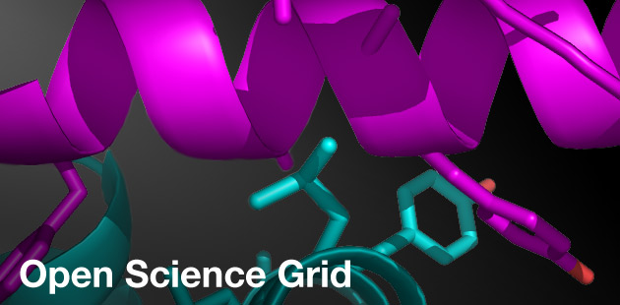
http://www.renci.org/wp-content/themes/renci2.0/images/sections/focus-areas/computing-technology/open-science-grid-b.jpg
Some Grids

Slide 23


