Slide 1
Probing datasets: 8 RNAs, all probed in vitro
Dataset ID | RNA | Class | N (nt) | Reagent | R (nt) | |E| | Source
TRP4P6_DMS_0007 | P4-P6 domain, Tetrahymena ribozyme | structured | 202 | DMS | 11–51 | 22 | RMDB
RNASEP_DMS_0000 | RNase P catalytic domain | structured | 265 | DMS | 4–53 | 22 | RMDB
HIV3PR_DMS_0001 | HIV-1 3' UTR | viral UTR | 261 | DMS | 34–83 | 20 | RMDB
ROTA_RFS11_DMS | Rotavirus segment 11 (full) | viral mRNA | 667 | DMS | 6–55 | 19 | RASP2
HOXA9_STD_0000 | Hox A9 mRNA 5' UTR | mRNA UTR | 1266 | 1M7 | 1–100 | 100 | RMDB
HOXA5_STD_0000 | Hox A5 mRNA 5' UTR | mRNA UTR | 237 | DMS | 1–50 | 31 | RMDB
CSDE1_DMS_0000 | Csde1 mRNA, nt 190–386 | mRNA | 197 | DMS | 1–50 | 39 | RMDB
YXJA_EQR220_BZCN | B. subtilis yxjA riboswitch leader | 5' leader | 220 | BzCN | 4–53 | 50 | RASP2
High reactivity → nucleotide unpaired
DMS reads A, C · SHAPE (1M7, BzCN) reads A, C, G, U
R = first ~50 nt with data at the 5' end
E = nucleotides of R that are scored (|E| = 19–100)
1
Notes:
Six RMDB datasets plus two from RASP v2. R and E are 1-based positions along each RNA. All conditions, masks and provenance are in the repository README.

Slide 2
The test: does a window change the prediction?
Full RNA, length N
A. Agreement with data
ρ(W) = Spearman( u(W), reactivity ) over E
Δρ(W) = ρ(N) − ρ(W)
Δρ > 0: window agrees worse than full fold
5'
3'
region R
Windows, anchored at the 5' end
W = smallest window (covers R)
W = 150 nt
W = N (reference) · step 10 nt (50 nt for Hox A9)
B. Change of the model itself
max over E of |u(W) − u(N)|
converged window: from here on ≤ 0.1
no experimental data used
Fold each window: RNAfold · CONTRAfold · MXfold2
u(W) = probability that each nucleotide is unpaired
Same E for every window and model
95% CI: paired block bootstrap over positions
(2000 resamples, 10-nt blocks)
2
Notes:
u is the unpaired probability from each model's base-pair probabilities. Spearman is rank-based, so reactivity normalisation does not matter. A is a data criterion, B is model-internal and can be computed for any sequence.

Slide 3
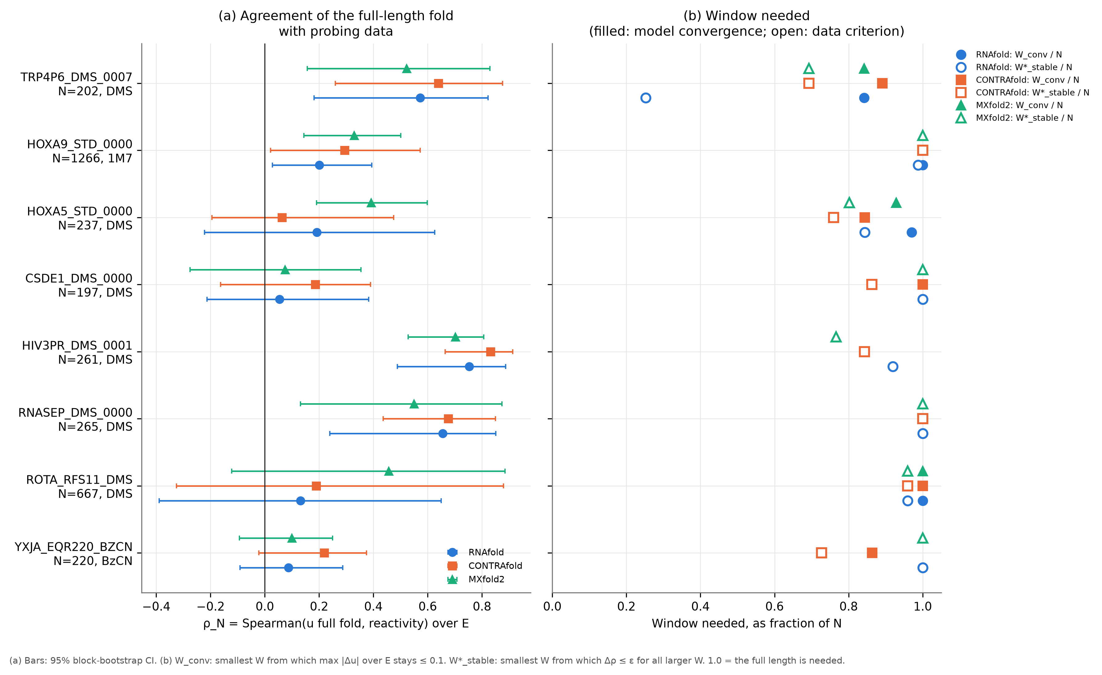
Full-length agreement, and the window each RNA needs
(a) ρ(N): full fold vs data
bar = 95% CI
structured: 0.5–0.8
mRNA / UTRs: 0.05–0.46
(b) window needed / N
filled: model converged
open: data criterion met
almost all ≥ 0.7 N
except RNAfold on P4-P6
(0.25 N)
3
Notes:
Panel (b): W_conv / N (filled) and W*_stable / N (open), the smallest window from which all larger windows satisfy the criterion. 1.0 means the full length is needed.

Slide 4
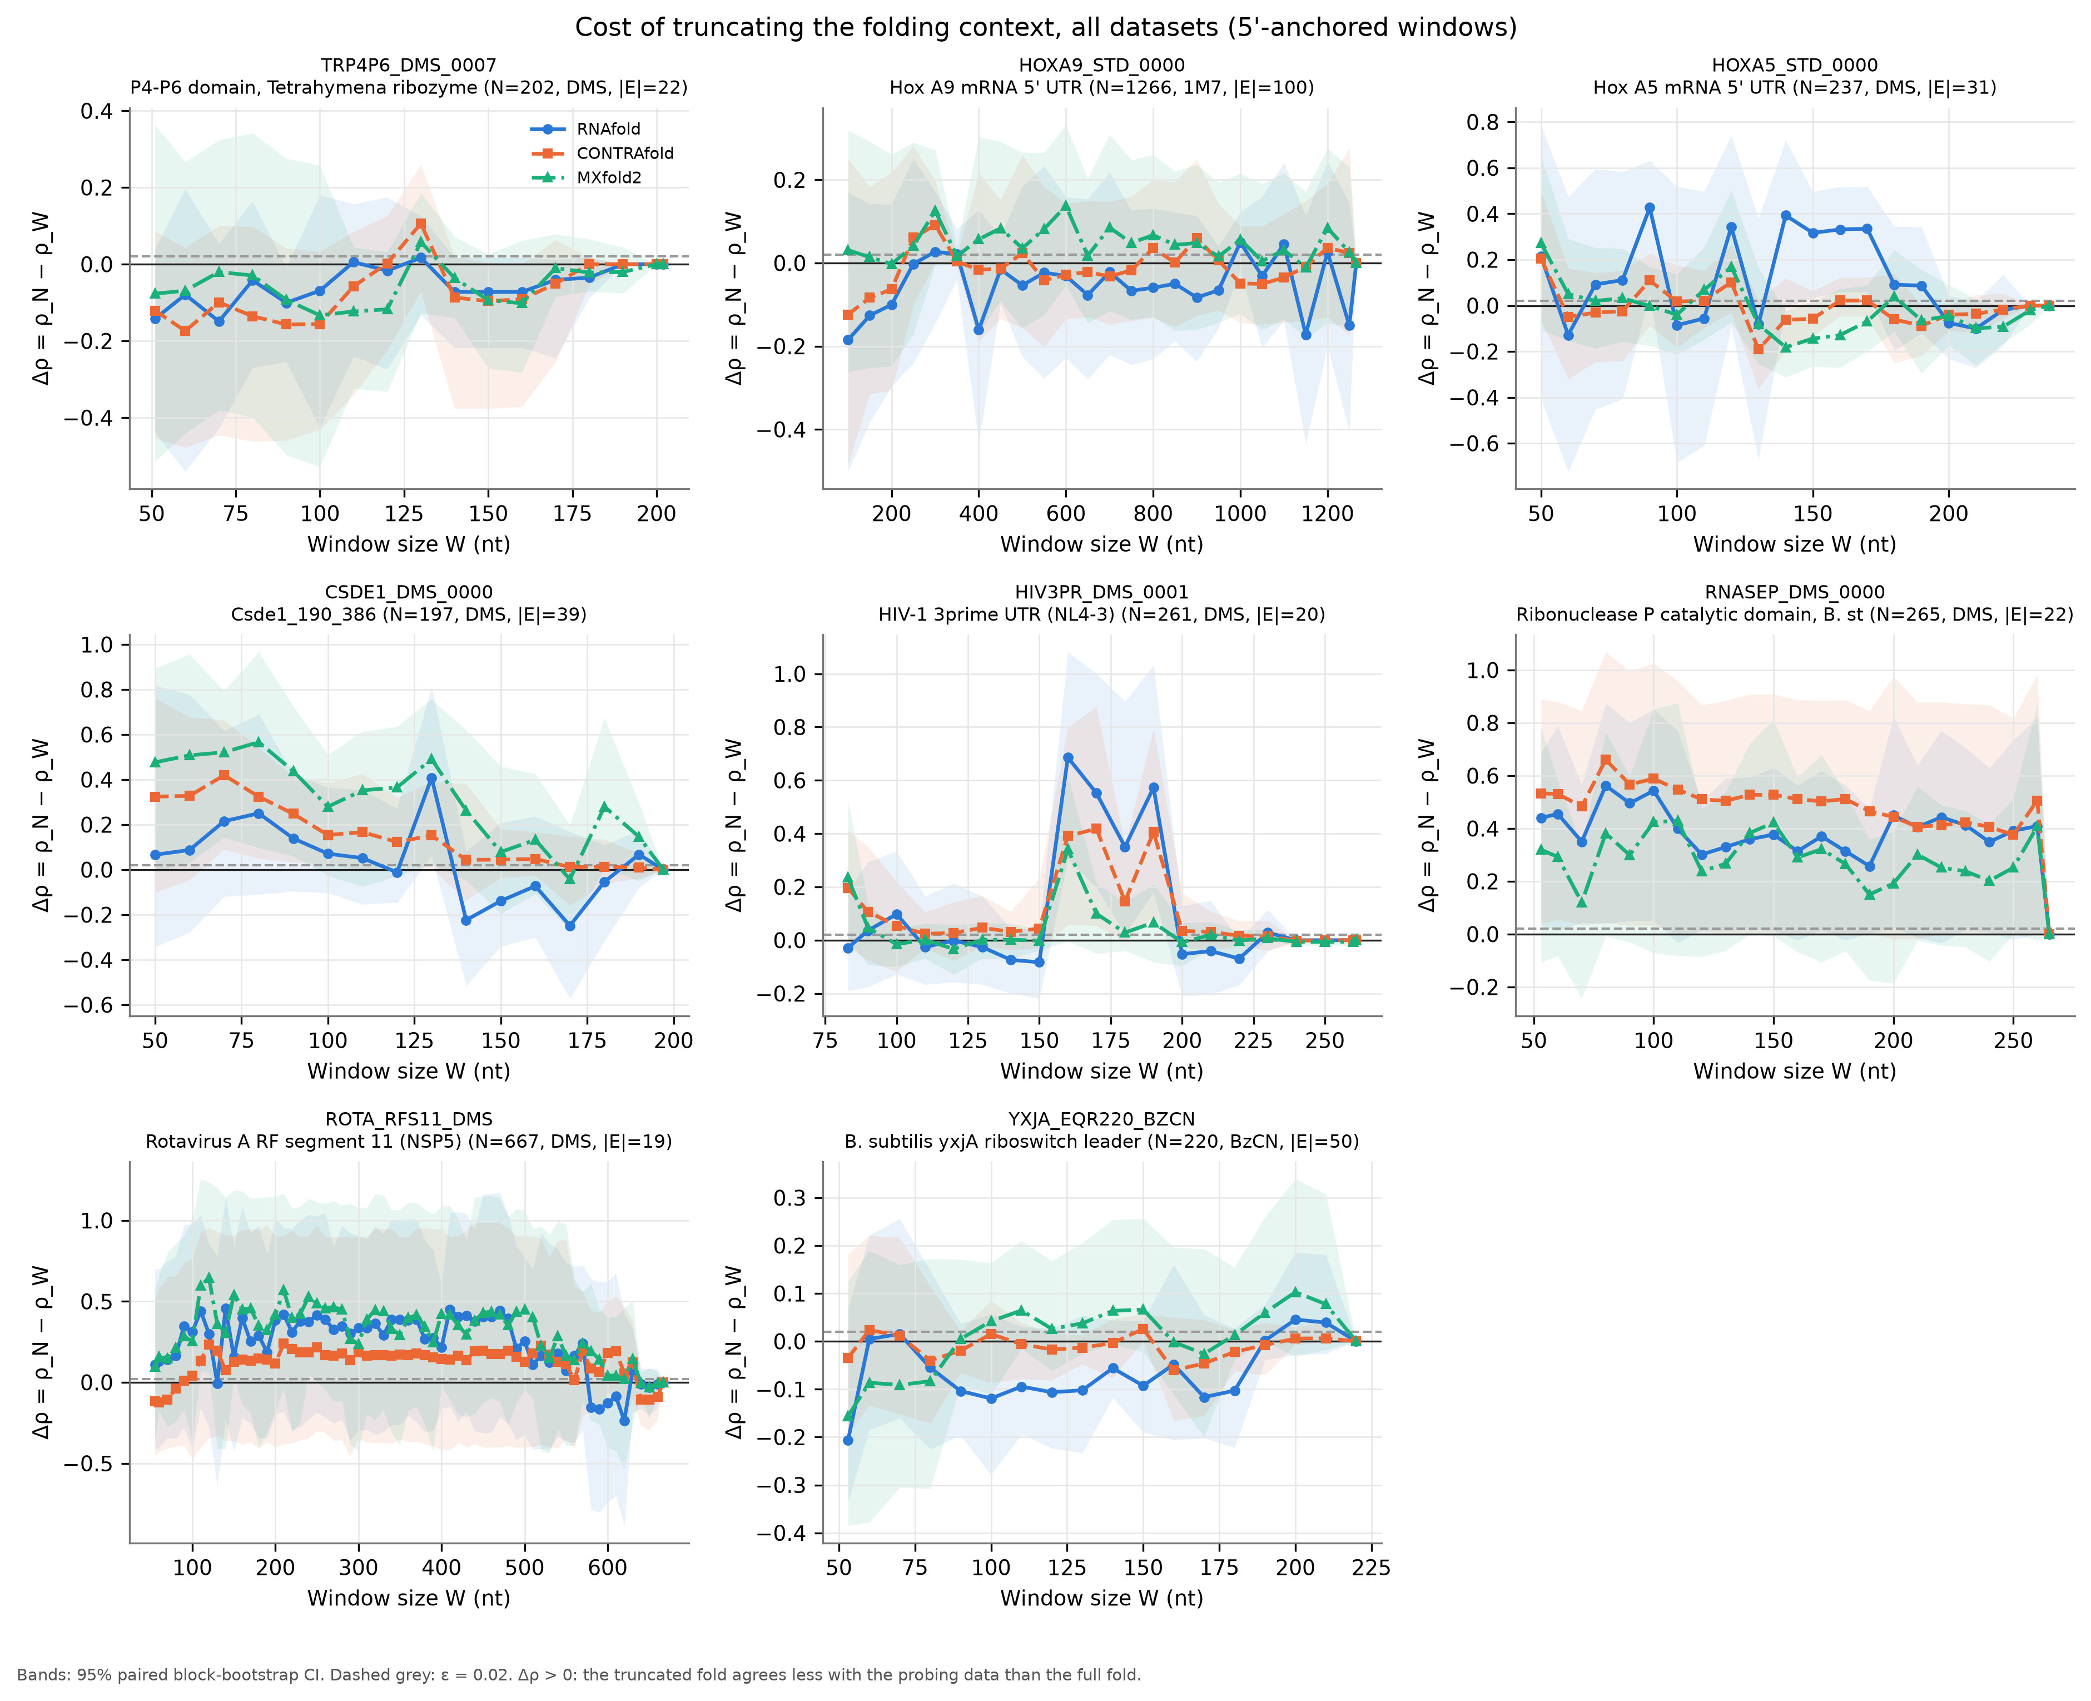
Cost of truncation depends on the RNA
How to read
x: window size W (nt) · y: Δρ(W) = ρ(N) − ρ(W)
above 0: window agrees worse with data
bands: 95% CI · dashed: ε = 0.02
RNase P: Δρ ≈ 0.3–0.6 at every W < N
HIV 3' UTR: fine at 100 nt, jump at 160–190 nt
Csde1: up to 0.5 for W ≤ 130 nt
P4-P6, Hox A5/A9, yxjA: no clear cost
Rotavirus: ~0.2–0.4, very wide CIs
Across 8 RNAs: no significant mean cost
Wilcoxon p ≥ 0.25 at W = 100 and 150 nt
4
Notes:
RNase P: the partner of the 5' helix lies at the 3' end, so any window misses it. HIV: windows of 160-190 nt cut a helix whose partner lies just outside.

Slide 5
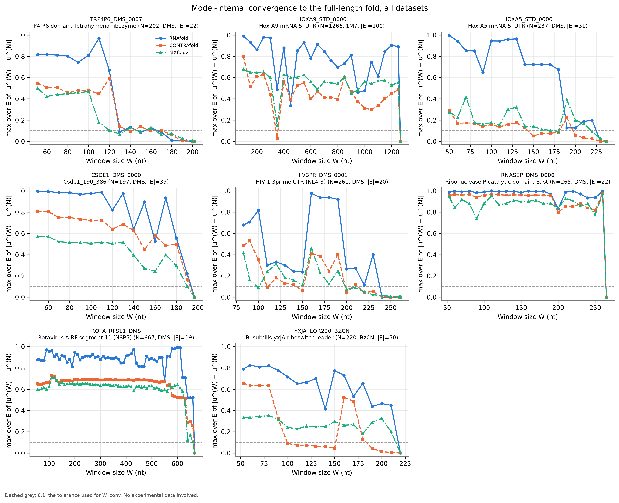
The prediction converges only near full length
How to read
x: window size W (nt)
y: max over E of |u(W) − u(N)|
dashed: 0.1 (converged) · no data used
Converged only at ≥ 0.77 N, every RNA and model
RNase P, Hox A9, Csde1, rotavirus: only at W = N
P4-P6, Hox A5, HIV: from 0.77–0.85 N
RNAfold moves most: often > 0.8
A short window gives a different fold
even where Δρ is not significant
5
Notes:
W_conv: smallest W from which max |u(W) - u(N)| over E stays <= 0.1 for all larger W. Values: P4-P6 170-180 of 202, Hox A5 200-230 of 237, HIV 200-240 of 261, yxjA 190-220 of 220.

Slide 6
Takeaways: which window to use?
Fixed window
Full length
Adaptive window
avoid: cuts helices, RNA-specific
default (done here up to 1.3 kb)
if the RNA is too long
No fixed window is safe: the needed window depends on each RNA
Bigger ≠ safer: a window can cut a helix (HIV, 160–190 nt)
Policy: fold the full length; if too long, grow W until
max |u(W) − u(N)| ≤ 0.1 over the region, per RNA, no data needed
Caveats: 8 RNAs, in vitro · 5' regions only (|E| = 19–100) · wide CIs
mRNA UTRs agree weakly with data even at full length
6
Notes:
Adaptive rule = W_conv: data-free, so it can be applied to any sequence. In this study it was never less conservative than the data criterion, except RNAfold on Csde1 where both reached the full length.

