Slide 1
Stingray 2
Gabriel Martins Lima Leonardo Masato Souza Horiba

Slide 2
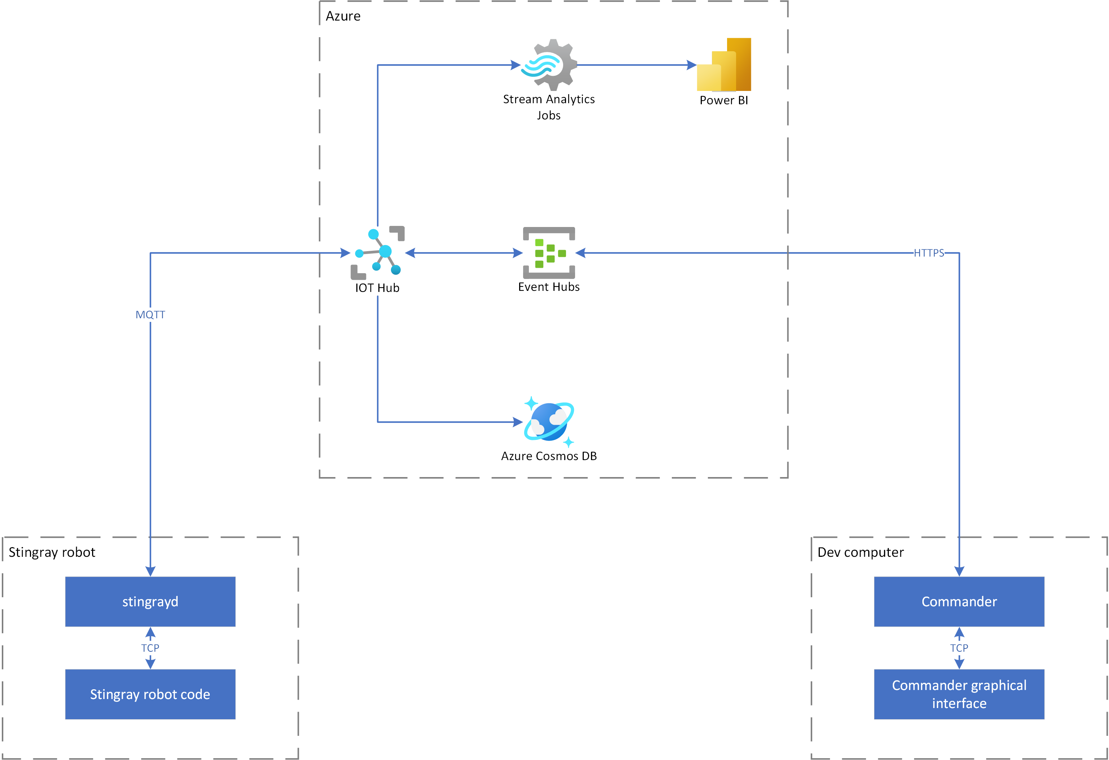
Architecture

Slide 3
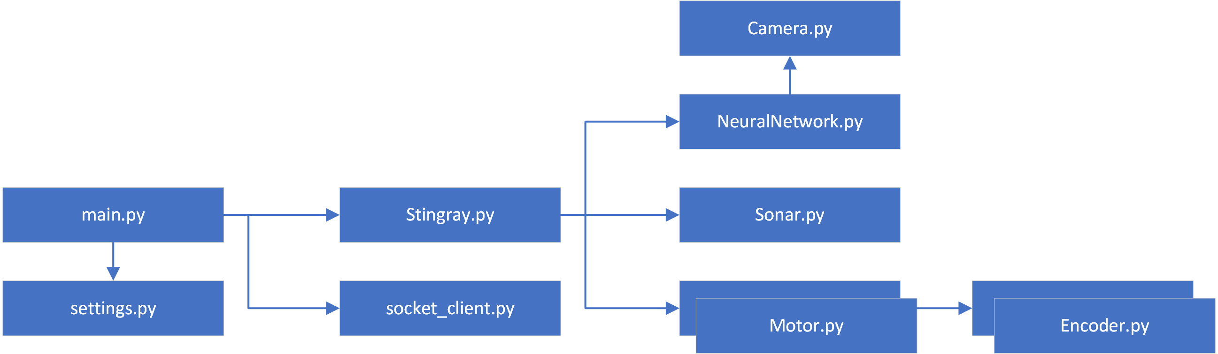
Stingray robot code

Slide 4
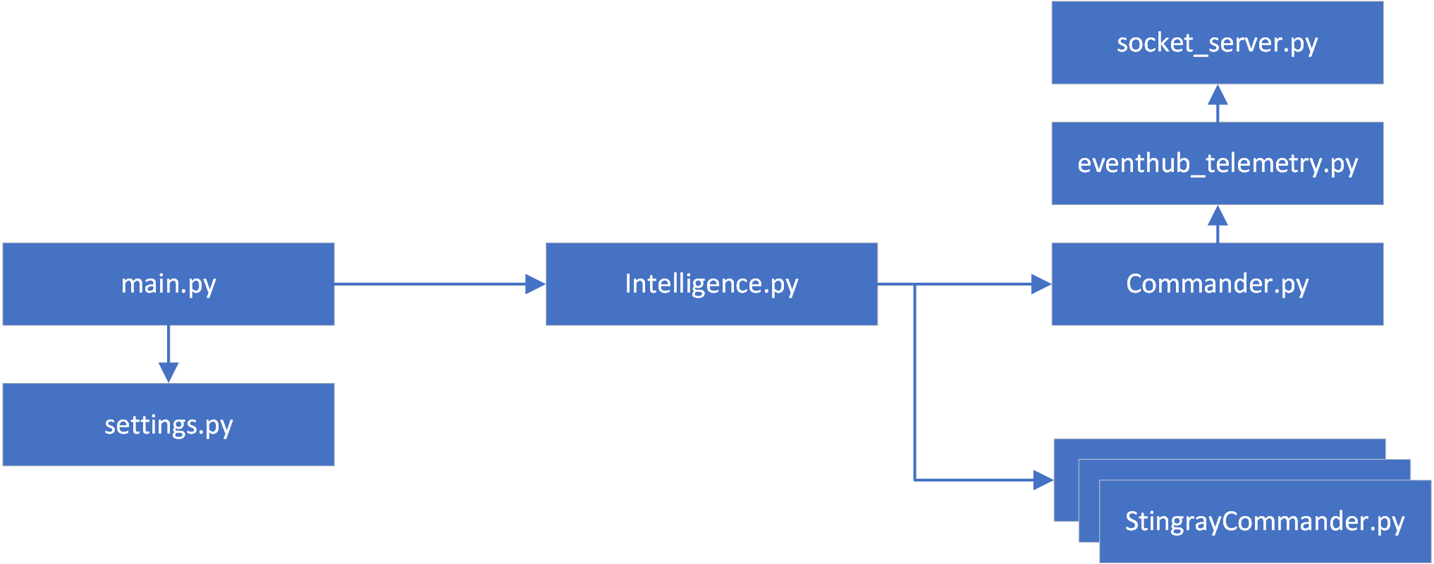
Commander

Slide 5
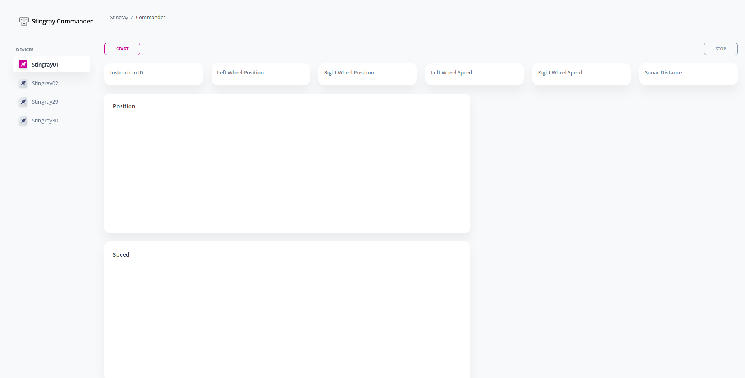
Commander graphical interface

Slide 6
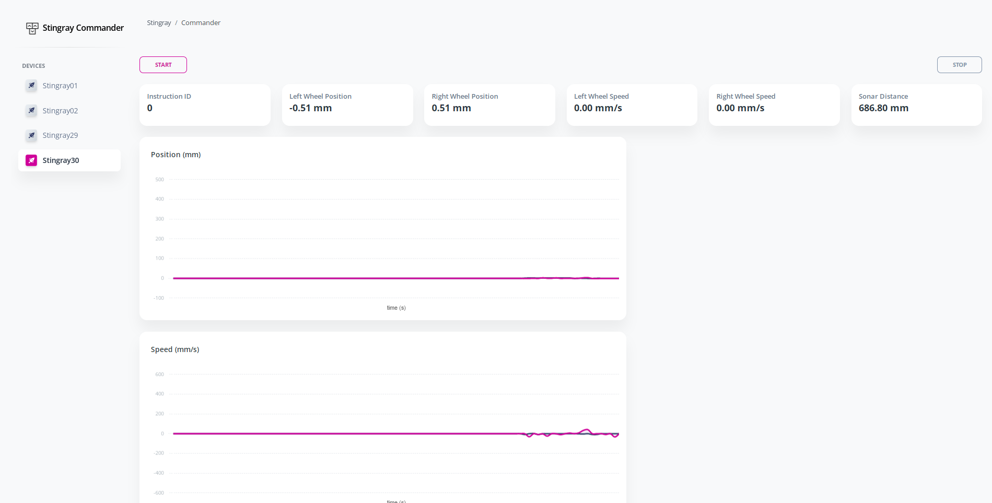
Commander graphical interface

Slide 7
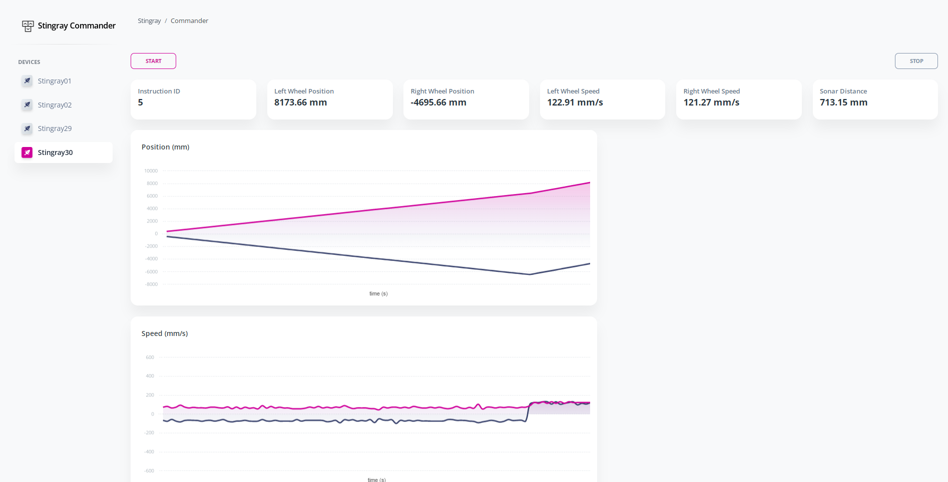
Commander graphical interface

Slide 8
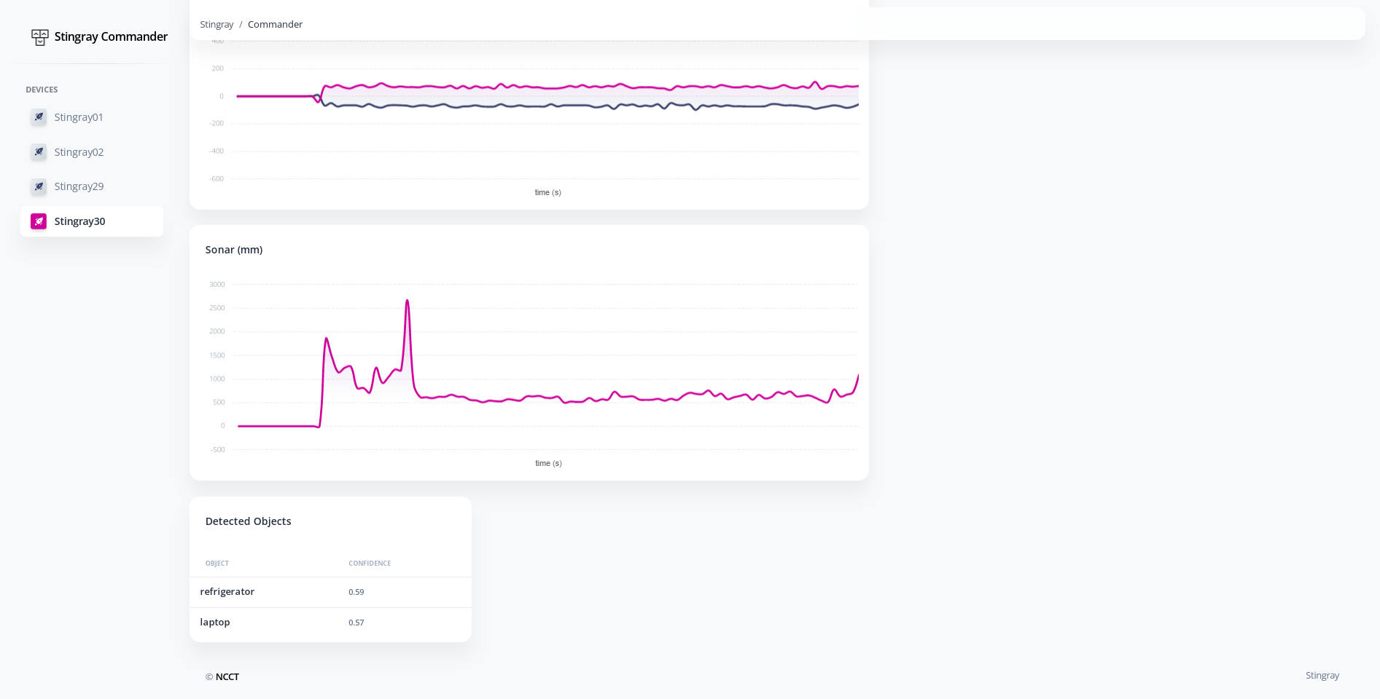
Commander graphical interface

Slide 9
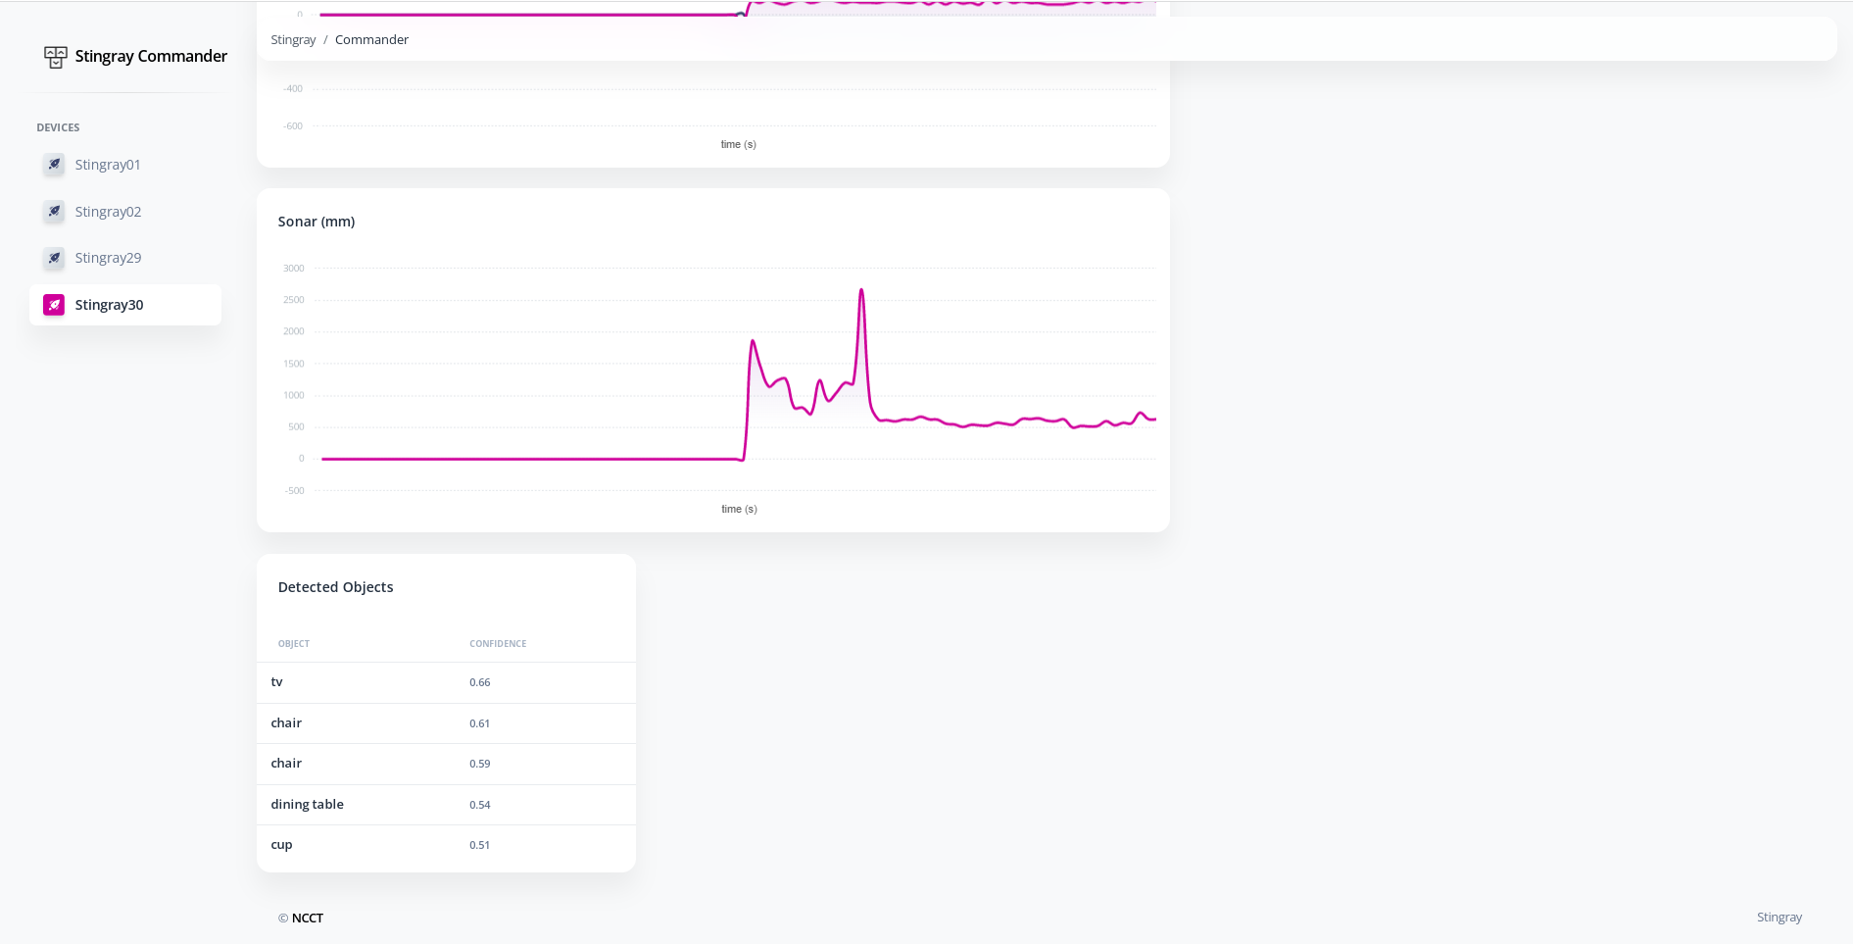
Commander graphical interface

