Slide 1

Student Study Room Booking System
By:
Jordan Goulet
Leonardo Kafuri
Bogdan Bielka

Slide 2



About Our Project
Purpose: To provide students with an organized and efficient way to book a study room.
Audience: Students and Staff
Technology Stack:
Front End: HTML, CSS
Back End: PHP, MySQL
Version control: GitHub
Deployment: Google Cloud

Slide 3
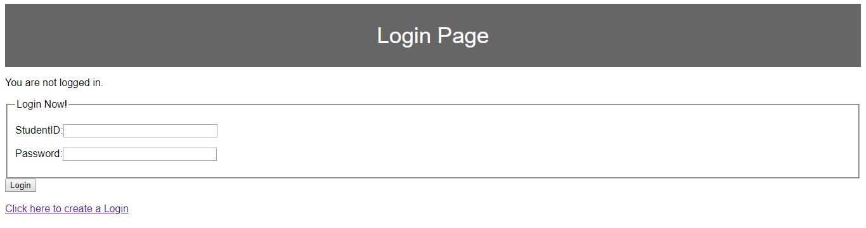
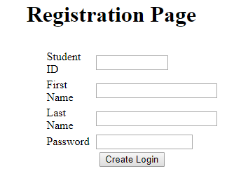
Authentication and Authorization
All registered users are prompted to login with a valid StudentID and Password.
New users have to first register before they can use the system.

Slide 4
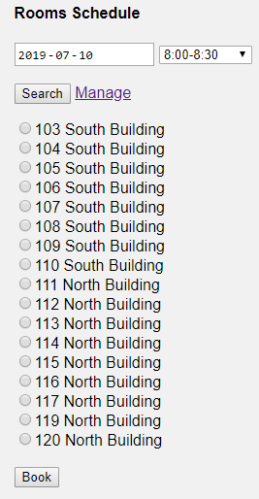
Create a Booking
User specifies the date and time they would like book a study room. The system then outputs only the available rooms.
Room 118 Not Available at
Specified time and date

Slide 5
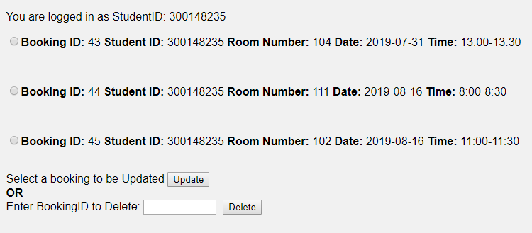
Manage a Booking
Displays all of the bookings of the logged in student.
The student may update or delete any of their bookings

Slide 6
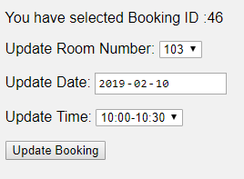
Update a Booking
BEFORE UPDATE
UPDATE MANAGER
Allows the student to update a selected BookingID.
An error message will be displayed if the update matches an existing booking.
AFTER UPDATE

Slide 7
What We Learned
A properly designed database has many benefits. The processes of adding, editing, deleting, and retrieving table data are greatly facilitated by a properly designed database.
1. Database development skills
2. Source Control
3. Database schema
4. Testing of our database
5. Database deployment
To effectively work as a group to implement a reliable and efficient database to connect to our front-end web application.

